Slide 1
INDEX STRUCTURES AND INDEX CREATION
Outline:
Understand the storage structure for database systems.
Understand the basic index structures for reducing the I/O cost.

Slide 2
Storage Hierarchy (1)
Main memory (primary storage): storage media that can be operated on directly by CPU.
Characteristics of main memory:
fast access to data
small storage capacity (typically several GB)
Volatile
Expensive
Memory
Disk

Slide 3
Storage Hierarchy (2)
Secondary storage (e.g., disk): cannot be directly processed by the CPU; it must be brought to the main memory first.
Characteristics of secondary storage:
Slow access to data
Large storage capacity
Non-volatile
Cheap

Slide 4
Disk Device (1)
Actuator
驱动电机
read/
write
Heads
磁头
Spindle
轴

Slide 5
Disk Device (2)
Track磁道: an information storing circle on the surface of a disk.
- A few hundred tracks per surface
- Between 4KB and 50KB of data per track
Cylinder柱面: the tracks with the same diameter on all surfaces of a disk pack
Sector扇区: a part of a track with fixed size; also known as blocks and pages
  Typical page size: 1KB, 2KB, 4KB, 8KB

Slide 6
Page I/O (1)
Page is the smallest unit for transferring data between the main memory and disk.
Address of a page:
(cylinder#, track#, block#)
Page I/O – one page I/O is the cost (or time needed) to transfer one page of data between the memory and the disk.

Slide 7
Access Methods: Sequential Access
Consider query:
select * from Employees where name = ‘Bill’;
Sequential access: (tuples are scanned one at a time) to evaluate the condition on name.
This is reasonable if
  Relation Employees is small, or
  High percentage of the tuples in the relation satisfy the condition.
Too slow for most other cases.

Slide 8
Access Methods: Hash Table (1)
Using a hash table:
Create a hash table based on the values of A in advance. Suppose h( ) is the hash function used.
To process a query with condition “A = v”, first use h(A) to find the bucket in the hash table and then compare v with the A-values in the bucket to identify qualified tuples.

Slide 9
Access Methods: Hash Table (2)
Example: Suppose Employees has 9 tuples.
Build a hash table based on Name.
Suppose we have 3 buckets and each can hold 3 entries and an overflow pointer.
Hash function: h(x) = seq(x) mod 3
  seq(x) returns the serial number of the first letter in x in the English alphabet.

Slide 10
Access Methods: Hash Table (3)
Hash Table
Stored Employees Table
SSN Name Salary
123456789 Bill 35k
234567891 Amy 28k
345678912 Bob 30k
456789123 Mike 27k
567891234 Liz 43k
678912345 Bill 30k
789123456 Ann 31k
891234567 Beth 25k
912345678 Roy 36k
Liz
Roy
0
Amy
1
Mike
Ann
Bill
2
Bob
Bill
Beth

Slide 11
Access Methods: Hash Table (4)
Evaluate query using the hash table:
select * from Employees where Name = ‘Bill’;
1. Apply hash function to obtain a bucket#:
hash(‘Bill’) = seq(‘Bill’) mod 3 = 2 mod 3 = 2
2. Search the identified bucket (and related overflow bucket(s)) for ‘Bill’ and follow proper pointer(s) to obtain the tuple(s).

Slide 12
Access Methods: Hash Table (5)
Using hash table can reduce search time substantially.
适合等值查询
不适合范围查询
哈希索引只包含哈希值和行指针，而不存储字段值。
哈希索引数据并不是按照索引值顺序存储的，所以也就无法用于排序。
如果哈希冲突很多的话，一些索引维护操作的代价也会很高

Slide 13
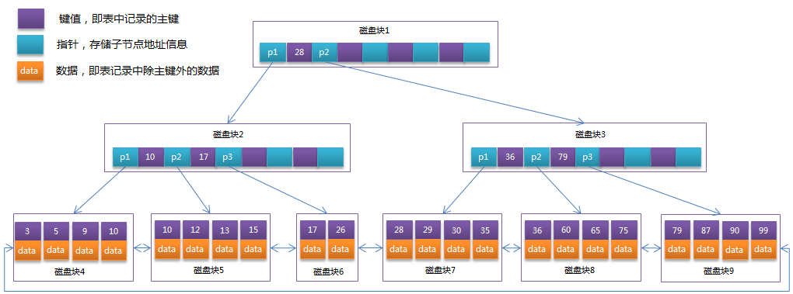
Access Methods: B⁺ Tree
A B⁺ tree is a balanced search tree
Each node is stored as a page

Slide 14
Access Methods: B⁺ Tree
A B⁺ tree is a balanced search tree
Each node is stored as a page
Format of an internal node:
p1 a1 … ai-1 pi ai … ak pk
a < a1
. . .
ai-1 <= a < ai
. . .
ak =< a

Slide 15
B+ Tree
Balanced tree
  Every path from the root to a leaf is of the same length
非叶子节点只存储键值信息。
所有叶子节点之间都有一个链指针。
数据记录都存放在叶子节点中。

Slide 16
Access Methods: B⁺ Tree
Build an index based on R.A:
(1) Sort R based on A and store the sorted R.
(2) Create a pair (a, p) for each tuple t, where a is t[A] and p is the address of t. Sort all pairs based on a.
(3) Build the leaf nodes, starting with pairs with the smallest a’s. Each leaf node has a pointer to the next leaf node.
(4) Build the upper level nodes, one level at a time.
(5) If insertion and update are expected, leave some free space in each page.

Slide 17
Access Methods: B⁺ Tree
Stored Employees Table
SSN Name Salary
e1: 234567891 Amy 28k
e2: 789123456 Ann 31k
e3: 891234567 Beth 25k
e4: 123456789 Bill 35k
e5: 678912345 Bob 30k
e6: 345678912 Fay 30k
e7: 567891234 Liz 43k
e8: 456789123 Mike 27k
e9: 912345678 Roy 36k
Page k
Page k+1
Page k+2
Page k+3
Page k+4

Slide 18
Access Methods: B⁺ Tree
Fay Roy
Ann Bill Fay
Mike Roy
Amy Ann
Beth Bill
Bob Fay
Liz Mike
Roy
e1
e2
e3
e4
e5
e6
e7
e8
e9

Slide 19
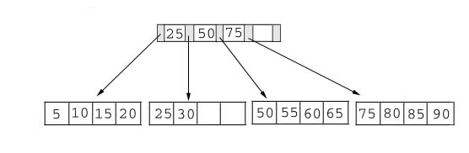
Example B+ Tree (4阶)
B+ 树的阶数就是一个节点存储的键的数量

Slide 20
Insertion
Rearrange the B+ tree, if necessary, to keep it balanced
Example 1: insert 28

Slide 21
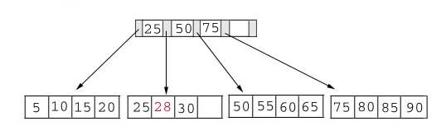
Insertion
Result:

Slide 22
Insertion
Example 2: insert 70

Slide 23
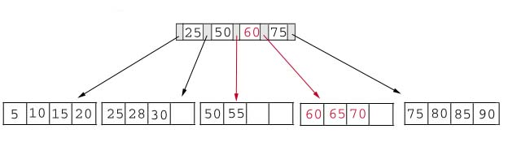
Insertion
Choose the middle key 60 and place it in the index page between 50 and 75. (Minimal changes to the tree.)

Slide 24
Insertion
Exercise: Insert 95

Slide 25
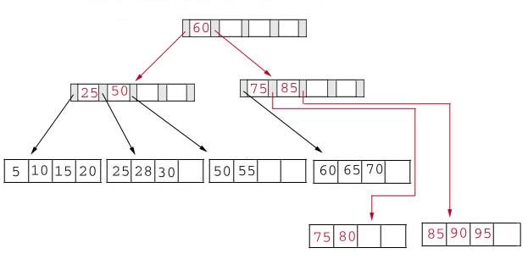
Insertion
Result:

Slide 26
Deletion
Example 1: Delete 70

Slide 27
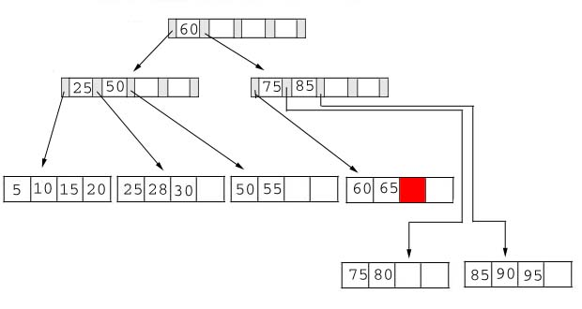
Deletion
Result:

Slide 28
Deletion
Example 2: delete 25

Slide 29
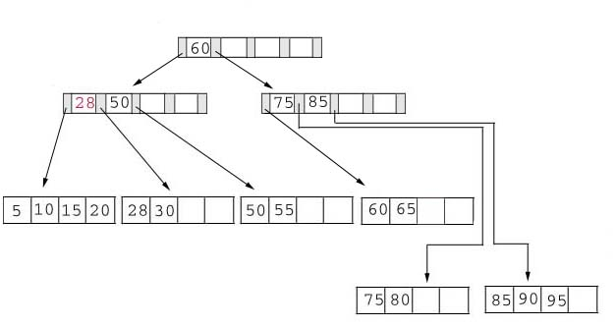
Deletion
Example 3: Delete 60

Slide 30
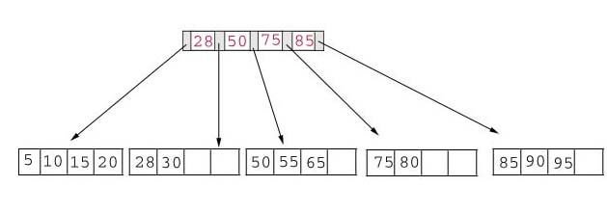
Deletion
Result:

Slide 31
Access Methods: B⁺ Tree
Normal height of a B⁺tree is only 2 or 3.
Example: Suppose Employees has 100,000 tuples of length 100 bytes. Each key value is 10 bytes and each pointer is 4 bytes. Each page is 2 KB.
Each cell (a, p) has 14 bytes.
Each page (2048 bytes) can contain 146 cells.
# of cells (a, p): 100000, needs 685 pages at the bottom level.
# of cells at next level: 685, needs 5 pages.
ceil （685*14/2048）=5
# of cells at next level: 5, needs 1 page.

Slide 32
Access Methods: B⁺ Tree
Indexes in databases are usually implemented as a B⁺ tree.
Definition: If the tuples of a relation R are stored in ascending (or descending) A-values, then the B⁺ tree index on A is a primary index 主索引(clustered index聚集索引).
Note: Primary index is not directly associated with the primary key. (i.e., there may not be a primary index on the primary key)
Definition: A secondary index次级索引 (non-clustered index) is an index on an attribute whose values are not sorted.

Slide 33
Access Methods: B⁺ Tree
Some questions:
Can we create multiple primary indexes for the same relation?
  Answer: No. A table can only be physically sorted once.
Can we create multiple secondary indexes for the same relation?
  Answer: Yes.
Which is faster: primary index or secondary index?
  Answer:
    If just retrieve one tuple, no difference.
    If multiple tuples are retrieved, primary index is usually faster as these tuples are likely clustered.

Slide 34
Guidelines on Index Creation (1)
Information that guides the creation of indexes is the transactional analysis of the requirements document.
The following are the main factors on whether or not to create an index on an attribute A:
  Search frequency: How frequently A is searched, including for evaluating conditions and joins?
  Update frequency: How frequently A is updated, including insertion and deletion?
  Candidate key: Must the values of A be unique?
  Size: How large is the relation containing A?
Notes:
Oracle’s recommendation: An index should be created if all of the following conditions are satisfied:
* The table contains a large number of tuples (large means over 100,000)
* The attribute contains a wide range of values
The attribute contains a large number of null values
Application queries frequently use the attribute in search/join conditions
Most queries retrieve a small percentage of the tuples (say 4%)

Slide 35
Guidelines on Index Creation (4)
Among all the attributes of a relation that should have an index, only one attribute can have a primary index, and all others will have secondary indexes.
Attribute A should be favored to have a primary index if:
  Searches on A are more likely to return multiple tuples (due to repeating values and range queries).
  A is the primary key of the relation (more joins are likely involve primary key).

Slide 36
An example (1)
Consider table R(A, B, C, D) with the following information:
A is the primary key and no other candidate key exists.
Approximately, the number of distinct values under B is two times of that under C and this ratio does not change.
Out of every 100 operations against R, 10 will be insertions; 10 will be deletions with 5 based on conditions on A and 5 based on conditions on B; 70 will be selection queries with 30 based on conditions on A, and 20 based on conditions on B and 20 based on conditions on C; and 10 will be updates with 5 based on conditions on B and 5 based on conditions on C. All conditions are equality conditions.
Discuss which attribute should be used to build the primary index and which attribute(s) should be used to build secondary
index(es).

Slide 37
An example (2)
From the given information, the following can be derived:
Out of every 100 operations:
45 need to search based on A (10 insertions, 5 deletions, 30 selections)
30 need to search based on B (5 deletions, 20 selections, 5 updates)
25 need to search based on C (20 selections, 5 updates)
0 need to search based on D

Slide 38
An example (3)
A should have a secondary index (having a primary index
on A does not improve efficiency because at most one tuple
will satisfy each condition).
D should not have any index because it is not used to
search in any operation.
B should have a secondary index and C should have a
primary index. Even though a slightly larger percentage of
all conditions involves B than C, the number of tuples
satisfying each condition involving C is two times of
that involving B because B has two times the number of
distinct values than C. This implies that if both B and
C had secondary indexes, each search based on C would
cost twice as much as each search based on B. Therefore,
having a primary index on C would reduce more cost than
having a primary index on B.

Slide 39
Creating Indexes in MySQL （1）
Indexes can be created when a table is being created.
Example:
create table Enrollments
(B_number varchar(10) not null,
course_no varchar(8) not null,
section_no int(2) unsigned not null,
grade varchar(2),
primary key (B_number, course_no, section_no),
Foreign key (B_number) references Students (B_number),
Foreign key (course_no) references Courses (course_no),
index (course_no)); -- a regular index

Slide 40
Creating Indexes in MySQL (2)
Create indexes when a table is being created.
Syntax:
create table table_name
( <column definitions>
index index_name (column_names),
unique index_name (column_names),
primary key index_name (column_names),
fulltext index_name (column_names),
spatial index_name (column_names));

Slide 41
Creating Indexes in MySQL (3)
Indexes can be added to an existing table using the alter table statement.
Syntax:
alter table table_name add index index_name (column_names);
alter table table_name add unique index_name (column_names);
alter table table_name add primary key (column_names);
alter table table_name add fulltext index_name (column_names);
alter table table_name add spatial index_name (column_names);
Example:
alter table Students add index gpa_index (GPA);

Slide 42
Creating Indexes in MySQL (4)
Indexes can be created directly using the create index statement.
Syntax:
create index index_name on table_name (column_names);
create unique index index_name on table_name (column_names);
create fulltext index index_name on table_name (column_names);
create spatial index index_name on table_name (column_names);

Slide 43
Creating Indexes in MySQL (5)
For all storage engines except for the Memory engine, indexes are implemented using B⁺ tree.
The default index type for tables in the Memory storage engine is hash.
You can change the default index type for a Memory table as follows:
create table table_name
( <column definitions>
index using btree (column_name),
) engine memory;

