Slide 1

BULE HORA UNVERSITY
COLLEGE OF COMPUTING AND INFORMATICS
DEPARTMENT OF SOFTWARE ENGINEERING
GROUP ASSIGNMENT
TITLE:- USER INTERFACE (UI) ANALYSIS OF INSTAGRAM
COURSE: HCI
COURSE CODE: SENG 8052
PREPARED BY:
Nanbon Bekele

Slide 2
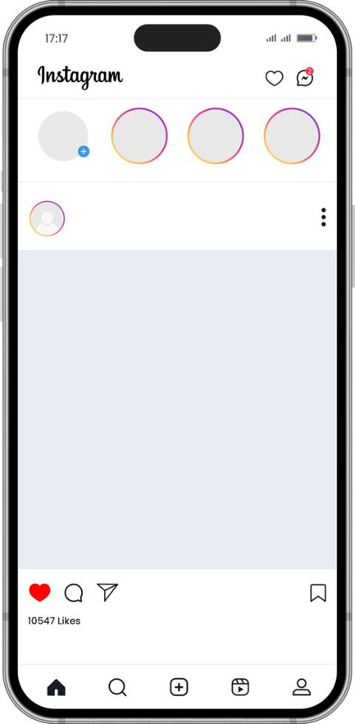
introduction
Instagram is one of the most popular social media platforms in Ethiopia.
Widely used by:
Youth
Students
Urban users
Designed mainly for visual communication
Photos
Short videos
Stories
Reels
Follows a mobile-first, visual-centric UI design
Goal: High engagement with simple and easy interaction

Slide 3
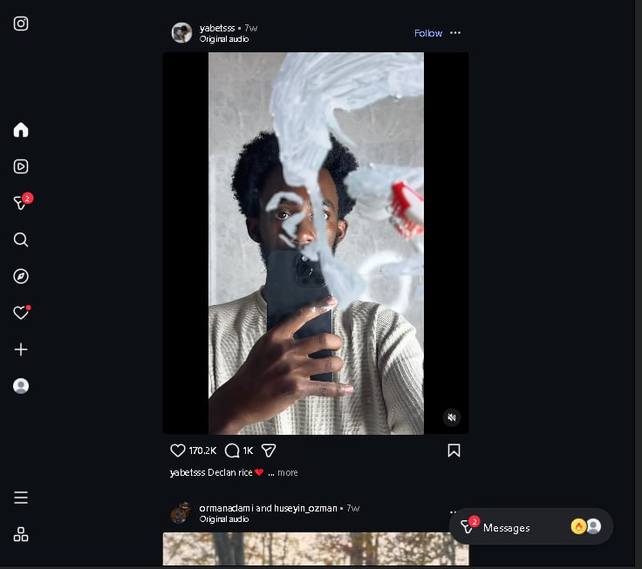
A. Strong Sides of Instagram UI
Visual-Focused Design
Images and videos dominate the screen
Minimal text and distractions
Clean layout improves:
Readability
Visual appeal
User focus

Slide 4

cont...
2. Intuitive & Simple Navigation
Bottom navigation bar:
Home
Search
Reels
Create
Profile
Designed for one-hand mobile use
Familiar icons for:
Like
Comment
Share
Easy to learn for new users

Slide 5
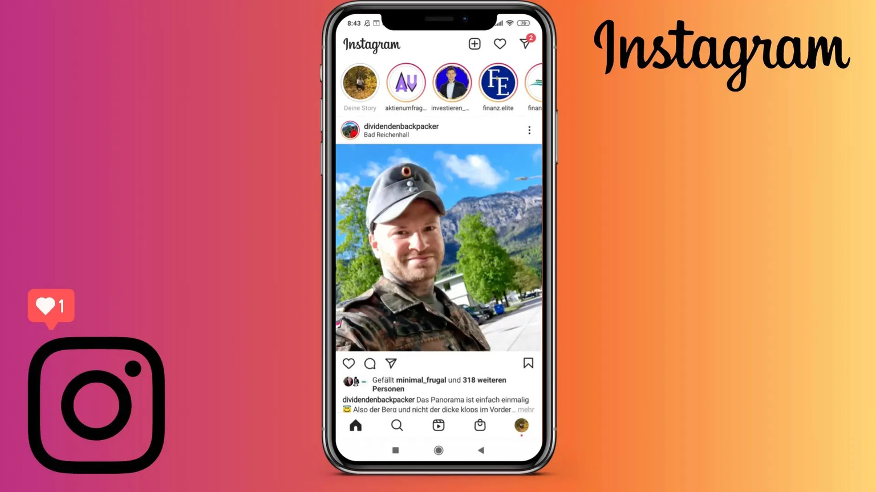
cont...
3. Consistency&Content Hierarchy
Consistent:
Colors
Icons
Layout
Reduces navigation errors
Clear content structure:
Stories at the top
Feed in the center
Reels in a separate section

Slide 6
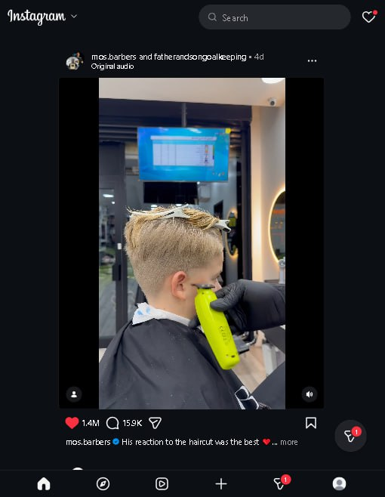
cont...
4. Smooth Interaction & Feedback
Gestures:
Double-tap to like
Swipe navigation
Smooth animations and transitions
Provides immediate feedback
Improves overall user satisfaction

Slide 7
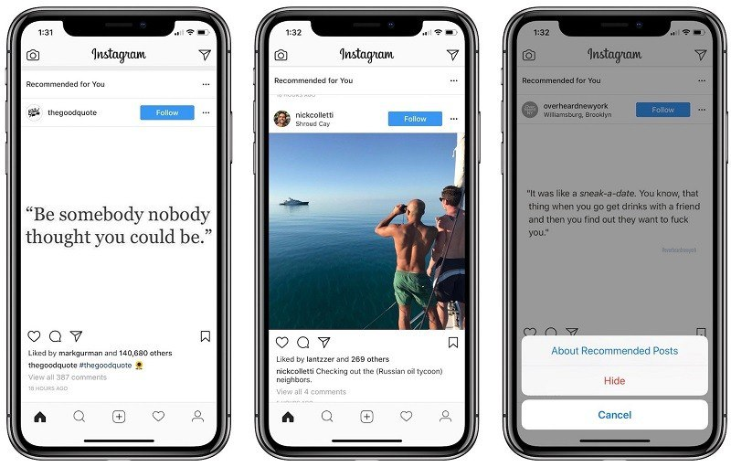
B. Weak Sides of Instagram UI
Algorithm-Controlled Feed
Feed mixes:
Followed content
Suggested posts
Low user control
No default chronological feed
Can frustrate some users

Slide 8
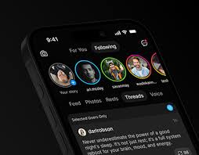
cont...
2. Frequent Interface Changes
Regular UI updates
Features change position
Confusing for:
Older users
Less tech-savvy users
Increases learning difficulty

Slide 9

cont...
3. Overemphasis on Reels
Reels are heavily promoted
Traditional photo posts get less visibility
Photo-focused users may feel ignored

Slide 10
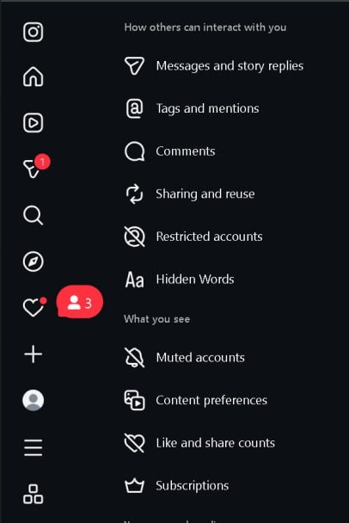
cont...
4. Limited Customization & Accessibility
Limited control over:
Feed order
Layout preferences
Accessibility features are limited
Less friendly for users with disabilities

Slide 11
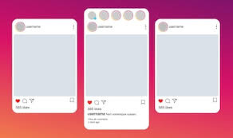
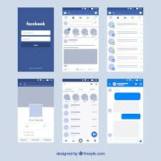
c. Comparison with Other Platforms
A. Instagram vs Facebook
Instagram:
Simple
Visual
Less cluttered
Facebook:
Feature-heavy
More complex
More user control
Instagram is easier to navigate

Slide 12
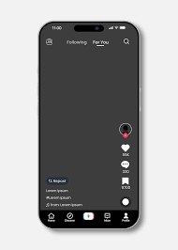
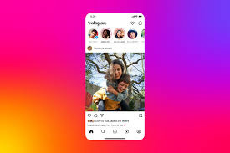
cont...
B. Instagram vs TikTok
TikTok:
Full-screen videos
Very immersive
Less structured
Instagram:
Mix of photos, stories, and reels
Better content variety
Clearer navigation

Slide 13
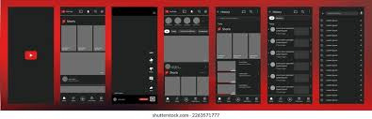
cont...
c. Instagram vs YouTube
YouTube:
Long-form videos
Detailed information
Complex interface
Instagram:
Short content
Faster interaction
Lighter UI

Slide 14
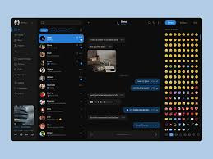
cont...
d. Instagram vs Telegram
Telegram:
Messaging-focused
High customization
Minimal visuals
Instagram:
Visual and social interaction
Less customization
More engaging design

Slide 15
cont...
Comparative Summary
Platform | UI Complexity | Content Type | User Control
Instagram | Medium | Photos & short videos | Medium
Facebook | High | Mixed content | High
TikTok | Low | Short videos | Low
YouTube | Medium–High | Long & short videos | High
Telegram | Low | Messaging & channels | High

Slide 16
THANK YOU

