Slide 1
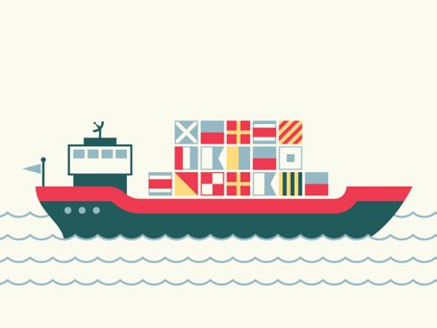
Evergreen Shipment Database
Team: Ankita Pathak, Nancy Jain, Qiyu Ye

Slide 2
Background
Background: Evergreen Shipment Company is based in Seattle, providing packing and shipping services.
Mission: To develop employee, supplier and customer management system for Evergreen Shipment company that would include all the employee details and respective regions under them, customer details and order's shipping and package details.

Slide 3

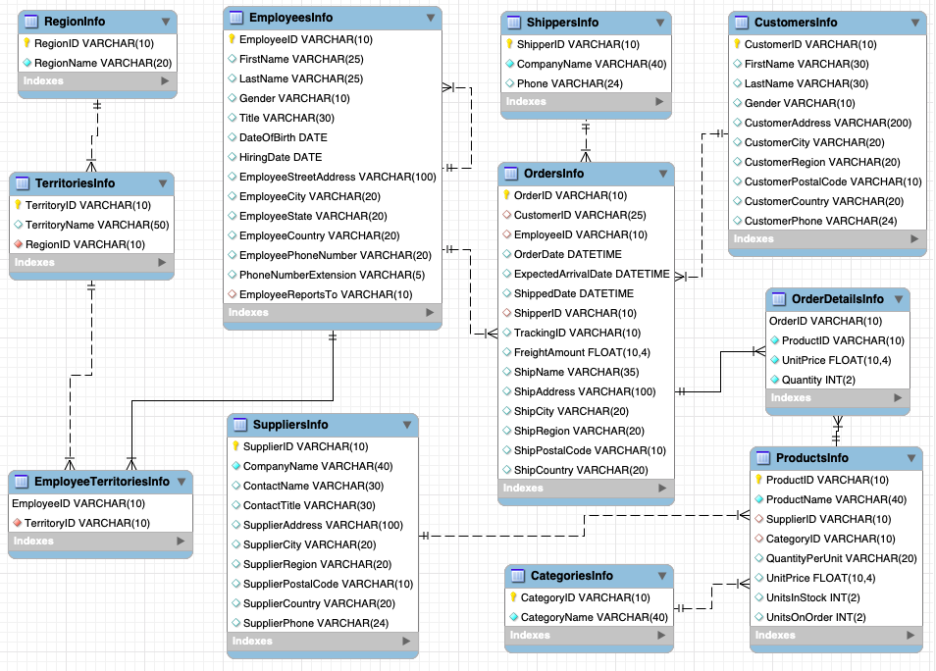



ER-Diagram Review
Notes:
Background: Evergreen Shipment Company is based in Seattle, providing packing and shipping services globally.
Mission: To develop employee, supplier and customer management system for Evergreen Shipment company that would include all the employee details and respective regions under them, customer details and order's shipping and package details.

Slide 4
Views
What is the invoice for each order for a customer?
Business Requirement:
Show the invoice of all the orders for Customer with a CustomerID 101
Select * from vw_Invoices where CustomerID = 'C101';
Notes:
Show all information (order, customer, shipper ) for each order

Slide 5
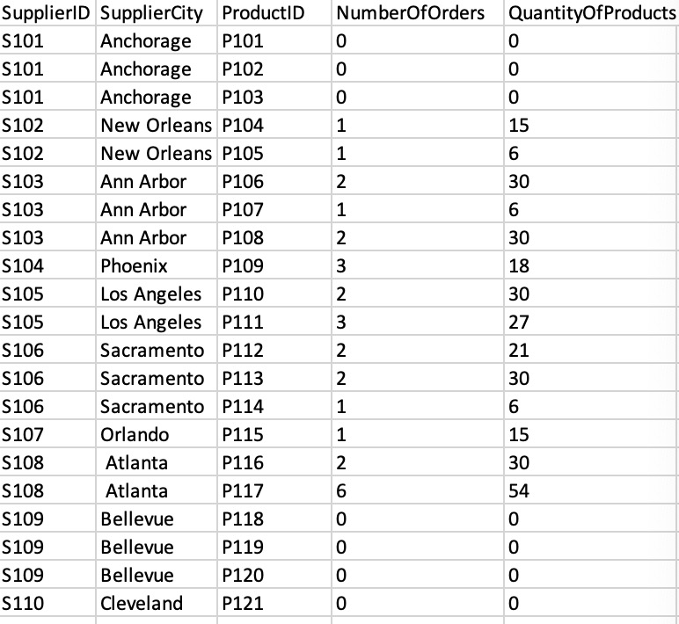
Analytical Queries
What are the sales for each product of each supplier?
Select s.SupplierID as SupplierID, s.SupplierCity as SupplierCity, p.ProductID as ProductID,
count(o.OrderID) as NumberOfOrders, IFNULL(sum(o.Quantity),0) as QuantityOfProducts
from SuppliersInfo s left join ProductsInfo p on s.SupplierID = p. SupplierID
left join OrderDetailsInfo o on p.ProductID = o.ProductID
group by s.SupplierID, p.ProductID;
Notes:
This analytical query is executed to get an overview of sales for each product type and supplier.

Slide 6
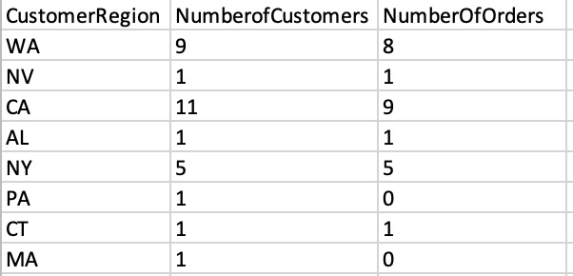
Analytical Queries
Where do customers come from? Which region has most customers?
Select c.CustomerRegion as CustomerRegion,
count(c.CustomerID) as NumberofCustomers,count(o.OrderID) as NumberOfOrders
from CustomersInfo c left join OrdersInfo o on c.CustomerID = o.CustomerID
group by c.CustomerRegion;

Slide 7

Power BI

Slide 8
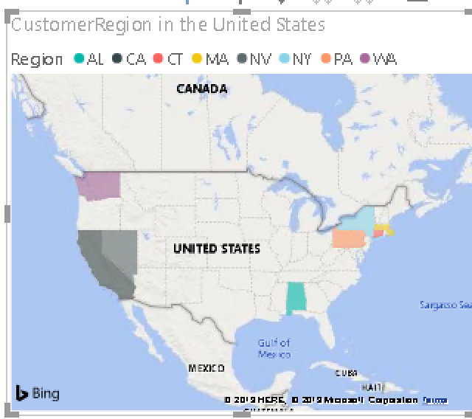
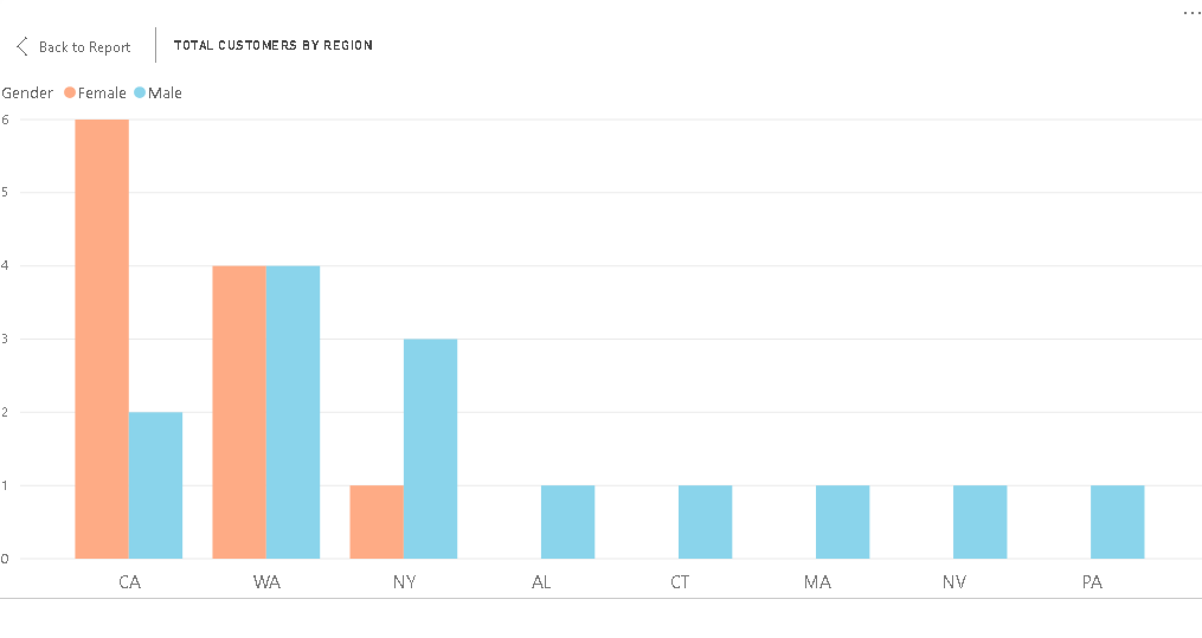
Insights on Customers and Region

Slide 9
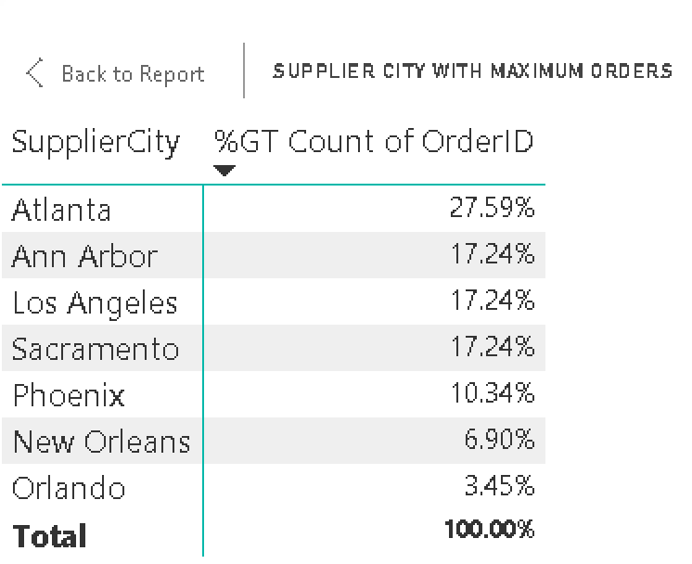
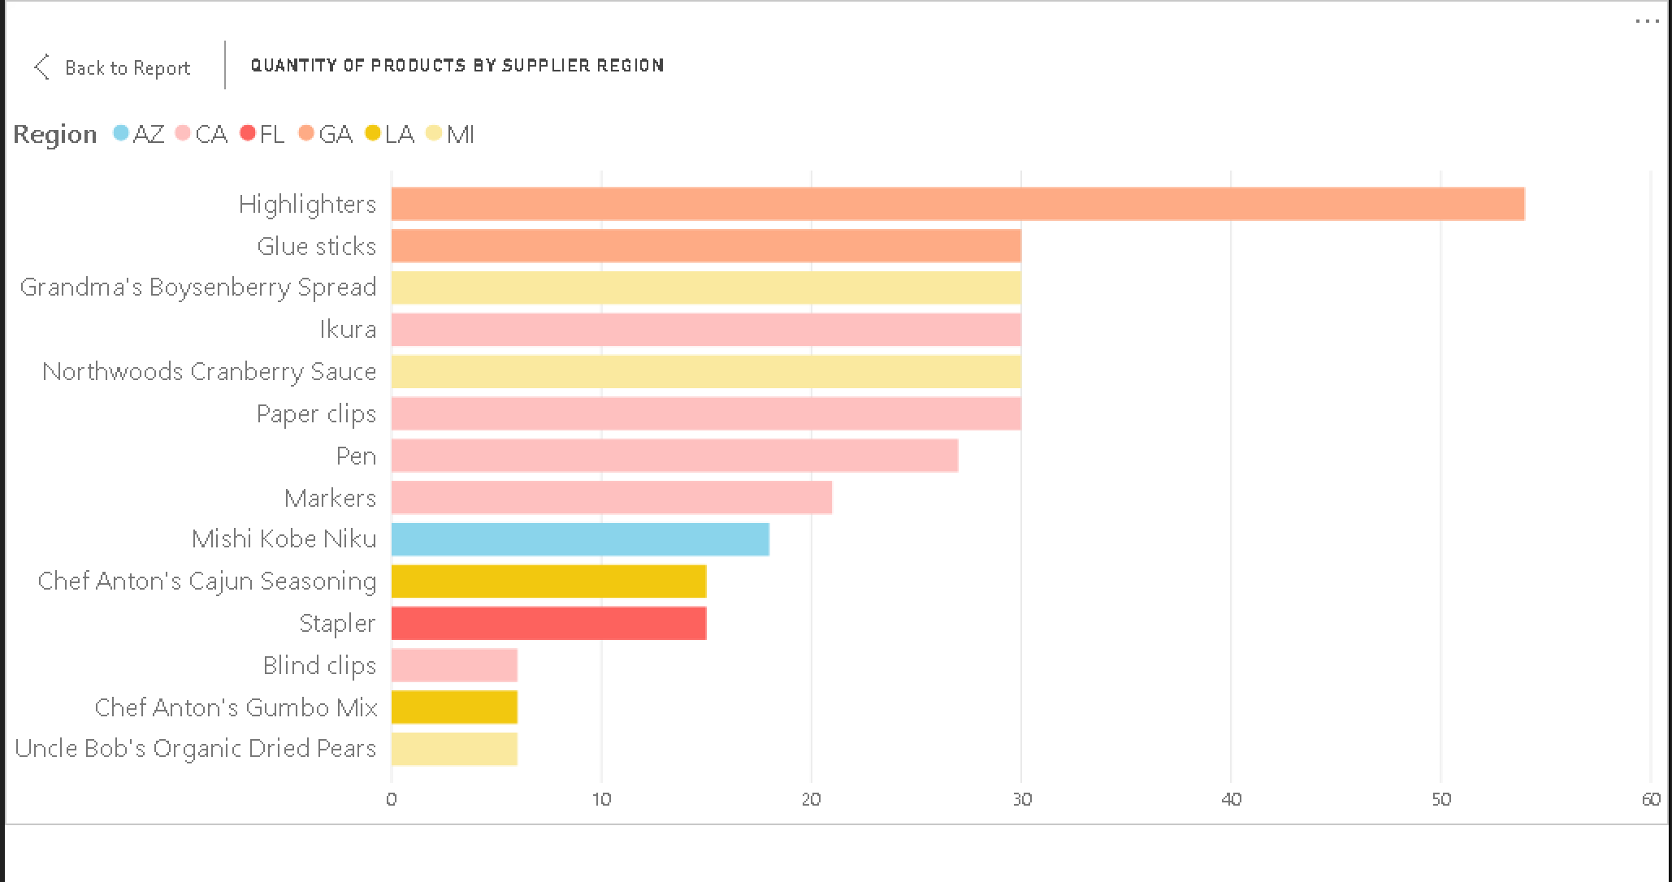
Insights on Suppliers and Region

Slide 10


Stored Procedures
What are the remaining in stock quantities of a product every time a new order is placed?
e.g: place an order 'O111' with 10 units of product 101.
CALL sp_AddModify_OrderDetailsAndProducts('O120', 'P101', 10);
CALL sp_AddModify_OrderDetailsAndProducts('O111', 'P101', 1000);
Notes:
This procedure is executed every time an order is placed or cancelled to update the quantity of product in the warehouse. Just provide orderID, productID and quantity of the product ordered.

Slide 11
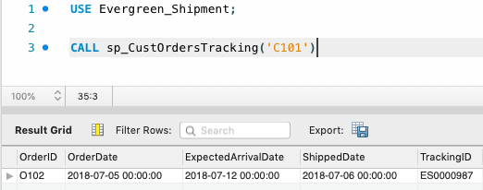
Stored Procedures
What is tracking information of customer?
e.g: track order for customer C101
CALL sp_CustOrdersTracking('C101')
Notes:
This procedure is executed every time an order is placed or cancelled to update the quantity of product in the warehouse. Just provide orderID, productID and quantity of the product ordered.

Slide 12
Lessons Learned
Manage data when various stakeholders involved.
Maintain an internal database for every stakeholder( customer, supplier, shipper, employee).
Notes:
Most challenging and learning part for us was Data Management, since we had to maintain an internal database for every stakeholder (customer, supplier, shipper, employee) such that every stakeholder has access to its complete information, and they do not have access to other stakeholder’s information. Hence, we created few views and analytical queries using MySQL and Power BI dashboard so that respective information can be viewed. Example: customer can view their invoices, without any access to internal database structure, suppliers can view their products information. We also created stored procedures keeping in mind that if any tracking of customer or sales is required or insertion and updating of product is required, that can we done just using a simple call procedure and putting values.

Slide 13
References
https://cloud.google.com/bigquery/docs/reference/standard-sql/analytic-function-concepts
https://dev.mysql.com/doc/refman/8.0/en/analyze-table.html
https://dev.mysql.com/doc/refman/5.7/en/create-procedure.html

Slide 14
THANK YOU !

