Slide 1
Modelling and Forecasting
of U.S. GDP
- By Haodi Tu, Huibo Jia, Nancy Jain
(Group 4)

Slide 2
Intro
Literature Review
Data Overview
Empirical model
Results and interpretation
Conclusion

Slide 3
Introduction
What is GDP?
Objective
Steps in the forecasting process

Slide 4
Literature Review (Background)
The importance of GDP
The components of GDP
How GDP calculated in US
Traditional Methods for quarterly GDP forecasting
The implementation of time series analysis

Slide 5
The importance of GDP
GDP reflect the economic development and people's living standards of a country and region
GDP enables policymakers and central banks to judge whether the economy is contracting or expanding
Notes:
To be more specific, the sharp increase in a country's GDP reflects the country's booming economy, increased national income, and improved consumption level. In this case, the country's central bank will have the potential to raise interest rates and tighten the money supply, while good national economic performance and rising interest rates will increase the attractiveness of the country's currency. Conversely, if a country’s GDP shows negative growth, indicating that the country’s economy is in a recession. When consumption power is reduced, the country’s central bank will likely cut interest rates to stimulate economic growth again. At this time, interest rates fall and economic performance is sluggish. The attractiveness of the country’s currency has thus also been reduced. Therefore, in general, a high economic growth rate will promote the rise of the national currency exchange rate, while a low economic growth rate will cause the country's currency exchange rate to fall.

Slide 6
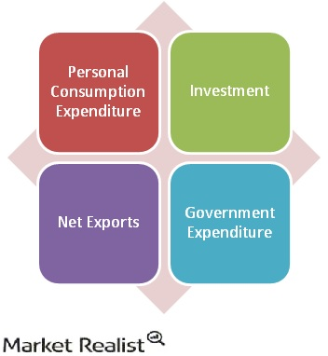
The components of GDP
Notes:
The four components are:
While calculating the GDP estimate, the Bureau first takes into account the sum of an individual’s personal consumption expenditures, that is, durable goods (such as furniture and cars), non-durable goods (such as clothing and food), and services (such as banking, education, and transportation).
Following personal consumption expenditures, the Bureau takes into account, sum of investments in private housing purchases (or residential investment), and businesses investment in non-residential structures, durable equipment, and computer software. Inventories at all stages of production being treated as investment, changes in the inventory levels are also added to GDP.
Next, the GDP accounts for the amount of net exports. Net exports equal the sum of exports less imports. Exports are the purchases of goods and services produced in the U.S. made by foreigners. These add to the GDP. Imports represent domestic purchases of foreign-produced goods and services. So, they must be deducted from the calculation of GDP. In the U.S., net exports are a drag on total GDP because the country regularly imports more than it exports, that is, net exports are in deficit.
The government component of the GDP accounts for the central government expenditure in national defense and non-defense, as well as State and local government’s expenditure estimates. Government purchases of goods and services are a compensation of government employees and purchases from businesses and abroad. However, government outlays for transfer payments or interest payments are not included in the GDP calculation.

Slide 7
How GDP is calculated
Usually, national statistical agency compiles the information from many sources to calculate GDP
Most countries follow established international standards: System of National Accounts, 1993, compiled by the International Monetary Fund, the European Commission, the Organization for Economic Cooperation and Development, the United Nations, and the World Bank
USA: Bureau of Economic Analysis (BEA)
Notes:
GDP in a country is usually calculated by the national statistical agency, which compiles the information from a large number of sources.
In making the calculations, however, most countries follow established international standards. The international standard for measuring GDP is contained in the System of National Accounts, 1993, compiled by the International Monetary Fund, the European Commission, the Organization for Economic Cooperation and Development, the United Nations, and the World Bank.
In the United States, GDP is estimate by the Bureau of Economic Analysis, or BEA, which is part of the Department of Commerce, and the practice is estimated and counted quarterly. Each time after the preliminary estimates, there will be the first revision and the final revision, and the main publication time is in the third week of each month。
In the United States, the ideal level would be growth by 3%, which indicating that economic development is healthy. Above this level, there may existing inflation pressure. However, if below 1.5% growth, it shows signs of economic slowdown and recession.

Slide 8
Traditional methods for Quarterly GDP forecasting
Qualitative:
Use of judgement
Strong subjectivity
Rarely used
Quantitative:
Cross-sectional data regression
Time-series analysis
Panel-data model
Input-output model
Notes:
1. Qualitative prediction method. This mainly refers to the method by which the forecaster judges the nature and direction of the future development of quarterly GDP based on practical. Due to its strong subjectivity, it is rarely used today.
2. Quantitative prediction method. It mainly refers to the method by which forecasters use traditional statistical data such as government statistics, survey data, and simulation data to predict quarterly GDP trends by using statistical methods or mathematical models, including cross-sectional data regression model, time series analysis model, panel data model and input-output model ( Jiang et al., 2017; Jansen et al.,2016).

Slide 9
The implementation of time-series analysis
AR
MA
ARMA
ARIMA – This is widely used
Andrei and Bugudui (2011) used the ARIMA (1,1,1) model in the study of US GDP. The results show that the US economy is on a rising trend.
Notes:
The time series contains the autoregressive model (AR), moving-average model (MA), autoregressive—moving-average model (ARMA), autoregressive integrated moving average (ARIMA). Modern econometric studies have shown that most economic time series is non-stationary and the ARIMA model has a good effect in dealing with non-stationary economic time series, so it is widely used. Andrei and Bugudui (2011) used the ARIMA (1,1,1) model in the study of US GDP. The results show that the US economy is on a rising trend.

Slide 10
Data Overview
Descriptive Statistics
Statistic | N | Mean | St. Dev. | Min | Pctl(25) | Pctl(75) | Max
GDP | 288 | 5,983.445 | 6,069.967 | 243.164 | 712.672 | 10,447.490 | 20,865.140
Notes:
Chatfield (1996) recommends more than 50 observations to build a reliable ARIMA model. In this study, we obtained our data from FRED website. The original source of our data is the Bureau of Economic Analysis. Our quarterly dataset consists of 288 records from 1947 to 2018 with variable of US GDP in billions of dollars. The summary statistics is shown in the table

Slide 11
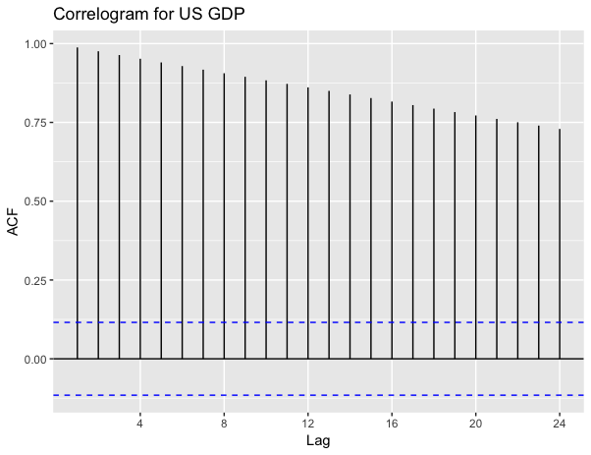
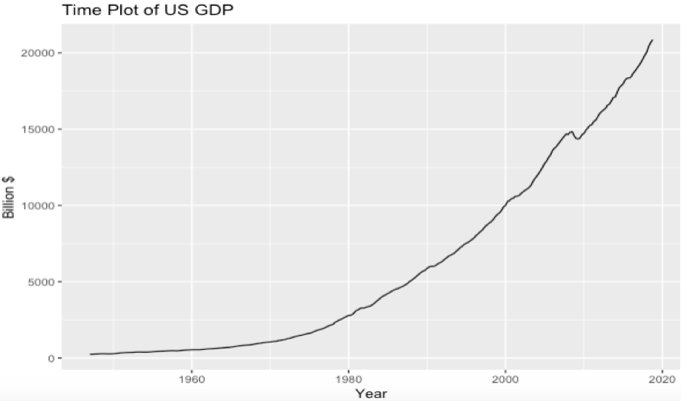
Data Overview
Notes:
The empirical characteristics of the univariate time series data were checked by obtaining time plots for the data. To gain an insight into univariate processes, autocorrelation functions ACF was considered. The ACF measures the ratio of the covariance between observations k lags apart and the geometric average of the variance of observations.
From the figures, a visual inspection of the time plots indicates that USGDP has shown the trend of exponential growth. This implies that both the mean and the variance are not constant. Therefore we regard it as a non-stationary time series.
A visual examination of the correlogram above confirms that the US GDP data is non-stationary. This kind of non-stationary time series which contains a seasonal trend can often be carried out by logarithmic transformation. The result is that the exponential trend will be transformed into a linear trend. Before embarking on further analysis using the Box-Jenkins methodology the data has to be transformed to achieve stationarity.

Slide 12
Forecasting Model and Estimation Methods
Model Identification
Preliminary analysis with initial data plot
Using AR and MA to decide which component should be used in the model
Model Estimation
Can be estimated by least-squares or by maximum likelihood
Regression and ARIMA (p, d, q)
Diagnostic Checking
Before forecasting, model must be checked for adequecy and accuracy
Adequecy: if the residuals left over after fitting the model is simply white noise
Accuracy: how well a model performs on new data that were not used when fitting the model
Model Forecasting
States the difference between in-sample forecasting and out-of sample forecasting.
Factors to build a reliable model: level of accuracy required, availability of data, time horizon that forecast is intended to cover

Slide 13
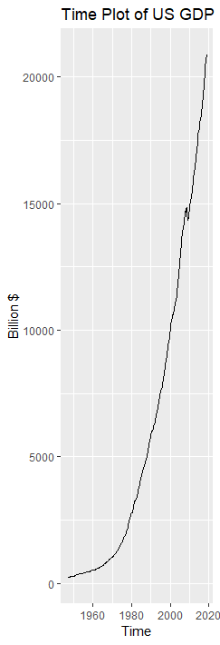
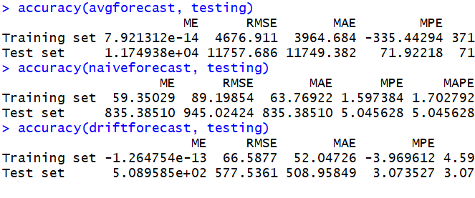
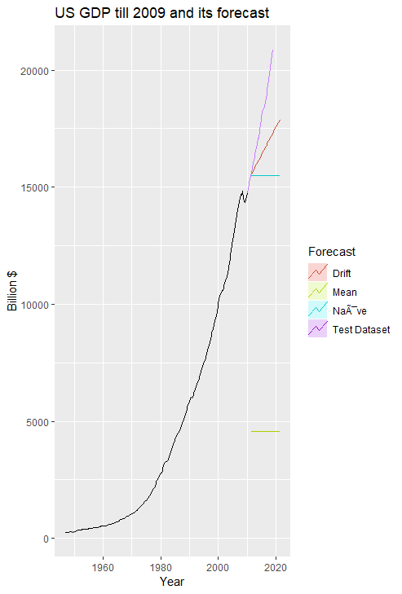
Results & Interpretation

Slide 14
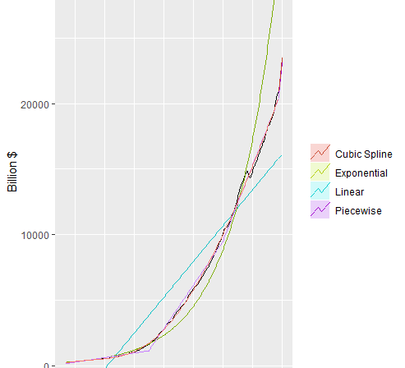

Slide 15
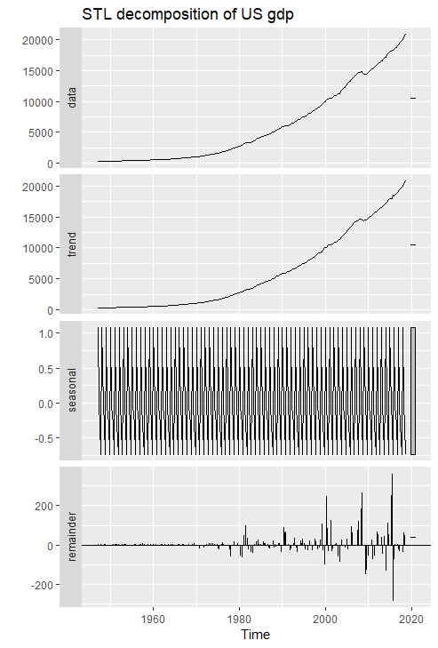
STL Decomposition Method

Slide 16
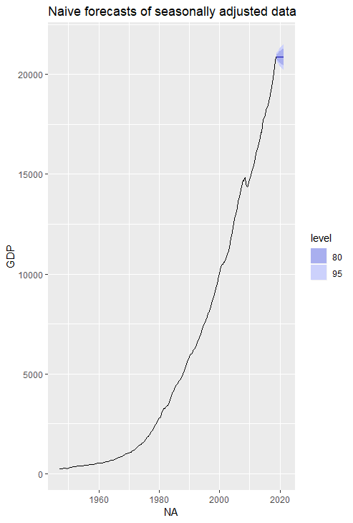
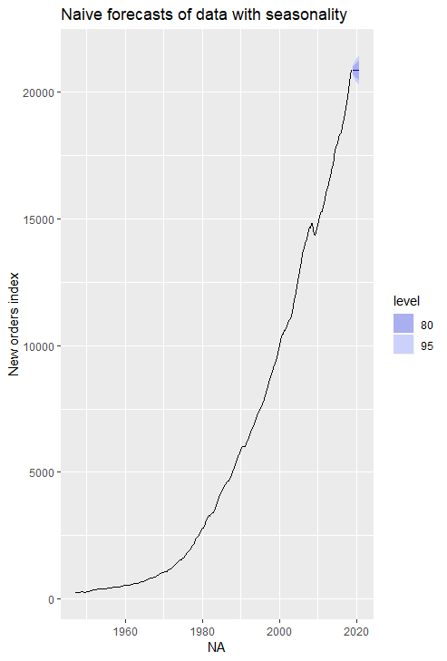

Slide 17
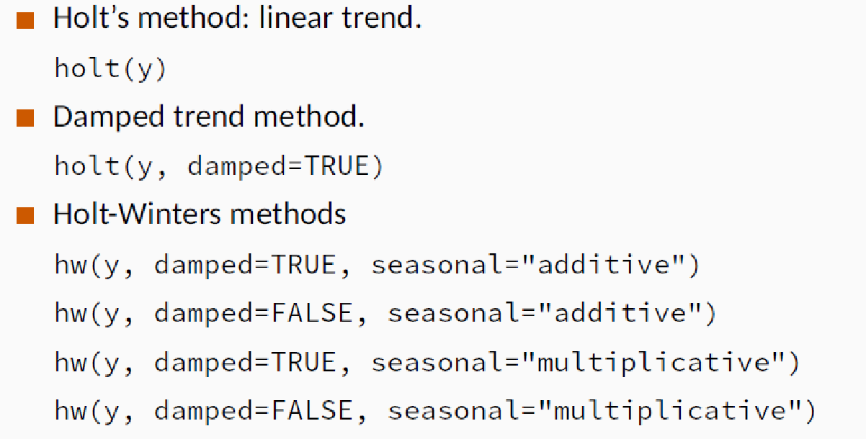
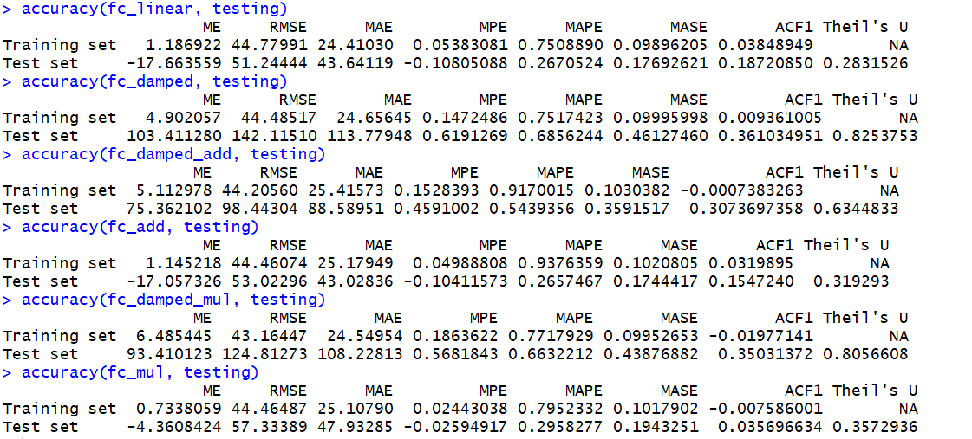
Exponential Smoothing

Slide 18
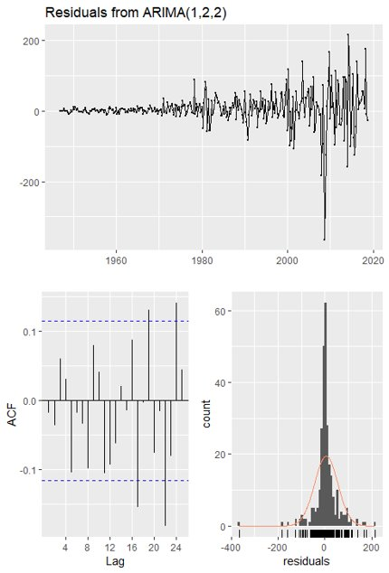
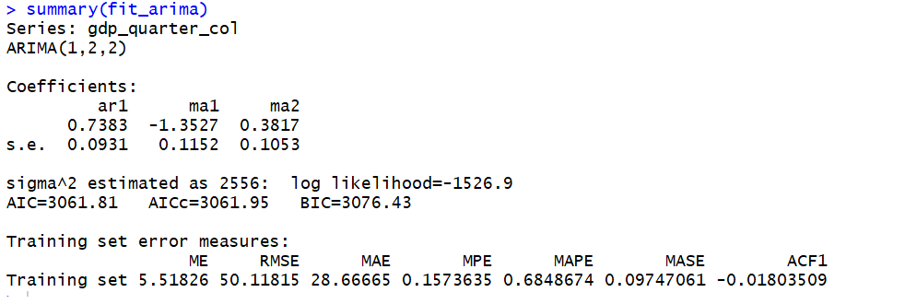
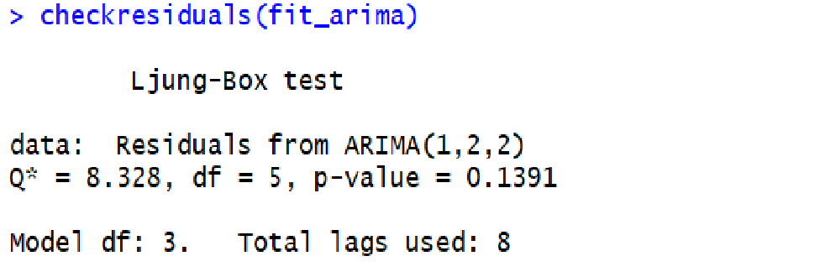
ARIMA

Slide 19

CONCLUSION

Slide 20
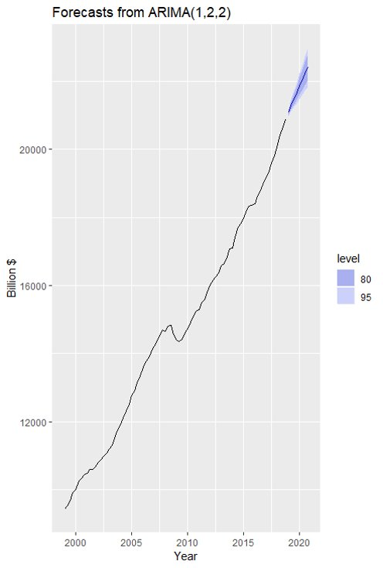
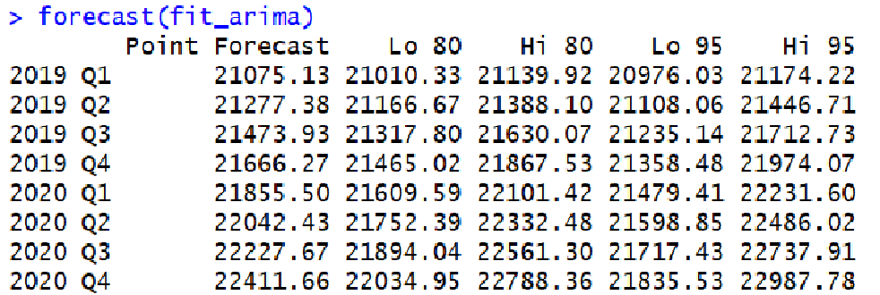

Slide 21
Thank You!

