Slide 1
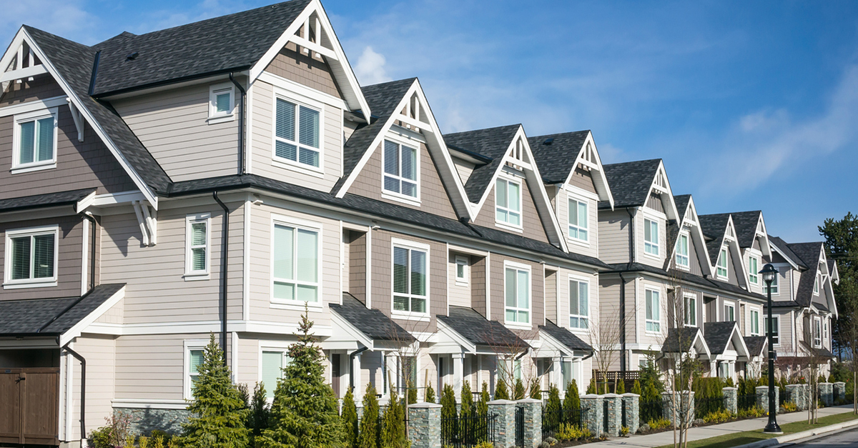

Mass Property Appraisal in Pierce County
An Applied Machine Learning Approach
Eirik Fosnaes, Nancy Jain, Han Li, Mark Russeff

Slide 2
Agenda
Introduction / Problem Statement
Data
Data Pre-processing
Stage one – Modeling results
Stage two – Clustering
Stage three – Clustering + Modeling results
Recommendations
Moving Forward
Q&A

Slide 3
Mass Appraisal Accuracy
Pierce County’s 2018 mass appraisals of property value have a Mean Absolute Percentage Error (MAPE) of 16.87% based of off the residential data we are using for our study.
Inaccurate manual models have a higher cost to taxpayers and may result in lost tax revenue for the county.
Can MAPE be decreased by implementing Automated Valuation Methods (AVM) that use various machine learning models and incorporate community data?

Slide 4

Data – Traditional Price Evaluation Metrics
Physical characteristics of the home
Square footage, Bathrooms, Bedrooms, Year Built
Fireplaces, View Quality, Stories
Condition of the home
Condition, Quality, Year Remodeled
Location Location Location
Township, XCoord, Ycoord
2018 Data included 15,668 observations and 28 attributes

Slide 5

Data – Community Quality
Crime
Violent Crime, Property Crime, Non-Property Crime
Quality of schools nearby
Average school ratings (provided by Zillow)
Parks
Number of parks within a two square mile radius
2018 data included 15,668 observations and 33 attributes

Slide 6
Data Pre-processing
Select Variables:
From property, improvement data and community data
Remove Null Values:
Remove the null values from table
Join Tables:
Join each table in one on the same "ParcelNumber"
Join the information of community with GIS X&Y-Coord
Narrow down to 2018:
Only select the data of the property which was sold in 2018
Selecting Sale Price Range:
Selected houses in the $100,000 to $3,000,000 Price Range

Slide 7
Stage One
Compare traditional data set with one containing community variables using four machine learning models.
Stage Two
Create three distinct clusters from both data sets.
K-means clustering
Stage Three
Compare the performance of the three clusters using the four machine learning models across both data sets.

Slide 8
Data
Decision Tree
MAE = $56,581.81
MAPE = 16.31%
Neural Network - One Hidden Layer
MAE = $59,757.08
MAPE = 17.55%
Data with Community
Decision Tree
MAE = $51,018.97
MAPE = 14.2%
Neural Network - One Hidden Layer
MAE = $56,580.35
MAPE = 16.08%
Neural Network - Two Hidden Layers
MAE = $48,679.33
MAPE = 14.23%
Random Forest
MAE = $43,041.97
MAPE = 12.8%
Random Forest
MAE = $39,648.27
MAPE = 11.31%
Neural Network - Two Hidden Layers
MAE = $46,133.86
MAPE = 13.22%
Stage One: Model Results
Random Forest with 1000 estimators and a max depth of 50 performed the best.
Observed a 4% improvement from the current MAPE using a Random Forest model.
Including community data improves the accuracy of the mass appraisals by 1.5%.

Slide 9

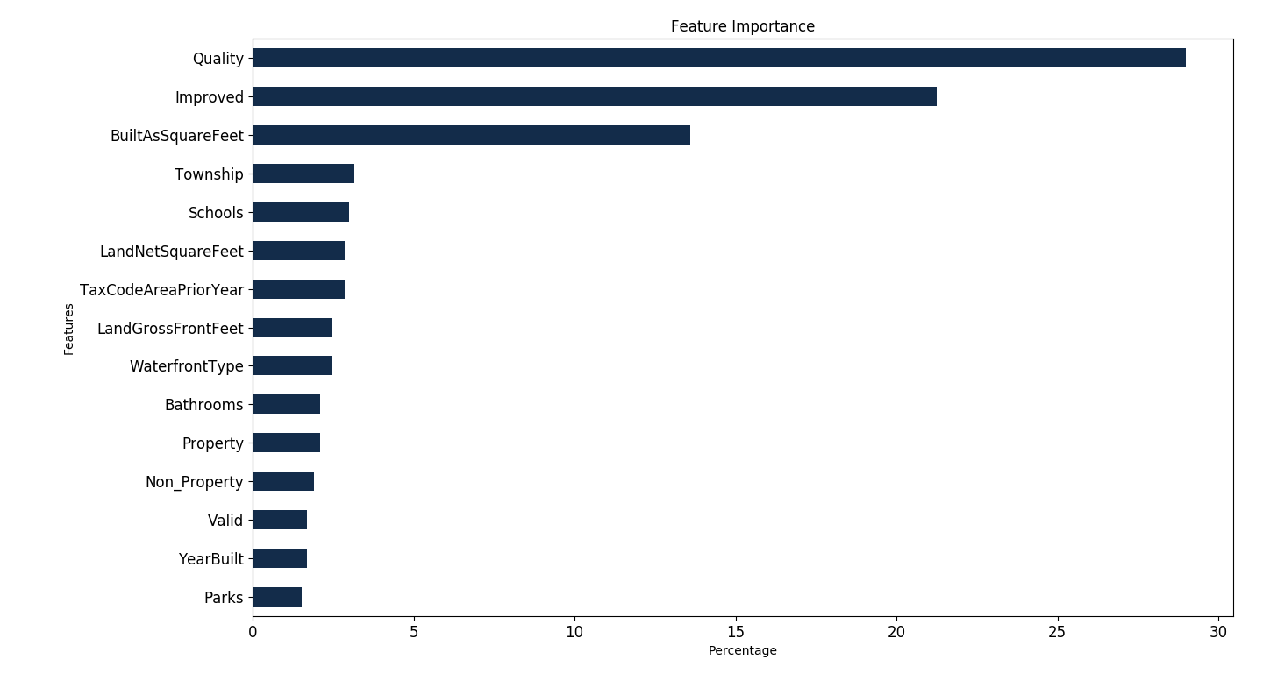
Random Forest – Feature Importance (With Community Data)

Slide 10
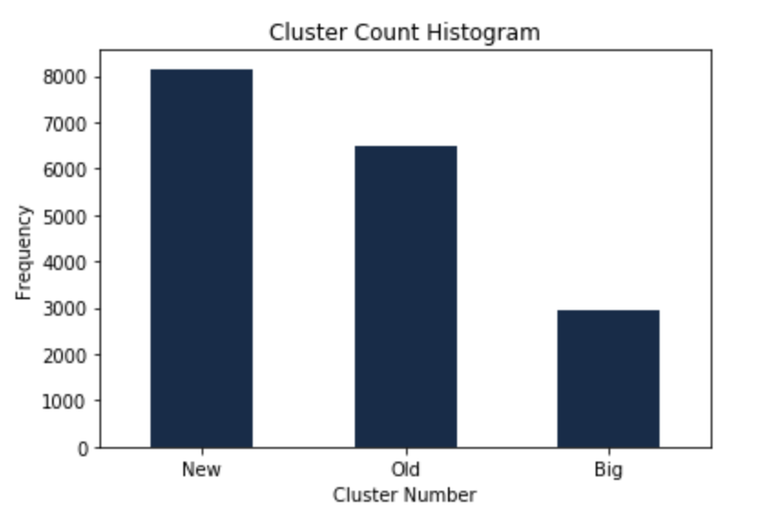
Stage Two:
K-Means Clustering
Cluster 0 = Old Homes
~75% were built before 1968.
Cluster 1 = New Homes
~75% were built after 1993
Cluster 2 = Large High Quality Homes
All of these homes have high quality ratings and high square footage.

Slide 11
Random Forest – Comparing Feature Importance Among Each Cluster
Features:
Quality – Most Important factor for Old and High-Quality Properties
Improved and Square Feet most important for New Homes
School ranking top 10 importance for all three clusters
Parks influence the price of property for all three clusters
Property and Non-Property crime is top 15 for all three clusters
Violent Crime Data is only featured for New Homes
Notes:
Quality is the most important factor to the sale price for both old and new properties. But not the most important for big high-quality properties.
School and violent crimes are critical factors to affect the sale price of old properties.
while the non-property crime only affect new house and big high-quality house.

Slide 12
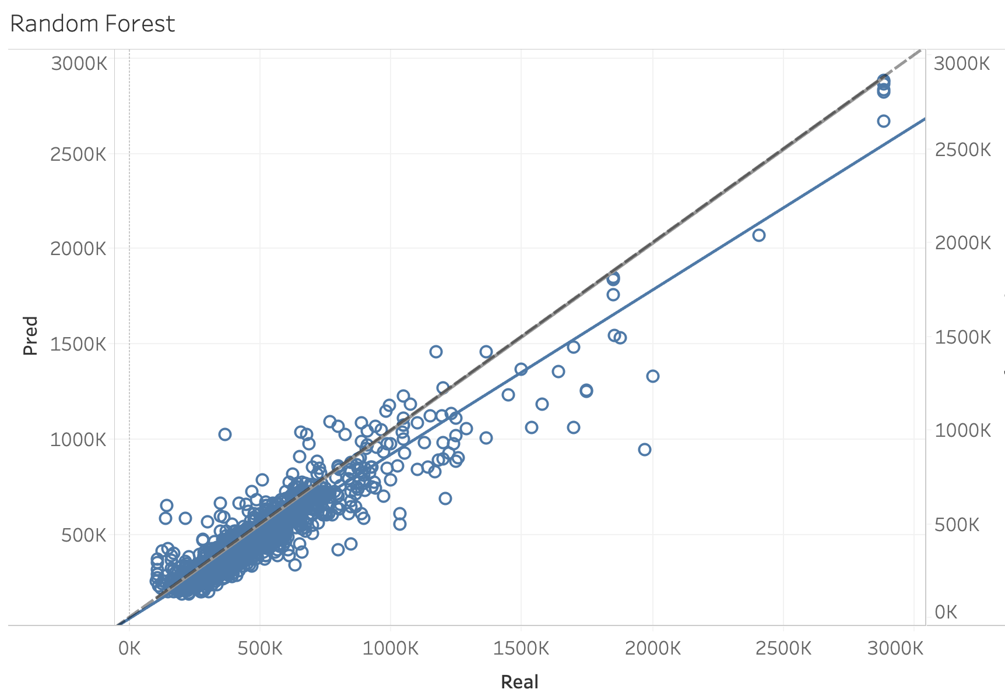
Random Forest Prediction vs Real Sale Price – Community Data
Reference Line
Trend of Prediction

Slide 13
W
Cluster 0
Old Homes
Decision Tree
MAE = $53,764.93
MAPE = 18.55%
Neural Network - One Hidden Layer
MAE = $57,596.57
MAPE = 20.19%
Cluster 1
New Homes
Decision Tree
MAE = $33,304.10
MAPE = 9.65%
Neural Network - One Hidden Layer
MAE = $38,917.08
MAPE = 11.19%
Neural Network - Two Hidden Layers
MAE = $49,232.77
MAPE = 17.39%
Random Forest
MAE = $45,425.96
MAPE = 15.98%
Random Forest
MAE = $25,049.42
MAPE = 7.39%
Neural Network - Two Hidden Layers
MAE = $31,378.29
MAPE = 9.09%
Cluster 2
Large Homes
Decision Tree
MAE = $107,859.21
MAPE = 17.53%
Neural Network - One Hidden Layer
MAE = $242,681.71
MAPE = 39.12%
Neural Network - Two Hidden Layers
MAE = $91,645.63
MAPE = 13.97%
Random Forest
MAE = $77,465.38
MAPE = 12.21%
Stage Three:
Clusters with no community data.
Running models on clusters yields more accurate results.
Old Homes prices are the most difficult to predict.
Weighted Average MAPE = 11.37% vs. 12.8%

Slide 14
W
Cluster 0
Old Homes
Decision Tree
MAE = $50,224.18
MAPE = 17.8%
Neural Network - One Hidden Layer
MAE = $50,128.39
MAPE = 18.09%
Cluster 1
New Homes
Decision Tree
MAE = $28,523.14
MAPE = 8.61%
Neural Network - One Hidden Layer
MAE = $35,773.74
MAPE = 10.82%
Neural Network - Two Hidden Layers
MAE = $42,179.65
MAPE = 15.21%
Random Forest
MAE = $37,142.25
MAPE = 13.49%
Random Forest
MAE = $21,531.39
MAPE = 6.67%
Neural Network - Two Hidden Layers
MAE = $28,871.99
MAPE = 8.79%
Cluster 2
Large Homes
Decision Tree
MAE = $93,897.91
MAPE = 14.97%
Neural Network - One Hidden Layer
MAE = $224,753.74
MAPE = 37.06%
Neural Network - Two Hidden Layers
MAE = $86,133.86
MAPE = 13.22%
Random Forest
MAE = $65,267.55
MAPE = 10.92%
Stage Three:
Clusters with community data.
Running models on clusters yields most accurate results.
Weighted Average MAPE = 9.89% vs. 11.31%

Slide 15
Recommendations for Pierce County Assessors' Office
Include Community Quality data
Cluster the data into smaller market segments
Implement Random Forest machine learning models
By implementing an AVM method for assessing property value potential decrease in the error rate of roughly 7%.

Slide 16
Pierce County Assessors' Office by The Numbers - 2018
Underestimating property values cost Pierce County $12.7 million in potential tax revenue
Overestimating resulted in $2.1 million in tax payer overpayments.
A 7% decrease in error = ~$880,000 in additional tax revenue & $150,000 less in overpayments by tax payers.
A fairer and more accurate approach, that will cost less over time to implement.

Slide 17
Moving Forward
Clustering residential properties based on the GIS location and density using DBSCAN clustering.
Using more GIS based Community Quality variables
Implement more sophisticated models, experiment with deep learning and ensemble techniques like stacking to improve accuracy.

Slide 18
Thank you!
Questions?

