Slide 1
PAWPAL+ PROJECT
DEMO

Slide 2
outline
Introduction
Demo
Conclusion

Slide 3
introduction
Pawpal+ is an AI-integrated app that allows users to schedule routine tasks.
App is currently restricted to dog and cats
App functions through AI integration
Assists owner(user) schedule daily tasks
Task are grouped into morning, afternoon, evenings
Conflicts are flagged
AI integration makes app dynamic
User can track tasks overtime and repeat as necessary

Slide 4
Intro. Contd.
API is not required to run app
MOCK API is used to show app functionality
API from any AI chatbot can be used to make app more dynamic
Pet breeds
Dogs
Golden retriever
Pomeranian
Bichon Frise
Cat
persian

Slide 5
demo
Quick demo instruction
Download all required files
Open using desired IDE
VS Code was used for the project
In terminal run – py –m streamlit run app.py**
**NB.: python –m streamlit run app.py can be used – system dependent
On landing page (streamlit)
Enter owner and pet name and save
Enter tasks of the day
Delete button allow for removal of incorrect entries
Generate schedule
Demo will show three examples
Golden retriever (dog)
Pomeranian(dog)
Persian (cat)

Slide 6
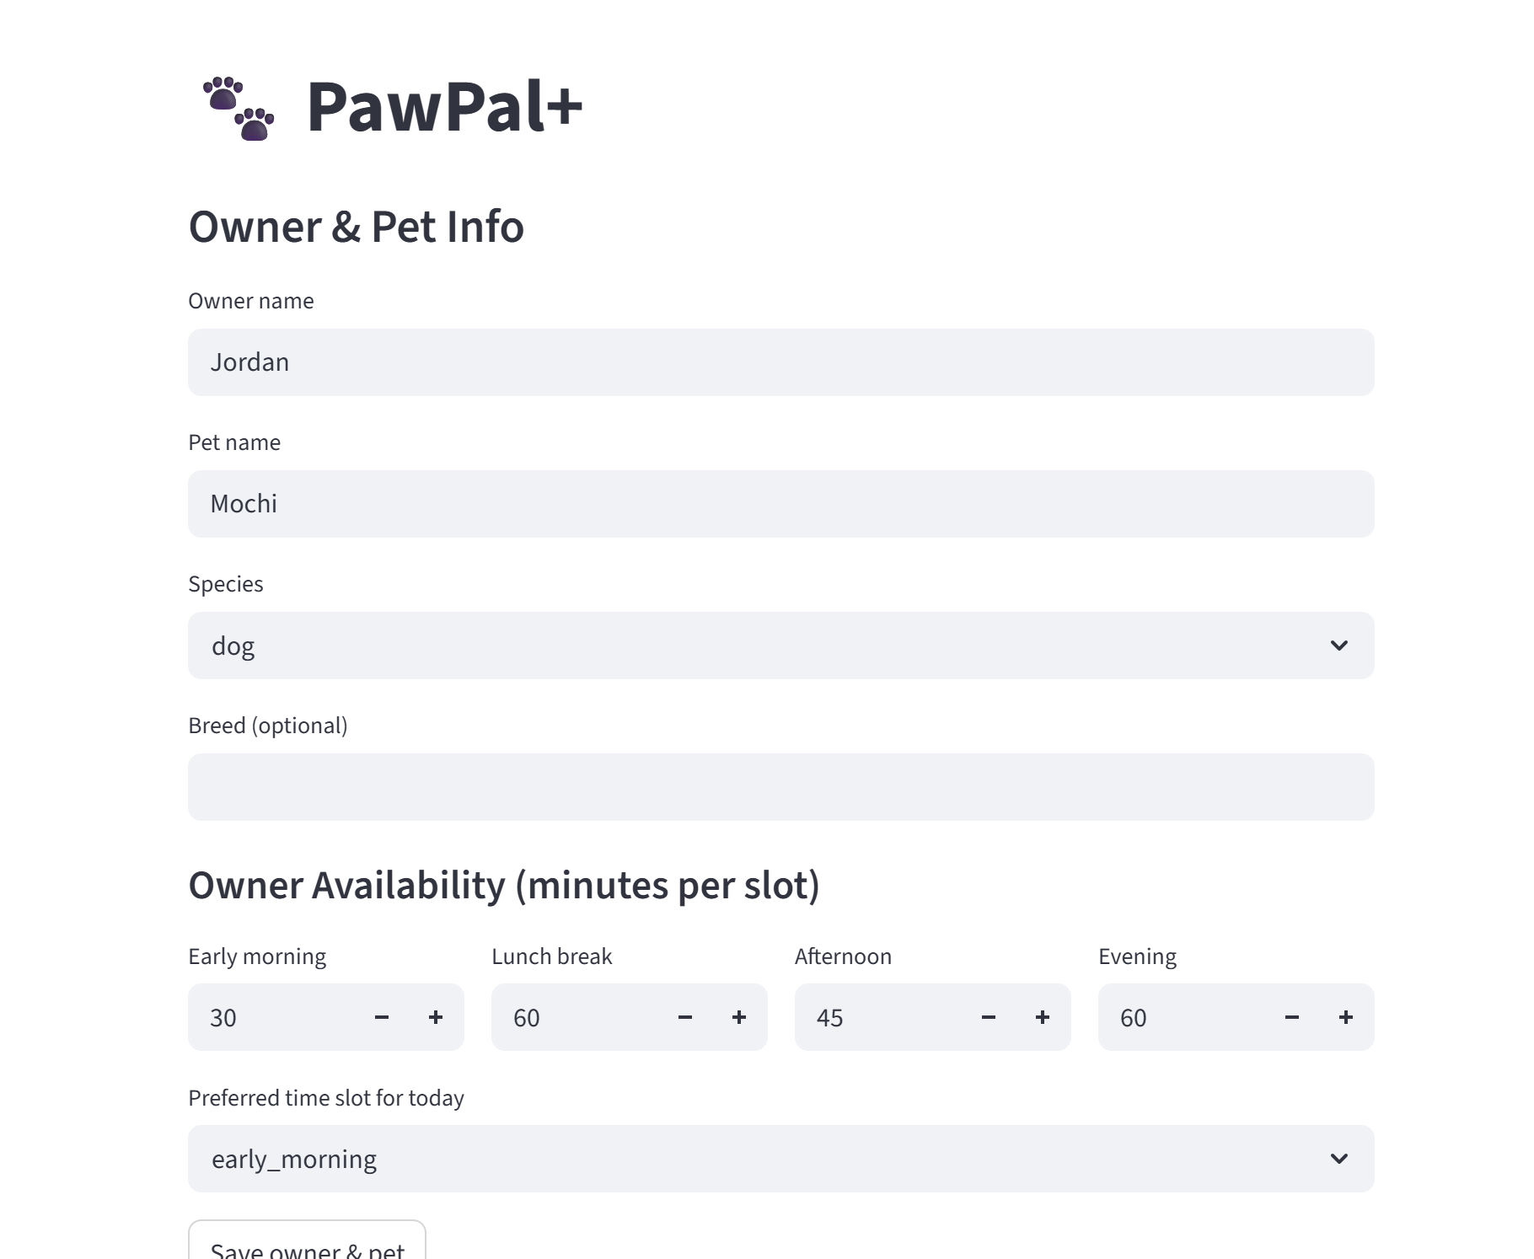
Demo (contd.)
Landing Page

Slide 7
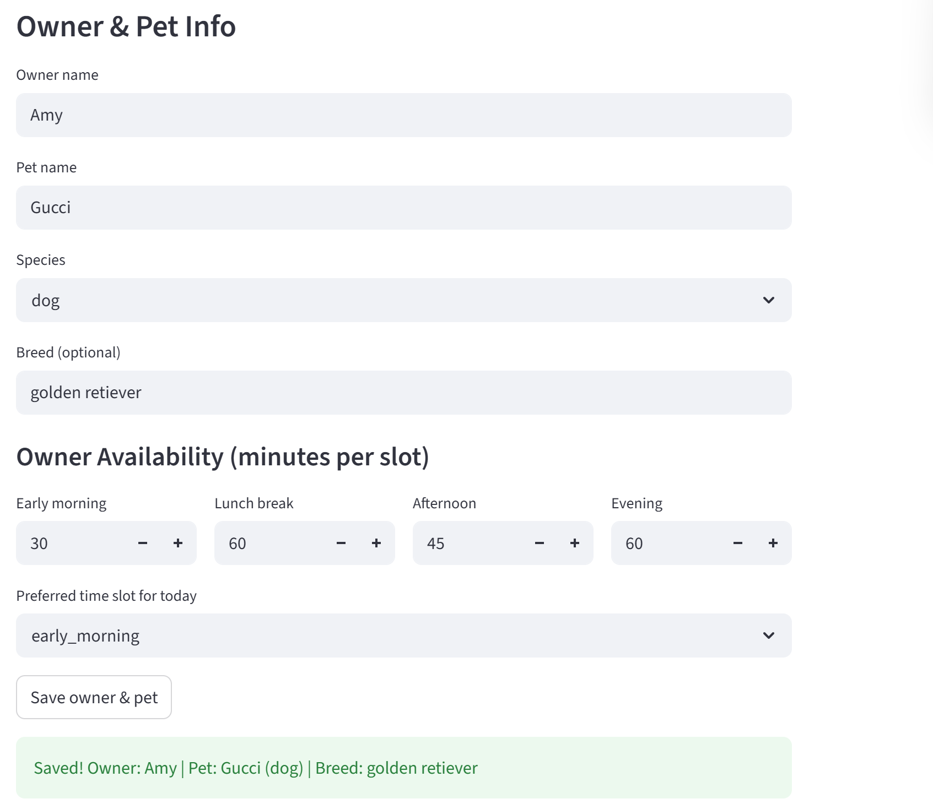
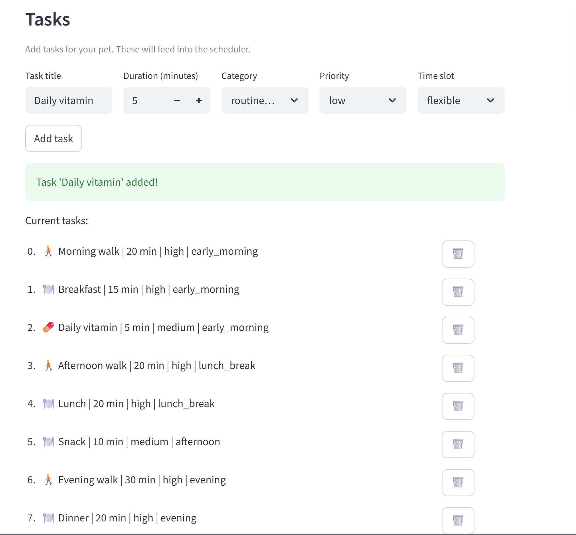
Demo (contd.)
Golden retriever

Slide 8
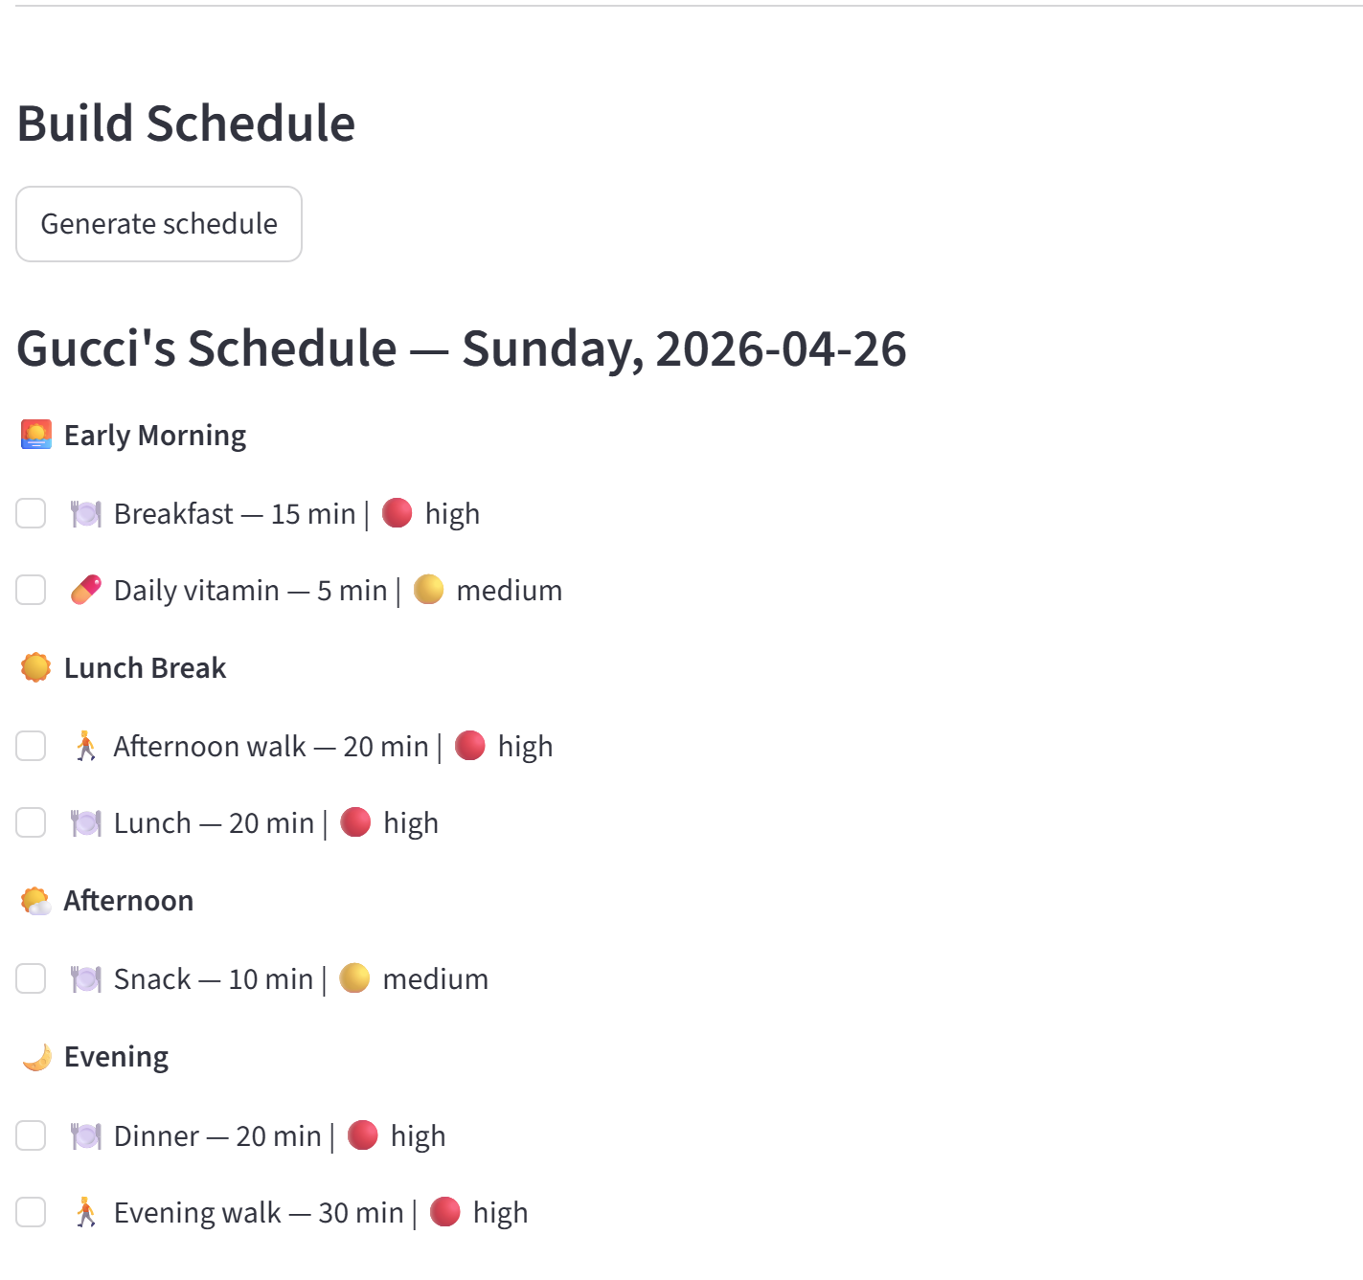
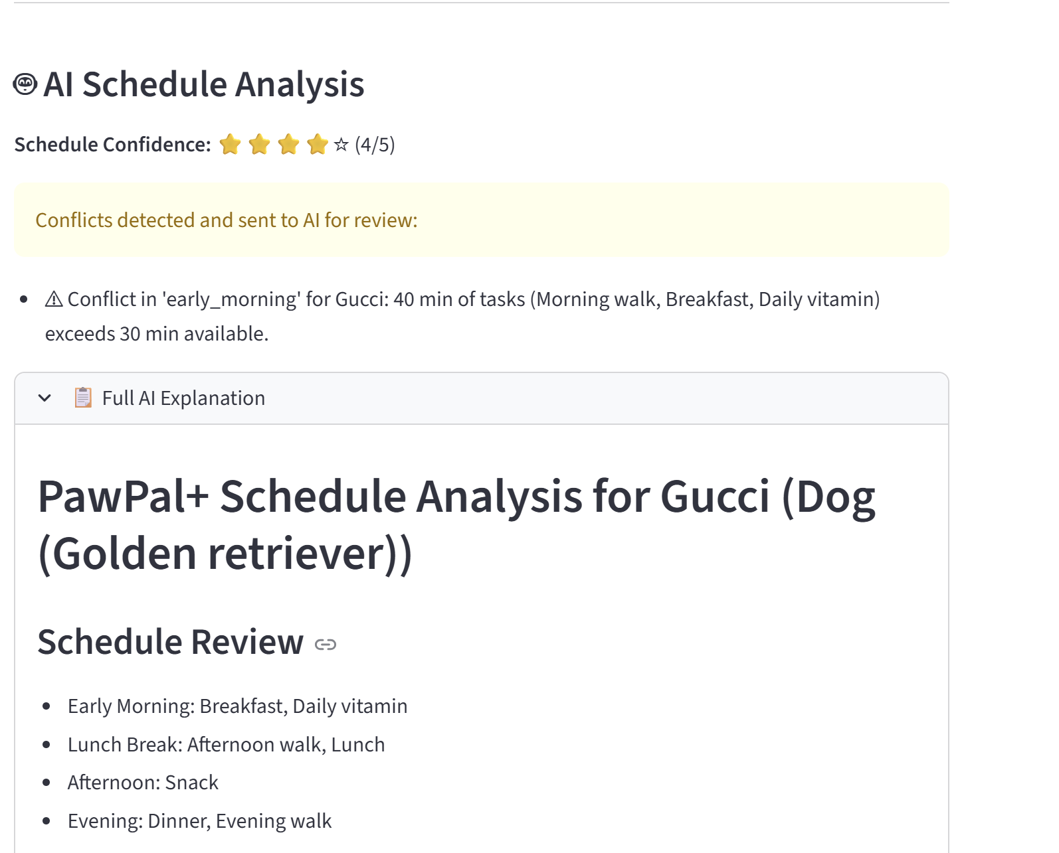
Demo (contd.)

Slide 9
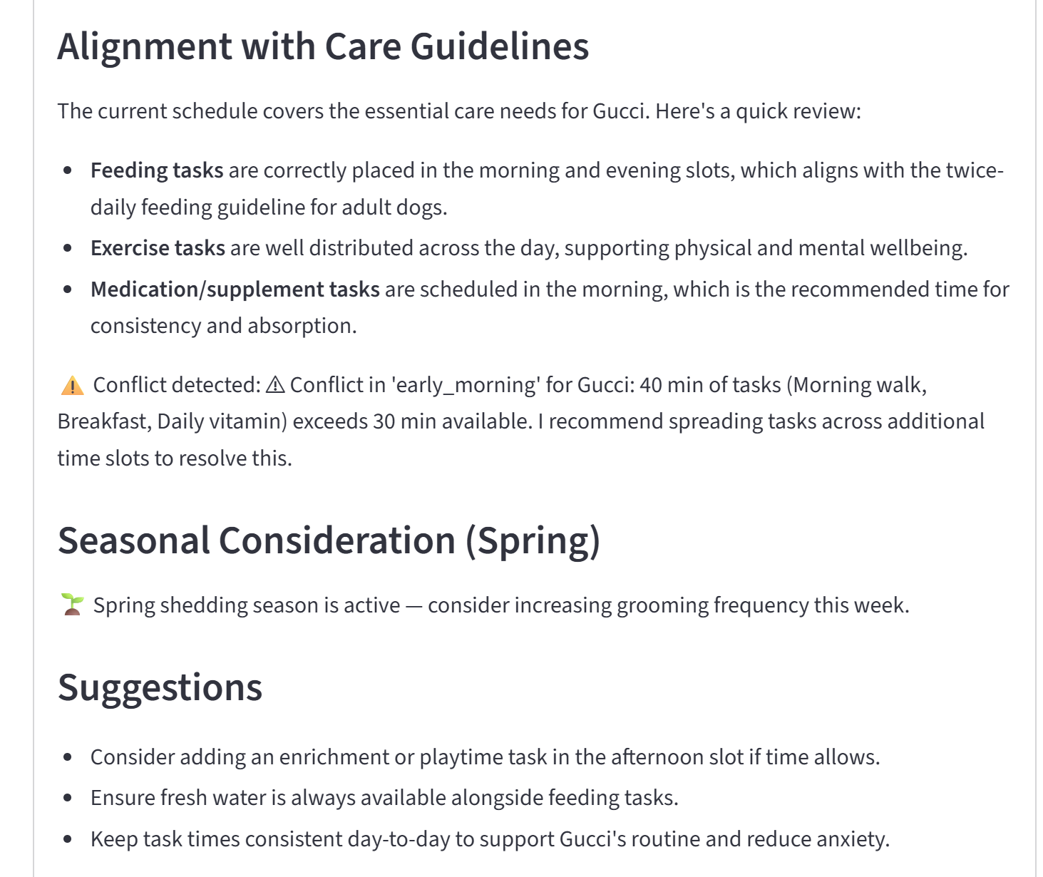
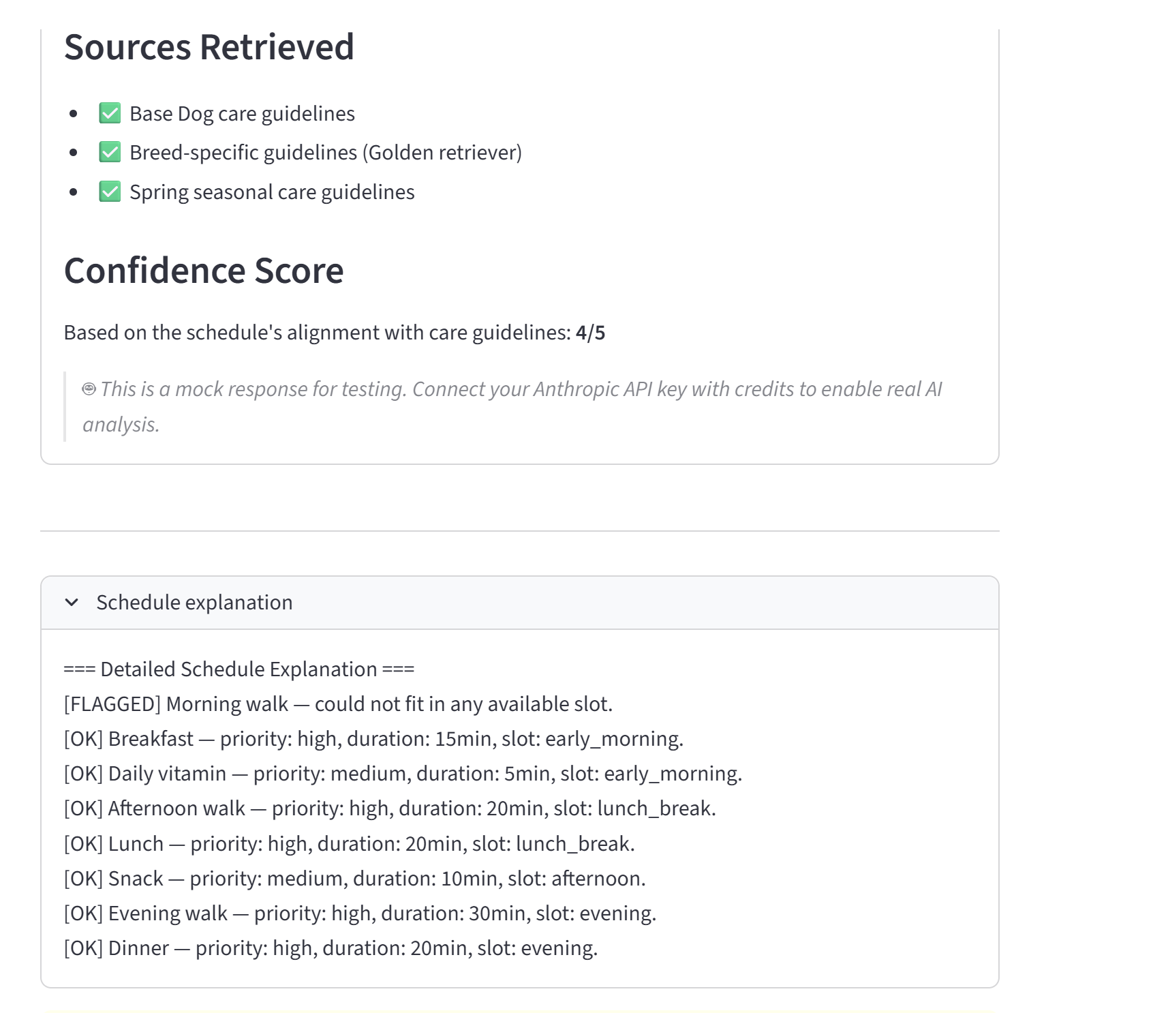
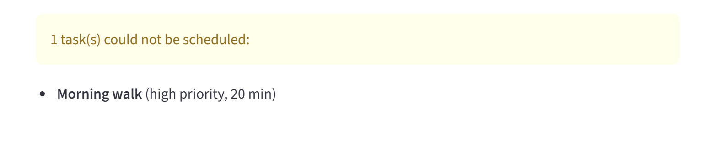
Demo (contd.)

Slide 10
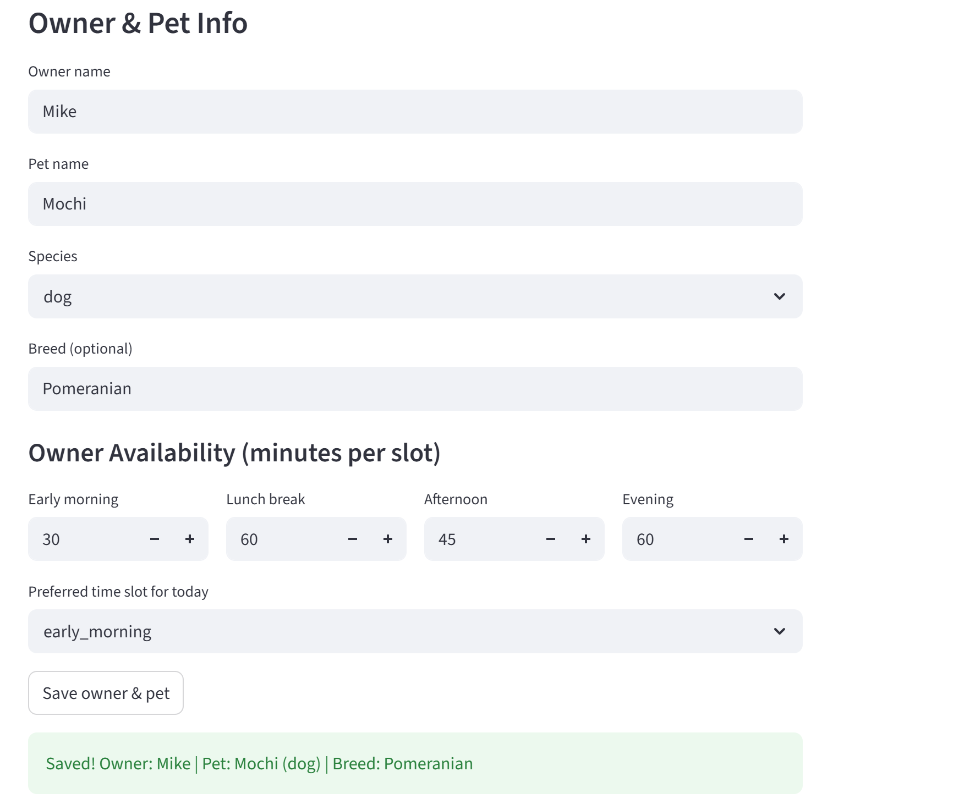
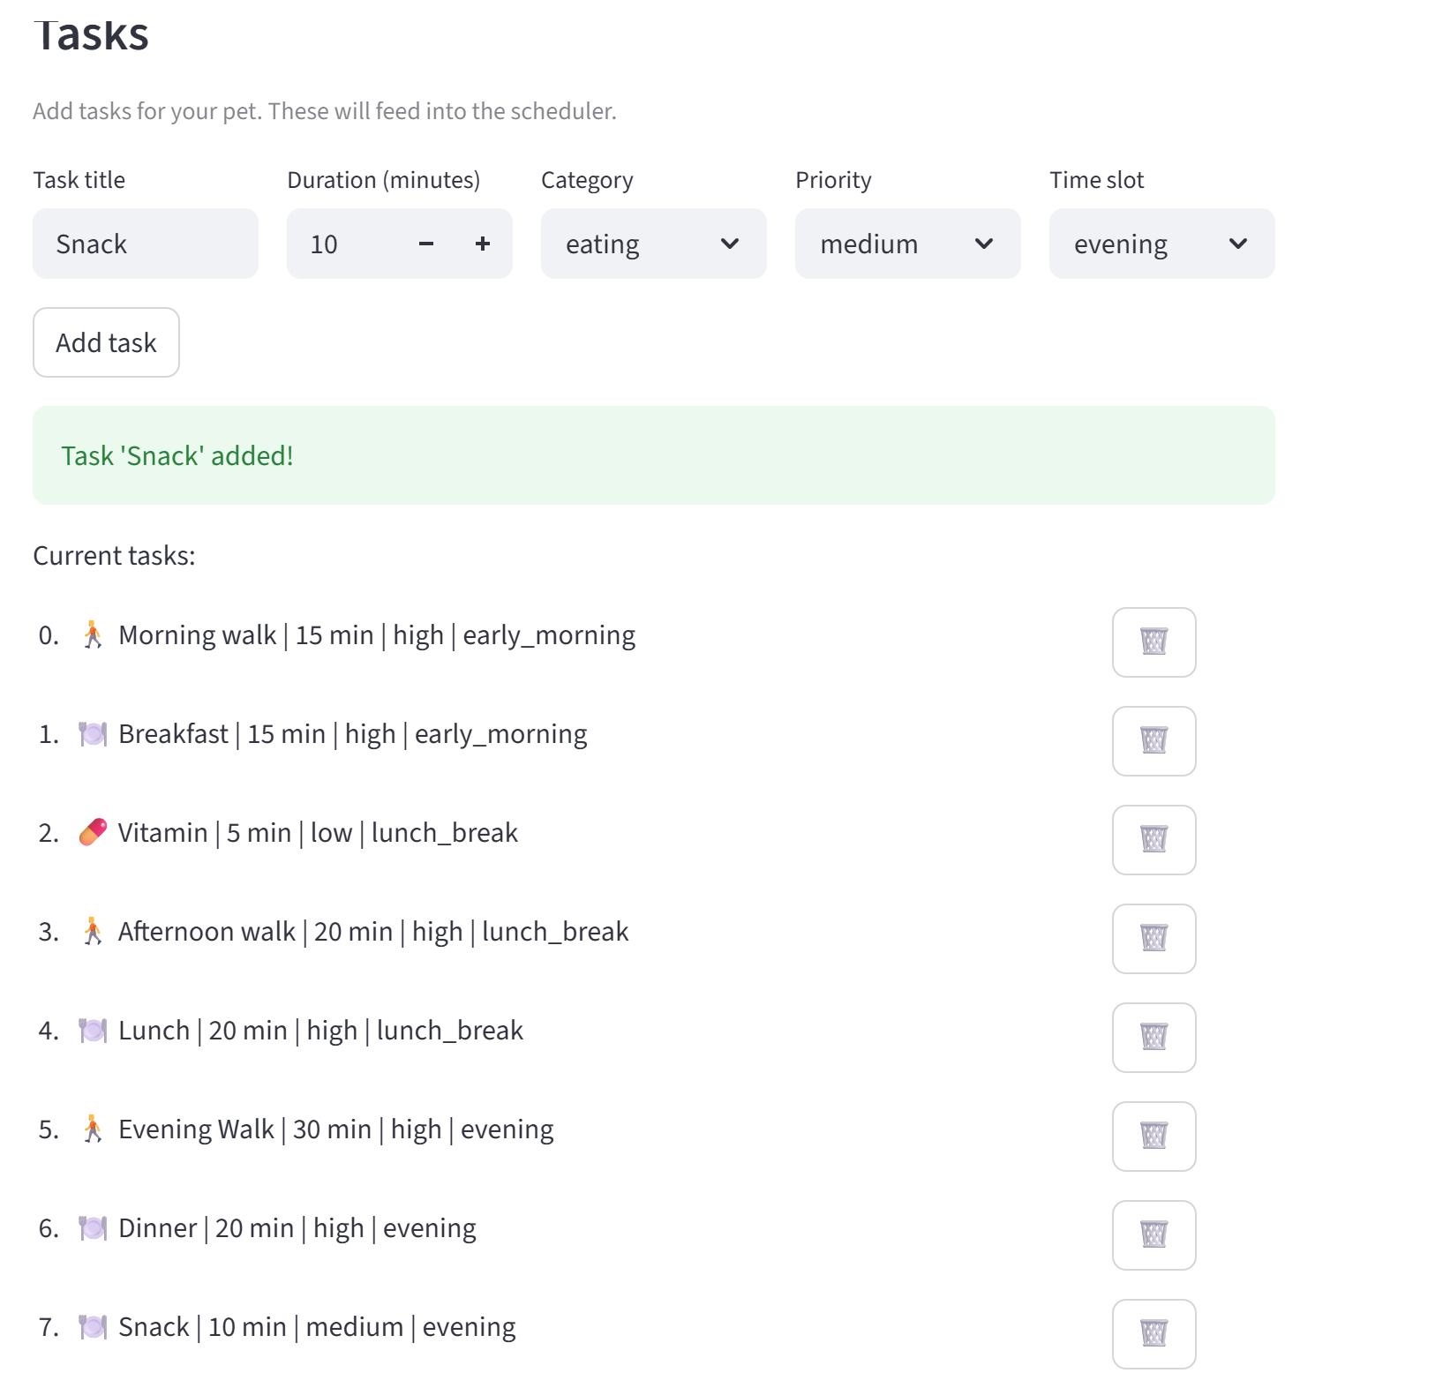
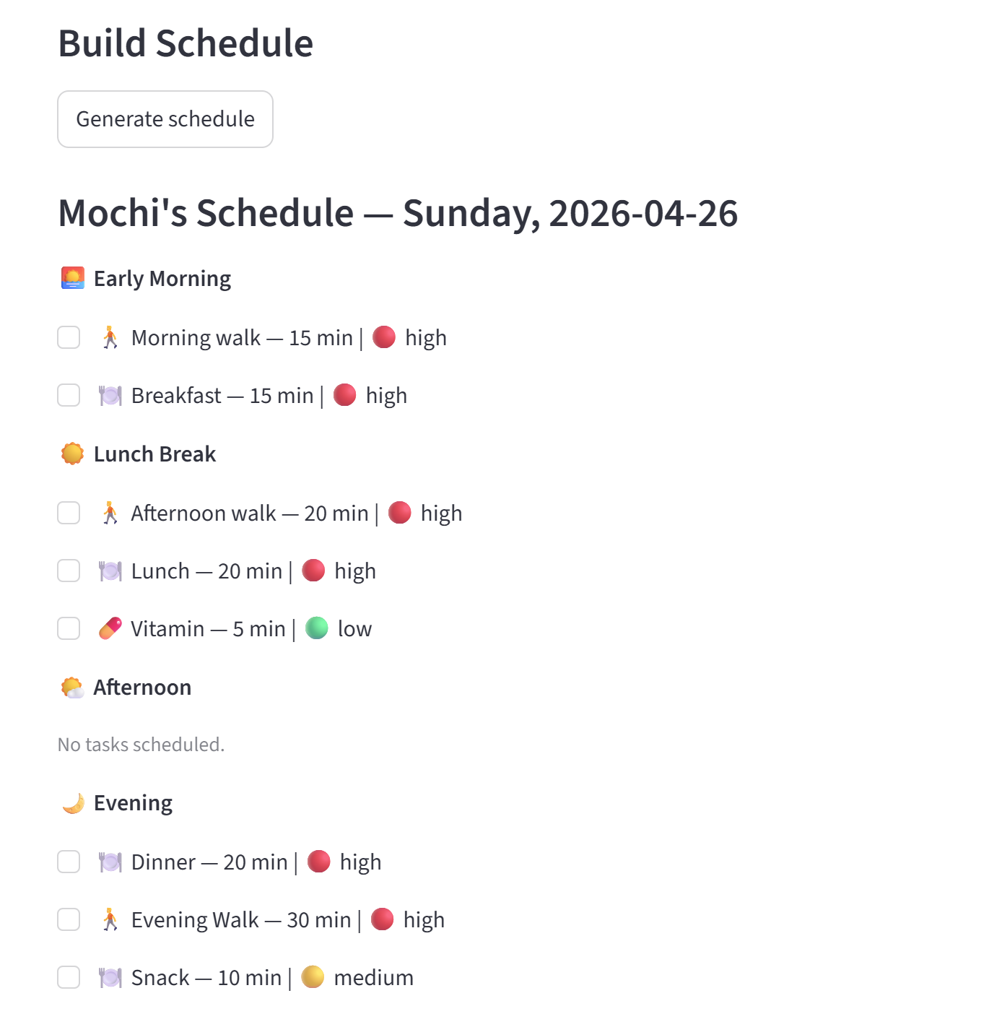
Demo (contd.)
Pomeranian

Slide 11
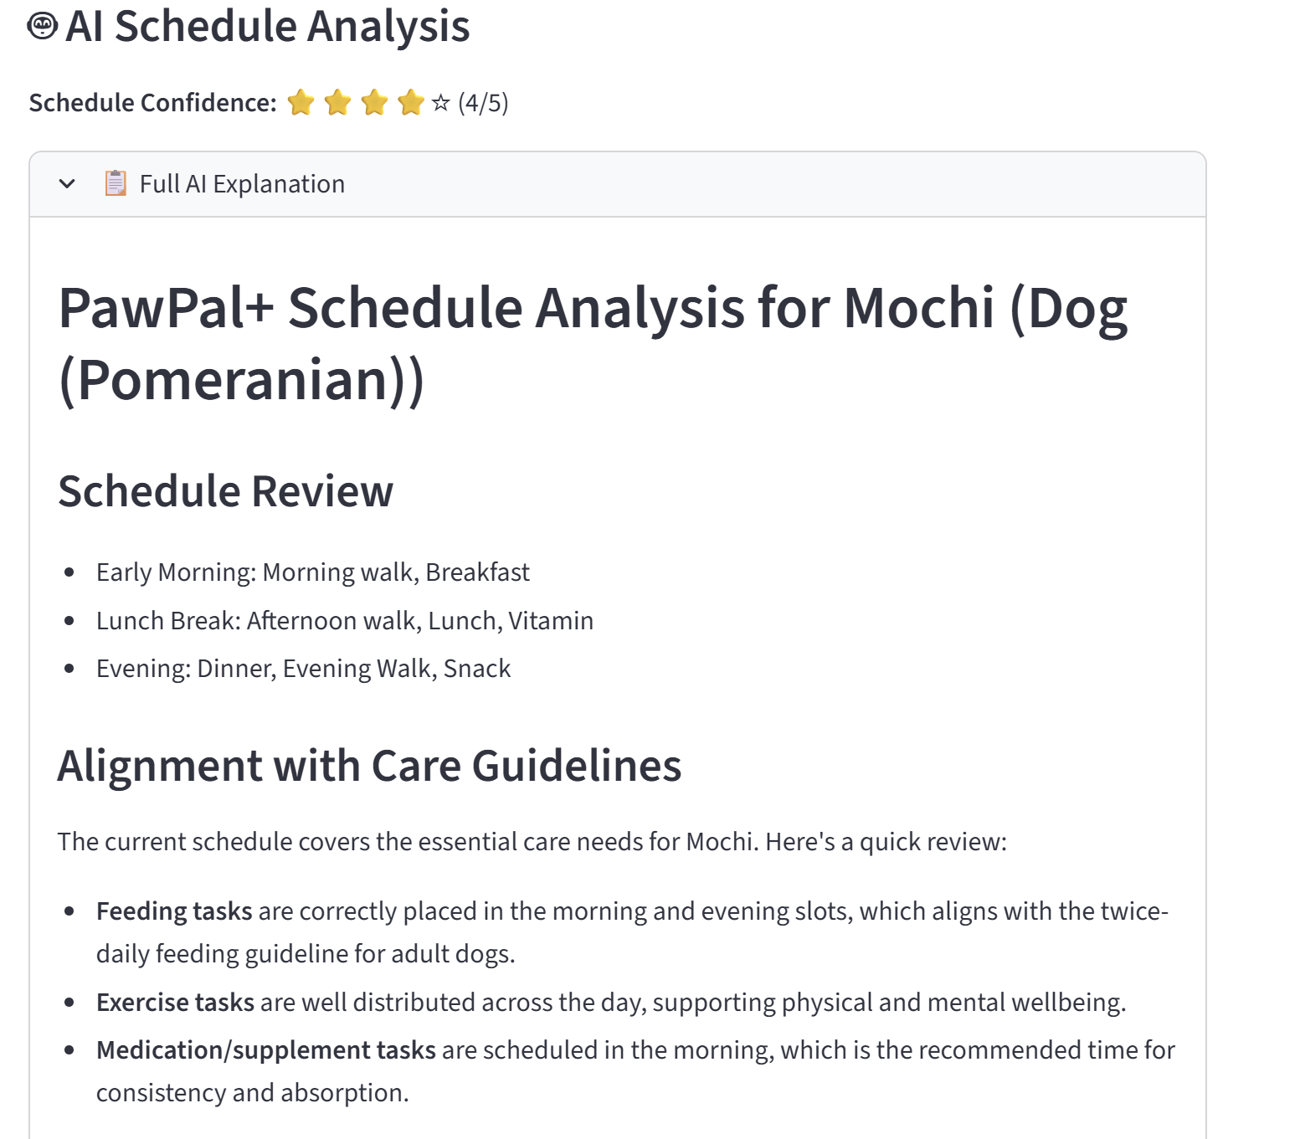
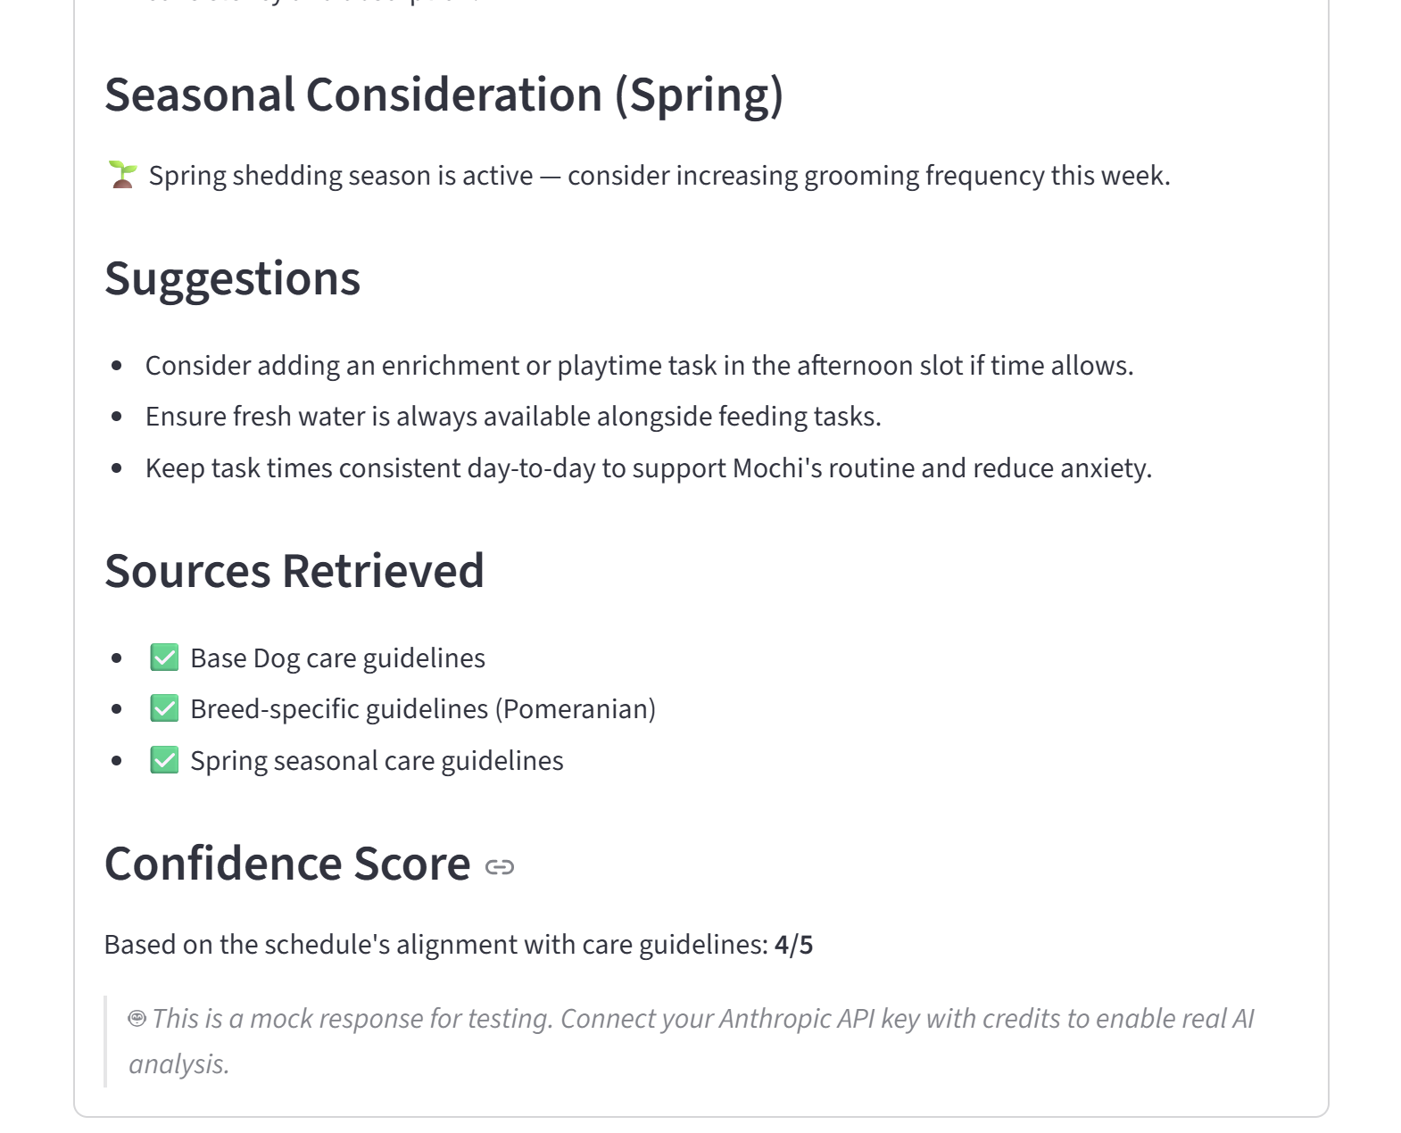
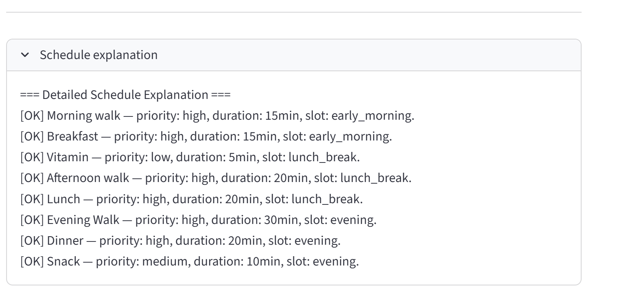
Demo (contd.)
Pomeranian

Slide 12
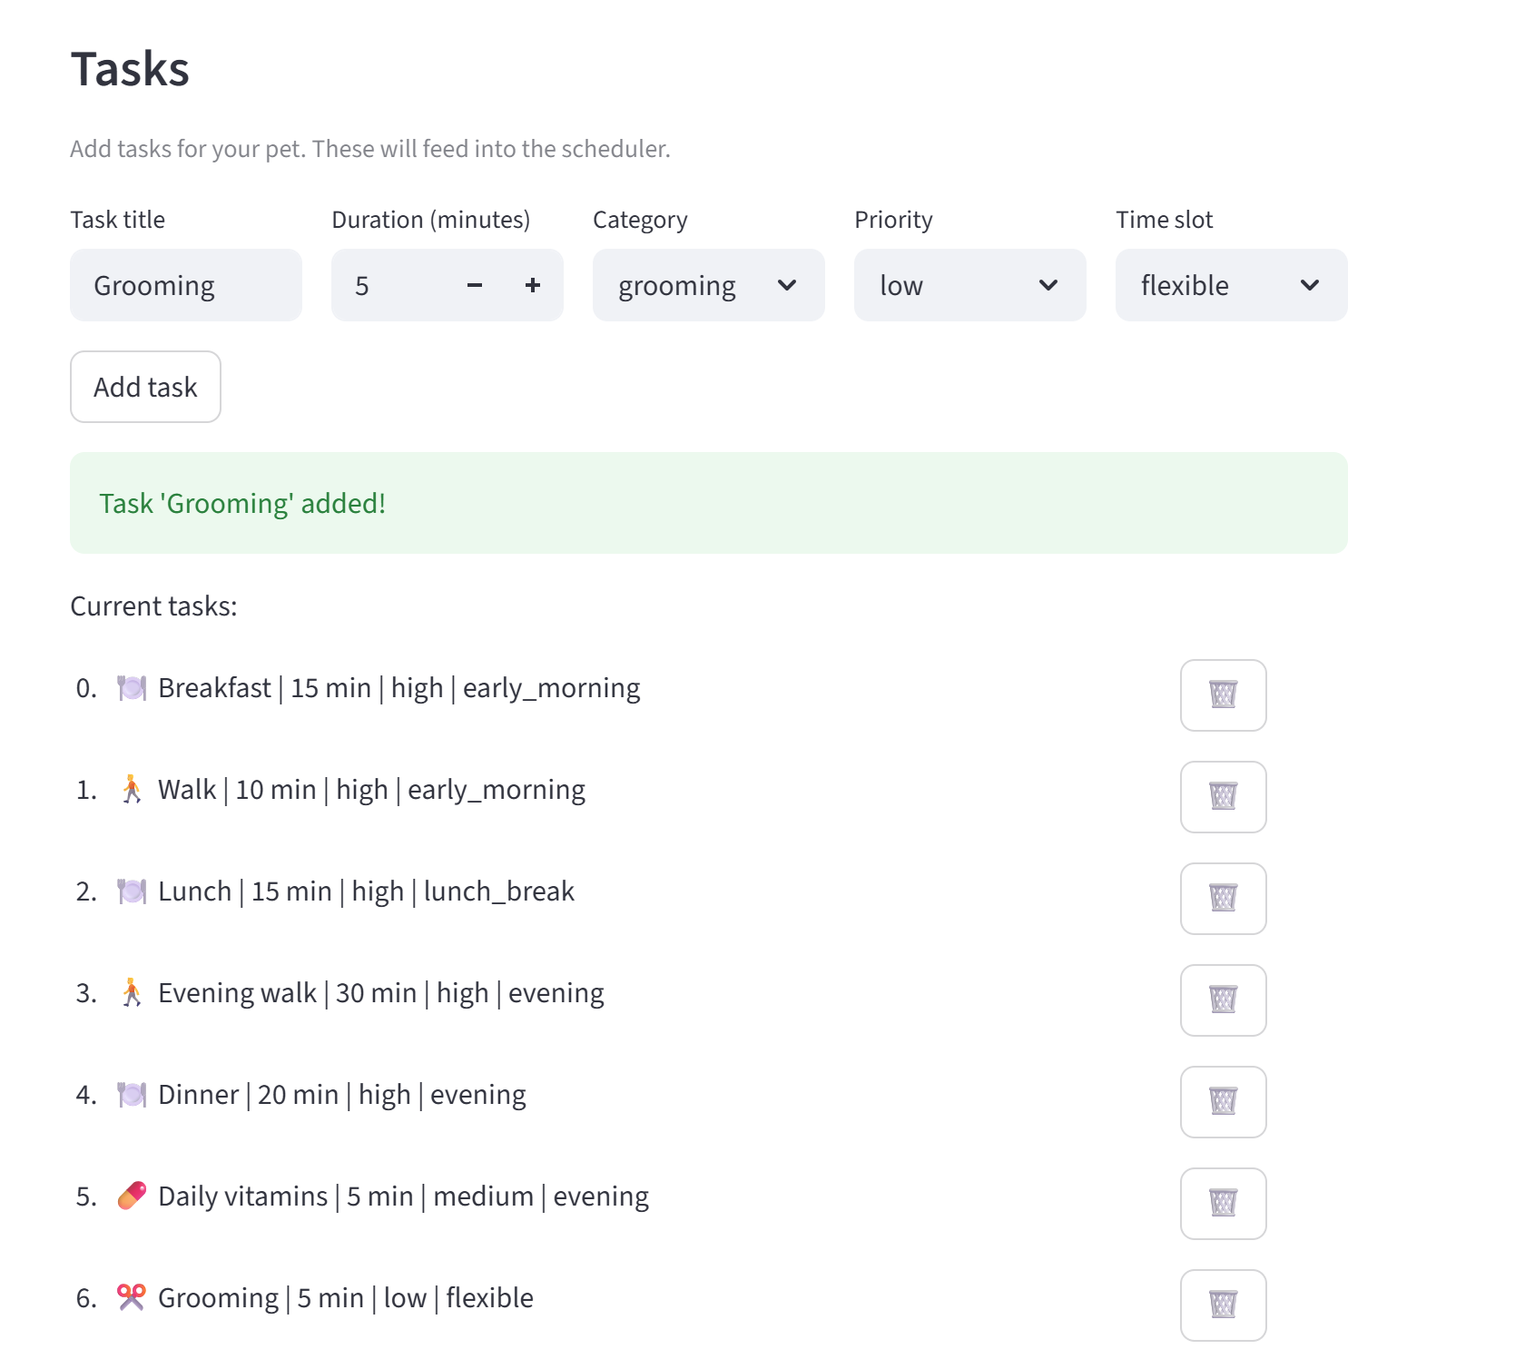
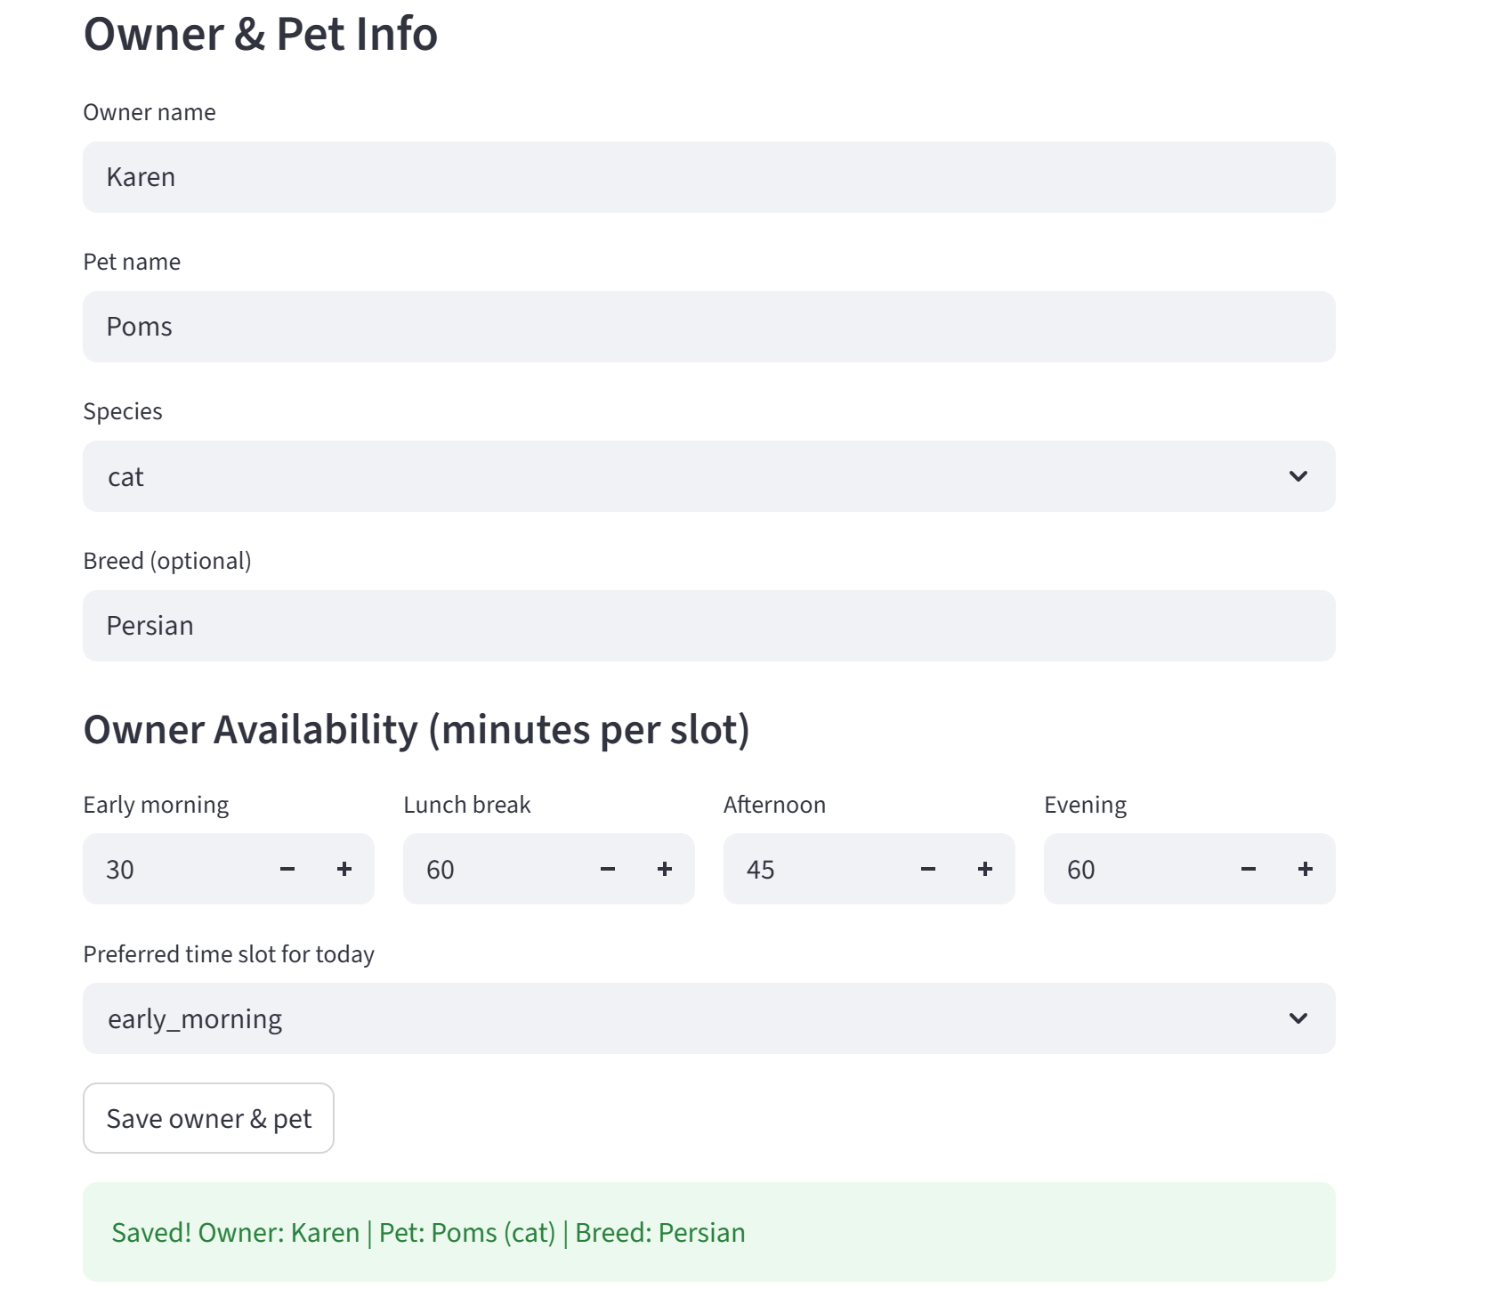
Demo (contd.)
Persian Cat

Slide 13
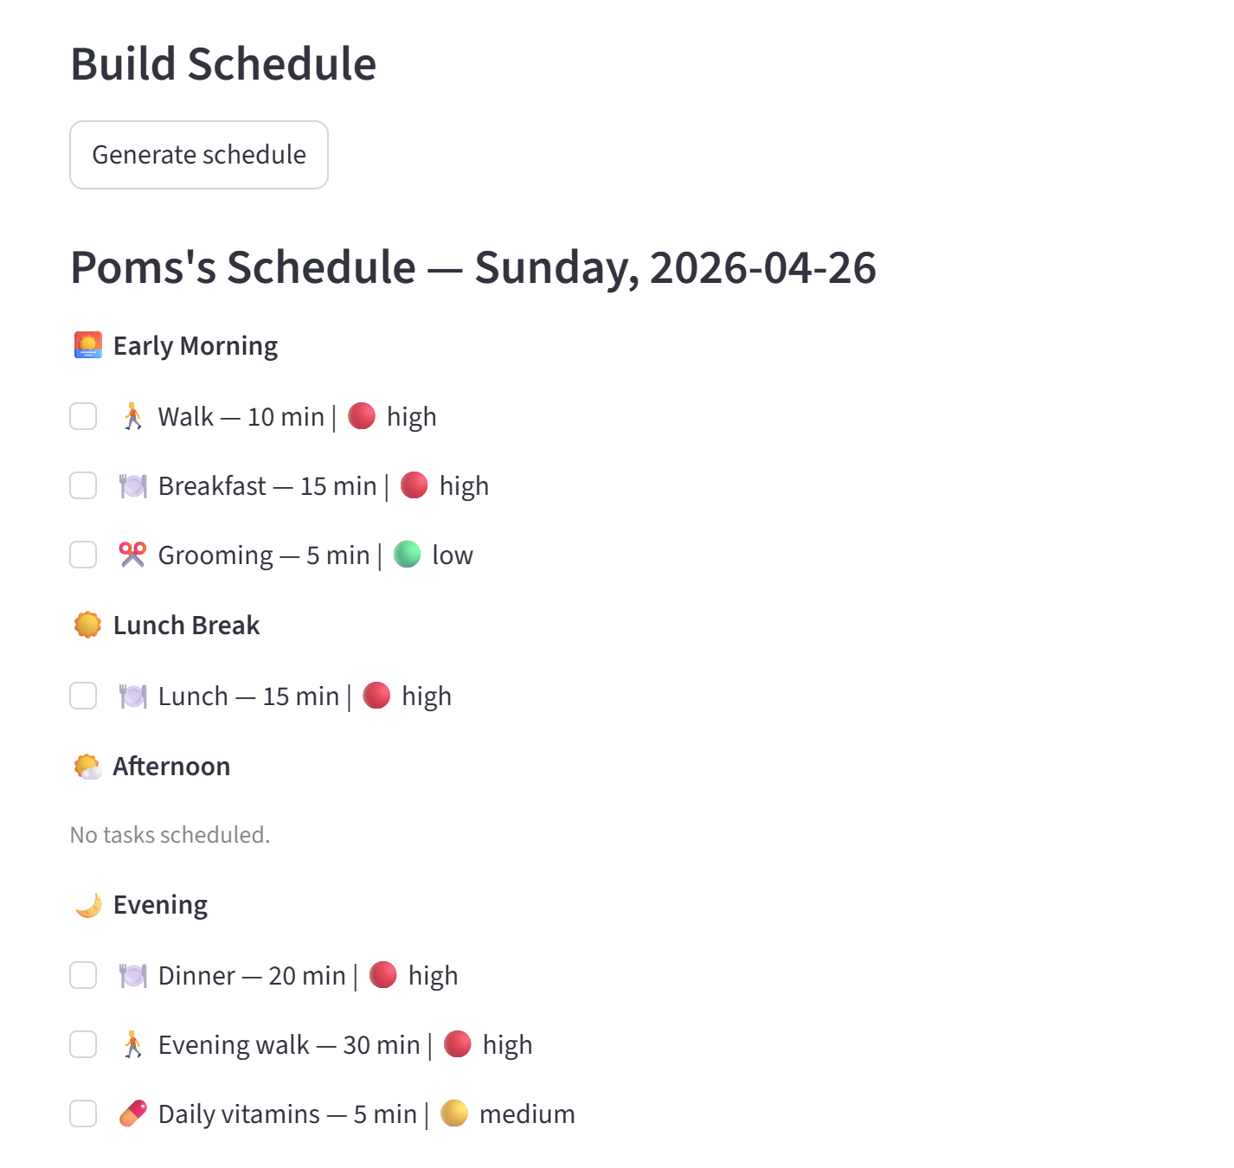
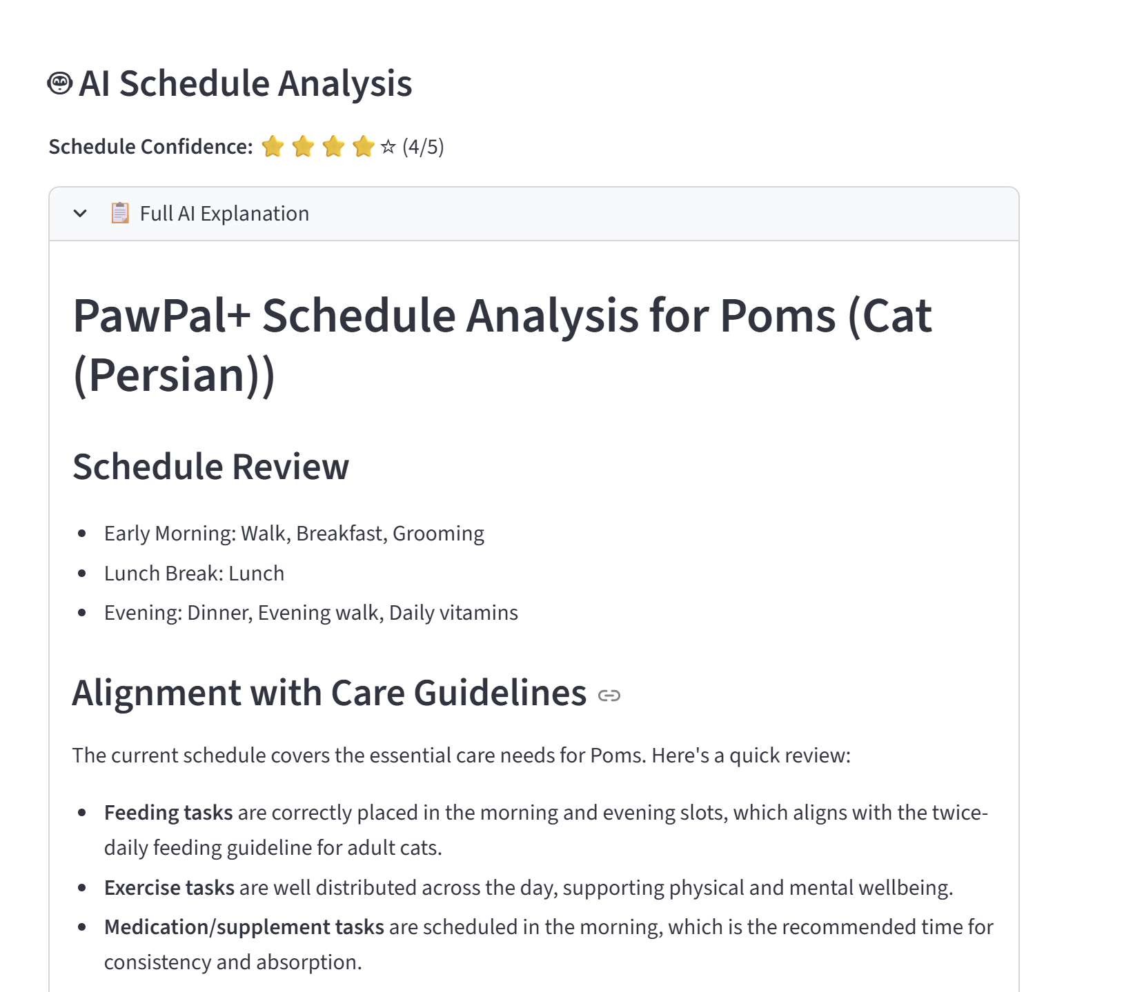
Demo (contd.)
Persian Cat

Slide 14
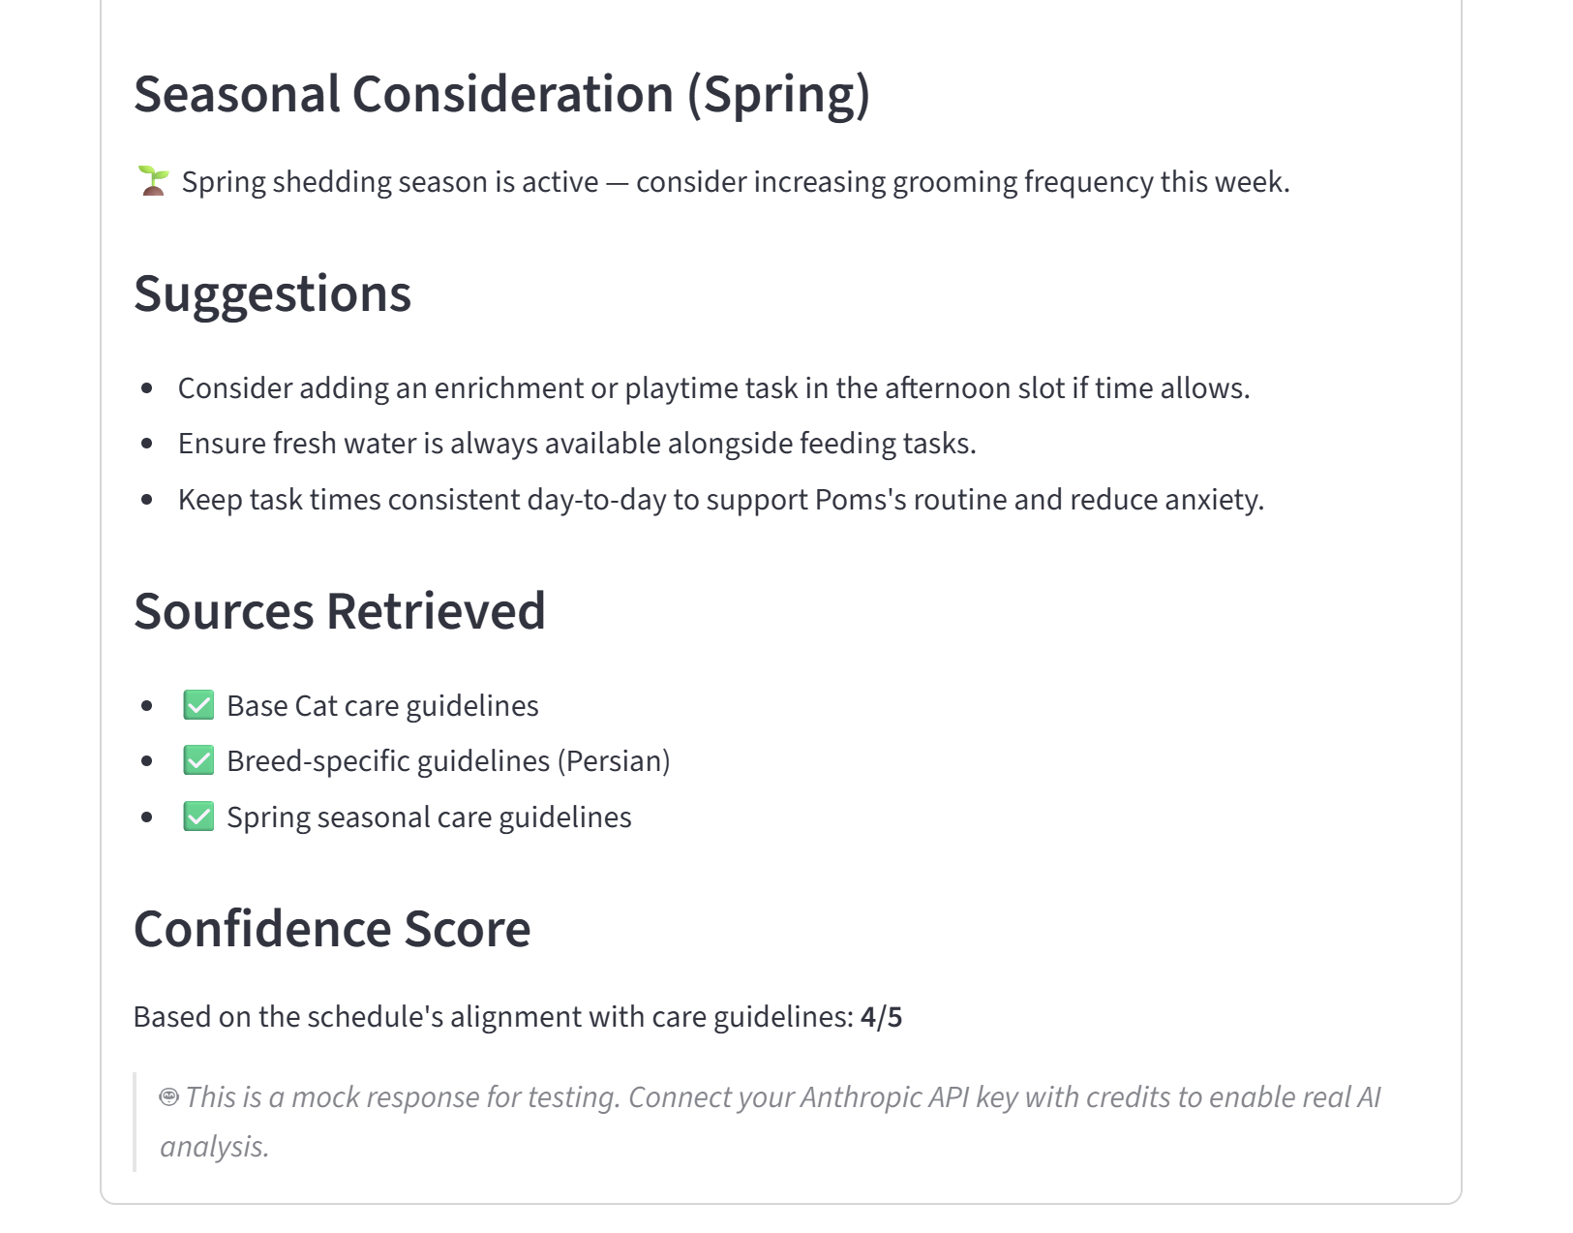
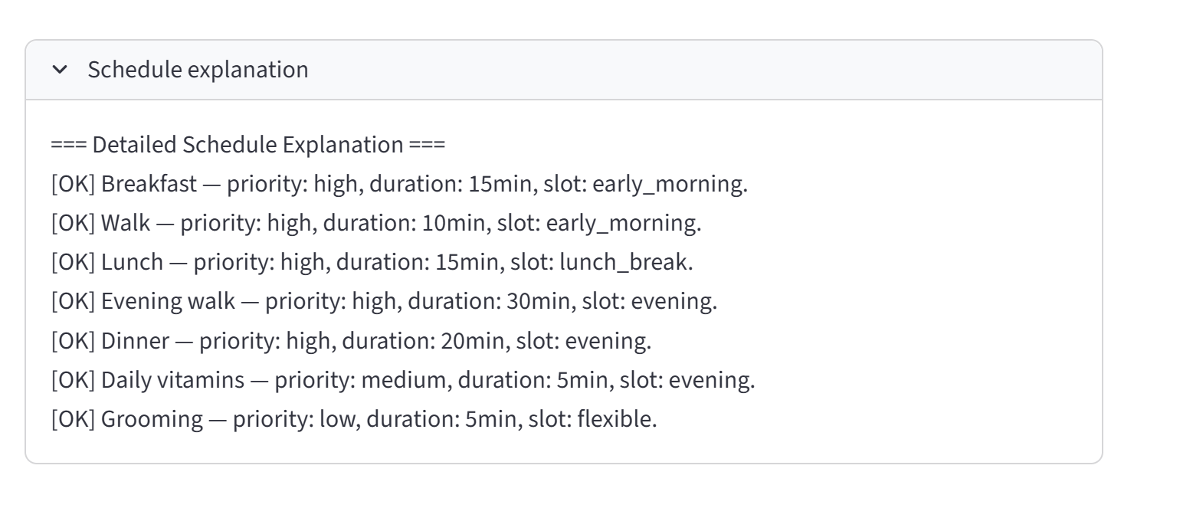
Demo (contd.)
Persian Cat

Slide 15
conclusion
App functionality
Generated schedule based on owner input
Allotted time can be changed to fit owner schedule
Mimics suggestions based on season
Conflict detection
Breed identification

Slide 16
Thank you!!!!!!

