Slide 1
Modeling the Coronavirus
Nancy Campos, Jake Vogt, Sarah Lauren Miller

Slide 2

Tools Used + Data Source
Python Matplotlib
Python Pandas
Jupyter Notebook
Tableau
Scikit - Sklearn
PostgreSQL
Data provided by World Health Organization (WHO)
Dates ranged from Jan 9, 2020 to April 7, 2020

Slide 3
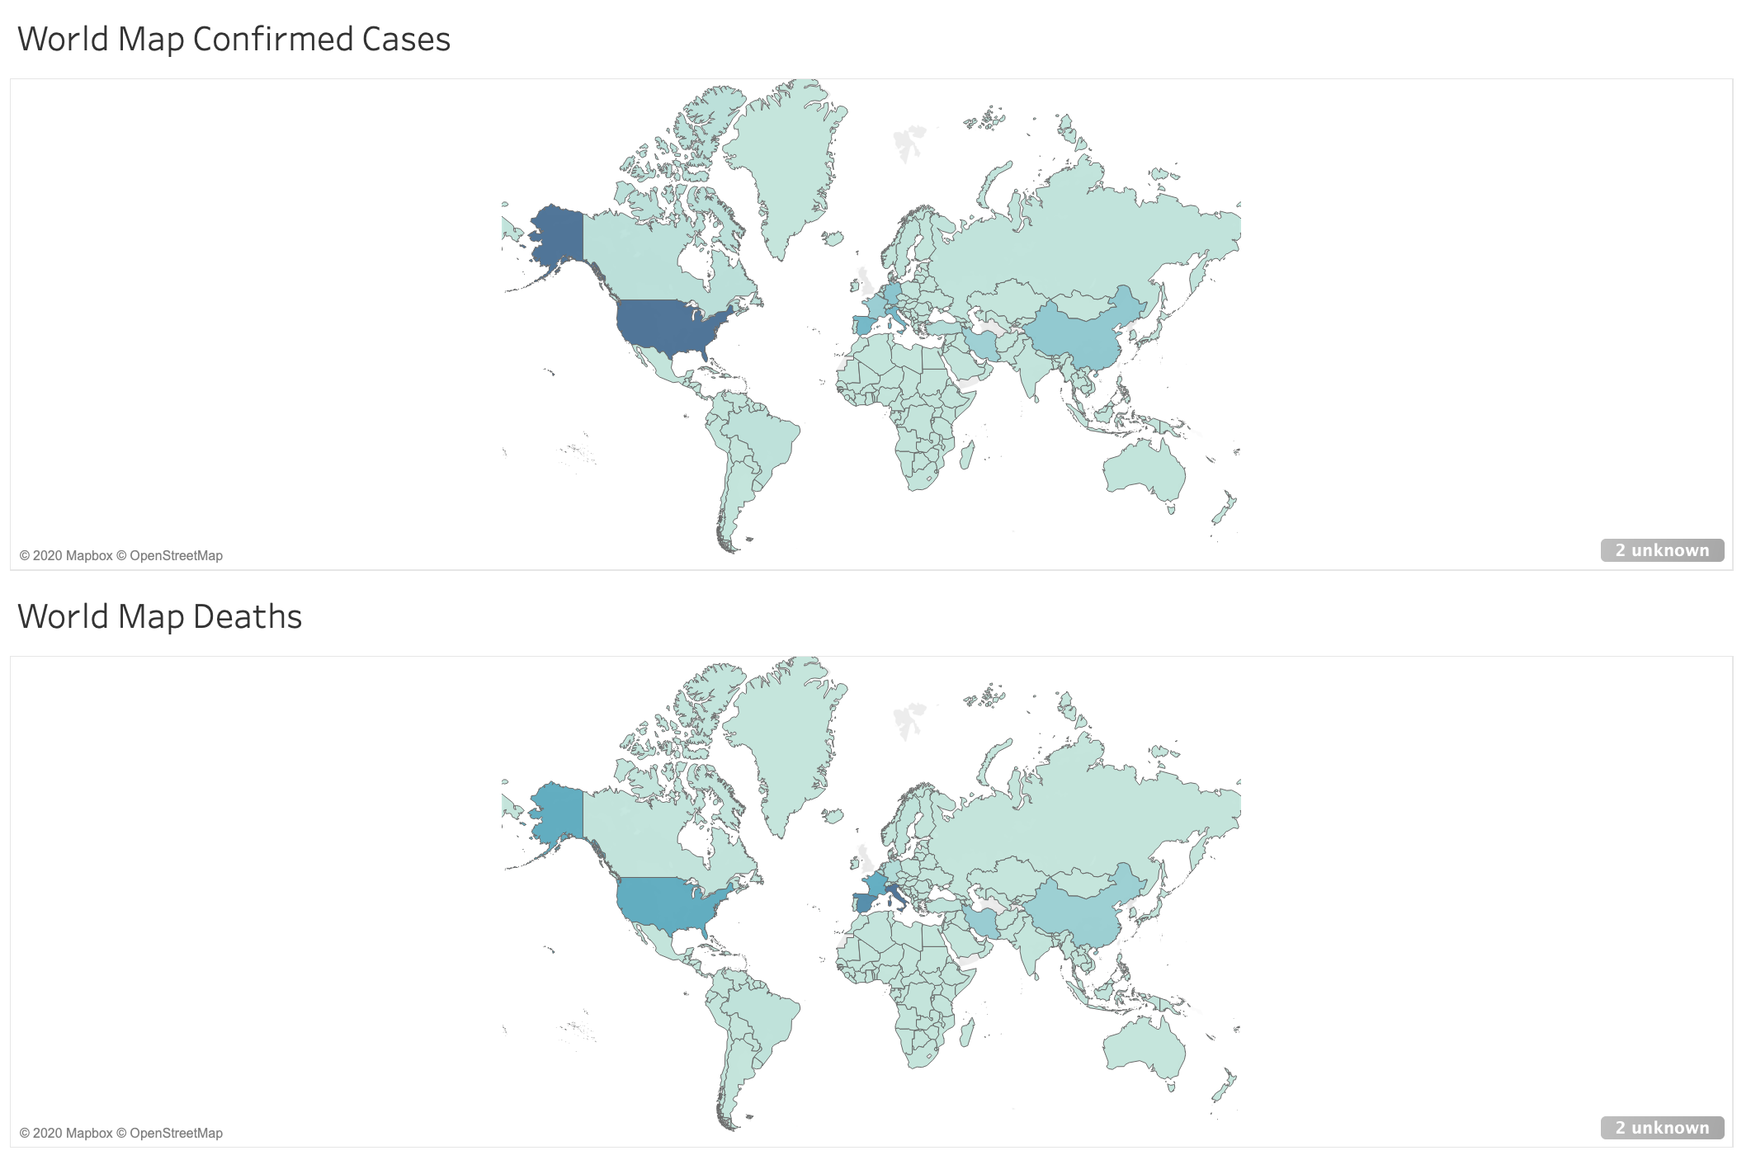
Familiarizing ourselves with the data
Notes:
Go to Tableau
Picking our countries

Slide 4
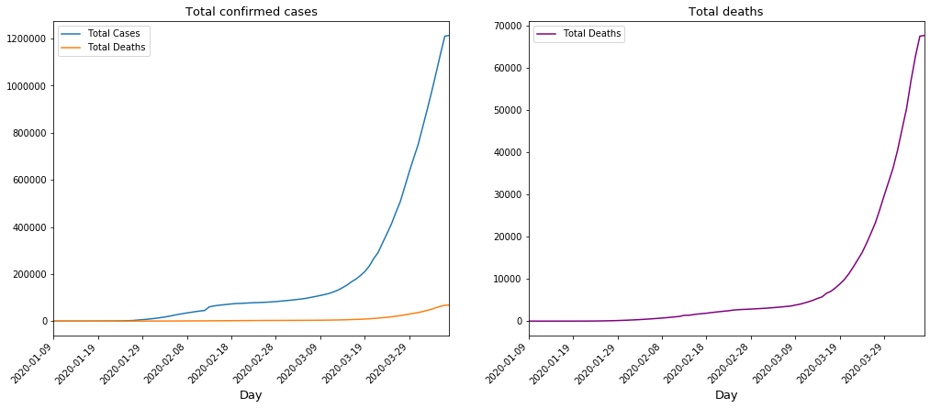
Global cases
Jupyter notebook, matplotlib, pandas

Slide 5
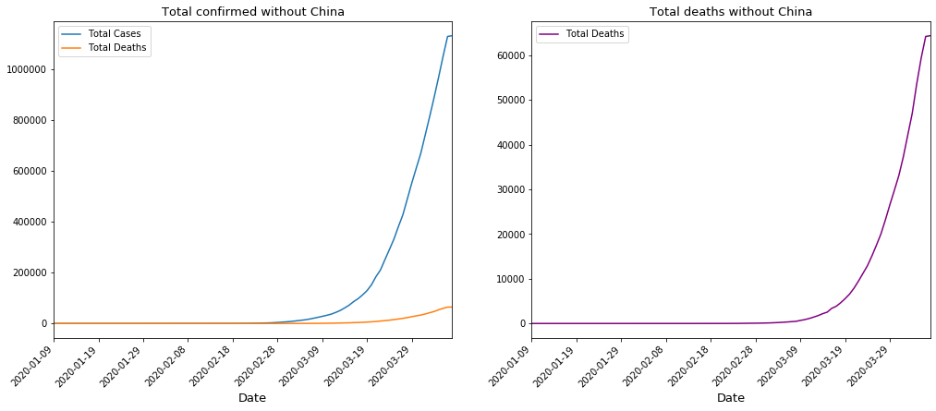
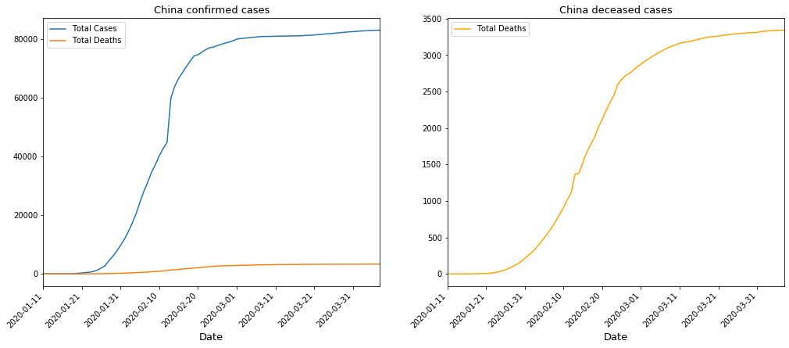
China is an anomaly
Notes:
Go into why this is different, and why we are not using the data from china to train our data

Slide 6
Training our Data
Trained our model with data from South Korea, Germany, Italy, Spain, and the USA
Linear regression was used to create predicted data based off of existing cases
Graphs were created using matplotlib to show total confirmed cases and deaths with actual case numbers and logarithmic values
Notes:
Trained with data around mid march. The exact day depends on the country. R squared for cumulative confirmed is 0.65, while the R squared for cumulative deaths was 0.45. Since the cumulative confirmed had a higher R squared value, we decided to move forward to train our data on cumulative confirmed.

Slide 7
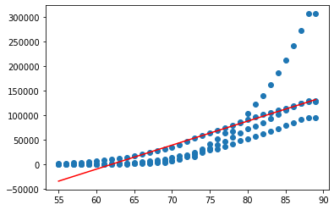
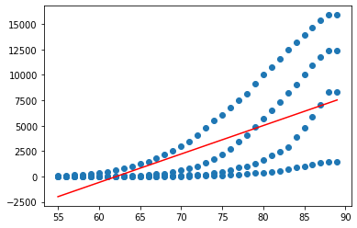
R2 Values
Cumulative Cases
Cumulative Deaths
Notes:
US, Spain, Germany, Italy
Trained with data around mid march. The exact day depends on the country.
The R squared value determines how good the data is for a linear regression fit. The R squared for cumulative confirmed is 0.65, while the R squared for cumulative deaths was 0.45. Since the cumulative confirmed had a higher R squared value, we decided to move forward to train our data on cumulative confirmed.

Slide 8
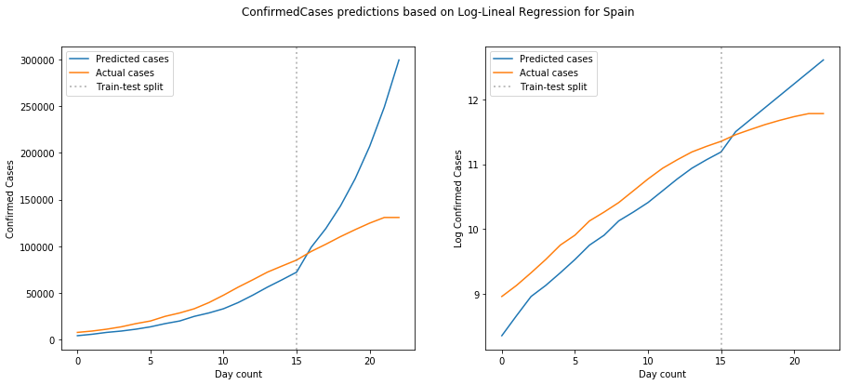
Predicting Confirmed Cases - Spain
Notes:
Log reduces the skew to make it easier to compare

Slide 9
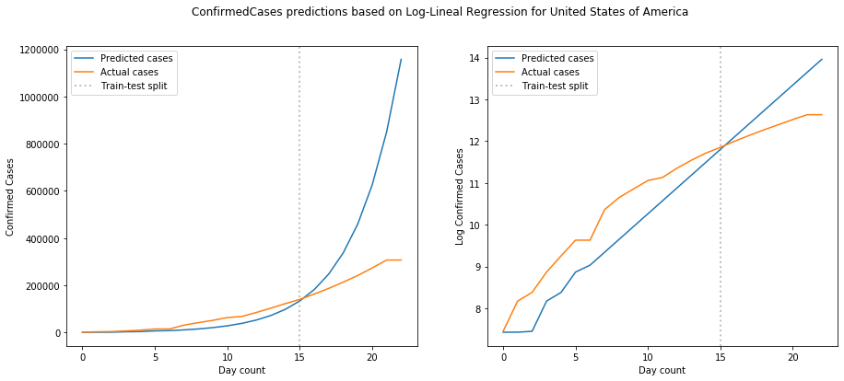
Predicting Confirmed Cases - USA
Notes:
This graph really shows how exponential our model is.
Log reduces the skew to make it easier to compare

Slide 10
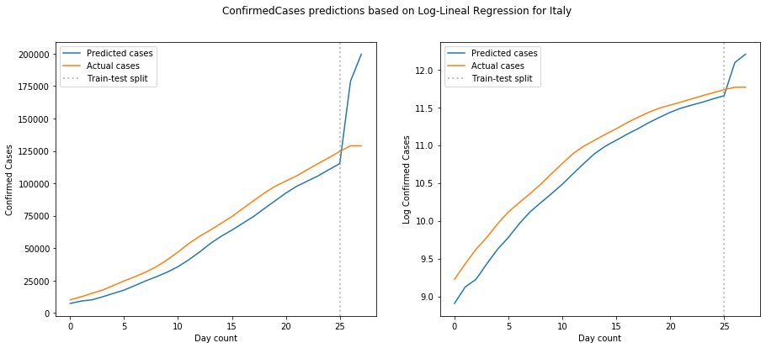
Predicting Confirmed Cases - Italy
Notes:
Log reduces the skew to make it easier to compare
The corona virus spread very quickly in Italy. Even before the world was aware of the coronavirus, Italy was seeing a large number of cases of “strange pneumonia.” The curve is beginning to flatten. Since our model expects more of an exponential increase in growth, we see a jump after the training data ends.
https://www.scmp.com/news/china/society/article/3076334/coronavirus-strange-pneumonia-seen-lombardy-november-leading

Slide 11
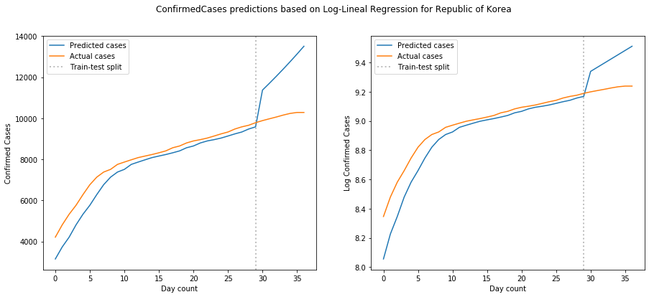
Predicting Confirmed Cases - South Korea
Notes:
Log reduces the skew to make it easier to compare
South Korea had one of the lowest sloping curve due to an aggressive testing and containment policy. This curve differs greatly from most countries curves, which explains the large jump.

Slide 12
Predicting future cases
Why is our model off?
Model assumes the environment stays the same, so the inconsistency could be due to policy changes quarantine and availability of testing
Every country handles the virus differently - it would be interesting to look at states/provinces as a next step as policies within countries may be more similar
As time goes on the model may change - would be interesting to watch in a few months

