Slide 1
SOCIAL MEDIA TOURISM CAPSTONE PROJECT
By Nancy Gupta

Slide 2
Introduction of the business problem.
a) Defining problem statement.
An aviation company that provides domestic as well as international trips to the customers now wants to apply a targeted approach instead of reaching out to each of the customers.
This time they want to do it digitally instead of tele calling.
Hence they have collaborated with a social networking platform, so they can learn the digital and social behavior of the customers
Provide the digital advertisement on the user page of the targeted customers who have a high propensity to take up the product separately for both mobiles and laptops.
b) Need of the study/project.
By leveraging digital tools and data analytics, the company aims to move away from mass marketing strategies towards a more focused and personalized approach. This allows them to tailor their advertising efforts to specific segments of their customer base who are most likely to engage with their services.
Traditional methods like tele-calling can be time-consuming and costly. By transitioning to digital advertising, the company can potentially reduce expenses associated with outbound marketing while reaching a wider audience through social networking platforms.
Collaboration with a social networking platform enables the company to gain valuable insights into the digital and social behavior of their customers. By analyzing this data, they can better understand customer preferences, interests, and behaviors, allowing for more precise targeting of advertisements.

Slide 3
By delivering targeted advertisements to users who are more likely to be interested in their services, the company can enhance the overall customer experience. Customers are more likely to appreciate relevant ads that align with their interests, leading to higher engagement and potentially increased conversions.
In today's digital age, companies that effectively leverage data and digital advertising techniques gain a competitive edge. By adopting this targeted approach, the aviation company can stay ahead of competitors and better position themselves in the market.
c) Understanding business/social opportunity
The leading trends towards the Social Networking has drawn high public attention from past ‘two’ decades. For both small businesses and large corporations, social media is playing a key role in brand building and customer communication.
Apart from social networking sites like Facebook, Twitter, Instagram, Snapchat etc, other categories like news, Communication, Commenting, Marketing, Banking, Entertainment etc. are also generating huge social media content every minute.
The understanding of the customer’s behaviors on a social media platform will result in targeting advertisements according to the needs and wants of the specific set of customers that can result in high propensity to take up the product.
Apart from this company can understand the problems associated with the customers that have posted bad reviews.
Then, instead of calling each and every customer, company can utilize its resources to improve revenue.

Slide 4
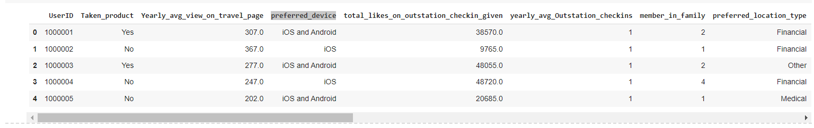
2) Data Report
a) Understanding how data was collected in terms of time, frequency and methodology
Data is collected through social media monitoring and online marketing analytics of the company’s page as well as various travelled related pages along with the monitoring of the customer’s account throughout the year on daily basis.
b) Visual inspection of data (rows, columns, descriptive details)
This is the top 5 rows of the data set.

Slide 5
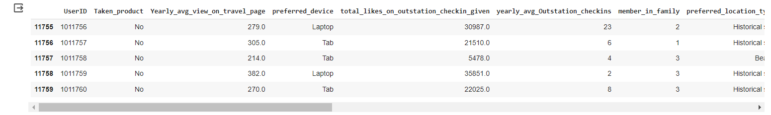
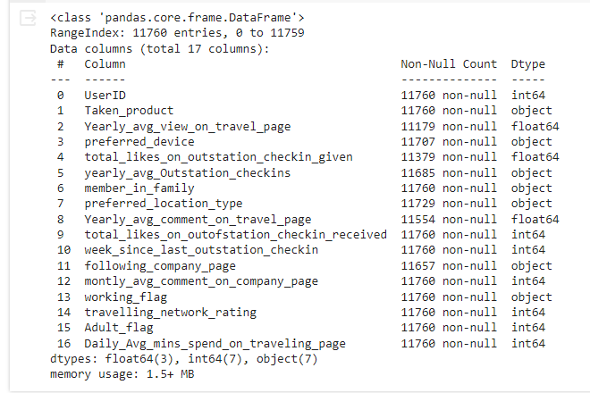
These are the last 5 rows of the Dataset.
Data Information

Slide 6
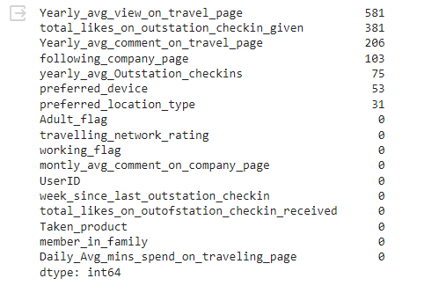

If we look at the Data Information image above , we find that the dataset has 11760 entries or rows and total 17 columns.
The entire dataset consists of 3 float type variables, 7 integer type variables and 7 object or string type variables.
No duplicate rows found in the data initially.
The data do contain null values in some of the columns.
The total number of null values in the dataset is 1430 out of 11760 which is around 12%.

Slide 7
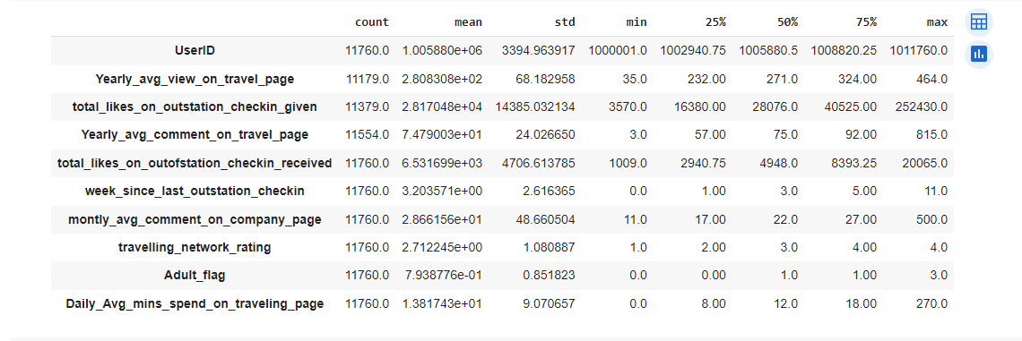

c) Understanding of attributes (variable info, renaming if required)
Data Description
Target Variable Count

Slide 8

If we look at the target variable (Taken Product) count, it clearly shows that there are high number of customers that have not purchased the product of the company.
If we look at data description closely, the average weeks since last outstation check-in is 2.62 and have below average travel rating of 2.71 meaning close friends of customers who also like travelling are very less.
The average weeks since last outstation check-in is 2.62
Average travel rating is also very less meaning close friends of customers who also like travelling are very less.
A large number of customers are using ‘Tab’ as their preferred device.
The customers spend an average of 9 minutes on a travelling page on daily basis
We see that the column “UserID” is not adding any value to the target variable hence have dropped the column.
After dropping the “UserID column there is a significant change in the dataset. We find 996 number of duplicated rows now. Hence we have dropped the duplicated rows from the dataset.
Now , we have 16 attributes in the dataset to look at.

Slide 9
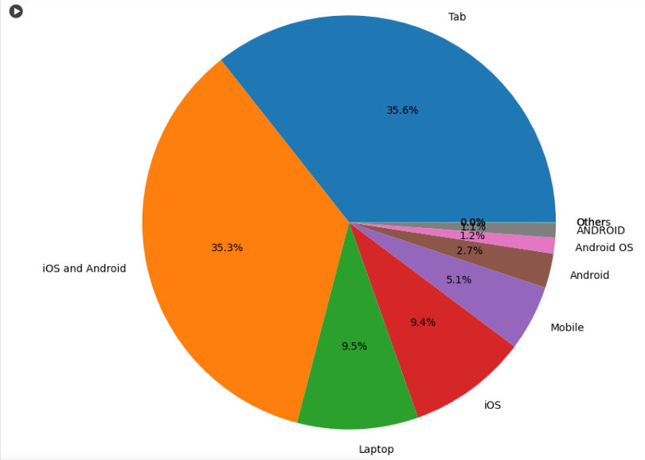
3. Exploratory Data Analysis
Pie-Chart representing preferred devices in the Dataset

Slide 10
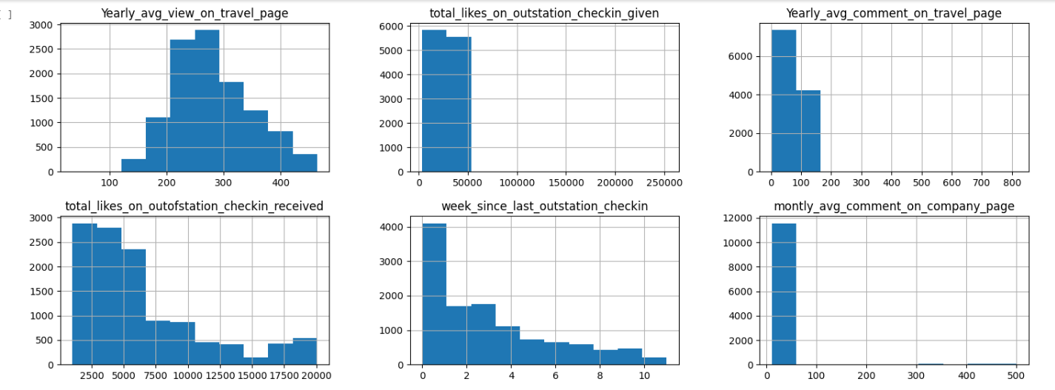
Histograms

Slide 11
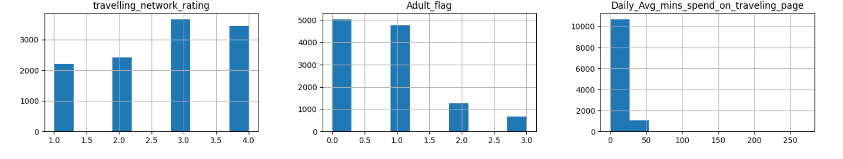
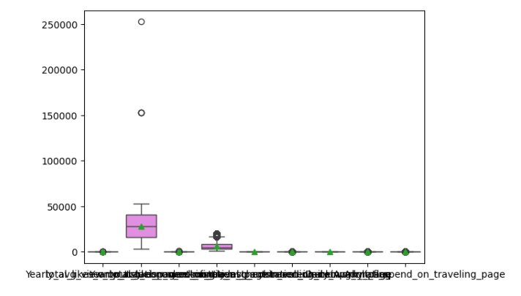
Boxplot of entire Dataset

Slide 12
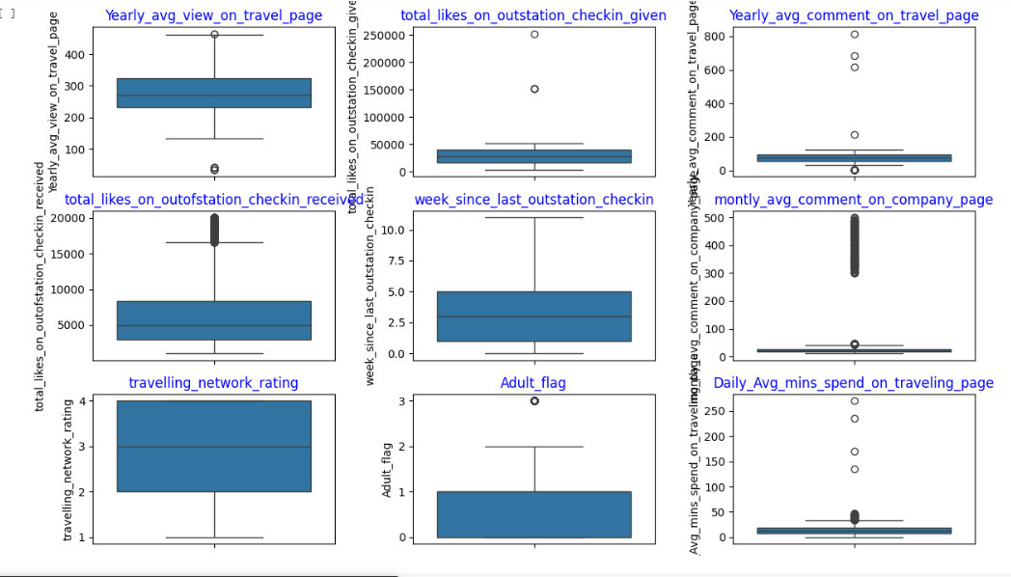
Boxplot of Individual columns in the Dataset

Slide 13
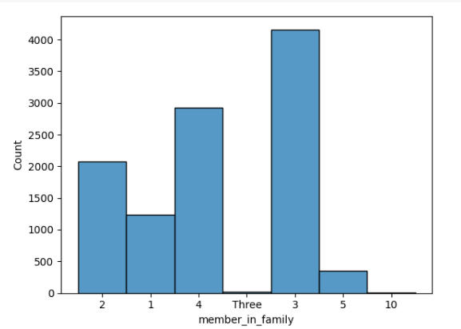
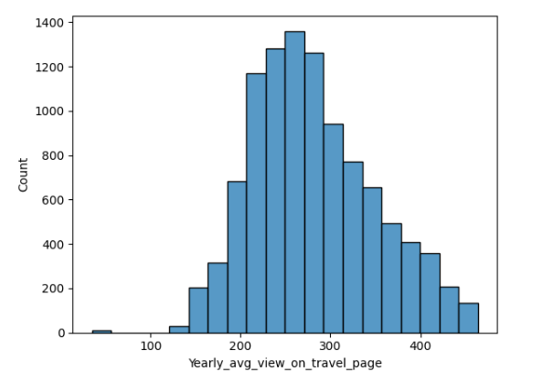
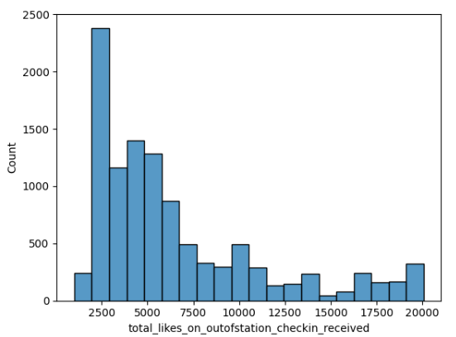
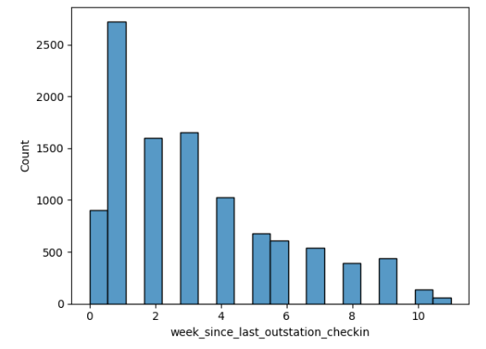
Histogram representing some key features

Slide 14
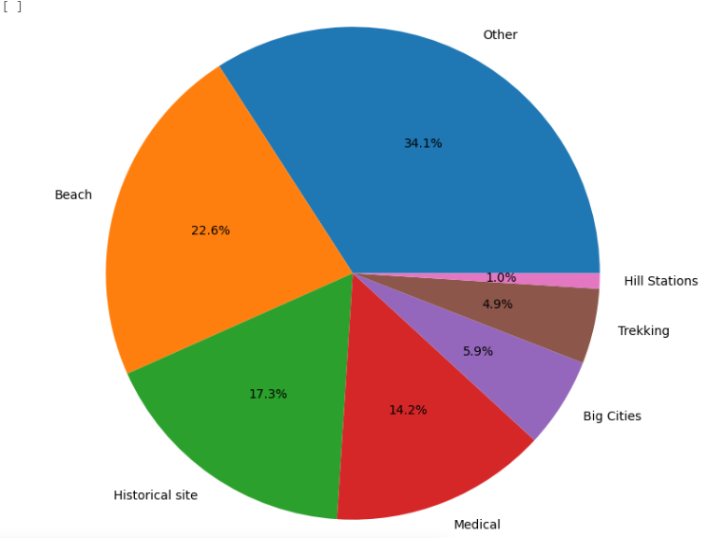
Pie-Chart representing Preferred Location

Slide 15
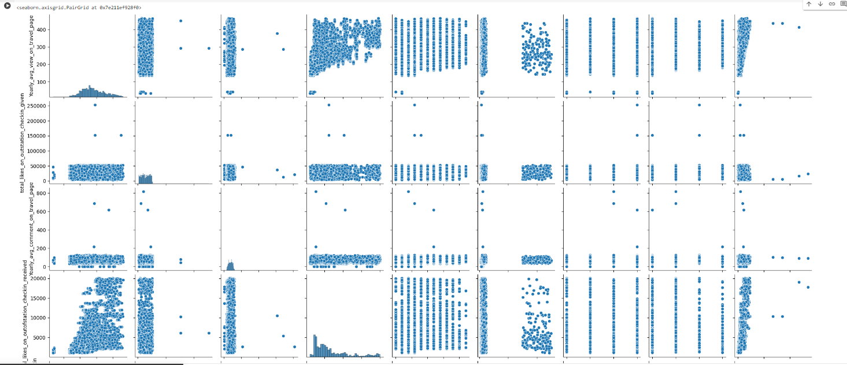
Pairplot - I

Slide 16
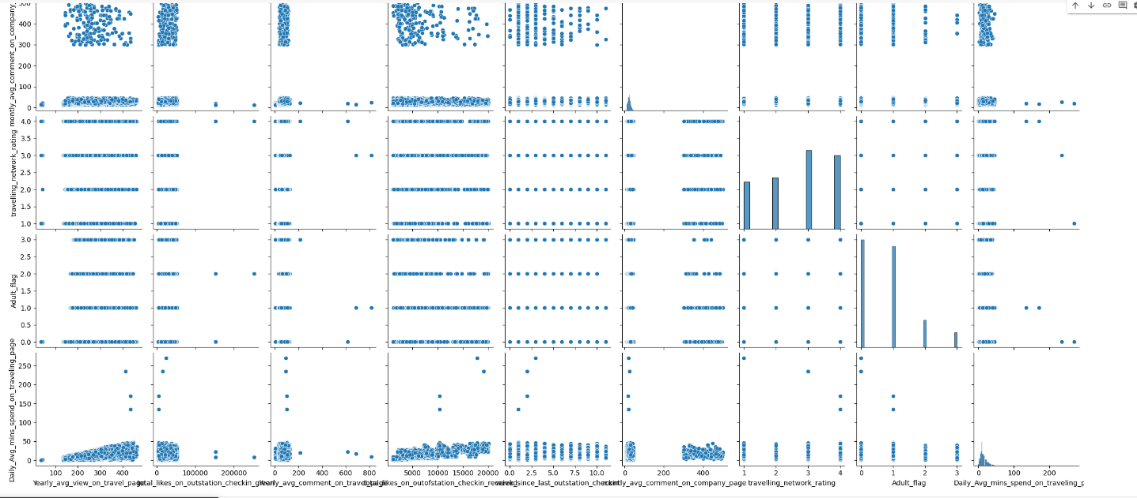
Pairplot - II

Slide 17
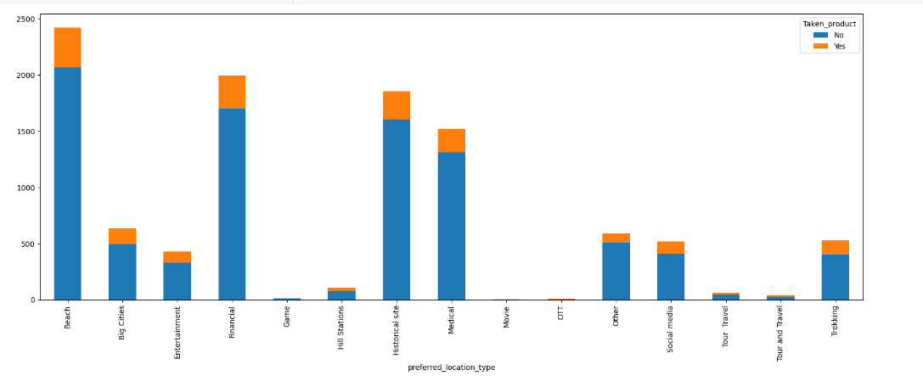
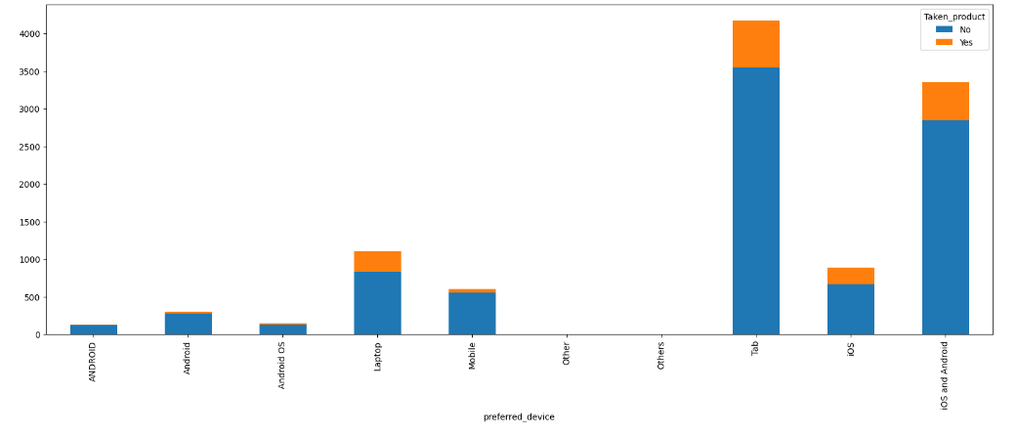
Crosstab of preferred location Vs Taken Product
Crosstab of preferred deviceVs Taken Product

Slide 18
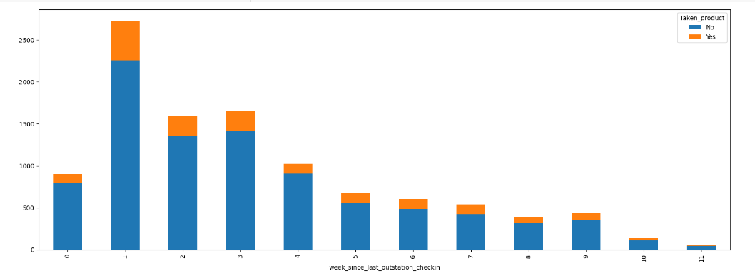
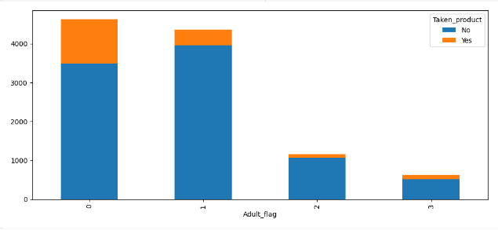
Crosstab of weeks since last outstation checkin Vs Taken Product
Crosstab of Adult Flag Vs Taken Product

Slide 19
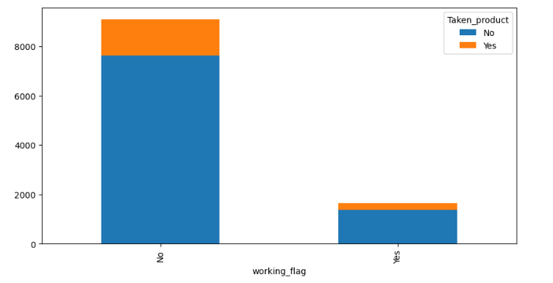
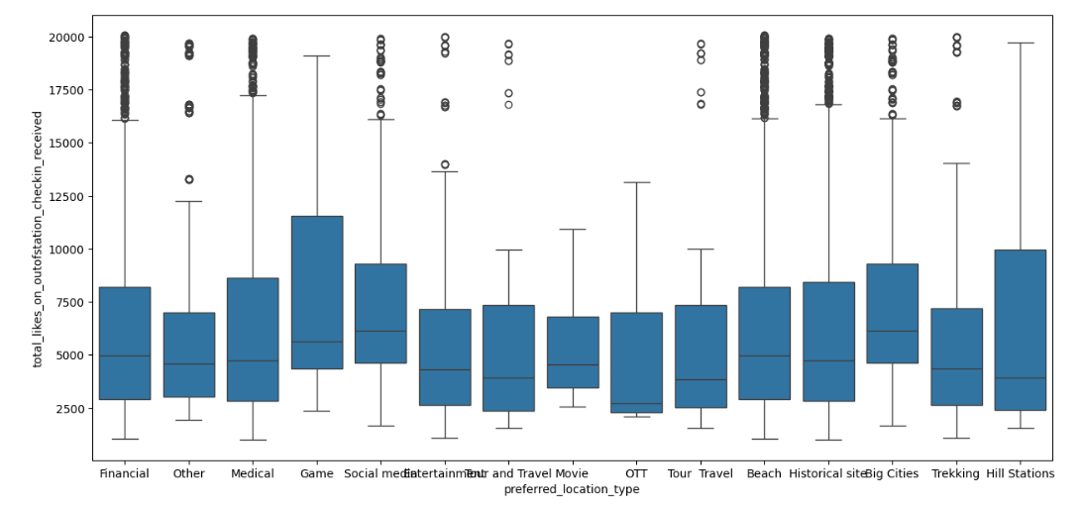
Working flag Vs Taken Product
Preferred Location vs Likes recieved

Slide 20
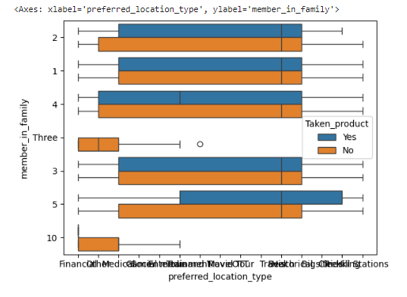
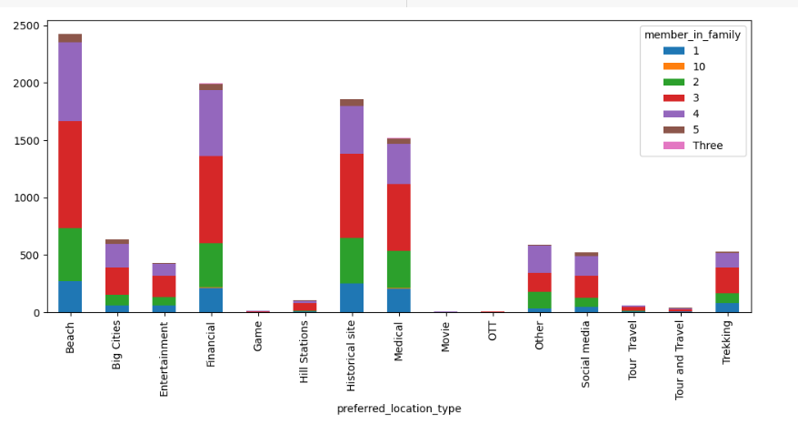
Preferred Location Vs Member In Family

Slide 21
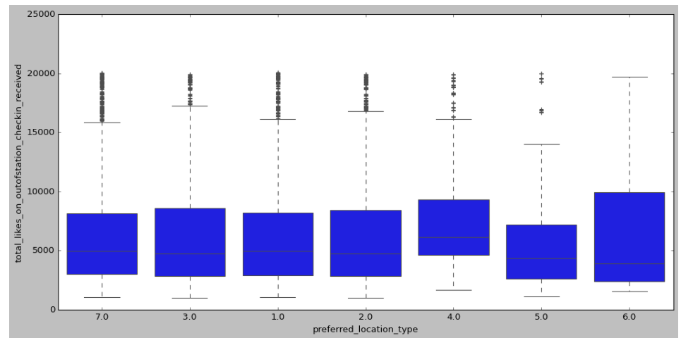
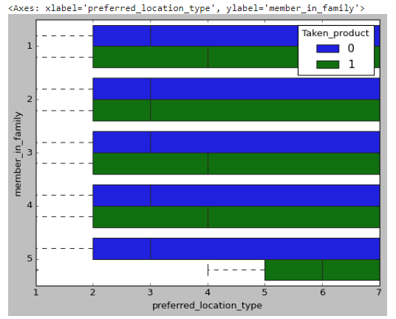

Slide 22
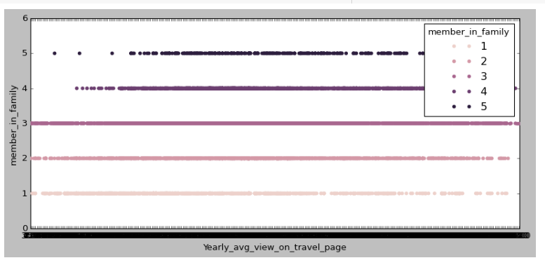
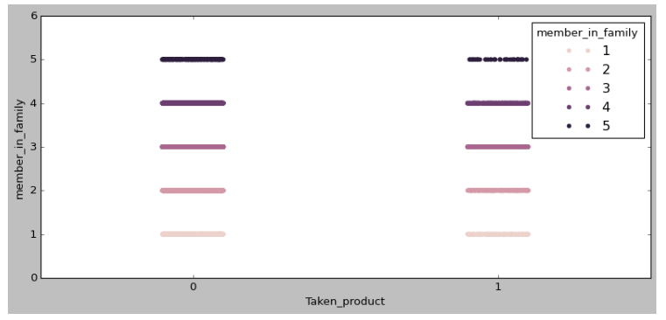

Slide 23
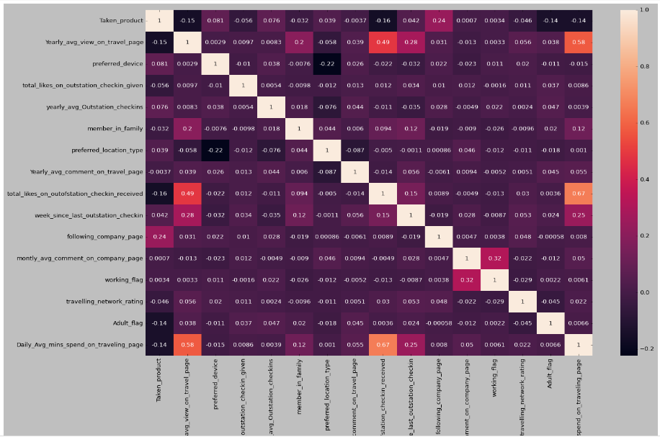
Correlation

Slide 24
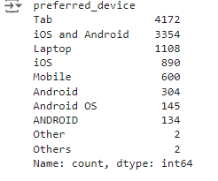

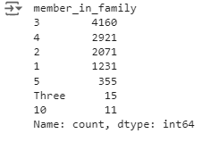
When we see the categorical features in the dataset , we find many abnormalities. Like the preferred device we see the following.
Then we changed it to
The other feature 'yearly_avg_Outstation_checkins’ that has ‘*’ as a value in it was treated and converted its datatype to float.
Next feature ‘member in family’ has

Slide 25
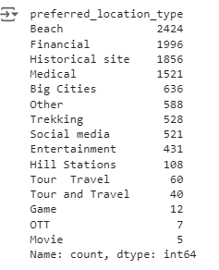
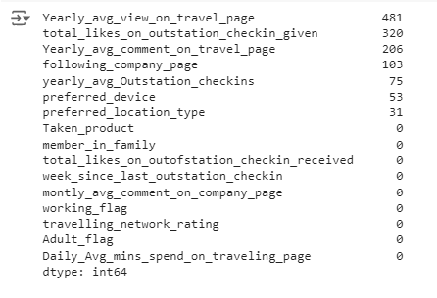
This was also treated and replaced into 5 categories.
Preferred location type data distribution was also not meeting the expectations.
Hence , replaced the irrelevant headings to ‘Other’ category.
Next we check the missing values

Slide 26
Imputed the missing values on the categorical features using their mode and imputed the missing values on the numerical features using their mean value
Next have treated the outliers using the upper range and lower range of the quartile.
Then have split the dataset in to Laptop dataset and Mobile dataset separately.
Next have created the dummy variables of the categorical features and then scaled the datasets using min max function separately for both Laptop and Mobile dataset.
Next have split both the datasets into training and testing datasets in 70:30 ratio.
Have built 5 models separately for both Mobile and Laptop datasets.
To begin with have chosen Logistic regression model as our target variable has to be an output which is a categorical variable with only two possible outcomes.
Second Model is ADA Boost or Adaptive boosting. The key feature of AdaBoost is its adaptive nature. It adjusts the weights of the training instances based on the errors of the previous classifiers.
Then KNN Model have been chosen as is based on the idea that similar instances exist in close proximity to each other
Next in Line is Decision Tree as they are intuitive and easy to understand
And Finally Random forest as it typically achieves higher accuracy compared to individual decision trees, especially when dealing with complex and highly imbalanced datasets like this one.

Slide 27
Insights from Analysis
Family with 3 to 4 members are more into tour and travel .
Yearly average view on travel page is somewhat around 3000 which needs a bit improvement
Outstation check-ins are found mostly at the beginning of the year
Beaches and Historical sites are highly in demand.
Major population uses mobile for social media indulgence and also purchasing the tickets.
Out of station check-ins are mostly updated in the 2nd , 3rd and 4th week since last check ins.
Youngsters who are below 18 or 21 years of age are more keen towards tour and travel as compared to the adults.
People who are not working are more interested and have purchased the tickets than the people falling under the working category.
Although the purchase for the Hill stations are not very high but is definitely a favourable place for people with highest number of likes received.
Family and couple prefers beaches and historical sites more but they also like to explore
We see very high correlation between total likes on outstation check-ins received and daily as well as yearly average mins spend on travelling page

Slide 28
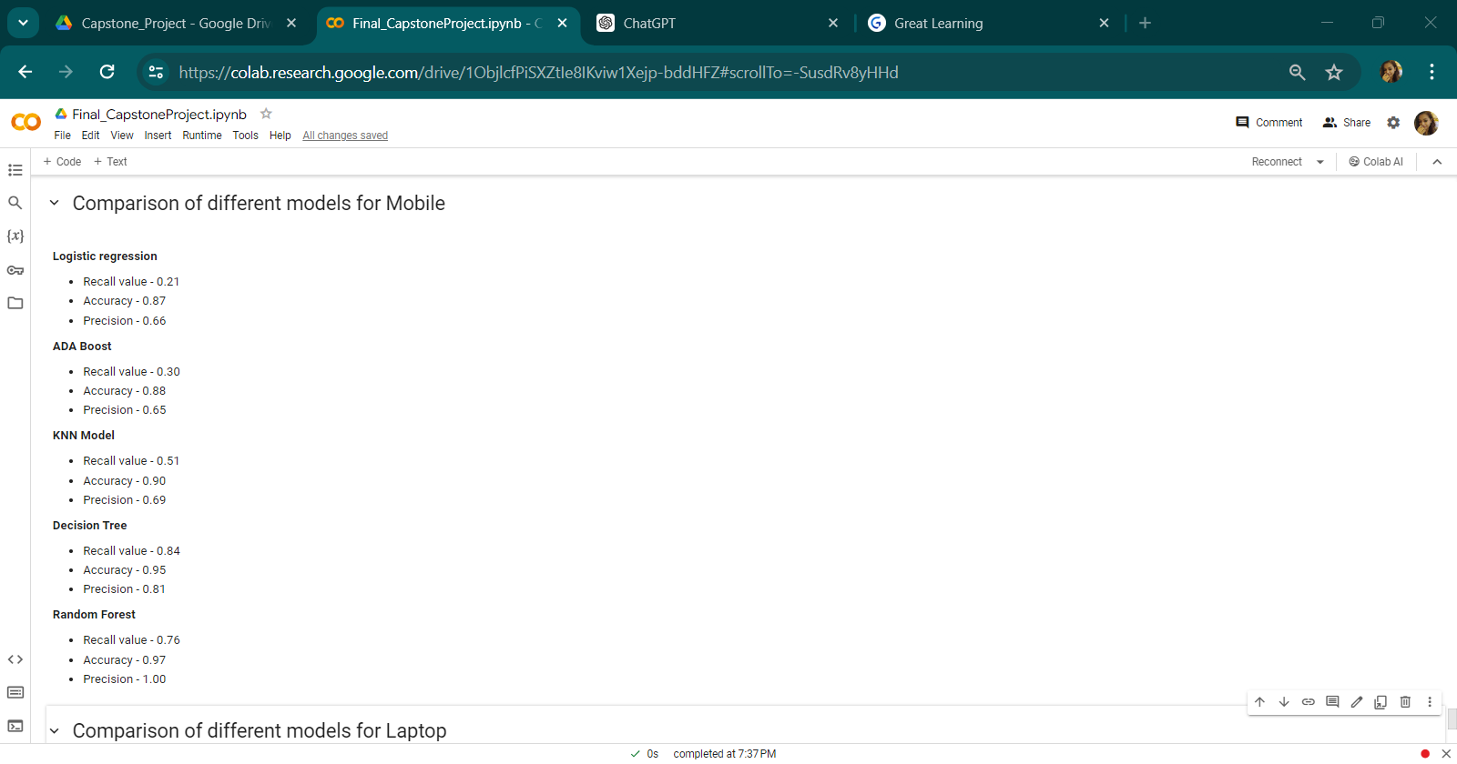
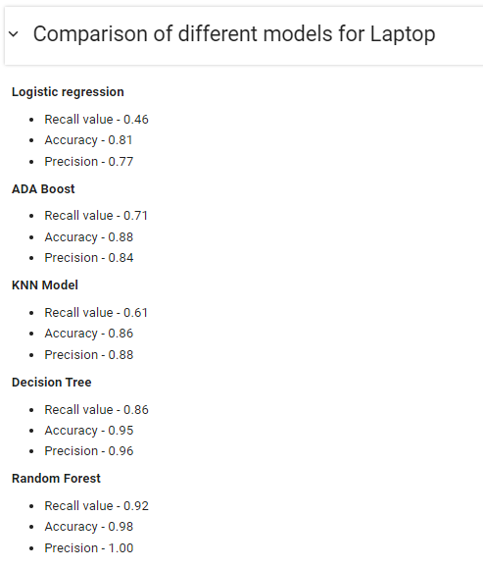

Slide 29
Insights from Analysis
If we check the recall values on Logistic Regression and ADA Boost for Mobile which is 21% and 30% respectively , we come to a conclusion that these two models are worst performing models as the recall value is not sufficient in this case. Accuracy however is fair with 87% and 88%
Logistic Regression and ADA Boost is fairly better performing in case of Laptop dataset that is 46% and 71% respectively , however we can not call it best performing model.
The KNN Model is an average performing Model for both Mobile and Laptop datasets which is 51% and 61% respectively.
Decision Tree and Random Forest are the best performing Models for Mobile dataset with recall value of 84% and 76% .
Decision Tree and Random Forest are the best performing models for laptop dataset as well with a recall value of 86% and 92%.
Random forest is slightly better performing In case of Laptop dataset.
The most important features that impacts majorly on the target variable for Mobile dataset are total_likes_on_outofstation_checkin_received , total_likes_on_outstation_checkin_given and Yearly_avg_view_on_travel_page
The most important features that impacts majorly on the target variable for Laptop dataset are Yearly_avg_view_on_travel_page , total_likes_on_outofstation_checkin_received and total_likes_on_outstation_checkin_given

Slide 30
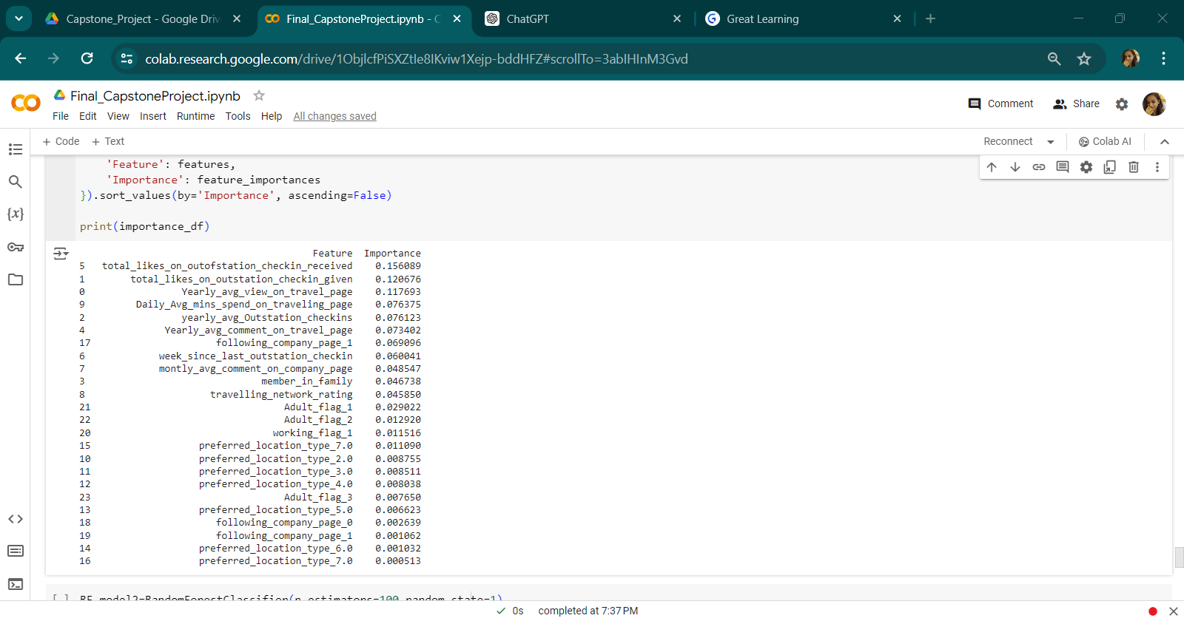
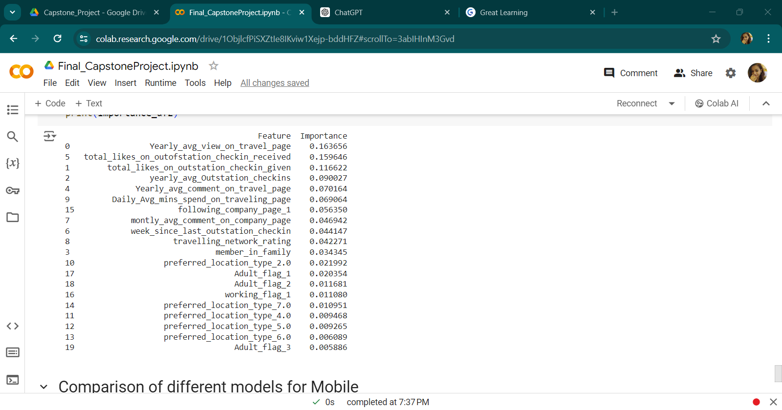
For Mobile
For Laptop

Slide 31
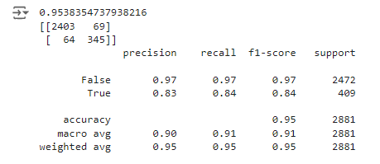
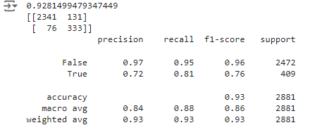
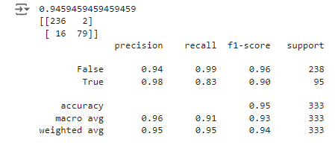
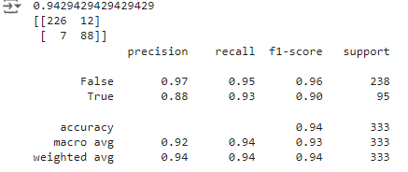
In order to avoid overfitting have applied SMOTE on both Decision Tree as well as Random Forest separately for mobile and laptop datasets for models to provide optimal results.
The above are the classification reports of test datasets for Mobile on Decision Tree before smote and after smote. Before applying smote the recall value is 84% which decreases to 81% after applying smote. Not very fruitful for the mobile dataset
If we see the above images of classification report of test datasets for Laptop on Decision Tree before and after smote , we see a drastic improvement in the recall value from 83% to 93% which is really good as a model. SMOTE works for Laptop Dataset in Decision Tree Model.

Slide 32
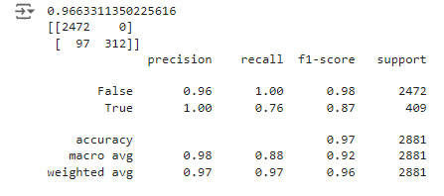
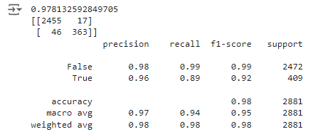
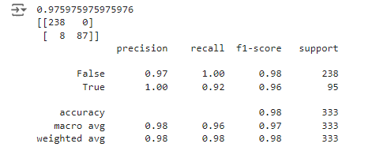
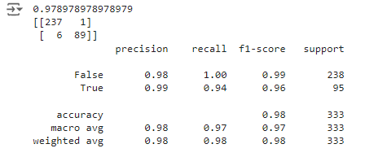
The above two images are the classification report of Random Forest Model on test dataset for Mobile. We see a very good improvement on the model after applying smote as the recall value goes up from 76% to 89%.
If we see the above classification reports of Random forest Model on test datasets for Laptop , there is improvement here as well . The recall value goes up from 92% to 94% which is even better.
Hence , Random Forest Model can be chosen as the best performing model for both Mobile as well as Laptop datasets with smote or without smote.

Slide 33
Recommendations
As the major sales depends on total likes received on check-ins hence we should focus more on advertising some preferred locations which people like a lot like hill stations , Beaches and Historical Sites.
As the buyers are more the youngsters and non working individuals, exciting deals and offers would attract them more specially at the beginning of the year.
In order to increase more indulgence of people on the page we must work on resource availability and improve the content on the social media.
After every purchase if the customer’s are given a coupon or some discount on the next purchase specially within the next 2nd , 3rd and 4th week , the sale chances are going to be high as mostly people keep checking the updates here in these scenarios.
As the working adults do not have much time to indulge on the mobile or laptop as compared to non working youngsters , the content must be updated and focused on weekend plans or short weekend trips on preferred locations with some attractive and cost effecting offers.

