Slide 1
MLSA FULL STACK DEVELOPMENT
PRESENTATION
NAME:NANCY GUPTA
UNIVERSITY ROLL NO:2300290120143
YEAR:2
BRANCH:CS
SECTION:B

Slide 2
INTRODUCTION
My name is Nancy Gupta. I am a 2nd-year B.Tech Computer Science student at KIET Group of Institutions,Ghaziabad. Currently.I'm an aspiring developer currently diving into the worlds of data structures and web development. I’m always eager to deepen my skills and explore new concepts, from building efficient algorithms to designing intuitive websites. My passion for learning drives me to continually expand my understanding, and I’m excited to see where this journey takes me!
Recently, I completed an internship with the Microsoft Learn Student Ambassadors program, focusing on full-stack web development. This experience allowed me to build real-world applications and explore cloud integration, strengthening my skills in HTML, CSS, JavaScript, React, Node.js, MongoDB, and Azure. These projects deepened my expertise and prepared me to tackle increasingly complex development challenges.

Slide 3
ABOUT PROJECTS
1.Calculator:A functional calculator built with a user-friendly interface that performs basic arithmetic operations. This project showcases my understanding of logic implementation and UI/UX design, aiming to make calculations intuitive and efficient for users.
2.Personal WebPage:My personal webpage serves as a digital portfolio that reflects my coding journey, projects, and interests. Designed with a vibrant and visually pleasing aesthetic, it highlights my skills in web development while presenting an engaging "About Me" section and links to other projects.

Slide 4
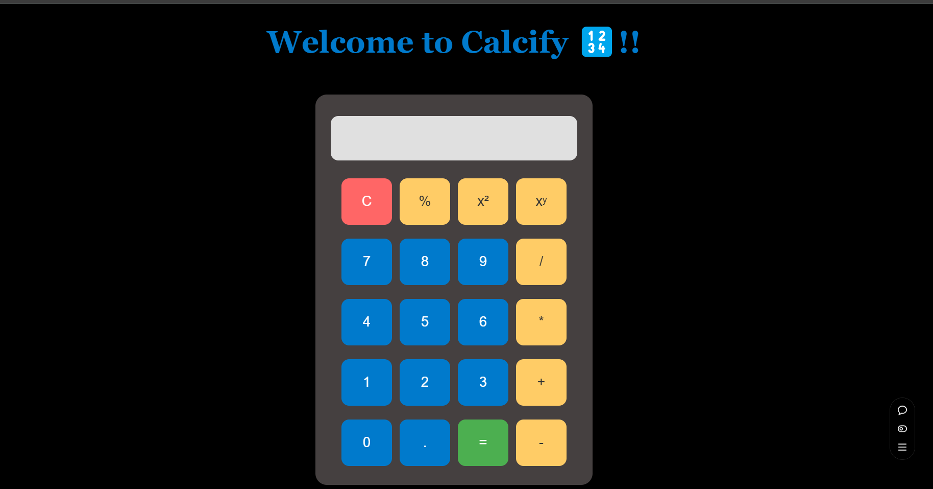
CALCULATOR

Slide 5
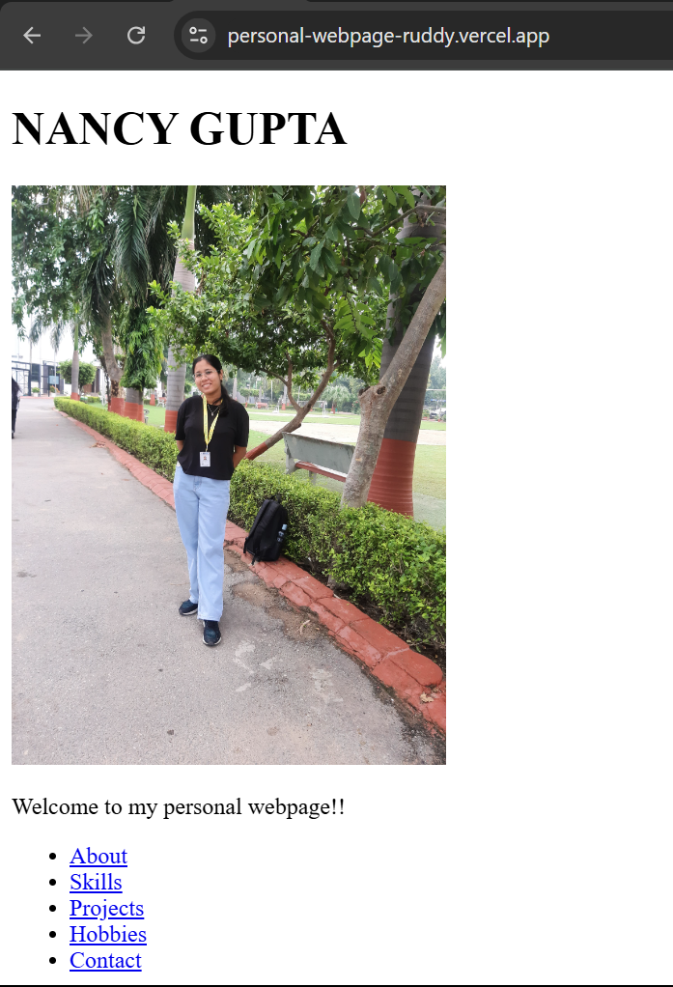
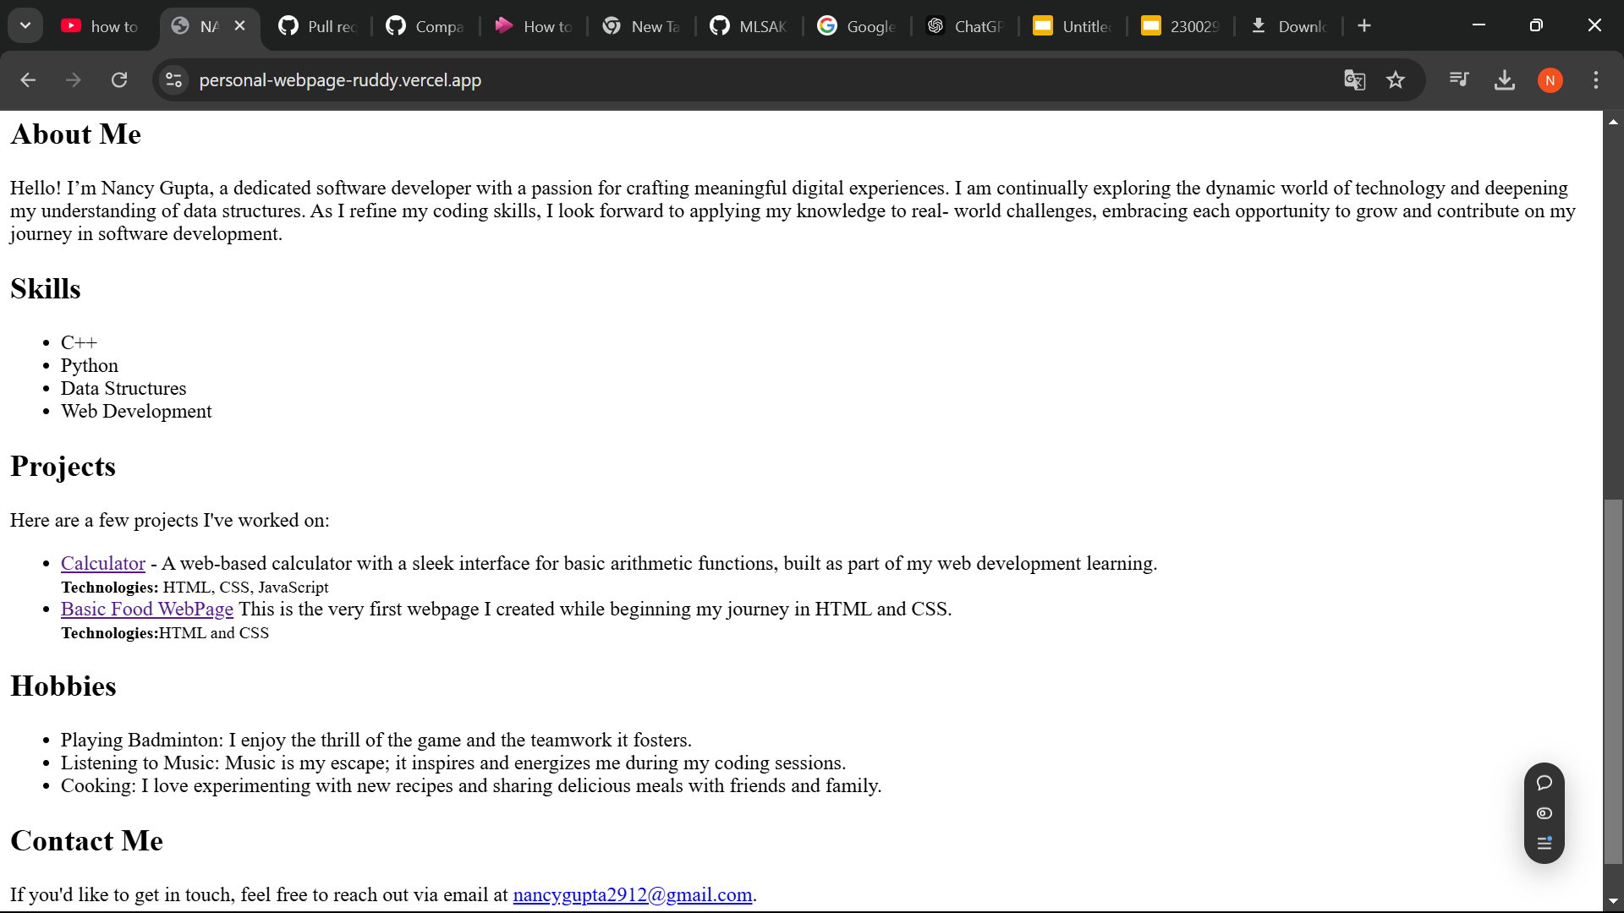
Personal WebPage

Slide 6
CONCLUSION
Completing the MLSA full-stack development internship has been an invaluable experience that broadened my technical skills and deepened my understanding of web development and cloud integration. The hands-on projects and mentorship allowed me to grow in confidence and expertise, equipping me with practical skills in technologies like HTML,CSS, Javascript,React, Node.js, and Azure. I’m incredibly grateful for this opportunity, which has prepared me to tackle future challenges with a solid foundation and enthusiasm.

Slide 7
THANK
YOU

