Slide 1
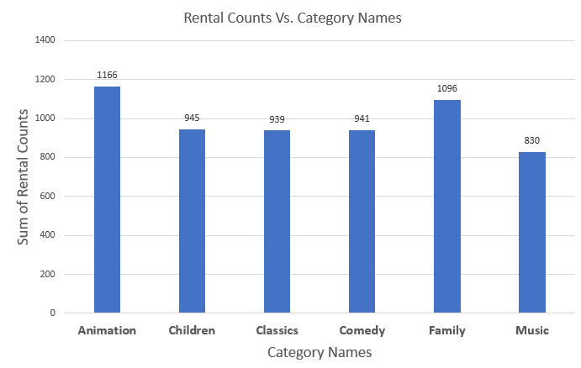
We want to understand more about the movies that families are watching. The following categories are considered family movies: Animation, Children, Classics, Comedy, Family and Music. Create a query that lists each movie, the film category it is classified in, and the number of times it has been rented out.
After adding all the rental counts in each category, this bar chart shows that most families prefer watching movies in the Animation category. Families prefer watching the Music category the least.

Slide 2
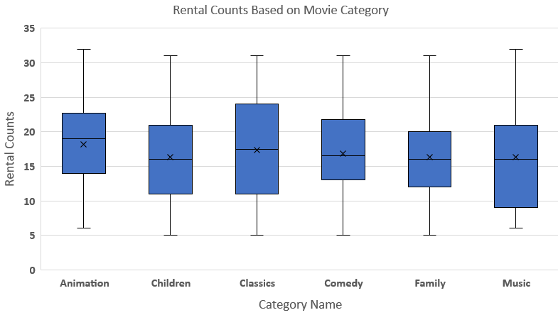
Compare each family movie film with the average rental count for each of the category.
Animation is the only category that has the mean-average that is less than the median-average, which means more of its rental counts are between 17 and 20
Because the mean-average and the median-average almost look exactly the same in classics, it seems like the data is normally distributed
Music looks like its data is skewed right and there are higher outliers after the 3rd quartile
Family is slightly skewed right but there’s a high concentration of data between the 1st and 3rd quartile. It also has a lot of different outliers
Children is slightly skewed right with fewer outliers in comparison to family movies
Comedy is slightly skewed right with lower range of outliers than family movies

Slide 3
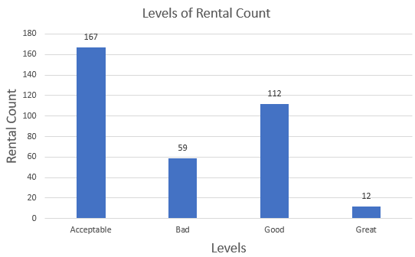
Write a query to display each of the family movie film, the rental count, and the level of the rental count: 'Bad' if the rental count is less than 10, 'Acceptable' if the rental count is between 10 and 20, 'Good' if the rental count is between 20 and 30, and 'Great' if the rental count is 30 and more.
Out of 350 family movie films, 59 movies were bad, 157 movies were acceptable, 112 were good, and only 12 of the movies had a high rental count of 30 or more, which was considered great.

Slide 4
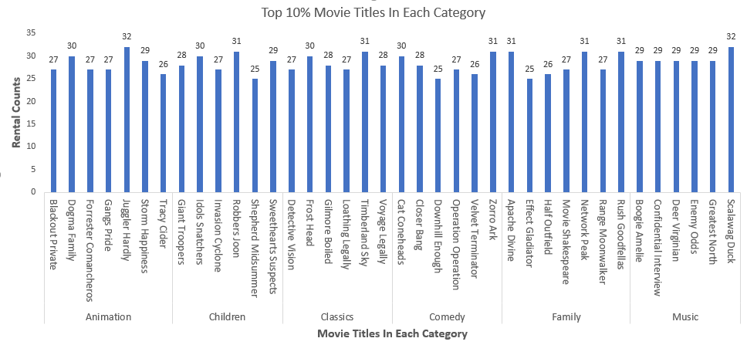
Provide the upper quartiles with the movie titles (top 10%) of each category.
Within each of the family movie categories, we can observe that Juggler Hardly has the highest rental count of 32 in Animation, Robbers Joon has the highest rental count of 31 in Children, Timberland Sky has the highest rental count of 31 in Classics, Zorro Ark has the highest rental count of 31 in Comedy, Apache Divine, Network Peak, and Rush Goodfellas all have the highest equal rental count of 31 in Family, and Scalawag Duck has the highest rental count of 32 in Music.

