Slide 1

FOREIGN DIRECT INVESTMENT ANALYSIS
Done By:
P L Nancy

Slide 2
PROBLEM STATEMENT
Investment is a game of understanding historic data of investment objects under different events but it is still a game of chances to minimize the risk we apply analytics to find the equilibrium investment. To understand the Foreign direct investment in India for the last 17 years from 2000-01 to 2016-17. This dataset contains sector and financial year-wise data of FDI in India Sector-wise investment analysis Year-wise investment analysis.

Slide 3
KEY METRICS
Sector - Wise Foreign Direct Investments
Year - Wise Foreign Direct Investments
Yearly Growth Rate
Top 15 Sectors

Slide 4
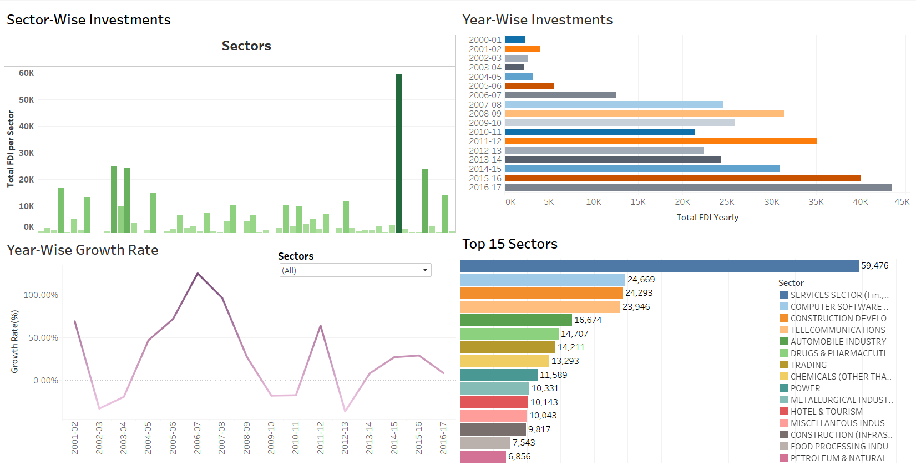
KEY METRICS VISUALS

Slide 5
INSIGHTS :
1. Sector - Wise Foreign Direct Investment Analysis
From the above bar plots we can see that Services Sector has consistently making investments every year and it has made it's highest investments in the year 2016-2017. On an average if we consider for the services sector has been has always been one the top investors for majority years.
There are some sectors that have made quite good investments each year and has again been consistent with doing so, here are some of the sectors: metallurgical industries, mining, power, computer software and hardware, telecommunications.
We can also see some of the sectors have made very few investments or has zero investments, if we consider on an average the coal production has majorly made either zero investments or zero investments for majority of the years.
And after sector Coal Production Coir and Ports have fewer investments or no investments in some years.

Slide 6
2. Year - Wise Foreign Direct Investments Analysis
We can observe here the investments starts from year 2000-01 with (fdi=2378.71) and has a slight increase till year 2002-03 with (fdi=2704.32) have seen growth and consistency, also the was a slight drop in the investments made in year 2003-04 with (fdi=2187.85).
From year 2004-05 with (fdi=3218.69) there is steady increase in the investments and year 2008-09 with (fdi=31395.96) has been a breakthrough, for the sectors but then there was a drop down from year 2009-2010 with (fdi=325834.38) until year 2010-2011 with (fdi=21383.07).
Again there was another breakthrough i.e., the sectors have witnessed a rise in the investment in the year 2011-12 with (fdi=35120.78) but year 2012-13 faced decreased in investments with (fdi=22423.59)
Lastly, year 2013-14(fdi=24299.32) to year 2016-17(fdi=43478.26) the sectors have seen huge increase in the investments made from the sectors.
From these observations we can conclude though there have a few drop-downs in the investments, it hasn't impacted the investments hugely. The peak investments are made in the year 2016-17. We can say that there has been a good improvements from the sectors over the period of years.

Slide 7
3. Yearly Growth Rate Analysis
If we observe the graph this is quite similar to the average fdi year-wise analysis. Since the investments start from year 2000-01 it is considered as the starting point.
If we observe the growth rate chart the years : 2001-02,2006-07,2011-12,2013-14,2015-16 have made prominent impact on the investments, as we can see in these years there is an expansion of investments.
The year 2006-07 has one of the highest expansion/growth rate compared to all the other years with a percentage value of 125.493208.
The years that had major contractions were 2002-03,2012-13. Though there was a decrease in growth rate for the year 2003-04 but it was slightly better than the previous year, i.e.; we can see that there is slight expansion.
Also the years from 2009-10 to 2010-11, we can see that there has neither been expansion nor contraction, while both the years have recorded the same growth rate.

Slide 8
CONCLUSION
Overall the analysis suggests positive trend of increasing FDI over the years, with certain sectors consistently performing well.
The years that have had a major breakthrough with increase in investments indicates potential growth and opportunities for further investments from the sectors.
Sectors with low or zero investments requires attention by improvising the strategies for making investments.
Despite the fluctuations over the years, the overall trajectory has a positive growth rate, indicating the investments made were good and were favourable.

Slide 9
THANK
YOU

