Slide 1
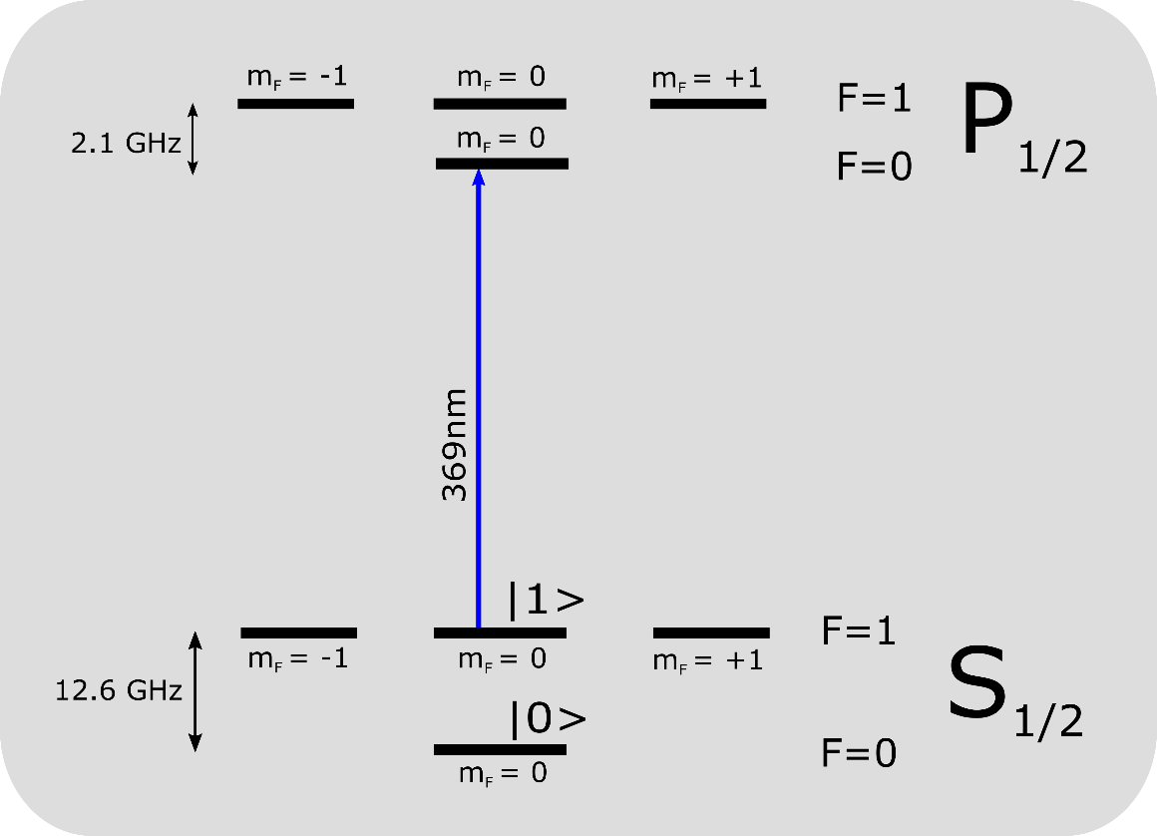
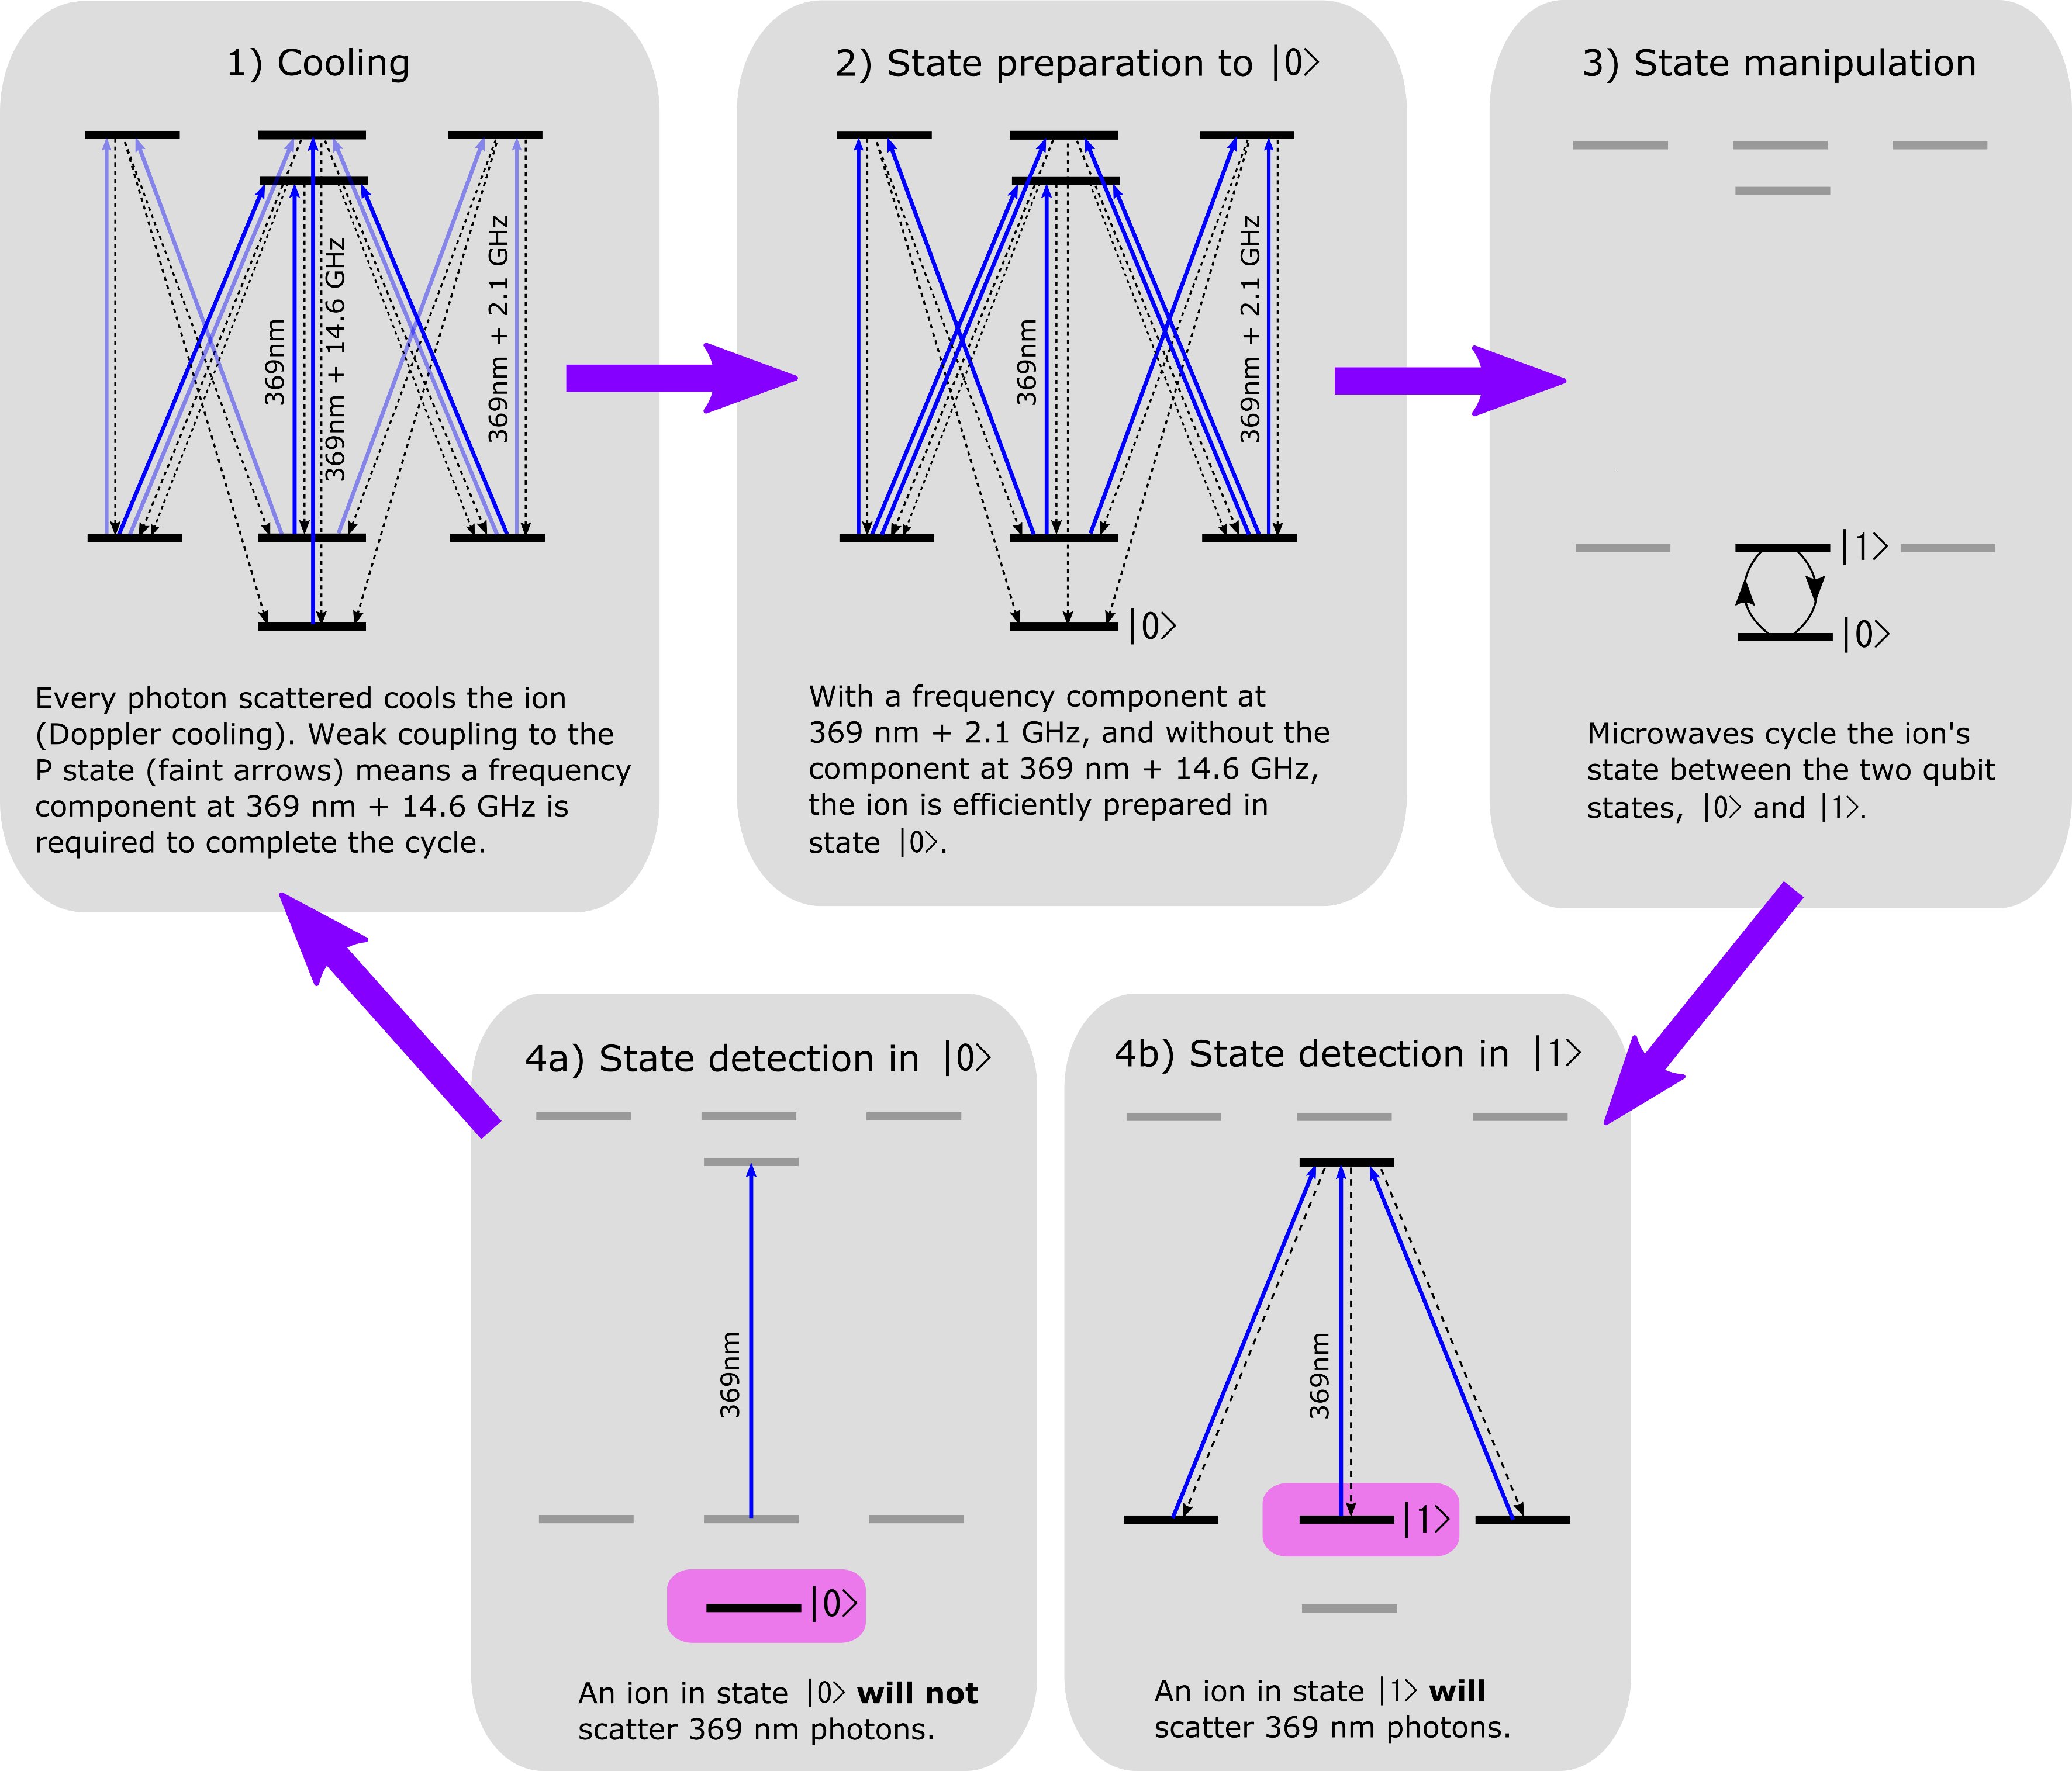
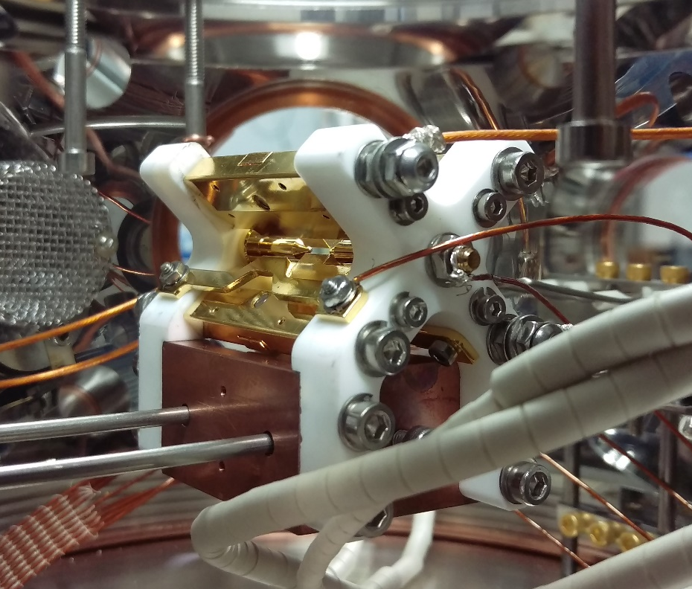
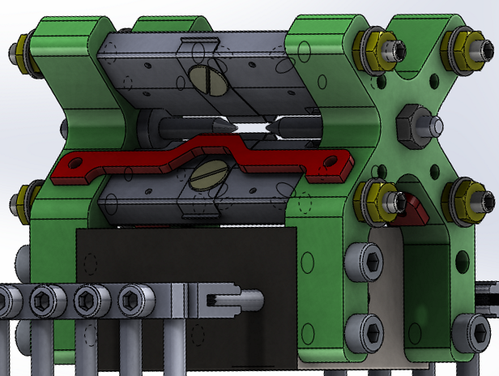
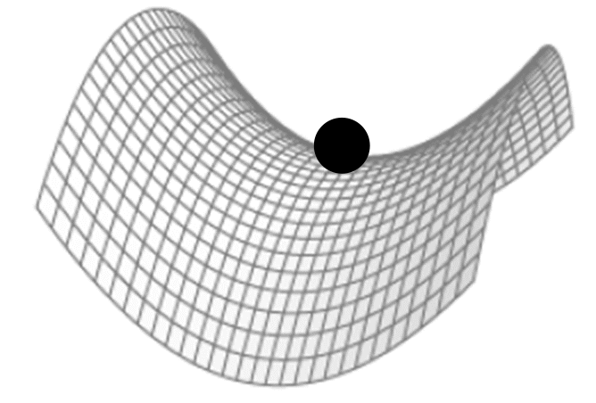
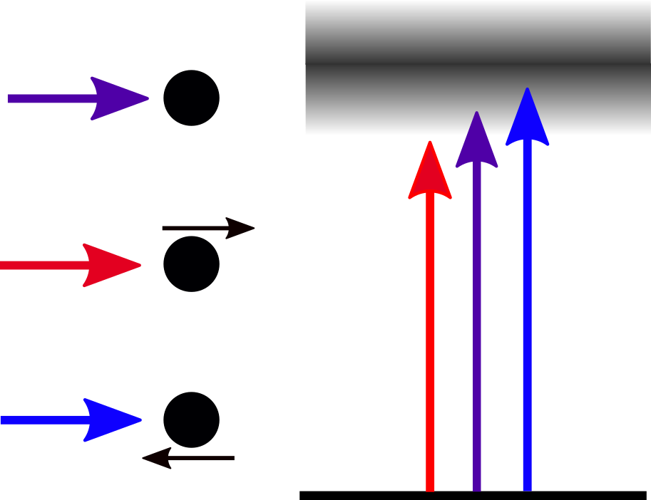
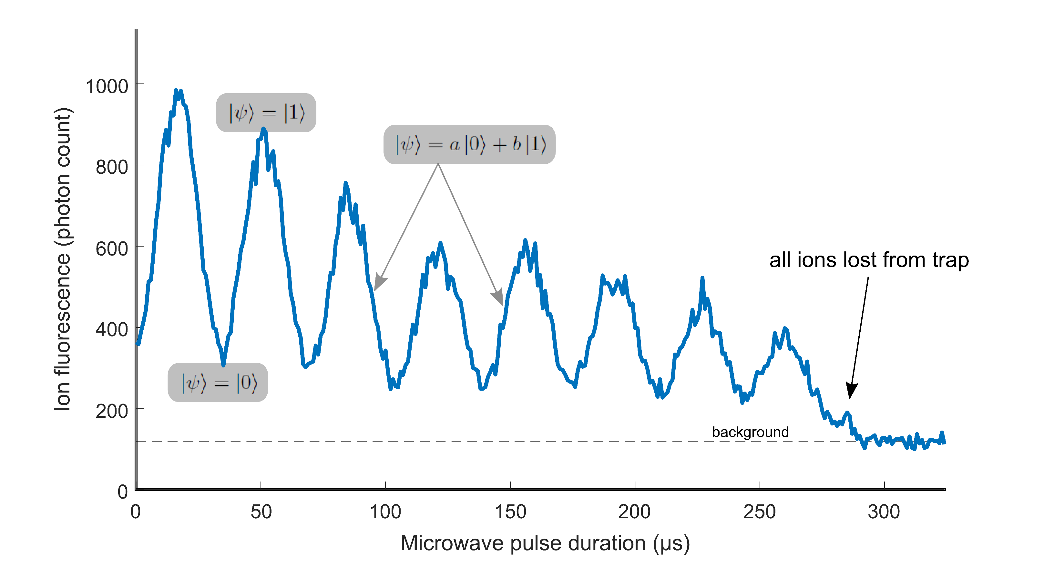
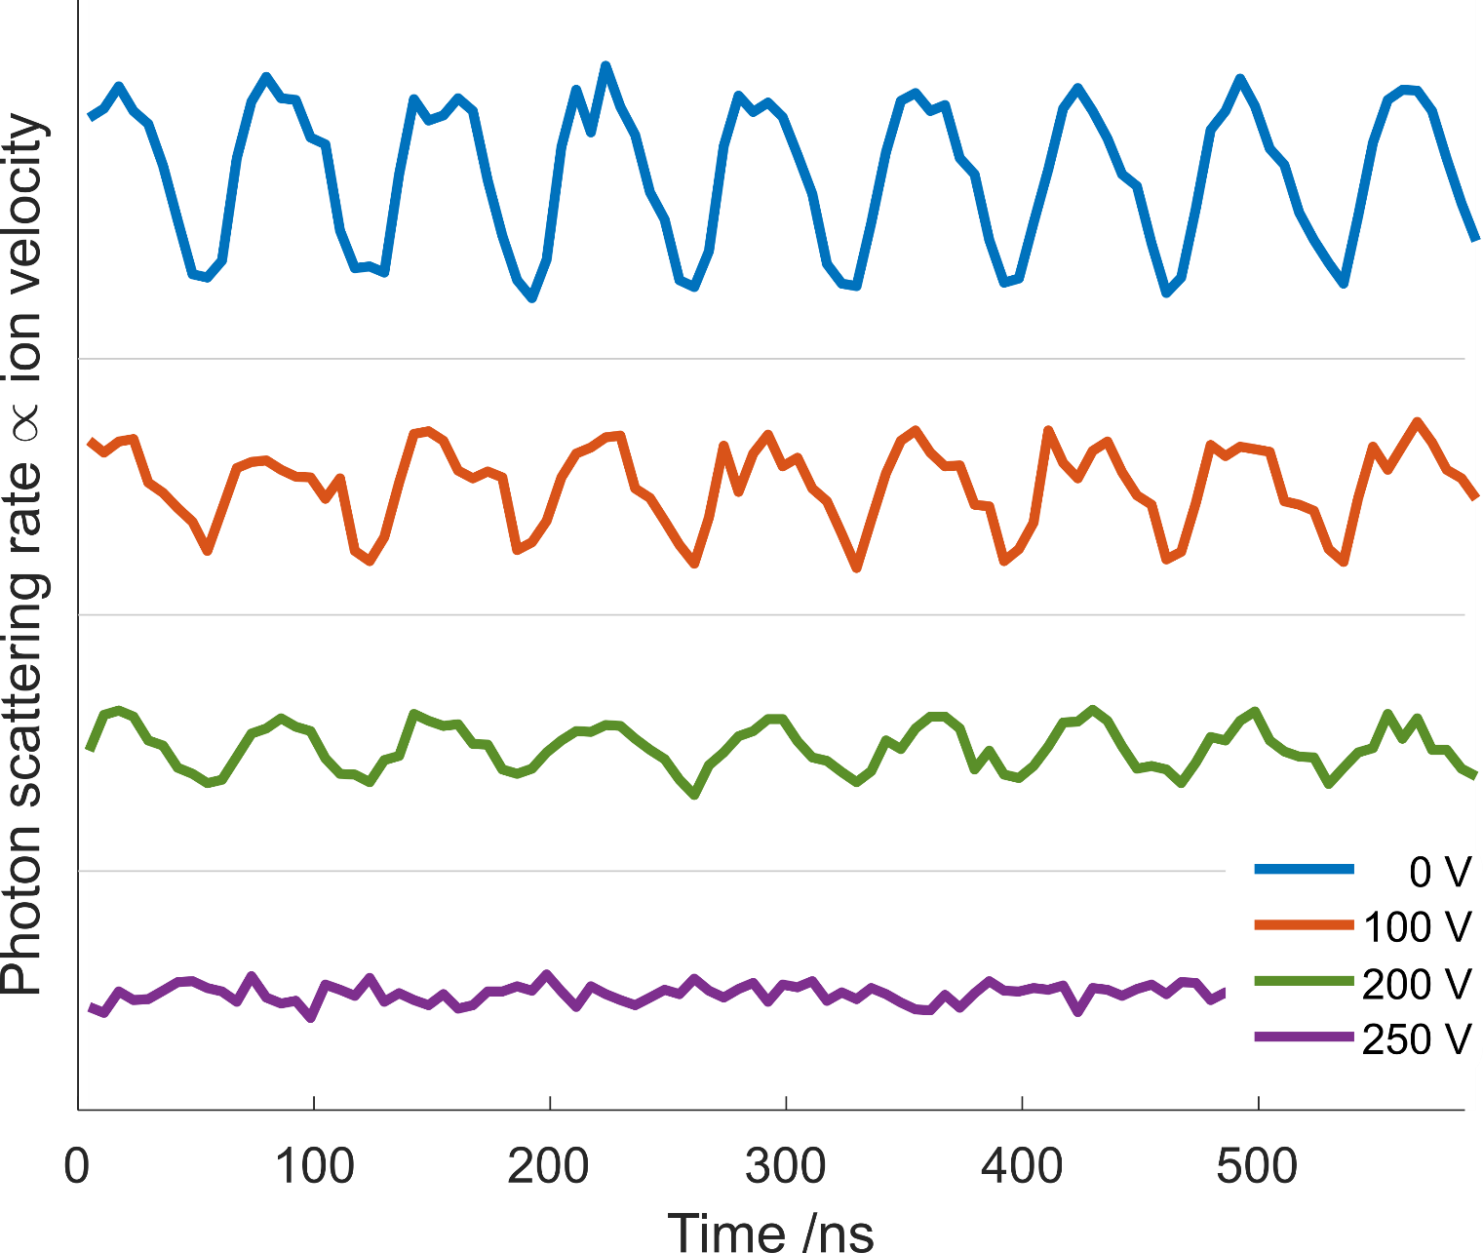
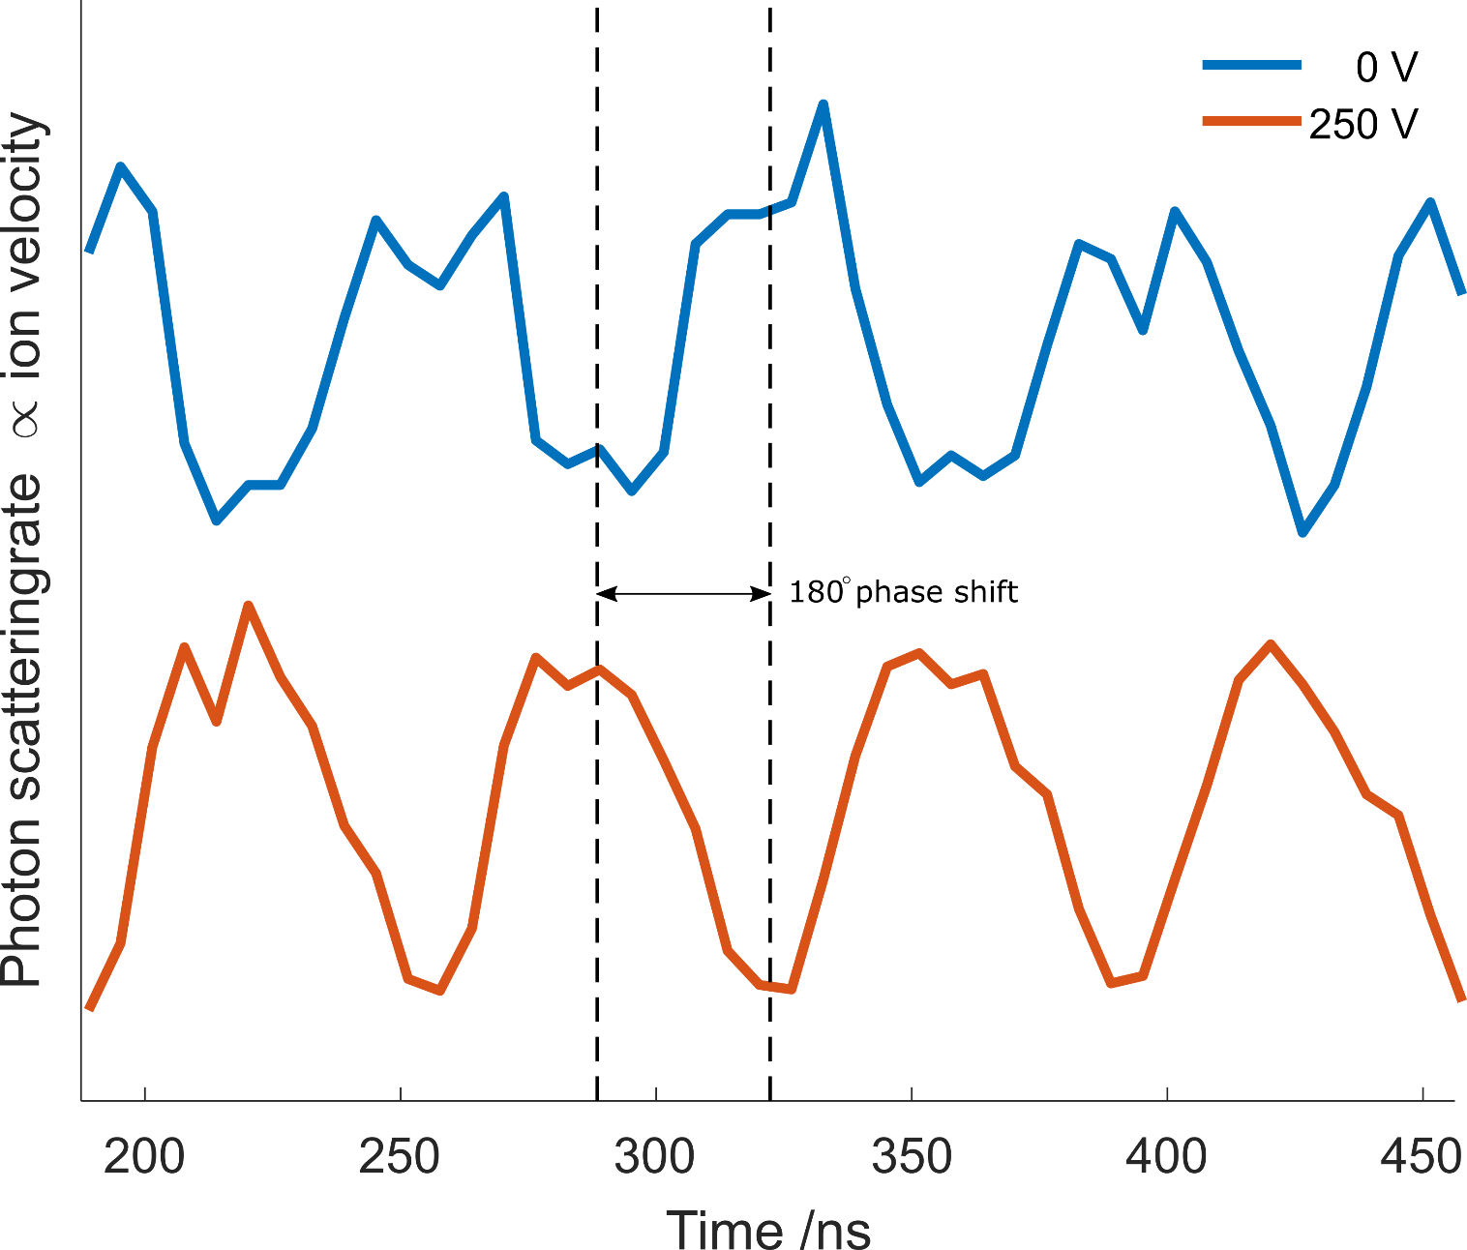
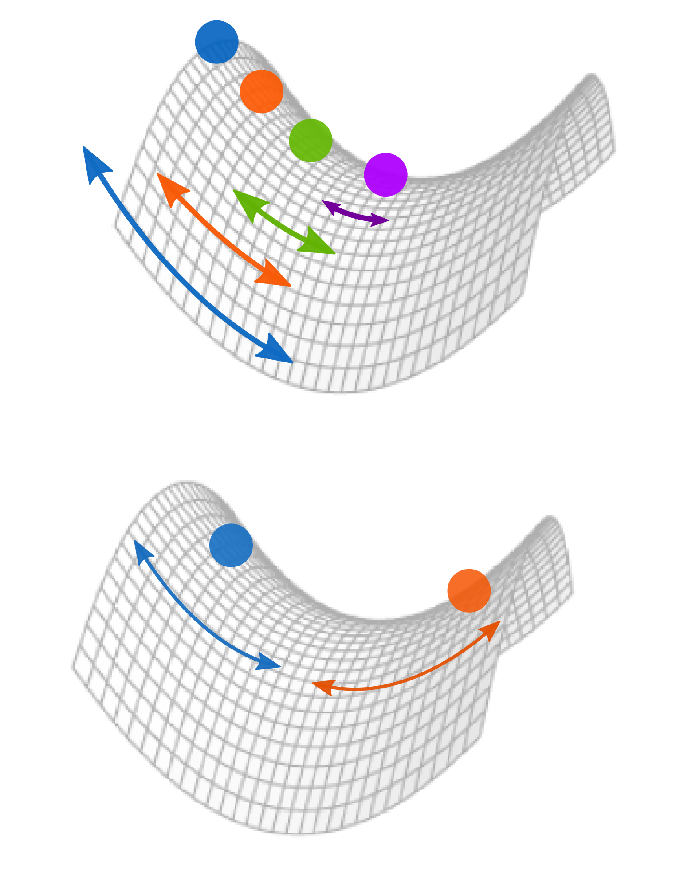


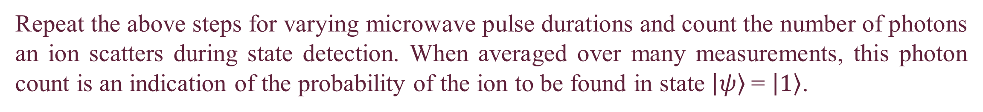

Making trapped ions quantum
Nancy Payne¹, Naleli Matjelo¹, Charles Rigby^{1,2}, Ncamiso Khanyile¹, Hermann Uys^{1,2}
¹ Laser Research Institute, Stellenbosch University, Stellenbosch
² Council for Scientific and Industrial Research, National Laser Centre, Pretoria
Contact: 19727887@sun.ac.za
Abstract
Challenge #2: getting a qubit
Precise preparation, manipulation and detection of ion qubit states is crucial in quantum computing and quantum simulation. In this work we trap and cool a cloud of Ytterbium 171 ions in a linear Paul trap by using a combination of dynamic and static electric fields to confine the ions. However, regardless of laser cooling, an ion will exhibit additional motion ("excess micromotion") if it does not sit at the centre of the ion trap. This motion can be detected by monitoring the ion's fluorescence and minimised by pushing the ion to the trap centre by using additional static electric fields. Once sufficiently cooled, the state of the ion can be controlled and detected by using lasers of appropriate power and wavelength. In this experiment, state manipulation was achieved with the application of microwaves to drive Rabi oscillations. The microwave field drives an ion between its two qubit states, which are directly analogous to the values 0 and 1 in classical computing, and these oscillations were observed via ion fluorescence.
A classical bit can be either 0 or 1. A quantum bit (qubit) can be either of the states, $\left|\left.ψ\right\rangle \right.=\left|\left.0\right\rangle \right.$or $\left|\left.ψ\right\rangle \right.$= $\left|\left.1\right\rangle \right.$, but also something in between, that is, a superposition:
$$\left|\left.ψ\right\rangle =a\left|\left.0\right\rangle \right.+b\left|\left.1\right\rangle \right.\right.$$
In our case, two of the S_{1/2} levels (Figure 6) are chosen as the qubit states.
Figure 6: Energy levels of Yb 171.
Experimental setup
Linear Paul trap (Figure 1): static and dynamic electric fields confine ions in a dynamic harmonic potential. Figure 2 shows the potential at one moment in time.
Once trapped, lasers are used to cool ions and control their state.
Figure 1: Our ion trap, photograph (left) and schematic (right). Electrode for micromotion compensation shown in red.
Figure 2: The saddle potential in a linear Paul (black circle represents an ion).
Figure 7: The steps required to perform a measurement on a qubit. In this case we are inducing Rabi oscillations for some time, then measuring the final state of the qubit.
Challenge #1: micromotion
(my ions won’t sit still)
What is micromotion and why is it a problem?
An ion feels zero force at the centre of the trap and a non-zero force elsewhere. This results in additional ion motion if the ion leaves the trap centre. However, we need our ions as motionless (i.e., as cold) as possible: additional motion affects atomic transition line shapes, reduces accuracy in high-precision work, and can impact ion confinement time.
How do we observe and remove micromotion?
An ion oscillating in space will have an oscillating scattering efficiency due to its motion and the resulting Doppler shift (Figure 3). We use static electric fields to push the ion closer to the trap centre, reducing the force the ion feels (and thus the ion’s velocity), which can be observed by monitoring the ion’s scattering efficiency.
Results: Rabi oscillations
(we have a qubit!)
Figure 3: Due to the Doppler effect, an ion’s scattering efficiency depends on its velocity. In this experiment we slightly red-detune the laser wavelength (purple) from the atomic transition wavelength such that the ion can still scatter photons. If the ion moves away from (towards) the laser beam, it “sees” a longer (shorter) wavelength so scatters less (more) efficiently, thus the scattering efficiency yields information on ion velocity.
Repeat the above steps for varying microwave pulse durations and count the number of photons an ion scatters during state detection. When averaged over many measurements, this photon count is an indication of the probability of the ion to be found in state $\left|\left.ψ\right\rangle \right.$= $\left|\left.1\right\rangle \right.$.
Figure 8: The photon count at different microwave pulse durations, indicating an oscillation of the ion wave function between the two qubit states. Each data point is an average of 50 measurements. The gradual decrease in amplitude is due to ions escaping the trap.
Observing and reducing micromotion
Finding the trap centre
Next steps
Figure 4: Ions that are on average closer to the centre of the trap (see below) have reduced motion and thus their photon scattering efficiency will have less variation (see above). The voltage corresponds to the static field that pushes the ions.
Figure 5: The motion of particles on opposite sides of the trap is 180˚ out of phase (see below), thus so is the corresponding scattering modulation (above). Observation of this “phase flip” means the ion has been pushed across the trap centre.
The successful observation of Rabi oscillations indicates that we can successfully prepare, manipulate and detect our qubit’s state. The next steps are:
Entanglement (between the motional and spin degrees of freedom).
Weak measurements (measurements that minimally disturb the state of a quantum system).
Measuring dynamic correlation functions (relating the value of an observable at one time, to the value of another observable at some later time).
This work is based upon research supported by the
South African Research Chair Initiative
of the Department of Science and Technology
and the National Research Foundation
Notes:
1

