Slide 1
Fast Failover & Resilience for
Campus Networks using SDN
A self-healing campus network with a central software brain, two independent paths, and measured sub-second recovery.
Software-Defined Networking · OpenFlow 1.3 · Mininet · Open vSwitch · Ryu
Presented by: Nanda Krishna J

Slide 2
1. Introduction
• A campus network connects every computer, phone, Wi-Fi AP and server in a university, hospital or office — the 'road system' for data.
• Modern campuses run real-time, loss-sensitive traffic: video calls, logins, payments, cloud apps.
• Links and devices fail routinely — cables unplugged, ports dying, switches overheating.
• Every failure that isn't healed instantly becomes a visible outage: frozen calls, dropped sessions, failed transactions.
• Goal: a network that heals from any single failure so fast users barely notice — with zero permanent traffic loss.
Fast Failover & Resilience for Campus Networks · SDN
2

Slide 3
2. Problem Statement
• When a link or switch fails, the network must detect it, compute a new route, and update every affected device — traffic is lost until it does.
• Traditional networks have no central view: each switch decides on its own and they must 'gossip' to agree.
• This makes recovery slow and capacity wasteful (details next slide).
• Core question of this project:
  – How can we make a campus network detect failures and fail over to redundant paths fast enough to protect live traffic — and prove it with real measurements?
Fast Failover & Resilience for Campus Networks · SDN
3

Slide 4
3. Traditional Approach & Its Limits
• Distributed protocols, no central brain — switches gossip to agree on routes:
  – STP / RSTP (Layer 2): prevents loops by switching OFF ~half the links, kept idle as standby — wasted capacity, no load balancing.
  – OSPF / IS-IS / BGP (Layer 3 routing): flood updates and each node recomputes — convergence from hundreds of ms to tens of seconds.
• Consequences:
  – Slow recovery → calls drop, sessions time out during the convergence window.
  – Inefficient → redundant links sit idle; no global optimisation or policy.
  – No single point that understands the whole network.
Fast Failover & Resilience for Campus Networks · SDN
4

Slide 5
4. Our Solution — Software-Defined Networking
• SDN splits the network into a 'brain' and 'muscle' — like an air-traffic-control tower and the planes:
  – Controller (tower): software with a complete, live map of every switch and cable; makes all routing decisions.
  – Switches (planes): simply follow rules the controller installs in advance.
• Because one brain sees everything, it can use ALL links, plan smarter routes, and react to failures in a coordinated, fast way.
• Built with industry-standard open tools: OpenFlow 1.3, the Ryu controller, Open vSwitch, and Mininet to emulate a full campus on one machine.
Fast Failover & Resilience for Campus Networks · SDN
5

Slide 6
5. Objectives
• Design a realistic, redundant campus topology (multi-tier, dual-homed).
• Build an SDN controller that forwards efficiently and reroutes on failure.
• Provide two layers of protection: pre-planned local backups + central re-routing.
• Inject REAL failures and measure detection, reroute time, outage, packet loss and recovery — not simulate.
• Visualise the live network and failovers in an operator dashboard.
• Compare honestly against traditional protocols (RSTP / OSPF / BGP).
Fast Failover & Resilience for Campus Networks · SDN
6

Slide 7
6. Methodology
• Network-first, UI-last: validate the networking system before building the dashboard.
• Built in 11 incremental phases, each validated before the next:
  – architecture → topology → controller → discovery → path computation → fast-failover → rerouting → metrics → REST API → dashboard → evaluation.
• Single source of truth: one model drives the emulated network, the controller and the dashboard.
• Measure, don't claim: an automated harness injects real OpenFlow port-downs and records packet-level evidence over many randomized trials.
Fast Failover & Resilience for Campus Networks · SDN
7

Slide 8
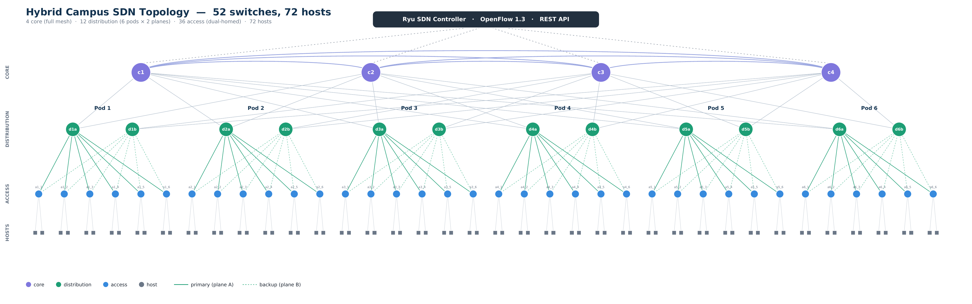
7. System Architecture
52 switches (4 core · 12 distribution · 36 access) and 72 hosts, in two independent planes (A/B); every access switch is dual-homed.
Fast Failover & Resilience for Campus Networks · SDN
8

Slide 9
8. How Traffic Is Managed
• Destination-rooted forwarding — forward by DESTINATION, not per conversation.
  – Structured MACs: every host under one access switch shares a /40 prefix.
  – One rule per destination access switch (≈36 rules/switch) → whole network runs on only ~2238 flows, not thousands.
• Each rule points to an OpenFlow GROUP holding the next-hop(s) toward that destination — effectively a delivery tree rooted at the destination.
• First packet / unknown → controller installs the rules; after that switches forward at line rate with the controller out of the data path.
• Loop-free broadcast/ARP via explicit spanning-tree flood rules.
Fast Failover & Resilience for Campus Networks · SDN
9

Slide 10
9. Resilience Mechanisms
• Two complementary layers of protection:
  – 1) Pre-planned local backups (OpenFlow fast-failover groups): every switch has a primary + backup exit installed in advance — instant local switchover on hardware.
  – 2) Controller re-routing: for bigger failures (a whole switch), the brain recomputes routes over the live graph and reinstalls only what changed.
• Two node-disjoint planes mean any single failure leaves a completely separate path intact.
• Failures are injected as REAL OpenFlow port-downs — the dashboard buttons cause genuine faults, not mock data.
Fast Failover & Resilience for Campus Networks · SDN
10

Slide 11
10. Experimental Setup
• Testbed: Mininet + Open vSwitch 3.3.9 + Ryu (OpenFlow 1.3), 52 switches / 72 hosts on one machine.
• Automated harness injects real failures mid-traffic across five failure types:
  – access-uplink, distribution–core, core–distribution, last-hop, and whole-switch failures.
• 103 randomized trials; for each we measure outage, packet loss, detection time, reroute time, and recovery — reporting medians, p95 and 95% CI.
• Evidence captured: controller CPU/RSS, installed-flow counts, and raw OpenFlow group/flow dumps.
Fast Failover & Resilience for Campus Networks · SDN
11

Slide 12
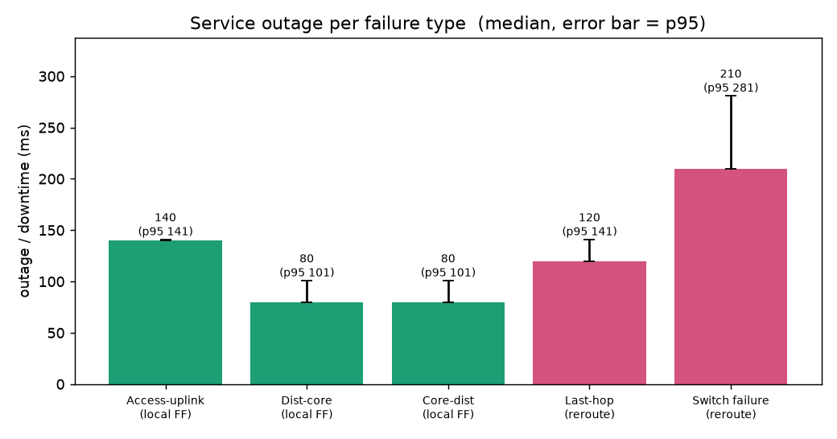
11. Results
Failure type | Recovery | Outage (median) | Delivery
Access uplink | rerouted | ~140 ms | 100%
Distribution–core | rerouted | ~80 ms | 100%
Last-hop | rerouted | ~120 ms | 100%
Whole switch | rerouted | ~210 ms | 100%
103 trials · 100% recovery on every failure.
Controller overhead: ~5.8% CPU, 65 MB RAM, 2238 flows across 52 switches.
Fast Failover & Resilience for Campus Networks · SDN
12

Slide 13
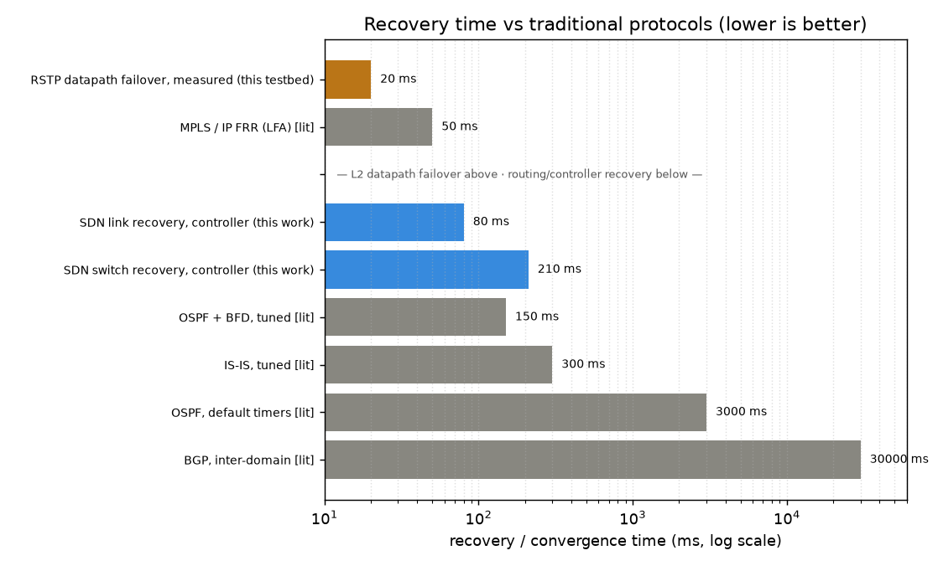
12. Comparison with Traditional Systems
• vs L3 routing (OSPF / IS-IS / BGP): our controller recovery is 10–1000× faster.
• vs RSTP: comparable local-failover speed, but we use ALL links (RSTP blocks ~half).
• Our wins: global view, deterministic disjoint backups, switch-failure handling, programmable policy.
• Honest note: in software OVS, datapath fast-failover needs hardware/BFD; here recovery is controller-driven (still sub-second).
Fast Failover & Resilience for Campus Networks · SDN
13

Slide 14
13. Features of Our Model
• Hybrid 3-tier topology, two disjoint planes, dual-homed access.
• Destination-rooted forwarding — scales by destinations, not host-pairs.
• Dual resilience: fast-failover groups + controller re-routing (100% recovery).
• ECMP load balancing — flows hashed across BOTH planes (uses every link).
• Live NOC dashboard: topology graph, path tracer, real failure buttons, reset.
• Link-load heatmap — colour every link by live throughput.
• Evaluation suite: statistical trials, datapath proofs, RSTP baseline, PDF report + Analysis tab.
Fast Failover & Resilience for Campus Networks · SDN
14

Slide 15
14. Conclusion & Future Work
• Built a self-healing SDN campus network with a central brain and two independent paths for everything.
• Proved with 103 real, repeated failure experiments: 100% recovery, sub-second (~80–210 ms) healing, with tiny controller overhead.
• Far faster and more efficient than the protocols networks use today.
• Future work: datapath fast-failover on real hardware (BFD), controller high-availability, congestion-aware adaptive routing, QoS and security policy.
Thank you.

