Slide 1




II Year B.Tech Industry Oriented Project (IoP) Project Review
II Year B.Tech Industry Oriented Project (IoP) Project Review
LOAN APPROVAL PREDICTION USING MACHINE LEARNING
Batch Details
VENNA NANDA JAYA KRISHNA : 22N31A67J1 POSHETTY SAI TEJA : 22N31A67D7
MOHD ALI : 23N35A6715
Under the guidance of
Mr M SURESH BABU , Asst.Professor
School of Emerging Technologies (CSE-Data Science)
Malla Reddy College of Engineering & Technology
(UGC Autonomous Institution – Govt. of India)

Slide 2
Abstract
II Year B.Tech Industry Oriented Project (IoP) Project Review
Our project aim is to predict whether loans will be approved or not using AI.
We gather data about applicants, including things like their personal details, financial history,loan amount,and credit score.
Then, we use different AI techniques to build models that can predict loan outcomes accurately, we test these models to see which one works best.
We also use methods to handle any unfairness or biases in the data.
Finally we create a simple tool that financial institutions can use to get quick predictions about loan approvals,making the process faster and fairer.
Recovery of loans is the most important for the banking sector, and improvement process Plays an important role in the banking sector.
The historical data of candidates was used to build a machine learning model using different classification algorithms.
The main objective of this project to predict whether a new applicant granted the loan or not using machine learning models trained on the historical data set.

Slide 3
Introduction
II Year B.Tech Industry Oriented Project (IoP) Project Review
However, the traditional methods for evaluating the creditworthiness of loan applicants have often been fraught with challenges such as subjectivity, time-consuming manual assessments, and the potential for human bias.
This project, titled "Loan Prediction Using Machine Learning," is a timely exploration of the intersection between finance and artificial intelligence.
It delves into the application of machine learning algorithms to streamline the loan approval process, enhance its accuracy, and reduce the associated risks.
We also offer a glimpse into the goals and objectives of this project, emphasizing the potential for machine learning to transform the landscape of lending and borrowing, paving the way for a more robust, efficient, and just financial system.

Slide 4
Existing System
II Year B.Tech Industry Oriented Project (IoP) Project Review
The enhancement in the banking sector, lots of people are applying for bank loans but the bank has its limited assets which it has to grant to limited people only.
So finding out to whom the loan can be granted which will be a safer option for the bank is a typical process.
In existing process, they use RF algorithm in loan approval system. But the efficiency and accuracy is pretty low.
Already banks provide online transaction system, online bank account opening system, etc,. But there is no loan approval system in the banking sector.
Then now we create a new system for loan approval. So now we move on to the proposed system.

Slide 5
Proposed System
II Year B.Tech Industry Oriented Project (IoP) Project Review
The proposed system for "LOAN APPROVAL PREDICTION USING MACHINE LEARNING" is a comprehensive solution that uses machine learning models, data analytics, and alternative data sources to improve loan evaluation.
The system includes data collection and preprocessing, feature engineering, machine learning models, performance evaluation, and the integration of non-traditional data sources.
Data preprocessing techniques will be employed to clean, transform, and normalize the dataset, while feature engineering will create relevant features from raw data.
Machine learning models will be trained on historical data to predict loan approval or rejection based on applicant attributes.
Continuous monitoring and improvement will be integral to the system's maintenance, responding to changing data trends and economic conditions.

Slide 6
II Year B.Tech Industry Oriented Project (IoP) Project Review
System Architecture

Slide 7










II Year B.Tech Industry Oriented Project (IoP) Project Review
System Architecture
INPUT CUSTOMER DETAILS
DATA PREPROCESSING
MODEL
DECISION TREE, LOGISTIC REGRESSION
TRAINING SET
OUTPUT

Slide 8
II Year B.Tech Industry Oriented Project (IoP) Project Review
Technical Requirements Specification (TRS)

Slide 9
Software Requirements Specification(SRS)
II Year B.Tech Industry Oriented Project (IoP) Project Review
Python 3.x
Required Python libraries: pandas, scikit-learn, joblib , numpy , tkinter
Provide a GUI using Tkinter for user input of loan application details.
Display the loan approval prediction result.
Machine Learning Models
The system uses the following machine learning models:
- Logistic Regression
- Support Vector Machines
- Decision Trees
- Random Forests.

Slide 10
Hardware Requirements Specification(HRS)
II Year B.Tech Industry Oriented Project (IoP) Project Review
Recommended Hardware Requirements
Operating System : Windows, MacOS, Linux
Processor: 8 GB of RAM.
Storage: 20 GB or more of free disk space.
Display: A monitor with a resolution of 1920x1080 or higher.
Input Devices: A keyboard and a mouse or other pointing device.

Slide 11
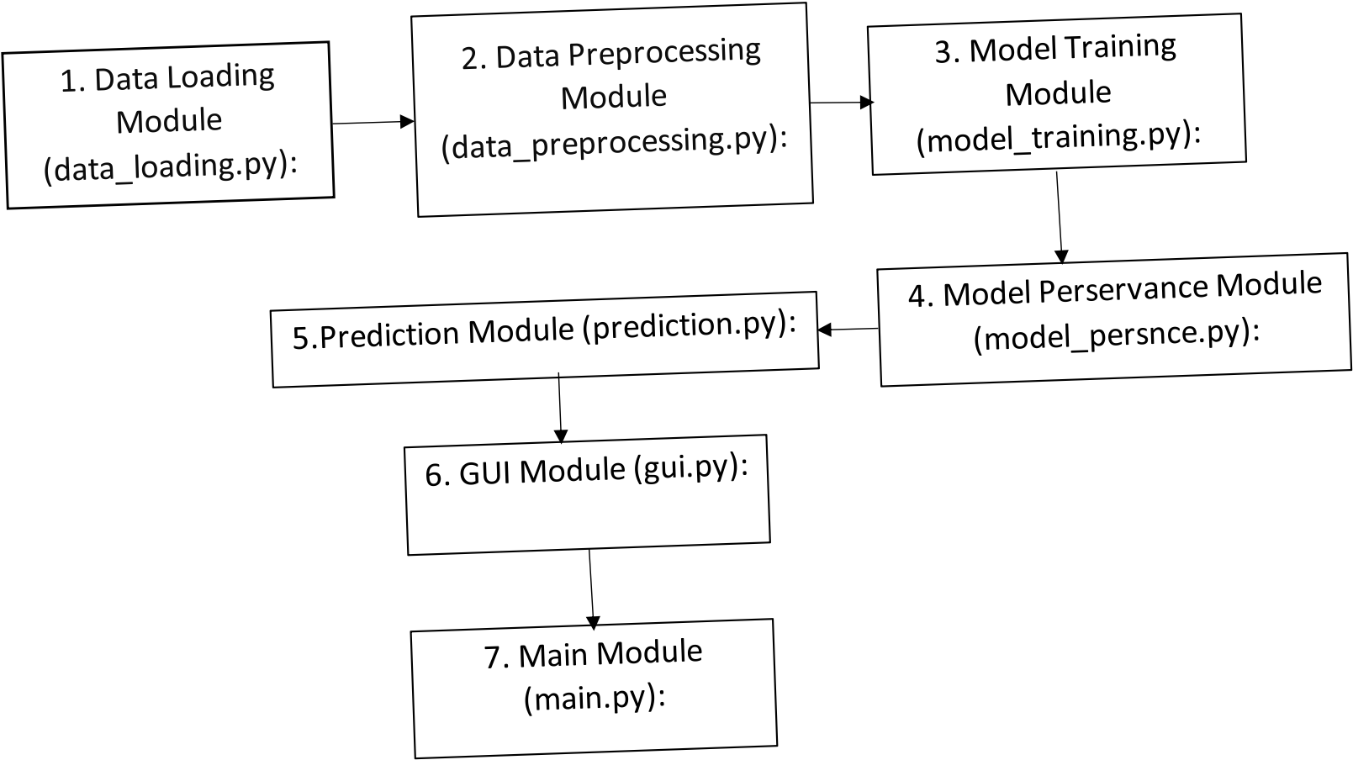
II Year B.Tech Industry Oriented Project (IoP) Project Review
Application Modules
School of Emerging Technologies: CSE (DS), CSE(IoT) & CSE(CyS) | MRCET (A) Campus

Slide 12
Implementation
II Year B.Tech Industry Oriented Project (IoP) Project Review
These are simplified examples to give you an idea of how each module might be implemented. Depending on specific requirements and the libraries we choose, may need to adjust these code snippets.
https://github.com/MokshithT/LoanApprovalSystemML/blob/main/Loan%20Status%20Prediction%20Using%20Machine%20Learning.ipynb
School of Emerging Technologies: CSE (DS), CSE(IoT) & CSE(CyS) | MRCET (A) Campus

Slide 13
II Year B.Tech Industry Oriented Project (IoP) Project Review
System Models (UML Diagrams)

Slide 14
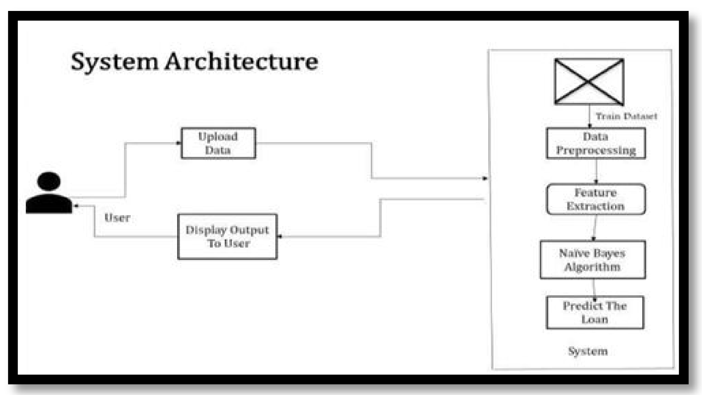
II Year B.Tech Industry Oriented Project (IoP) Project Review
Dataflow Diagram

Slide 15
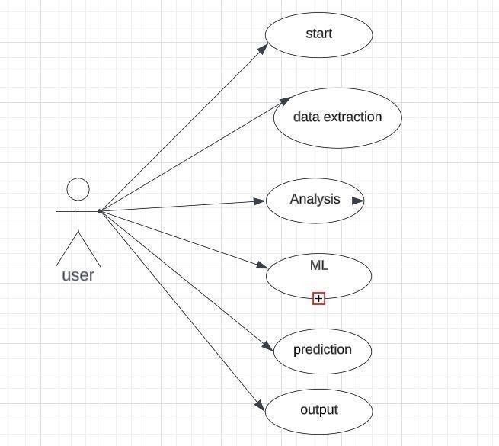
II Year B.Tech Industry Oriented Project (IoP) Project Review
Use-Case Diagram

Slide 16
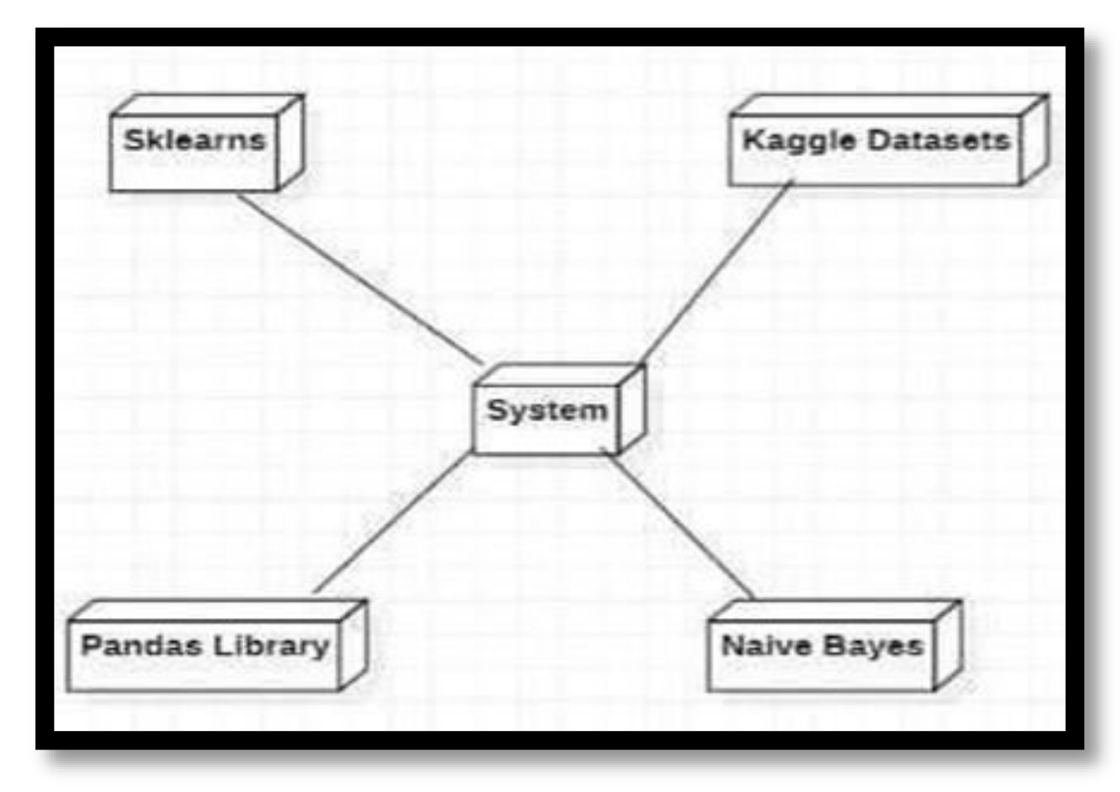
II Year B.Tech Industry Oriented Project (IoP) Project Review
Sequential Diagram

Slide 17
II Year B.Tech Industry Oriented Project (IoP) Project Review
Output Screens

Slide 18
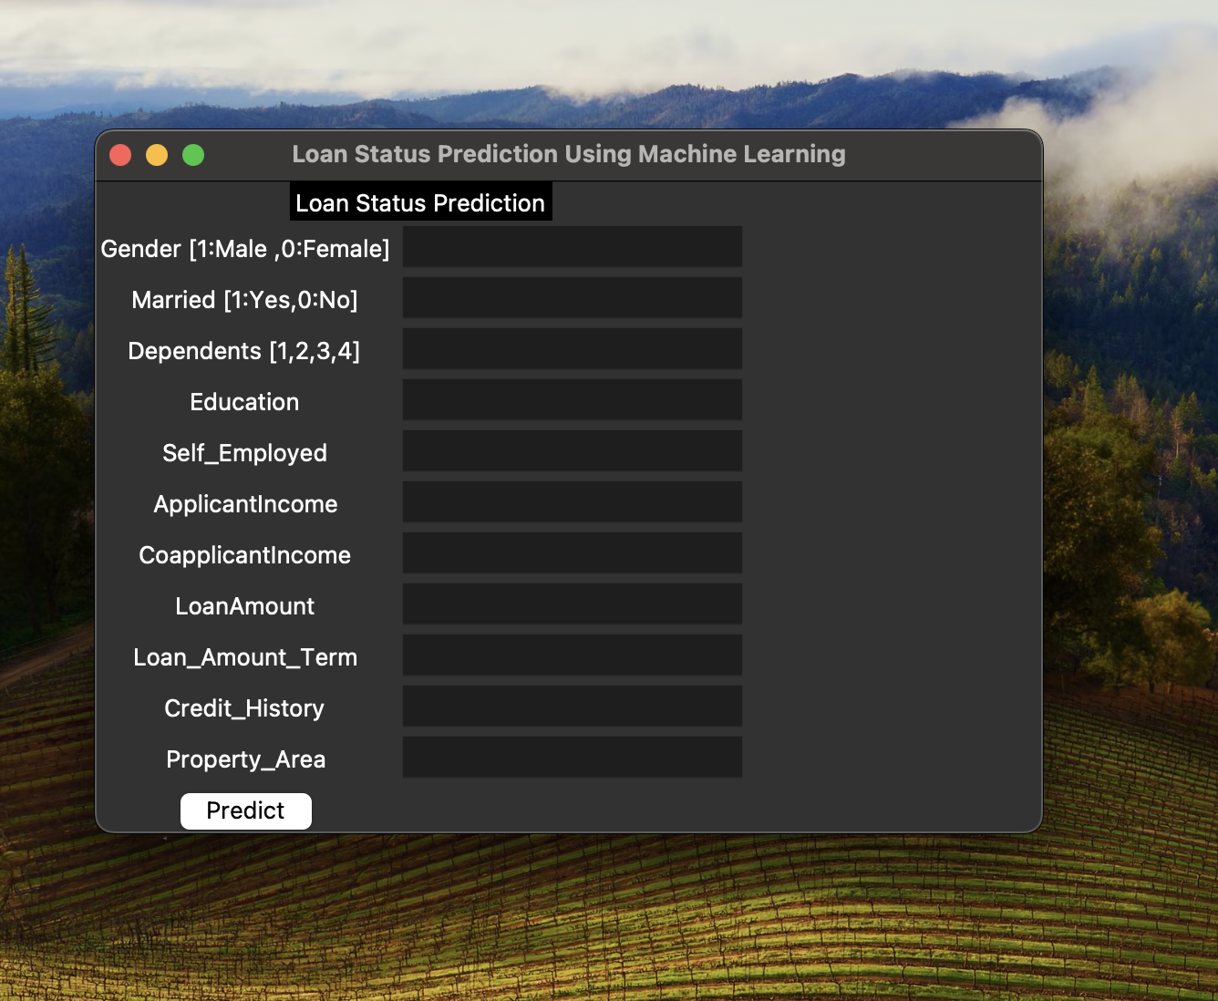
II Year B.Tech Industry Oriented Project (IoP) Project Review
Output Screens

Slide 19
II Year B.Tech Industry Oriented Project (IoP) Project Review
Conclusion & Future Scope

Slide 20
II Year B.Tech Industry Oriented Project (IoP) Project Review
Conclusion
In conclusion, the Loan Status Prediction System demonstrates a comprehensive approach to predicting loan approval using machine learning.
Through modularization, the code is organized into distinct and purposeful modules, from data loading and preprocessing to model training, hyperparameter tuning, and a user-friendly GUI.
The Random Forest model, optimized through hyperparameter tuning, is employed for accurate predictions.
The application not only provides a robust backend for machine learning tasks but also offers a convenient GUI for users to input data and receive instant loan approval predictions.
This modular and well-structured system facilitates maintainability, scalability, and ease of integration into diverse applications.

Slide 21
II Year B.Tech Industry Oriented Project (IoP) Project Review
Future Scope
The Loan Approval Prediction System using machine learning lays the foundation for a dynamic and evolving financial decision-making process.
Looking ahead, there are several avenues for future enhancement and expansion that can contribute to the system's continued effectiveness and relevance.
Firstly, the incorporation of additional features into the machine learning model can enhance its predictive capabilities.
Techniques like neural networks or gradient boosting may uncover complex patterns within the data that traditional models might overlook.
Regular updates to the model based on new data and retraining schedules can ensure that the system remains robust and aligned with real-world scenarios.

Slide 22
II Year B.Tech Industry Oriented Project (IoP) Project Review
Thank you
VENNA NANDA JAYA KRISHNA
POSHETTY SAITEJA
MOHD ALI

