Slide 1

Azure Resource Deployments Using ARM Templates

Slide 2
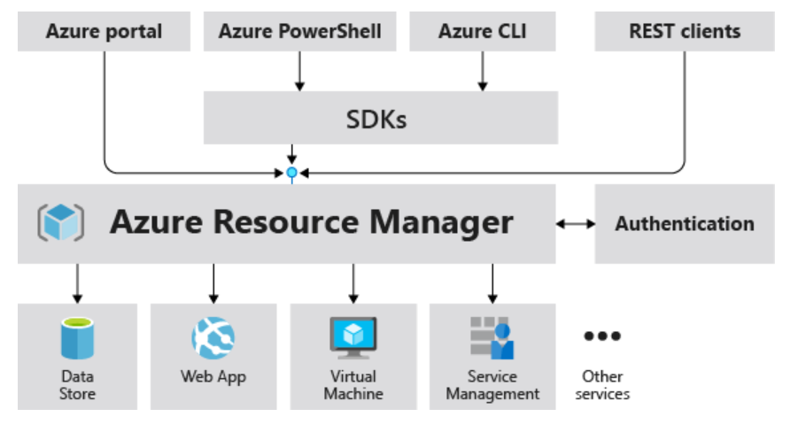
Azure Resource Manager
ARM (Azure Resource Manager) is the deployment and management service for Azure.
When a user sends a request from any of the Azure tools, APIs, or SDKs, Resource Manager receives the request.
It authenticates and authorizes the request.
Resource Manager sends the request to the Azure service, which takes the requested action.
As all requests are handled through the same API, you see consistent results and capabilities in all the different tools.

Slide 3
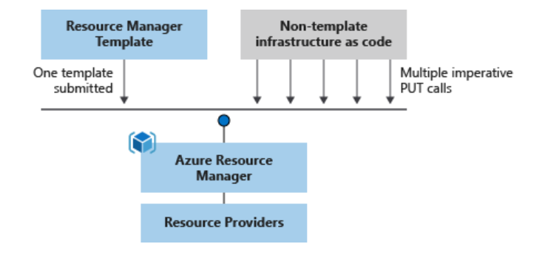
What is ARM Template
ARM (Azure Resource Manager) Template is a JavaScript Object Notation (JSON) file that defines one or more resources to deploy to a resource group or subscription.
The template uses declarative syntax, which lets you state what you intend to deploy without having to write the sequence of programming commands to create it.
In the template, you specify the resources to deploy and the properties for those resources.
The template can be used to deploy the resources consistently and repeatedly.
ARM Templates enable you to implement infrastructure as code for your Azure solutions.

Slide 4
How to Modularize ARM Templates
ARM (Azure Resource Manager) Template is a JavaScript Object Notation (JSON) file that defines one or more resources to deploy to a resource group or subscription.
The template uses declarative syntax, which lets you state what you intend to deploy without having to write the sequence of programming commands to create it.
In the template, you specify the resources to deploy and the properties for those resources.
The template can be used to deploy the resources consistently and repeatedly.
ARM Templates enable you to implement infrastructure as code for your Azure solutions.

Slide 5
Why ARM Templates
Declarative syntax - Resource Manager templates allow you to create and deploy an entire Azure infrastructure declaratively.
Repeatable results: Repeatedly deploy your infrastructure throughout the development lifecycle and have confidence your resources are deployed in a consistent manner.
Orchestration: You don't have to worry about the complexities of ordering operations. Resource Manager orchestrates the deployment of interdependent resources so they're created in the correct order.
Built-in validation: Your template is deployed only after passing validation. Resource Manager checks the template before starting the deployment to make sure the deployment will succeed.
Modular files: You can break your templates into smaller, reusable components and link them together at deployment time.
CI/CD integration: You can integrate templates into your continuous integration and continuous deployment (CI/CD) tools, which can automate your release pipelines for fast and reliable application and infrastructure updates. By using Azure DevOps and Resource Manager template task, you can use Azure Pipelines to continuously build and deploy Azure Resource Manager template projects.

