Slide 1
Ministry/ Organization name: National Jute Board, Min of Textiles
Problem Statement : Software to track the goods through its delivery path and ensure safe delivery
Team Name : The Detectives Team Leader Name : Nandakrishna College Code : U-0733
IDEA

Slide 2
Idea / Approach details
The idea is to label each product with a one-to-one counterfeit-proof feature(RFID) and to then track it using a global delivery system based on a Blockchain.
A package delivery system based on the blockchain technology which would help enhance security with data integrity and the verification of both users and data.
A web app will be built for the same to remotely track the most recent position of every package on the move.
Deploying the service on a blockchain service such as AWS or Microsoft Azure thus reducing the setup and maintenance costs of servers.
Tracking using RFID technology.
Technology Stack
Blockchain (Ganache for a local ethereum network and Truffle for testing and deploying. Metamask to manage wallets and interact with ethereum network.)
RFID Technology
Web App Development (HTML, CSS, Javascript, Materialize/Bootstrap for front-end. Http-server and web3 library to call our smart contracts’ methods.)

Slide 3
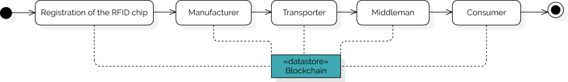
Example of Delivery System
Registration of the RFID chip: The RFID chip is configured for every product, ensuring the authenticity and the integrity of the product.
Manufacturer: In the production process, the manufacturer inserts the RFID chip into the product.
Transporter: The resulting data (for example location changes, transitions, temperature, humidity, vibrations, etc.) are linked with the product ID and stored in the Blockchain. In the Blockchain the product can be identified via the one-to-one RFID chip and contains all recorded data from the transport process.
Middleman:The finished product is delivered to the final consumer via the intermediary. Any changes in the state (location, transitions, temperature, humidity, vibrations, etc.) are stored in the Blockchain.
Consumer: The intermediary gets the products to the consumer. The consumer is clearly identified by the RFID chip. It can inspect and verify all relevant manufacturing and transport data.

Slide 4
Why Blockchain?
Multiple parties are involved in transactions along a supply chain, and each typically has its own version of the truth. This results in many errors, duplicates and redundancies. A single common general ledger that is tamper-proof mitigates many of these inefficiencies.
Decentralized: eliminates the risk of a single point of failure in the network.
Immutable: Data is written onto the blockchain in a way that cannot be altered without detection.
Consensus: ensures that a single entity does not control the blockchain and also allows for the permissioning of data.
Democratic: Ensures transparency and stakeholders participating in the blockchain network have an equal voice on issues such as data ownership, rights, data sharing, and protection
Provides efficient provenance tracking
Smart supply logistics will prevent loss of goods and will provide accurate information of commision and other intermediary services.

Slide 5
Why RFID?
Improve the quality and transparency of data across the supply chain.
Increased productivity- more accurate and lesser time spent on taking inventory.
Reliable and real-time tracking and tracing of inventory in challenging environment.
Guarantees authenticity of the product.
The flexibility and cost-effectiveness of passive RFID tags makes it possible to attach or embed them to a wider range of objects, making them suitable for textile products.
RFID tags with larger on-board memory capacity can even store additional information about the asset.

Slide 6
Idea / Approach details
Use Cases
Can be used to track delivery of any packages like genuine raw materials and processed textiles.
Identification of counterfeits, Inventory control, Warehousing
Distribution, Logistics, Automatic object tracking
Dependencies/Show Stoppers
The same RFID that was previously scanned cannot be used for product registration again. A new RFID is required for each package.

Slide 7
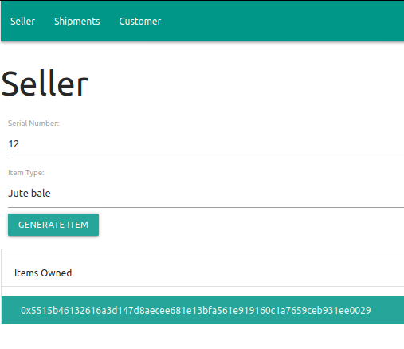
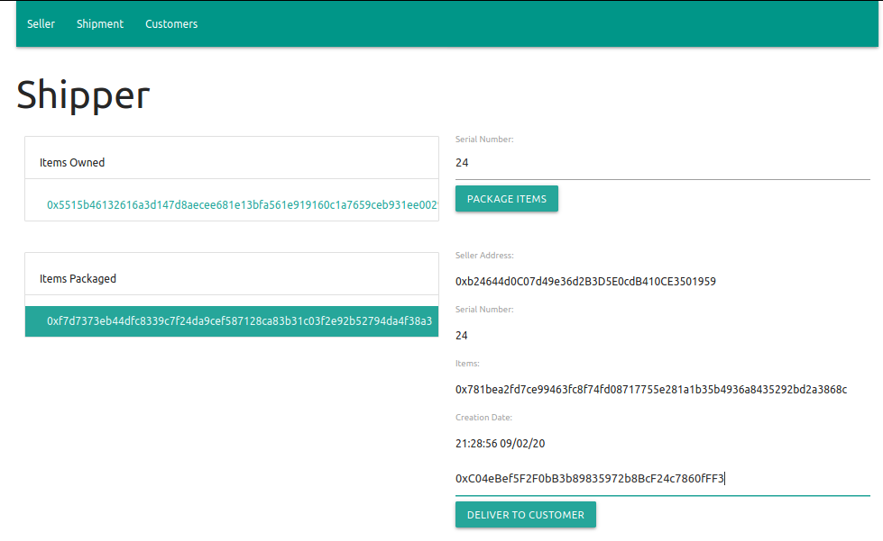
Our Prototype for Internal Hackathon:
Fig. 1: Items are logged into the blockchain system initially
Fig. 2: Shows all items under an entity and allows them to log into the system that it has been packaged for delivery.

Slide 8
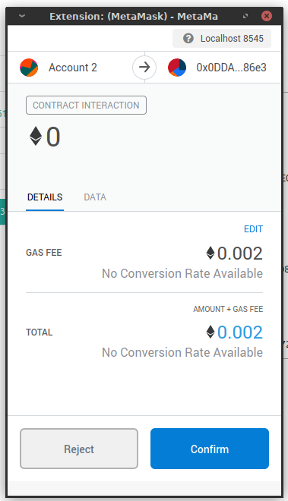
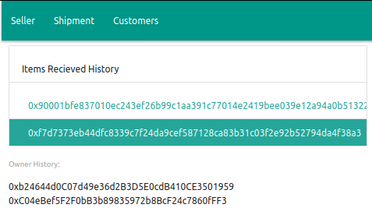
Fig. 4: Selecting an item gives the history of owners, thus allowing for efficient and secure tracking of its delivery path
Fig. 3: Metamask allows us to manage wallets, make valid transactions and interact with ethereum network.

