Slide 1

Cryptographic Failures: Practical Case Studies for Penetration Testers
Concise technical briefing for final-year B.Tech students specialising in penetration testing and entry-level cybersecurity interviewers. Focus: implementation and management failures (not cryptanalysis). Real incidents from 2024–2026 as interview-ready case studies.

Slide 2




ROOT CAUSE
What "Cryptographic Failures" Means
Cryptographic failures occur when systems using encryption, hashing, or signing are misconfigured, improperly implemented, or poorly managed — enabling credential theft, data leakage, or integrity loss without breaking the underlying math.
Implementation
Key Management
Operational Exposure
Incorrect usage of APIs, weak parameters (low iterations), or missing nonces/IVs.
Exposed keys, hard-coded secrets, inadequate rotation or access controls.
Backups, logs, or source code leaked with ciphertext or hashes enabling offline attacks.

Slide 3
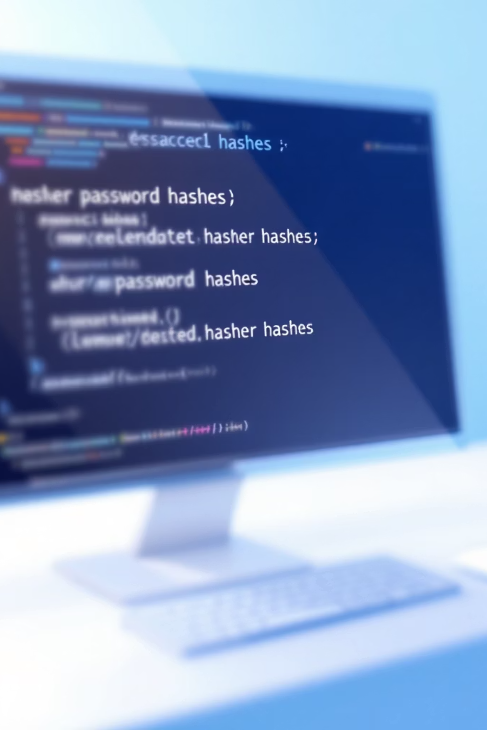

Case Study 1 — Internet Archive (Oct 2024): Weak Hashing
Attackers exfiltrated user data for ~31M accounts. Passwords were hashed with Bcrypt, but failures in parameter selection and exposure turned them vulnerable to offline cracking.
Core failure: weak cost (work factor) + exposed database and code allowing targeted offline brute-force.

Slide 4

Technical Breakdown — Why Bcrypt Alone Wasn't Enough
- Bcrypt is CPU-bound but requires a sufficiently high cost factor to resist modern parallel cracking on GPUs/ASICs.
- If salts are reused, missing, or predictable, attackers can precompute targeted tables.
- Exposure of source code revealed hashing parameters and allowed attackers to optimise cracking strategies.
Work factor too low → faster brute force
Insufficient unique salt per account → attacker's advantage
Leaked config + hash dump → offline, scalable attacks

Slide 5
Interview-Focused Takeaways (How to Explain This)
Clear root cause
Demonstrable impact
Resumable talking points
Not "Bcrypt is broken" — rather poor parameterisation and operational exposure.
Offline cracking converts hashed dumps into valid credentials used for account takeover and credential stuffing.
Describe mitigations, detection, and testing you would perform during a pentest.

Slide 6
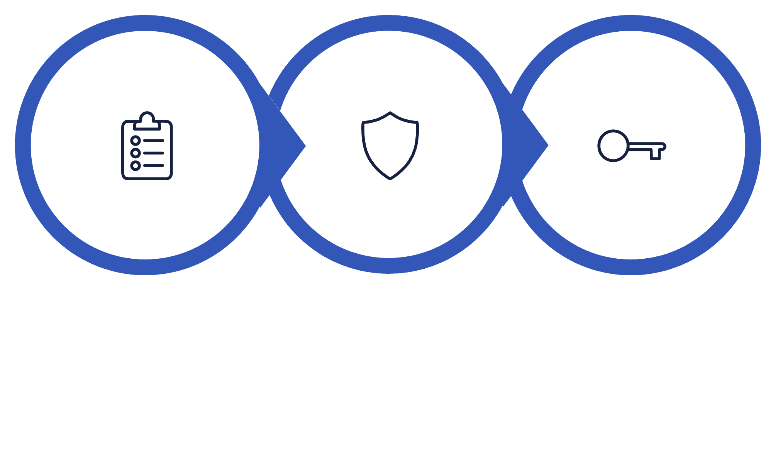



Assess
Harden
Protect
Practical remediation path used by incident responders and secure engineers — useful for checklist answers in interviews.

Slide 7

Pentest Checklist: What to Test
Verify hashing algorithms and parameters (work factor, iterations)
Confirm per-account unique, cryptographically-random salts
Search repos/backups/logs for leaked secrets, config files, or hash dumps
Attempt realistic offline cracking on sampled hashes (ethics & scope permitting)
Validate secure password reset flows and MFA adoption

Slide 8






Mitigation — Strong Defaults
Mitigation — Key & Secret Hygiene
Mitigation — Detection
Monitor dark web, alert on new dumps, and instrument telemetry for abnormal access patterns.
Set high cost factors by default; document acceptable ranges and review annually.
No hard-coded secrets; use managed KMS and enforce rotation policies.

Slide 9

How To Frame This on Your Resume / In Interviews
Context: "Investigated Internet Archive breach (Oct 2024) — analysed password storage and exposure."
Action: "Performed configuration review, identified low Bcrypt cost and salt weaknesses; simulated offline cracking in lab."
Result: "Proposed migration plan to Argon2id with phased re-hash and improved key management; prepared incident detection playbook."

Slide 10

Final Notes — Practical, Testable, Defendable
When discussing cryptographic failures: be precise about the implementation fault, quantify the exposure, propose measurable mitigations, and describe testing steps you would perform during a pentest. These specifics demonstrate both technical depth and practical readiness for entry-level roles.

