Slide 1

Understanding the TCP/IP Model
The universal language of the internet that powers every bit of data you see online

Slide 2
Four Layers, One Unified Framework
The TCP/IP model is the practical architecture used to transmit data across networks worldwide
Application Layer
Transport Layer
HTTP, SMTP protocols
TCP, UDP protocols
Internet Layer
Network Access Layer
IP addressing, routing
Physical transmission

Slide 3

Application Layer
Where User Data Begins
Transforms emails, webpages into network-ready format
HTTP for webpages
SMTP for emails
High-level communication details

Slide 4

Transport Layer
Host-to-host communication and data integrity
TCP
Breaks data into segments
Ensures correct order, error-free delivery
UDP
Faster, "best-effort" delivery
Ideal for live video streaming

Slide 5

Internet Layer
The GPS of the model
Uses IP addresses to package segments into packets and route across networks
Determines the best path for data to reach its destination

Slide 6
Network Access Layer
Fiber Optic Cables
Ethernet Wires
Wi-Fi Signals
High-speed data transmission
Wired network connections
Wireless data transfer
Manages hardware-level details including MAC addresses

Slide 7
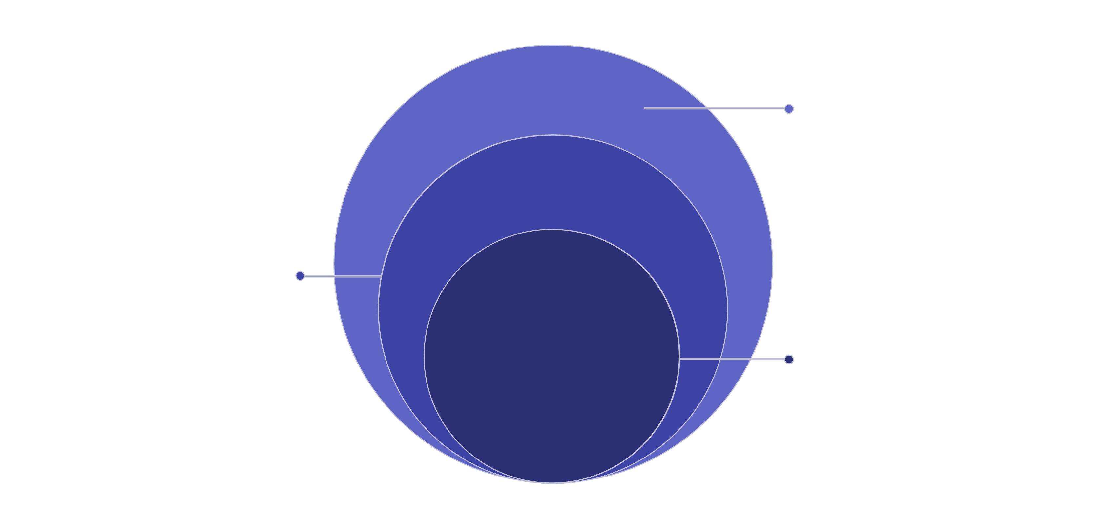
Encapsulation Process
Each layer adds specific header information, creating a nested package
Internet & Network Access
Adds IP and link headers for delivery
Transport Layer
Prepends transport header (ports)
Application Layer
Adds application header and payload

Slide 8

Real-World Applications
Email Communication
Web Browsing
SMTP protocol at work
HTTP protocol in action
Video Streaming
UDP protocol for speed

Slide 9
Key Takeaways
1
Four-layer framework powers the internet
2
Each layer has specific responsibilities
3
Encapsulation ensures reliable delivery
From user applications to physical transmission
Application, Transport, Internet, Network Access
Headers added at each layer for accurate routing

Slide 10

The Foundation of Digital Communication
Understanding TCP/IP is essential for navigating modern networking

