Slide 1


Insecure Design: Why Good Code Can’t Save a Bad Foundation
Moving beyond implementation to security architecture
SECURE BY DESIGN

Slide 2




The Broken Foundation
Insecure Implementation
Bugs, missing patches, input validation errors — found in code & tests
Insecure Design
Flawed logic, weak authentication flows, insecure assumptions — architecture-level
Analogy
"A locked door on a house with no front wall" — implementation can't compensate for bad design

Slide 3
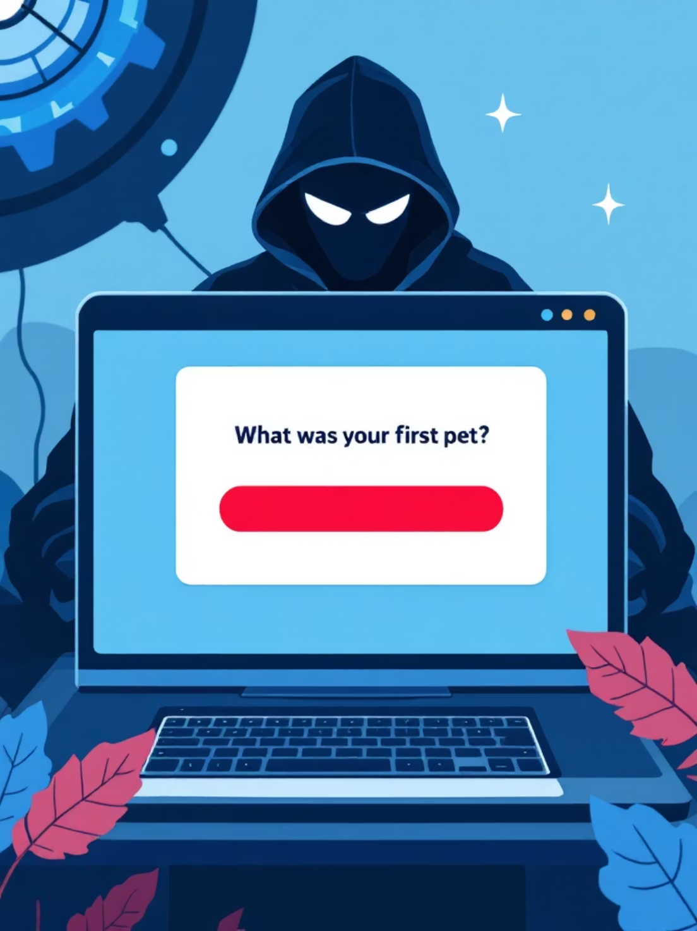
Case Study — Security Questions
Why it fails
Answers often publicly discoverable (social profiles, public records)
Low entropy — guessable or reused across sites
Prone to social engineering and account recovery attacks
Architectural lesson
Authentication and recovery flows are design-level decisions — require threat modeling and alternatives

Slide 4
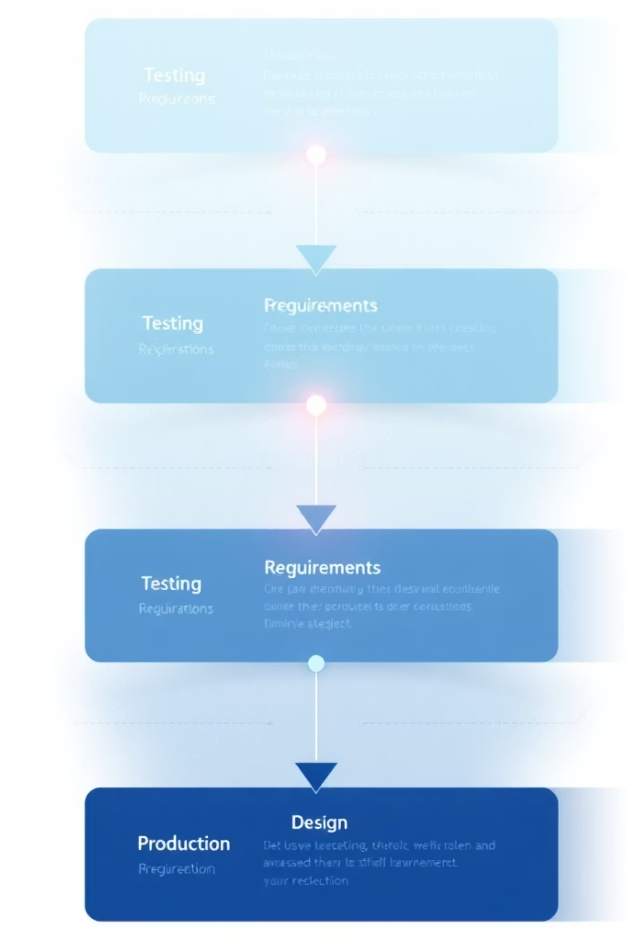




Shift Left: Design Before Code
$1 spent on secure design ≈ $100 saved on post-breach fixes
Requirements
Define security objectives, acceptable risk, compliance constraints
Design
Threat models, secure patterns, data flow & boundary decisions
Implementation
Secure-by-default libraries, code reviews, static analysis
Testing & Ops
Pentest, runtime monitoring, incident playbooks

Slide 5
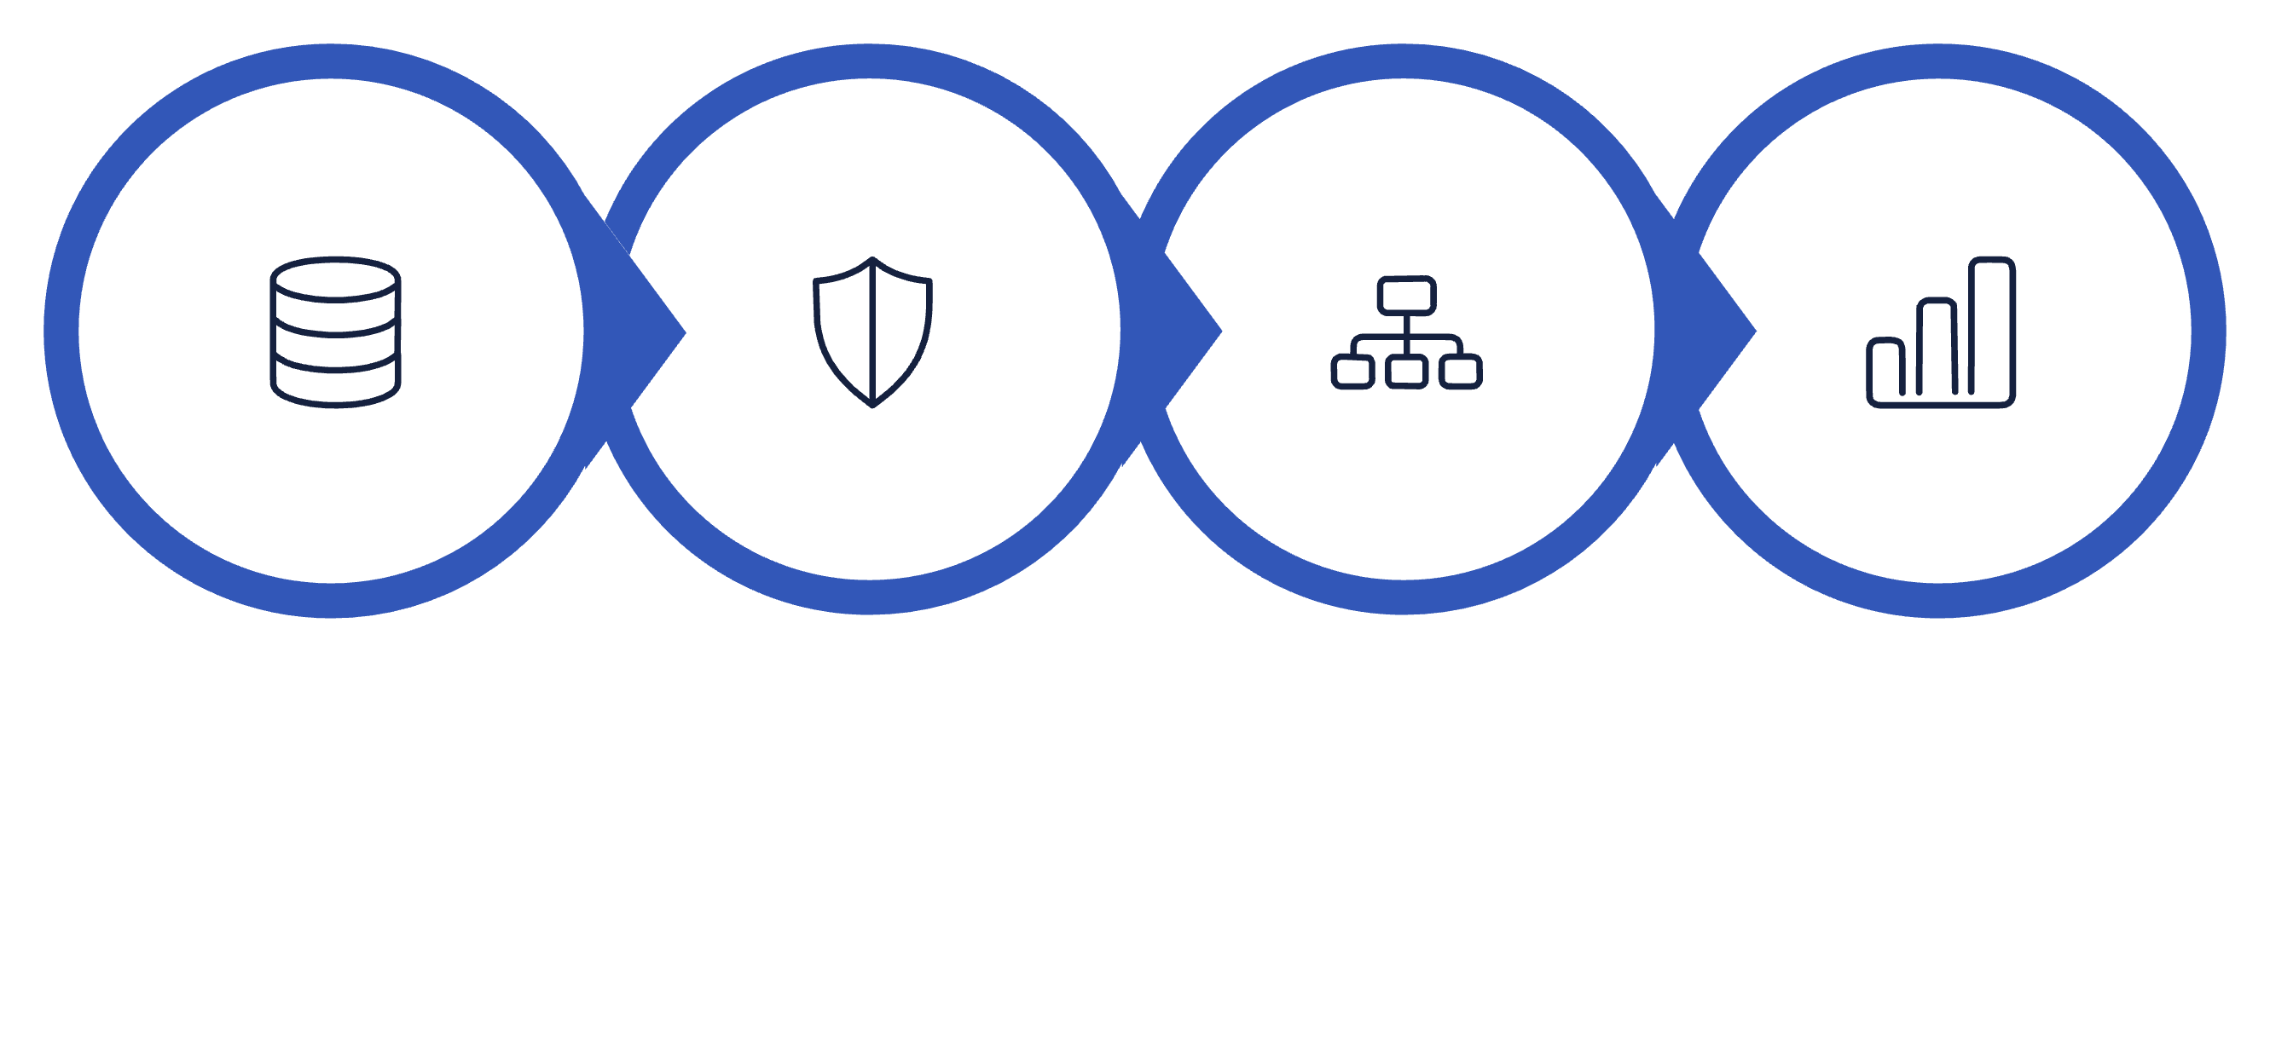




Threat Modeling in Practice
Asset Identification
Threat Enumeration
Abuse Case Mapping
Risk Prioritization
Think like a hacker during the whiteboard phase — map real abuse cases, not just happy paths

Slide 6



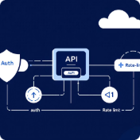
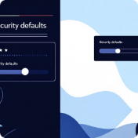
Secure Design Patterns
MFA (Multi-Factor)
Time-based OTP
Least Privilege
Gateway & Centralized Auth
Limit scope of credentials; separate duties and reduce blast radius
Combine possession + knowledge factors; remove sole reliance on recovery Qs
Short-lived secrets reduce replay and guess windows
Enforce auth, logging, and rate limits at the edge — single source of truth
Secure Defaults
Opt-in protection, feature flags for risky behavior, safe fail states
Mantra: "Don’t reinvent the wheel; use the gold standard."

Slide 7
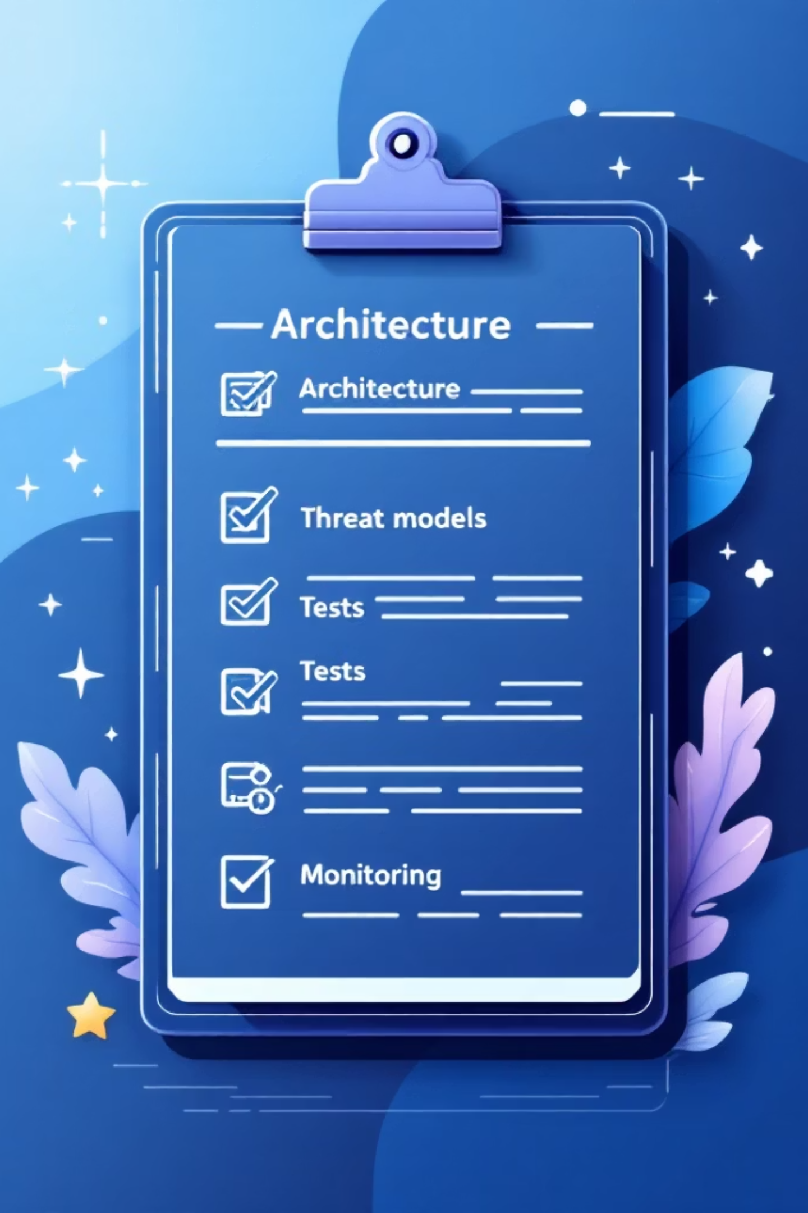

Conclusion & Action Checklist
1. Design-first
2. Threat model
3. Use patterns
Make security a requirements item, not an afterthought
Map abuse cases early; review at each milestone
MFA, TOTP, least privilege, centralized auth
4. Measure & iterate
Metrics, monitoring, regular red-teaming
Security is an architectural choice, not a last-minute add-on.
Takeaway: Shift investment left — small upfront design effort prevents large downstream losses

