Slide 1

Injection Attacks — Real-World Case Study
Examining a high-impact SQL injection breach and practical defenses

Slide 2
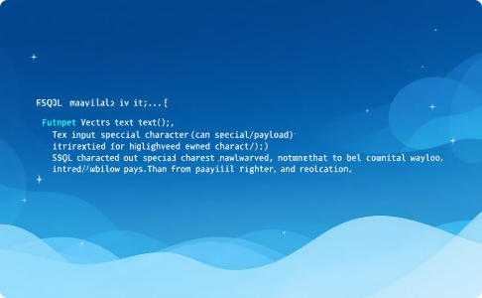
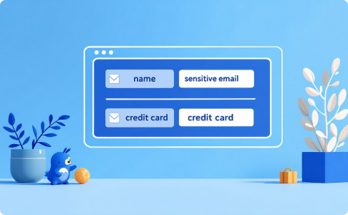
Attack Surface: Search Field
Unfiltered Input
Back-end Exposure
Search box accepted raw user input — no sanitization
Direct concatenation into SQL query reached customer DB

Slide 3
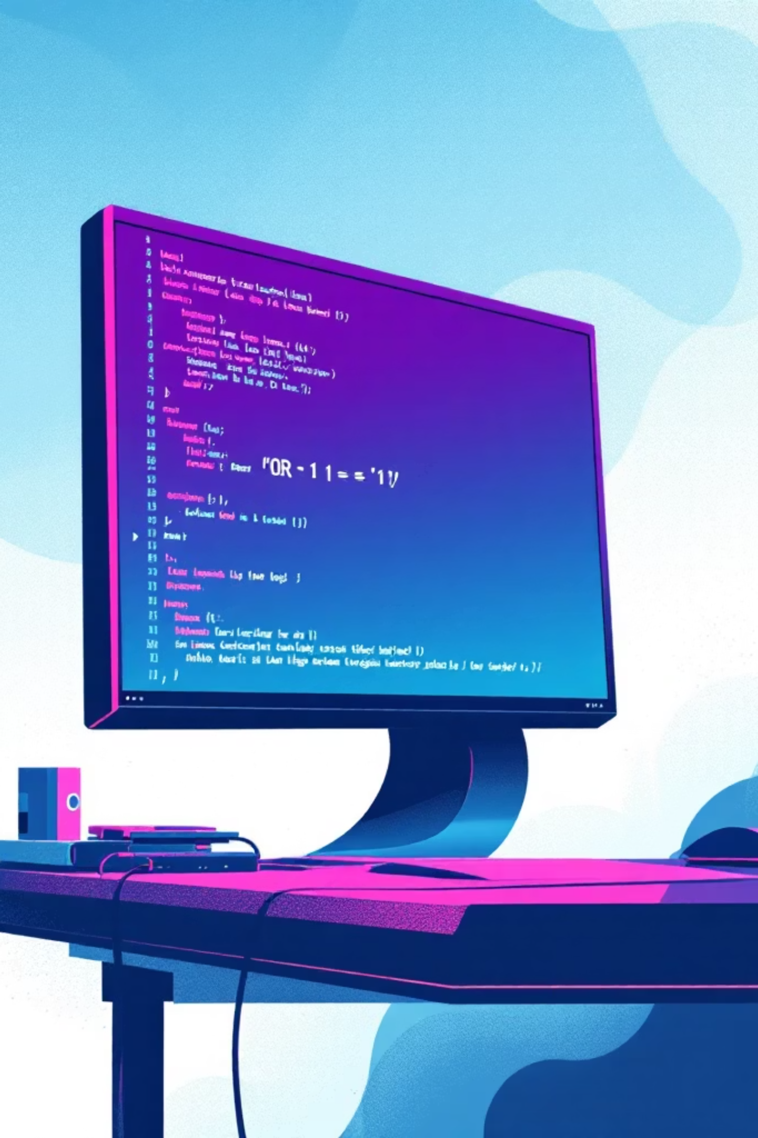
Breach Timeline (Condensed)
01
02
Recon
Exploit
Attacker probes inputs and error messages
Payload injected into search parameter
03
Extraction
Automated data dump of customer records

Slide 4
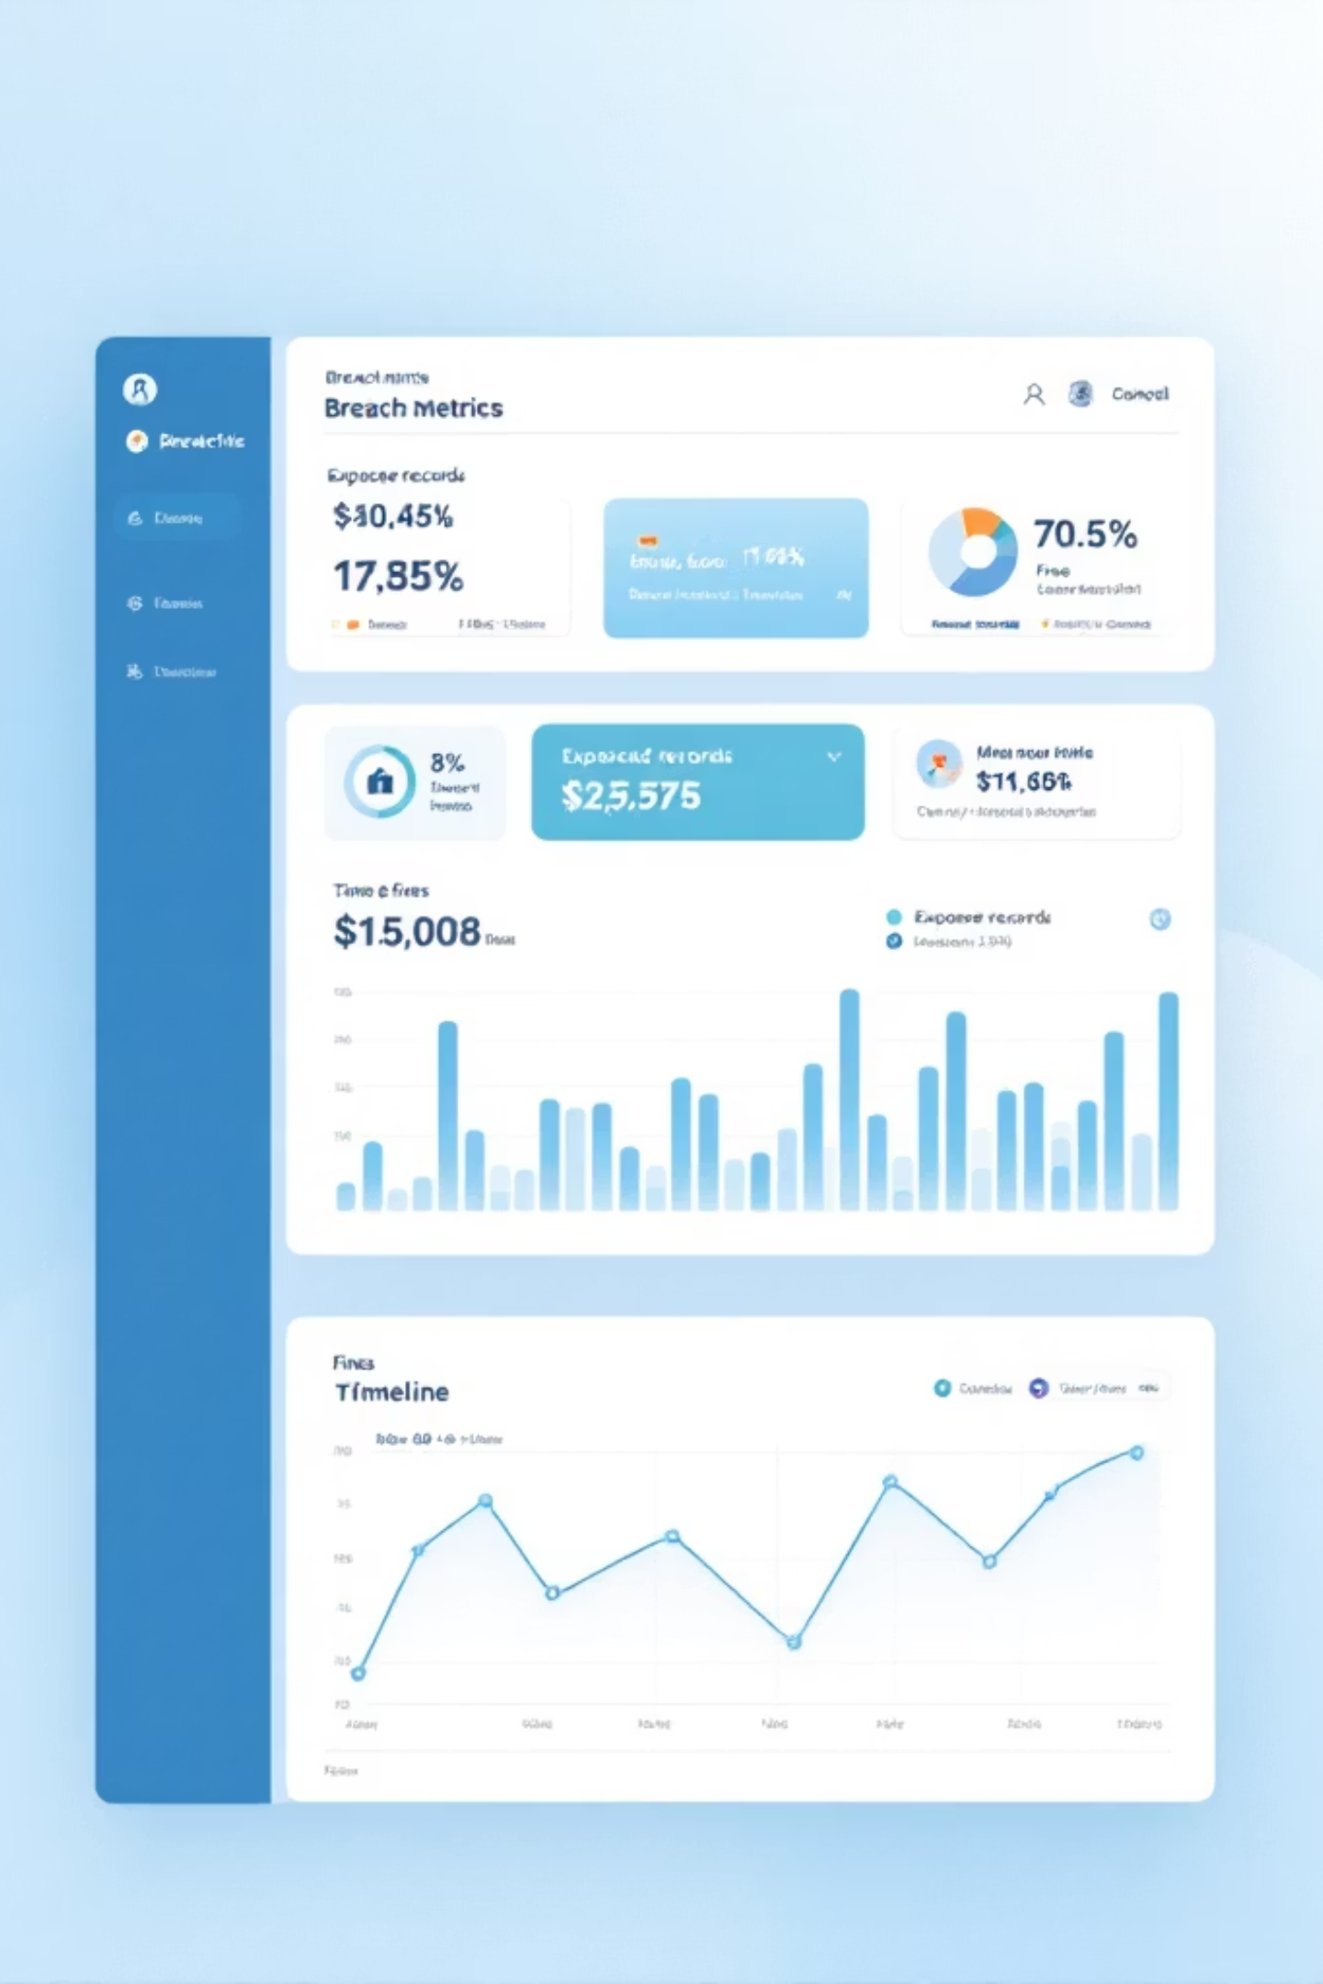
Impact at a Glance
1.2M
$4.5M
Years
Records Exposed
Regulatory Fines (approx)
Reputation Recovery Time
Multi-year brand and revenue impact

Slide 5
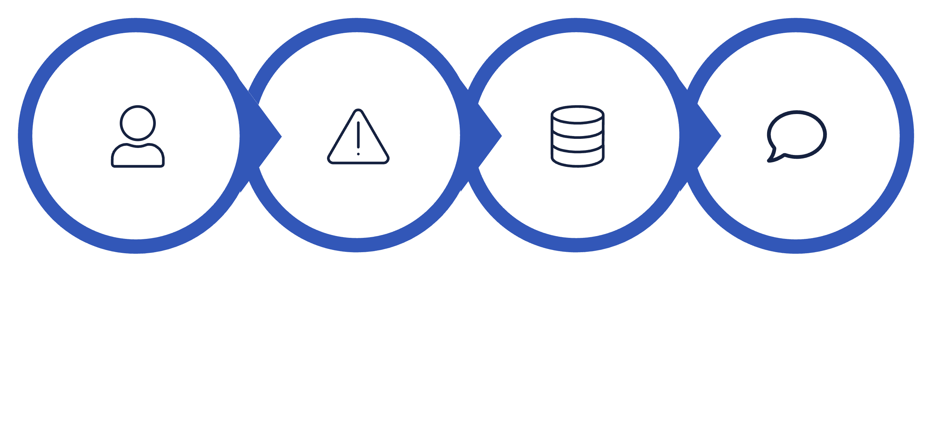




Unsanitized Input
Concatenated SQL
Data Exfiltration
User Input
How one unsanitized request escalated into full data exfiltration

Slide 6
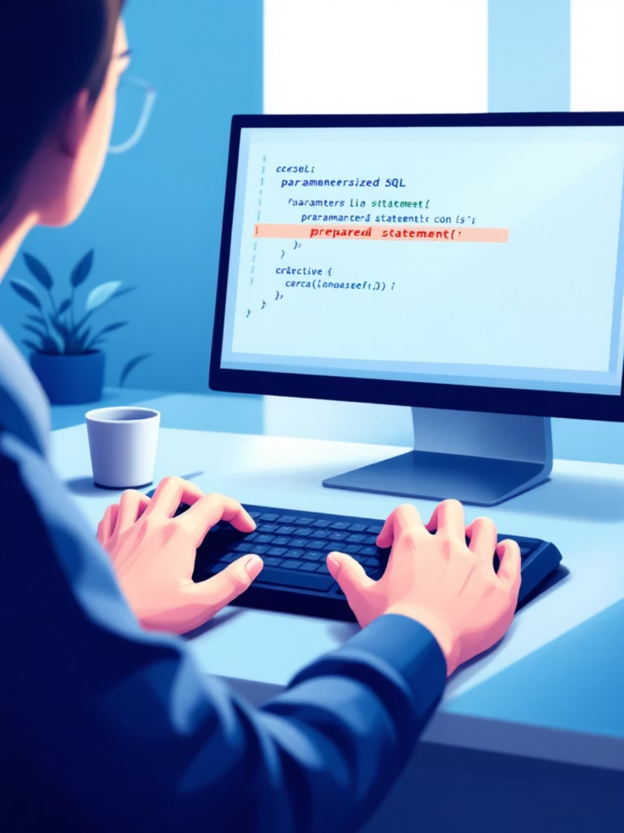
Defenses — Code Level
Parameterized queries / Prepared Statements
Use ORM safely; avoid raw SQL
Input validation: whitelist over blacklist
Escape outputs where appropriate

Slide 7

Defenses — Testing & Monitoring
Regular Pen Tests
Scheduled and after major releases
Runtime Monitoring
WAF + anomaly detection for suspicious queries
Error Hardening
Hide stack traces and DB errors from users

Slide 8

What Interviewers Expect
Explain SQLi vectors and mitigation succinctly
Show hands-on proof: exploit demo + fix
Mention secure design: least privilege, parameterization
Reference OWASP Top 10 and testing methodology

Slide 9

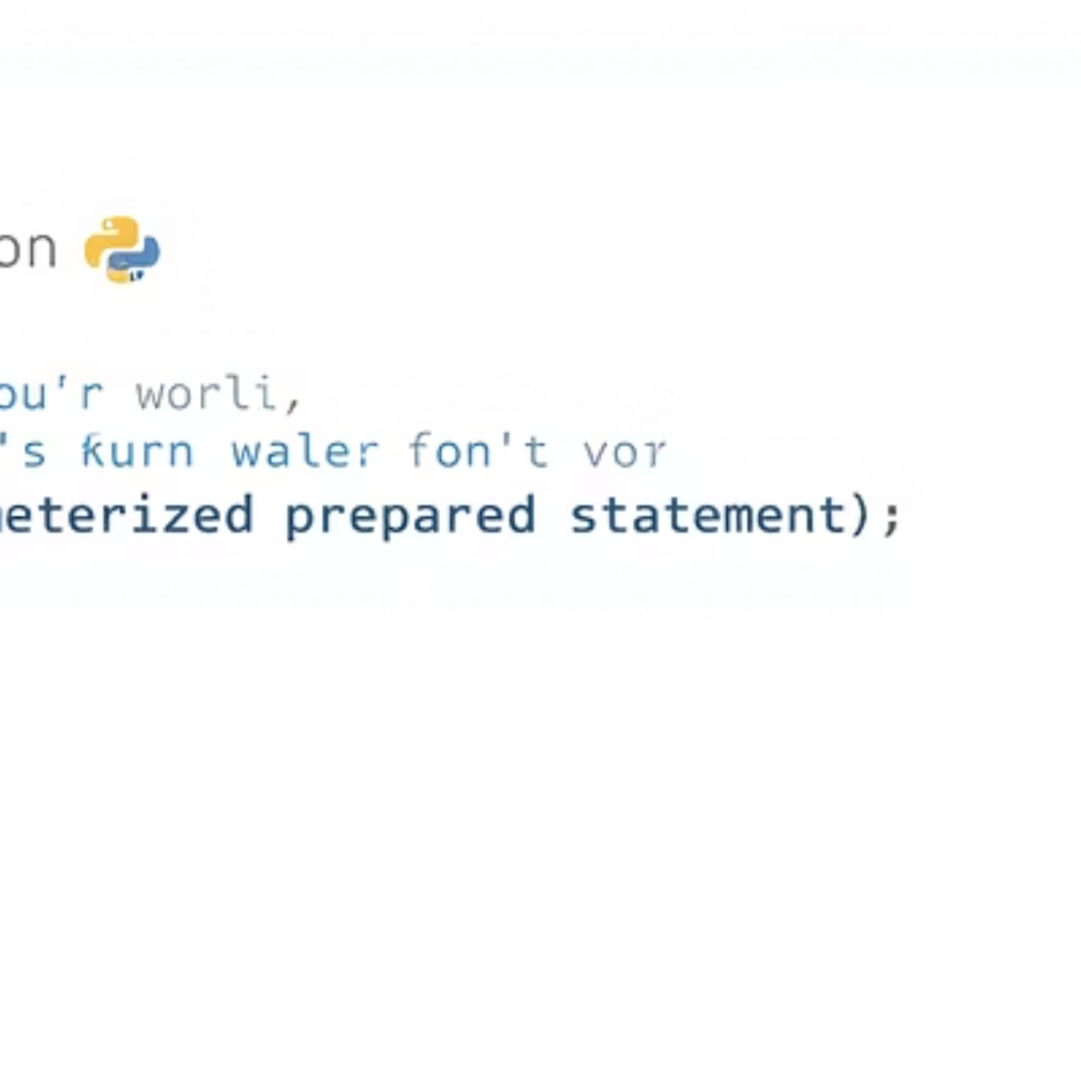
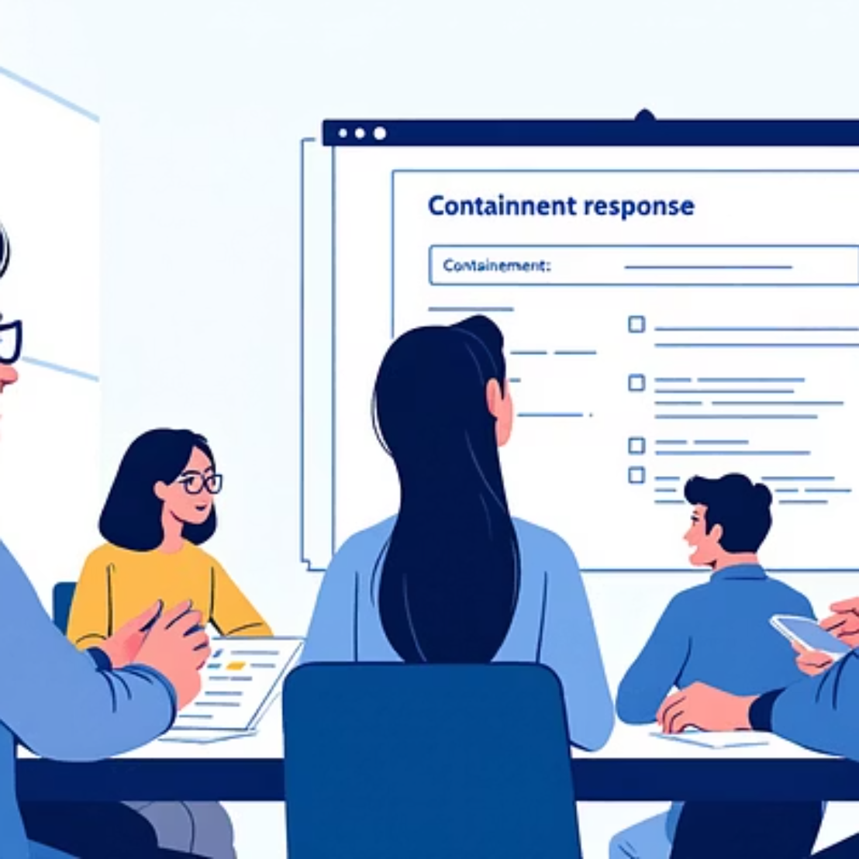
Practical Artifacts to Include
Demo code, pentest notes, remediation plan — concise and reproducible

Slide 10

Key Takeaways & Next Steps
Prevention First
Test Often
Parameterize + validate inputs
Automated + manual pentesting
Prepare to Explain
Include demo, fix, and impact in interviews
Use this case to build interview stories and lab exercises. Theme color: #3257b8ff

