Slide 1

Mishandling of Exceptional Conditions
Definition: Mishandling of Exceptional Conditions occurs when an application encounters an unexpected error and responds in a way that reveals sensitive debugging information, leaks system state, or crashes into an insecure "fail-open" state.

Slide 2
Common Causes
Verbose Error Messages
Fail-Open Design
Uncaught Exceptions
Displaying full stack traces, database connection strings, or internal file paths directly to the end-user.
When an error occurs during an authentication or authorization check, the system defaults to "allow" instead of "deny."
Allowing the underlying framework (like Java, .NET, or Node.js) to handle the error, which often reveals the specific version of the software being used.
Inconsistent Error Responses
Resource Exhaustion via Errors
Providing different errors for "User not found" vs. "Incorrect password," which allows for username enumeration.
Failing to release memory or file handles when an exception is thrown, leading to a Denial of Service (DoS).

Slide 3

Impact
Information Leakage
Attackers gain a "blueprint" of your environment, including database names, API keys, or logic vulnerabilities.
Privilege Escalation
If a security check fails and the system "fails-open," an unauthorised user may gain administrative access.
System Downtime
Poorly handled exceptions can cause the entire application to crash or enter an infinite loop.
Targeted Attacks
Detailed version info in errors allows attackers to search for specific, unpatched CVEs for your exact software stack.

Slide 4
Preventive Measures
1
Generic Error Messages
Always show the user a friendly, non-technical message (e.g., "An unexpected error occurred. Please try again later.") while logging the technical details privately.
2
Fail-Closed Logic
Ensure that if a security-critical function fails, the default action is to revoke access and log the event.
3
Global Exception Handlers
Use a centralised "catch-all" block to prevent unhandled exceptions from reaching the browser.
4
Sanitise Logs
Ensure that even though logs are technical, they do not store sensitive data like passwords or PII (Personally Identifiable Information).
5
Custom Error Pages
Configure your web server (NGINX, IIS, Apache) to show custom 404/500 pages rather than the default server banners.

Slide 5

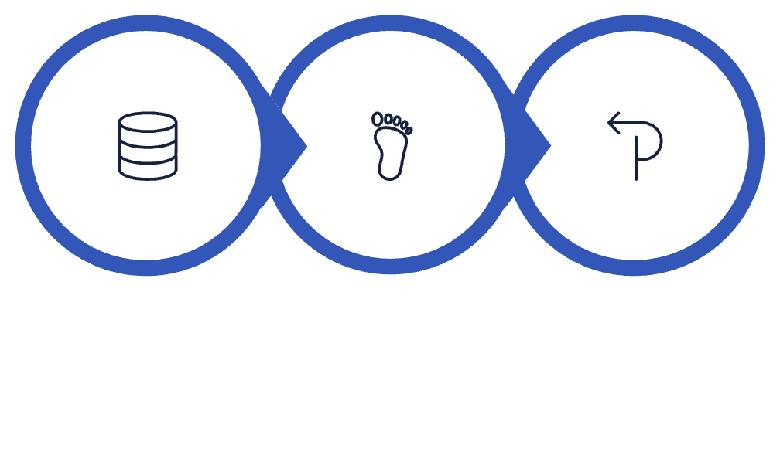



Real-World Case Study: The "Stack Trace" Map
The Incident
The Failure
The Result
The Incident
The Failure
A mid-sized fintech platform failed to handle a database timeout exception during a routine maintenance window.
When the database went offline, the login page displayed a full Java stack trace to any visitor. This trace included the database internal IP address, the schema name, and the specific SQL library version being used.
The Result
An attacker used the library version info to find a known remote code execution (RCE) vulnerability. By the time the database was back online, the attacker had already established a reverse shell using the information gathered from the error message.

