Slide 1
Database Management Systems
By:
Dr. Neha Nandal
Computer Science and Engineering

Slide 2
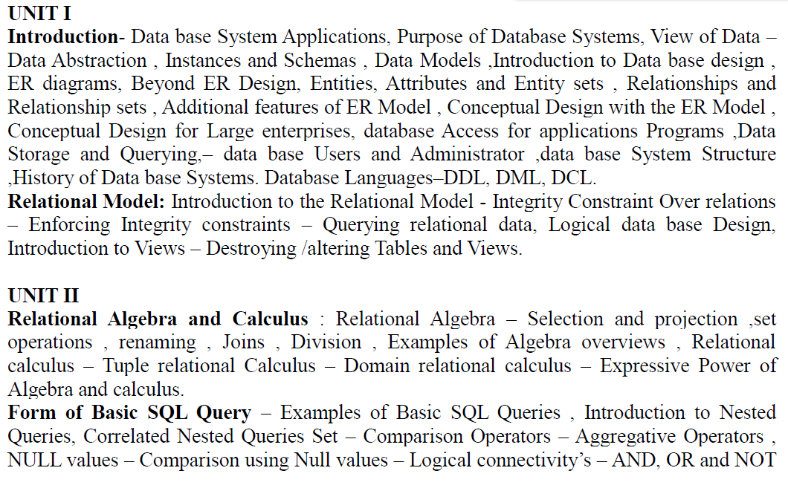
DATABASE MANAGEMENT SYSTEMS

Slide 3
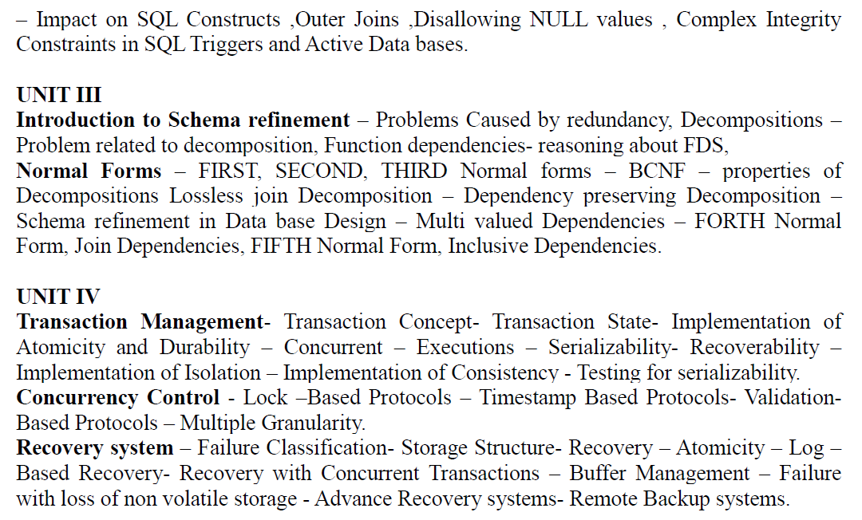
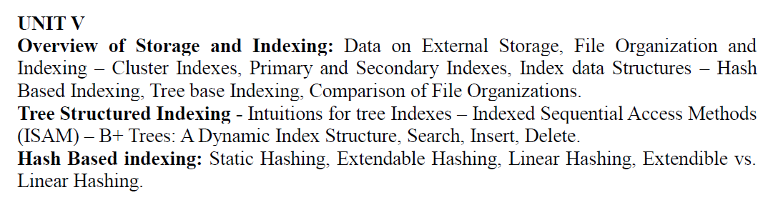

Slide 4
TEXT BOOKS:
1. Data base System Concepts, Silberschatz, Korth, McGraw hill, Sixth Edition.(All UNITS except III th)
2. Data base Management Systems, Raghurama Krishnan, Johannes Gehrke, TATA McGrawHill 3rd Edition.

Slide 5
Unit 4:
What is a Transaction?
A transaction is an event which occurs on the database. Generally a transaction reads a value from the database or writes a value to the database.
Although a transaction can both read and write on the database, there are some fundamental differences between these two classes of operations. A read operation does not change the image of the database in any way. But a write operation, whether performed with the intention of inserting, updating or deleting data from the database, changes the image of the database.
These transactions bring the database from an image which existed before the transaction occurred (called the Before Image or BFIM) to an image which exists after the transaction occurred (called the After Image or AFIM).

Slide 6
Four Properties of Transactions
Every transaction, for whatever purpose it is being used, has the following four properties. Taking the initial letters of these four properties we collectively call them the ACID Properties. Here we try to describe them and explain them.
Atomicity: This means that either all of the instructions within the transaction will be reflected in the database, or none of them will be reflected.
Say for example, we have two accounts A and B, each containing Rs 1000/-.
We now start a transaction to deposit Rs 100/- from account A to Account B.
Read A;
A = A – 100;
Write A;
Read B;
B = B + 100;
Write B;

Slide 7
The transaction has 6 instructions to extract the amount from A and submit it to B. The AFIM will show Rs 900/- in A and Rs 1100/- in B.
Now, suppose there is a power failure just after instruction 3 (Write A) has been complete. What happens now? After the system recovers the AFIM will show Rs 900/- in A, but the same Rs 1000/- in B. It would be said that Rs 100/- evaporated in thin air for the power failure. Clearly such a situation is not acceptable.

Slide 8
The solution is to keep every value calculated by the instruction of the transaction not in any stable storage (hard disc) but in a volatile storage (RAM), until the transaction completes its last
instruction. When we see that there has not been any error we do something known as a COMMIT operation. Its job is to write every temporarily calculated value from the volatile storage on to the stable storage. In this way, even if power fails at instruction 3, the post recovery image of the database will show accounts A and B both containing Rs 1000/-, as if the failed transaction had never occurred.

Slide 9
Consistency:
If we execute a particular transaction in isolation or together with other transaction, (i.e. presumably in a multi-programming environment), the transaction will yield the same expected result.
To give better performance, every database management system supports the execution of multiple transactions at the same time, using CPU Time Sharing. Concurrently executing transactions may have to deal with the problem of sharable resources, i.e. resources that multiple transactions are trying to read/write at the same time.
For example, we may have a table or a record on which two transaction are trying to read or write at the same time. Careful mechanisms are created in order to prevent mismanagement of these sharable resources, so that there should not be any change in the way a transaction performs. A transaction which deposits Rs 100/- to account A must deposit the same amount whether it is acting alone or in conjunction with another transaction that may be trying to deposit or withdraw some amount at the same time.

Slide 10
Isolation: In case multiple transactions are executing concurrently and trying to access a sharable resource at the same time, the system should create an ordering in their execution so that they should not create any anomaly in the value stored at the sharable resource.
There are several ways to achieve this and the most popular one is using some kind of locking mechanism. Again, if you have the concept of Operating Systems, then you should remember the semaphores, how it is used by a process to make a resource busy before starting to use it, and how it is used to release the resource after the usage is over. Other processes intending to access that same resource must wait during this time. Locking is almost similar. It states that a transaction must first lock the data item that it wishes to access, and release the lock when the accessing is no longer required. Once a transaction locks the data item, other transactions wishing to access the same data item must wait until the lock is released.

Slide 11
Durability: It states that once a transaction has been complete the changes it has made should be permanent. As we have seen in the explanation of the Atomicity property, the transaction, if completes successfully, is committed.
Once the COMMIT is done, the changes which the transaction has made to the database are immediately written into permanent storage.
So, after the transaction has been committed successfully, there is no question of any loss of information even if the power fails. Committing a transaction guarantees that the AFIM has been reached. There are several ways Atomicity and Durability can be implemented. One of them is called Shadow Copy. In this scheme a database pointer is used to point to the BFIM of the database. During the transaction, all the temporary changes are recorded into a Shadow Copy, which is an exact copy of the original database plus the changes made by the transaction, which is the AFIM. Now, if the transaction is required to COMMIT, then the database pointer is updated to point to the AFIM copy, and the BFIM copy is discarded. On the other hand, if the transaction is not committed, then the database pointer is not updated. It keeps pointing to the BFIM, and the AFIM is discarded. This is a simple scheme, but takes a lot of memory space and time to implement. If you study carefully, you can understand that Atomicity and Durability is essentially the same thing, just as Consistency and Isolation is essentially the same thing.

Slide 12
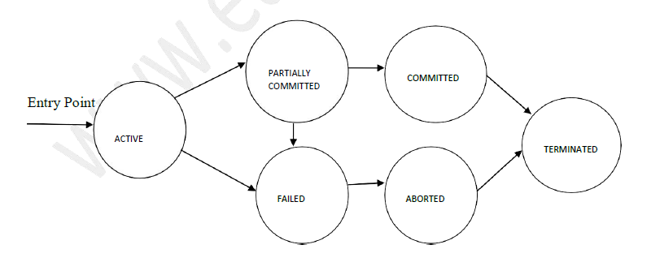
Transaction States

Slide 13
There are the following six states in which a transaction may exist:
Active: The initial state when the transaction has just started execution.
Partially Committed: At any given point of time if the transaction is executing properly, then it is going towards it COMMIT POINT. The values generated during the execution are all stored in volatile storage.
Failed: If the transaction fails for some reason. The temporary values are no longer required, and the transaction is set to ROLLBACK. It means that any change made to the database by this transaction up to the point of the failure must be undone. If the failed transaction has withdrawn Rs. 100/- from account A, then the ROLLBACK operation should add Rs 100/- to account A.

Slide 14
Aborted: When the ROLLBACK operation is over, the database reaches the BFIM. The
transaction is now said to have been aborted.
Committed: If no failure occurs then the transaction reaches the COMMIT POINT. All the temporary values are written to the stable storage and the transaction is said to have been committed.
Terminated: Either committed or aborted, the transaction finally reaches this state.

Slide 15
Concurrent Execution
A schedule is a collection of many transactions which is implemented as a unit. Depending upon how these transactions are arranged in within a schedule, a schedule can be of two types:
Serial: The transactions are executed one after another, in a non-preemptive manner.
• Concurrent: The transactions are executed in a preemptive, time shared method.

Slide 16
In Serial schedule, there is no question of sharing a single data item among many transactions,
because not more than a single transaction is executing at any point of time. However, a serial
schedule is inefficient in the sense that the transactions suffer for having a longer waiting time and
response time, as well as low amount of resource utilization.
In concurrent schedule, CPU time is shared among two or more transactions in order to run them
concurrently. However, this creates the possibility that more than one transaction may need to access
a single data item for read/write purpose and the database could contain inconsistent value if such
accesses are not handled properly. Let us explain with the help of an example.

Slide 17
T1
Read A;
A = A – 100;
Write A;
Read B;
B = B + 100;
Write B;
T2
Read A;
Temp = A * 0.1;
Read C;
C = C + Temp;
Write C;
T2 is a new transaction which deposits to account C 10% of the amount in account A.
If we prepare a serial schedule, then either T1 will completely finish before T2 can begin, or T2 will
completely finish before T1 can begin.

Slide 18
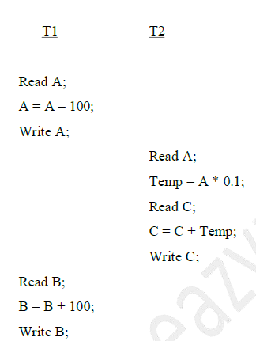
if we want to create a concurrent schedule, then some Context Switching need to be made, so that some portion of T1 will be executed, then some portion of T2 will be executed and so on. For example say we have prepared the following concurrent schedule.
We have made some Context Switching in this Schedule, the first one after executing the third instruction of T1, and after executing the last statement of T2. T1 first deducts Rs 100/- from A and writes the new value of Rs 900/- into A. T2 reads the value of A, calculates the value of Temp to be Rs 90/- and adds the value to C. The remaining part of T1 is executed and Rs
100/- is added to B.

Slide 19
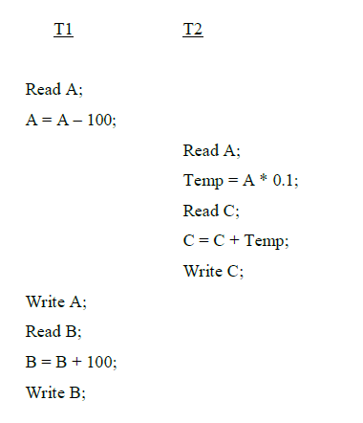
It is clear that a proper Context Switching is very important in order to maintain the Consistency and Isolation properties of the transactions. But let us take another example where a wrong Context Switching can bring about disaster. Consider the following example involving the same T1 and T2

Slide 20
This schedule is wrong, because we have made the switching at the second instruction of T1. The
result is very confusing. If we consider accounts A and B both containing Rs 1000/- each, then the
result of this schedule should have left Rs 900/- in A, Rs 1100/- in B and add Rs 90 in C (as C should
be increased by 10% of the amount in A). But in this wrong schedule, the Context Switching is being
performed before the new value of Rs 900/- has been updated in A. T2 reads the old value of A,
which is still Rs 1000/-, and deposits Rs 100/- in C. C makes an unjust gain of Rs 10/- out of
nowhere.
In the above example, we detected the error simple by examining the schedule and applying common
sense. But there must be some well formed rules regarding how to arrange instructions of the
transactions to create error free concurrent schedules. This brings us to our next topic, the concept of
Serializability.

Slide 21
Schedules
Schedule – a sequences of instructions that specify the
chronological order in which instructions of concurrent transactions
are executed
● A schedule for a set of transactions must consist of all
instructions of those transactions
● Must preserve the order in which the instructions appear in
each individual transaction.
■ A transaction that successfully completes its execution will have a
commit instructions as the last statement
● By default transaction assumed to execute commit instruction
as its last step
■ A transaction that fails to successfully complete its execution will
have an abort instruction as the last statement

Slide 22
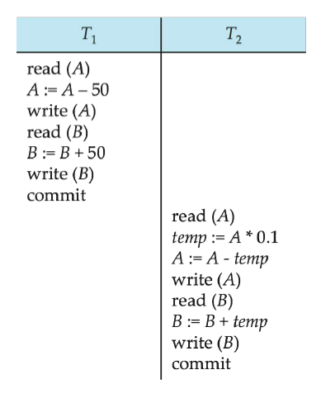
Schedule 1
■ Let T1 transfer $50 from A to B, and T2 transfer 10% of the balance from A to B. 
■ An example of a serial schedule in which T1 is followed by T2 : 

Slide 23
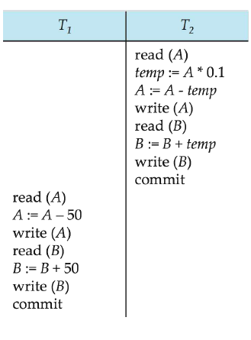
Schedule 2
■ A serial schedule in which T2 is followed by T1 : 

Slide 24
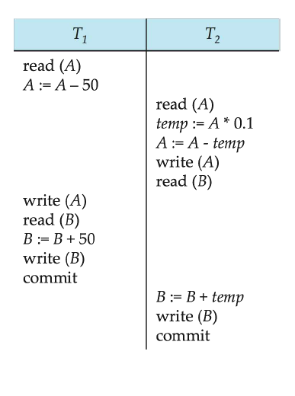
The following concurrent schedule does not preserve the sum of ―A + B‖ 

Slide 25
Serializability
■ Basic Assumption – Each transaction preserves database
consistency.
■ Thus, serial execution of a set of transactions preserves
database consistency.
■ A (possibly concurrent) schedule is serializable if it is
equivalent to a serial schedule. Different forms of schedule
equivalence give rise to the notions of:
1. conflict serializability
2. view serializability

Slide 26
We ignore operations other than read and write instructions
■ We assume that transactions may perform arbitrary
computations on data in local buffers in between reads and
writes.
■ Our simplified schedules consist of only read and write
instructions.

Slide 27
Conflicting Instructions
■ Let li and lj be two Instructions of transactions Ti and Tj
respectively. Instructions li and lj conflict if and only if there
exists some item Q accessed by both li and lj, and at least one of
these instructions wrote Q.
1. li = read(Q), lj = read(Q). li and lj don’t conflict.
2. li = read(Q), lj = write(Q). They conflict.
3. li = write(Q), lj = read(Q). They conflict
4. li = write(Q), lj = write(Q). They conflict
■ Intuitively, a conflict between li and lj forces a (logical) temporal
order between them.
● If li and lj are consecutive in a schedule and they do not
conflict, their results would remain the same even if they had
been interchanged in the schedule.

Slide 28
If a schedule S can be transformed into a schedule S´ by
a series of swaps of non-conflicting instructions, we say
that S and S´ are conflict equivalent. 
■ We say that a schedule S is conflict serializable if it is 
conflict equivalent to a serial schedule

Slide 29
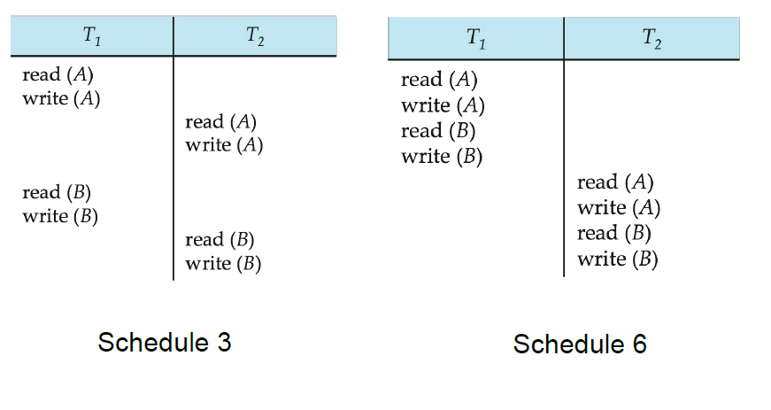
Schedule 3 can be transformed into Schedule 6 -- a serial schedule where
T2 follows T1, by a series of swaps of non-conflicting instructions.
Therefore, Schedule 3 is conflict serializable. 

Slide 30
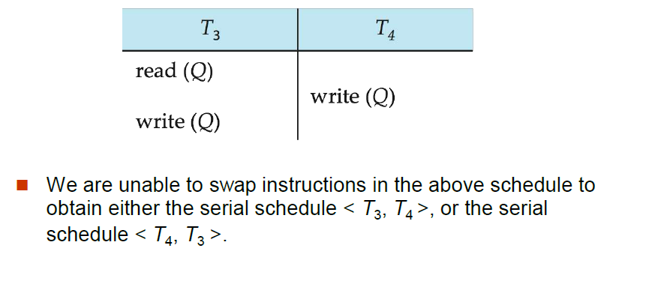
Example of a schedule that is not conflict serializable:

Slide 31
IMPLEMENTATION OF ATOMICITY AND DURABILITY USING SHADOW COPY
In the shadow-copy scheme, a transaction that wants to update the database first creates a complete copy of the database. All updates are done on the new database copy, leaving the original copy, the shadow copy, untouched. If at any point the transaction has to be aborted, the system merely deletes the new copy. The old copy of the database has not been affected.
This scheme is based on making copies of the database, called shadow copies, assumes that only one transaction is active at a time. The scheme also assumes that the database is simply a file on disk. A pointer called db-pointer is maintained on disk; it points to the current copy of the database.

Slide 32
If the transaction completes, it is committed as follows:
First, the operating system is asked to make sure that all pages of the new copy of the database have been written out to disk. (Unix systems use the flush command for this purpose.)
After the operating system has written all the pages to disk, the database system updates the pointer db-pointer to point to the new copy of the database; the new copy then becomes the current copy of the database. The old copy of the database is then deleted.

Slide 33
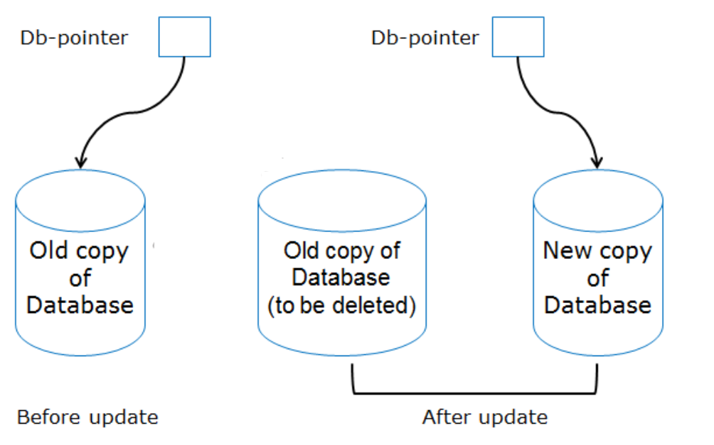
The transaction is said to have been committed at the point where the updated db pointer is written to disk.

Slide 34
How the technique handles transaction failures:
If the transaction fails at any time before db-pointer is updated, the old contents of the database are not affected.
We can abort the transaction by just deleting the new copy of the database.
Once the transaction has been committed, all the updates that it performed are in the database pointed to by db pointer.
Thus, either all updates of the transaction are reflected, or none of the effects are reflected, regardless of transaction failure.

Slide 35
How the technique handles system failures:
Suppose that the system fails at any time before the updated db-pointer is written to disk. Then, when the system restarts, it will read db-pointer and will thus see the original contents of the database, and none of the effects of the transaction will be visible on the database.
Next, suppose that the system fails after db-pointer has been updated on disk. Before the pointer is updated, all updated pages of the new copy of the database were written to disk.
Again, we assume that, once a file is written to disk, its contents will not be damaged even if there is a system failure. Therefore, when the system restarts, it will read db-pointer and will thus see the contents of the database after all the updates performed by the transaction.

Slide 36
TCL Commands in SQL
Here are code snippets and their corresponding outputs for TCL commands:
SQL Command | Code Snippet | Output
COMMIT | BEGIN; -- SQL statements COMMIT; | Changes made in the transaction saved permanently.
ROLLBACK | BEGIN; -- SQL statements ROLLBACK; | Changes made in the transaction rolled back.
SAVEPOINT | BEGIN; -- SQL statements SAVEPOINT my_savepoint; -- More SQL statements ROLLBACK TO my_savepoint; | Savepoint created and later used to roll back to a specific point in the transaction.

Slide 37
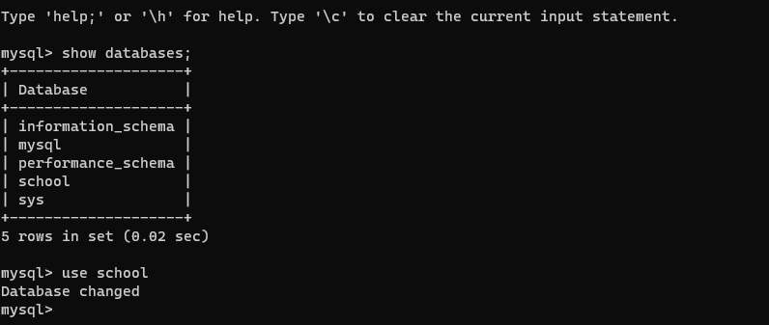

Slide 38
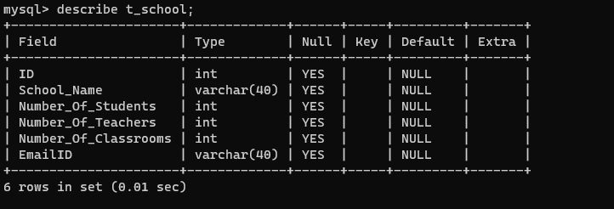

Slide 39
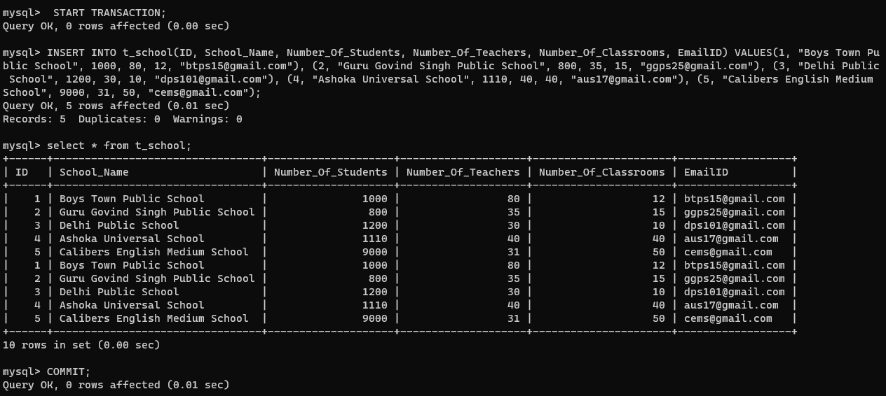

Slide 40

MySQL, by default, commits every query the user executes. But if the user wishes to commit only the specific queries instead of committing every query, then turning off the auto commit is useful.

Slide 41
2. SAVEPOINT
We can divide the database operations into parts. For example, we can consider all the insert related queries that we will execute consecutively as one part of the transaction and the delete command as the other part of the transaction. Using the SAVEPOINT command in SQL, we can save these different parts of the same transaction using different names. For example, we can save all the insert related queries with the savepoint named INS. To save all the insert related queries in one savepoint, we have to execute the SAVEPOINT query followed by the savepoint name after finishing the insert command execution.

Slide 42
3. ROLLBACK
While carrying a transaction, we must create savepoints to save different parts of the transaction. According to the user's changing requirements, he/she can roll back the transaction to different savepoints. Consider a scenario: We have initiated a transaction followed by the table creation and record insertion into the table. After inserting records, we have created a savepoint INS. Then we executed a delete query, but later we thought that mistakenly we had removed the useful record. Therefore in such situations, we have an option of rolling back our transaction. In this case, we have to roll back our transaction using the ROLLBACK command to the savepoint INS, which we have created before executing the DELETE query.

Slide 43
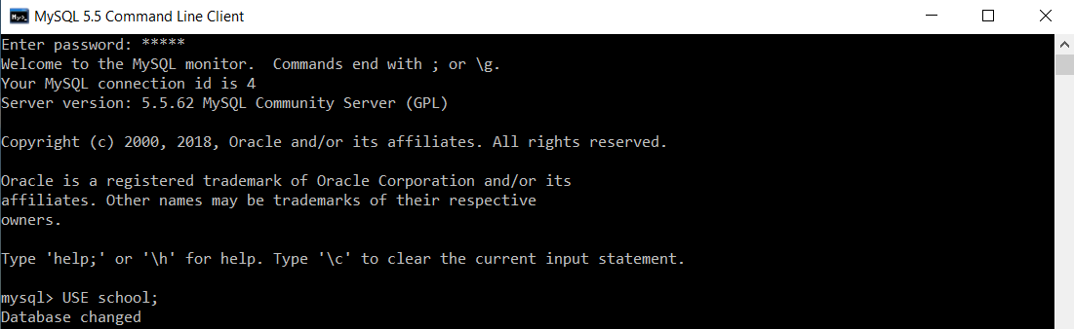

Slide 44
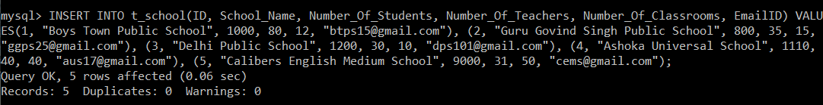





mysql> SELECT *FROM t_school;

Slide 45
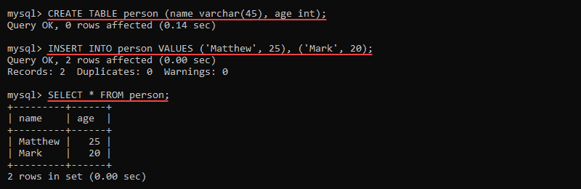
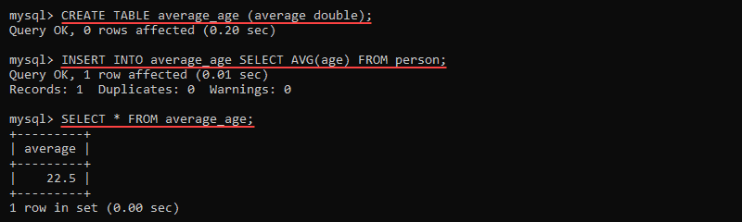
TRIGGERS

Slide 46
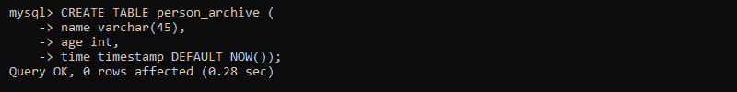
delimiter //
CREATE TRIGGER person_bi BEFORE INSERT
ON person
FOR EACH ROW
IF NEW.age < 18 THEN
SIGNAL SQLSTATE '50001' SET MESSAGE_TEXT = 'Person must be older than 18.';
END IF; //
delimiter ;

Slide 47
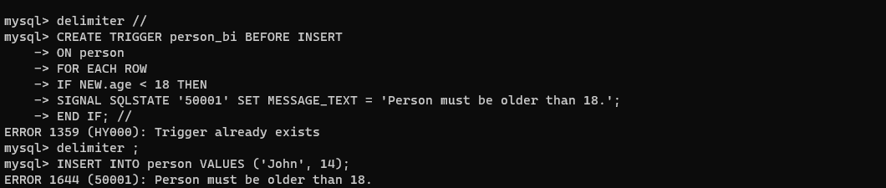

Slide 48
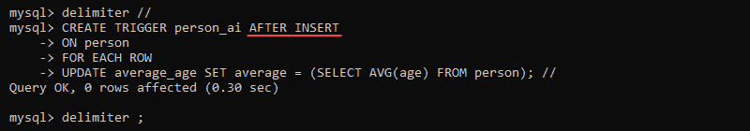
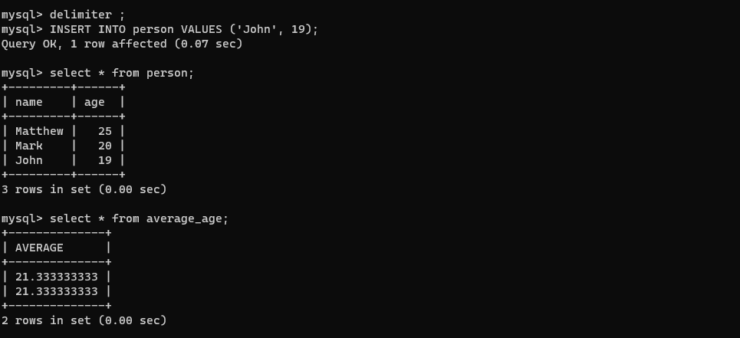

Slide 49
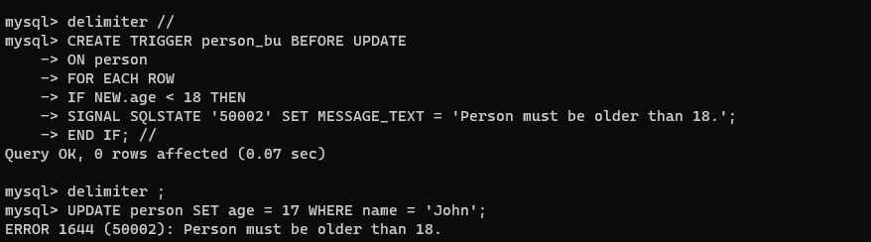

Slide 50
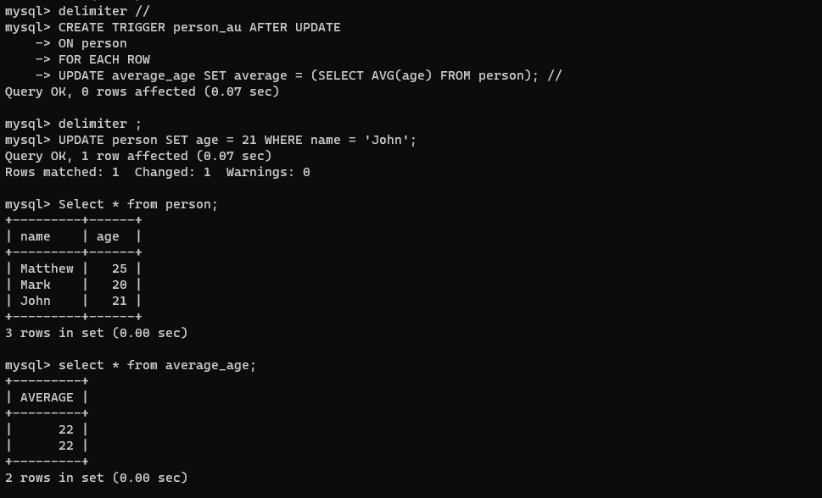

Slide 51
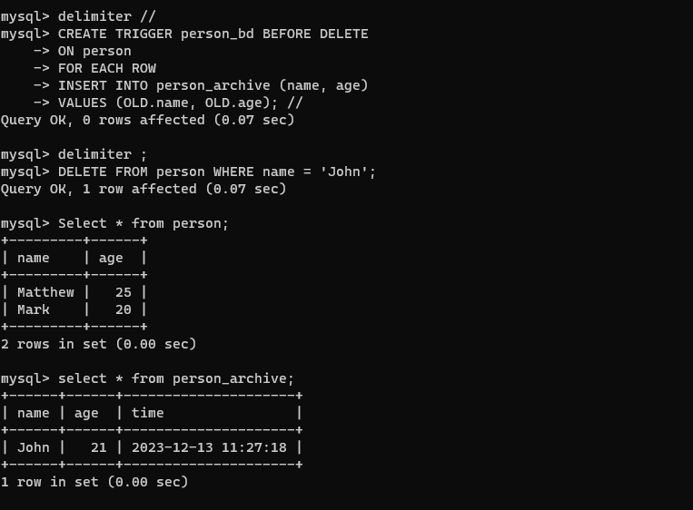

Slide 52
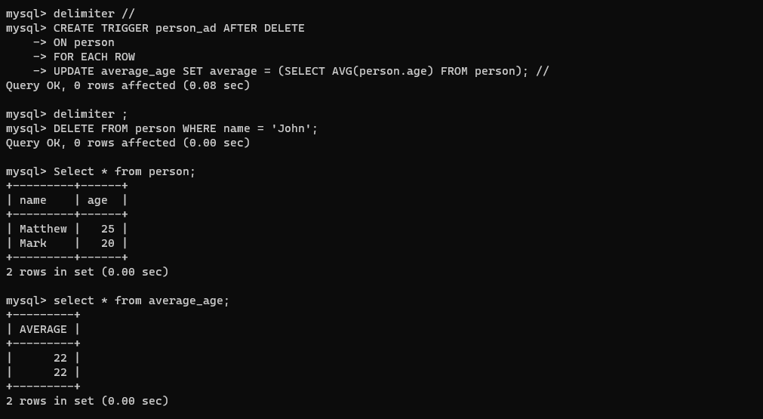

Slide 53
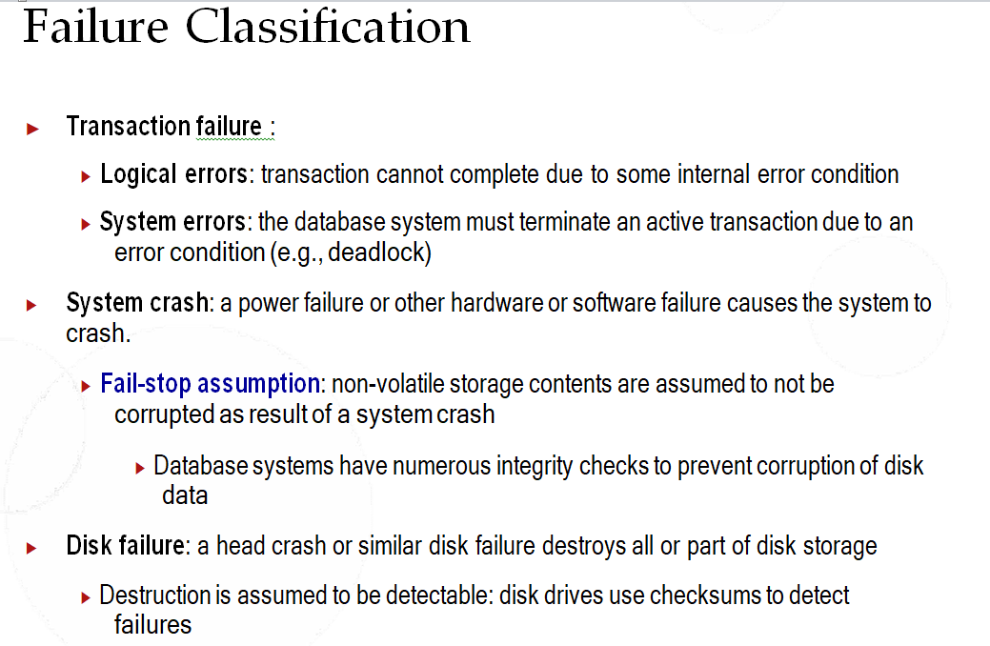

Slide 54
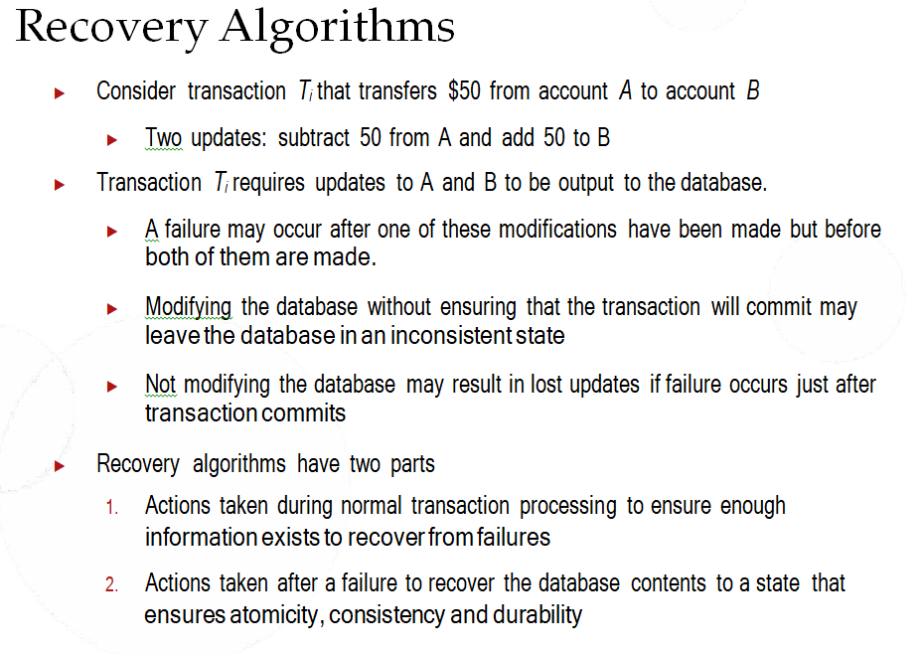

Slide 55
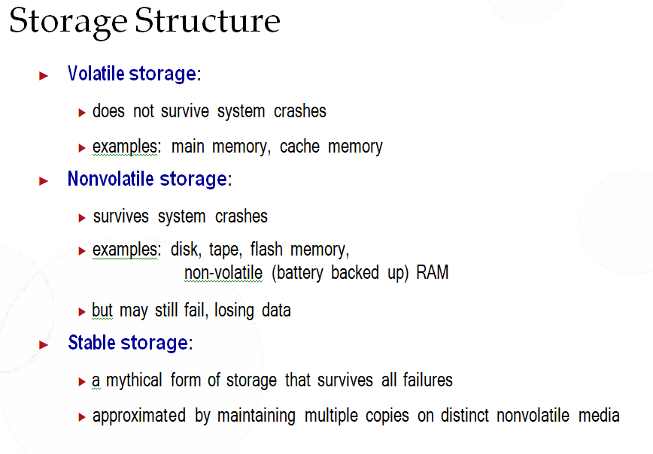

Slide 56
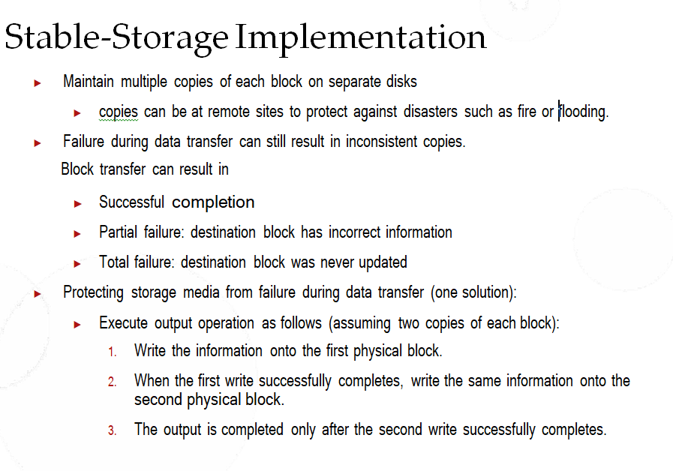

Slide 57
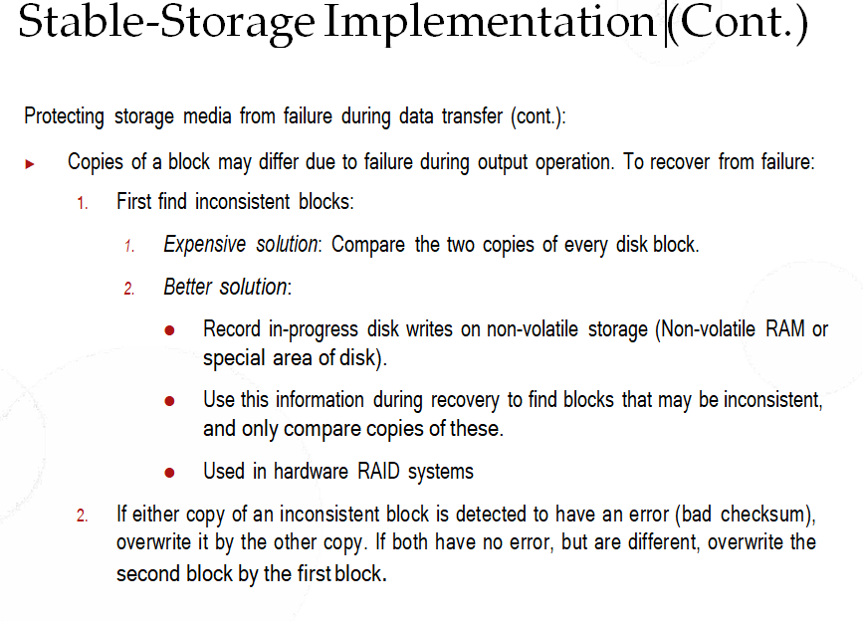

Slide 58
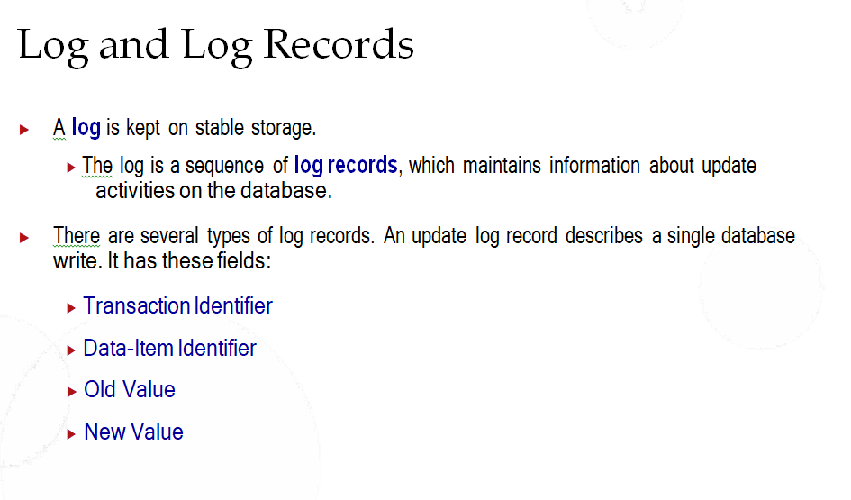

Slide 59
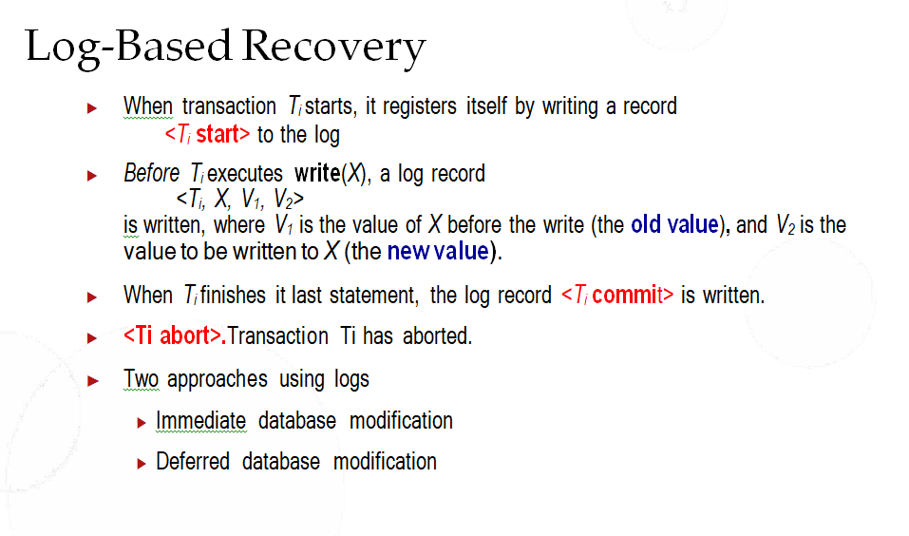

Slide 60
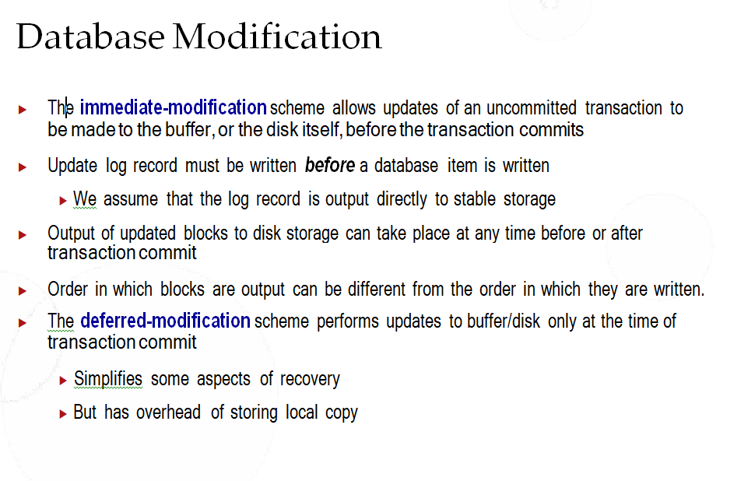

Slide 61
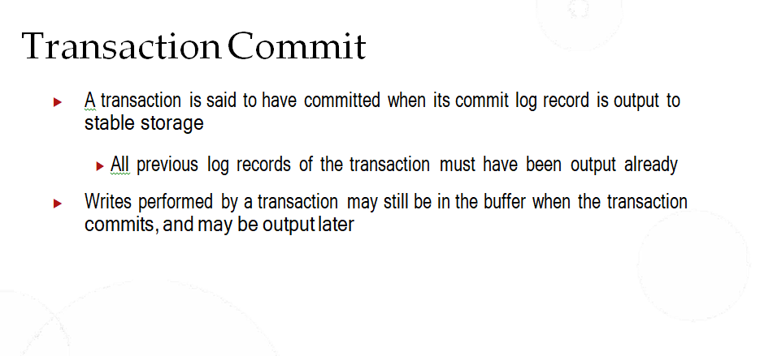

Slide 62
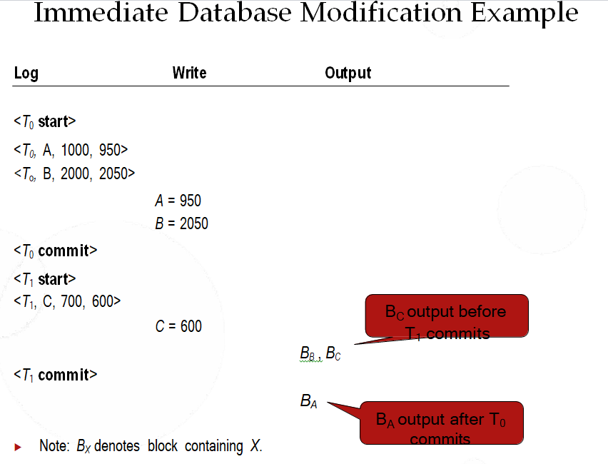

Slide 63
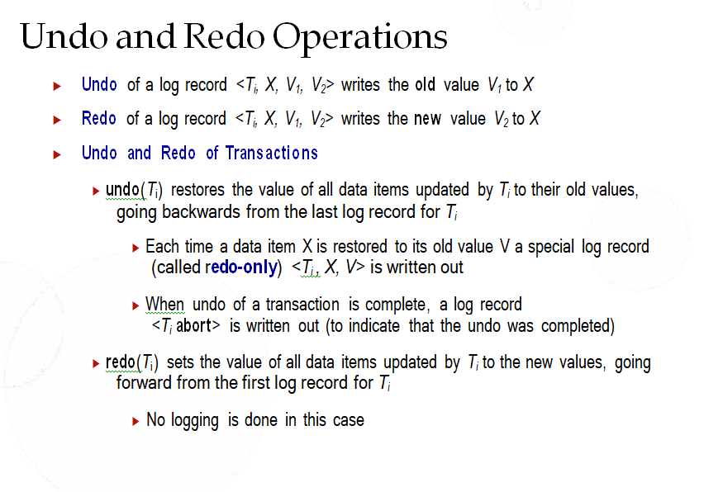

Slide 64
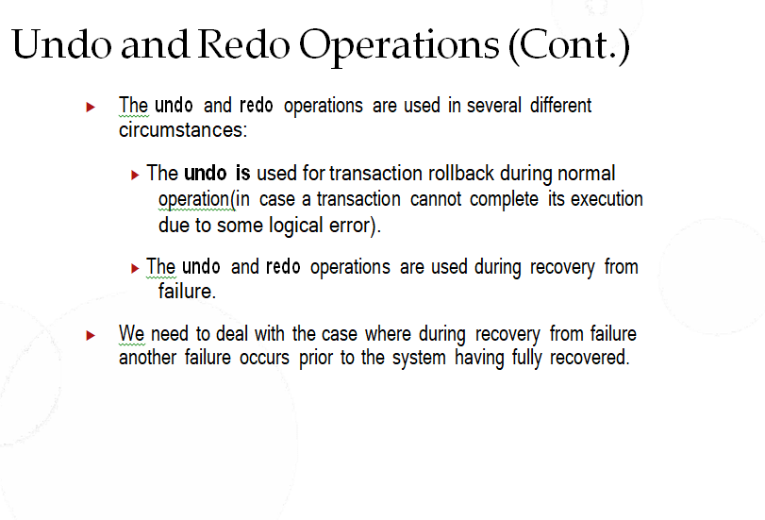

Slide 65
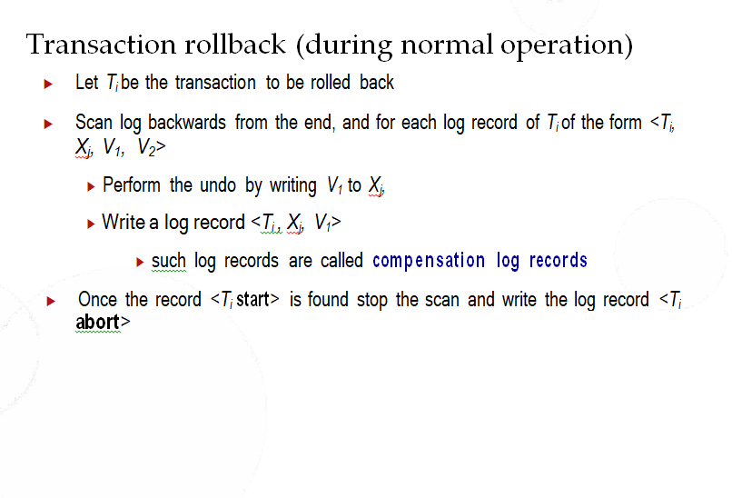

Slide 66
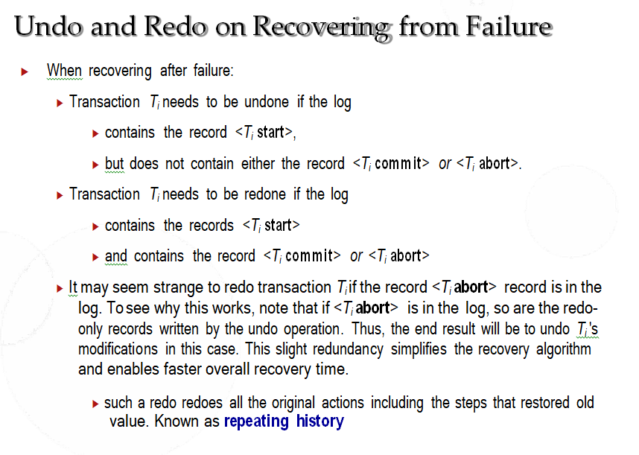

Slide 67
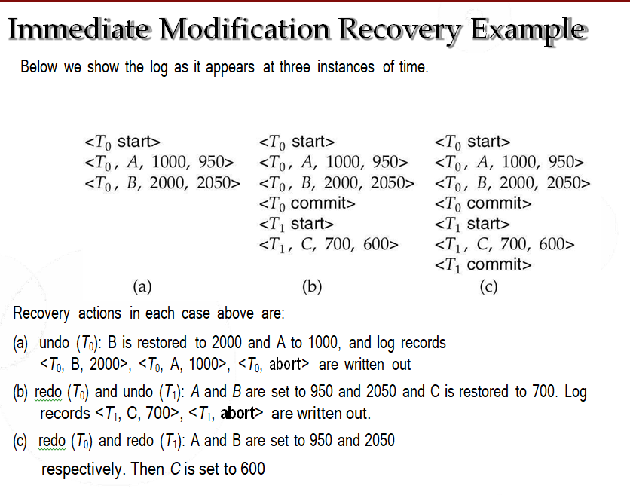

Slide 68
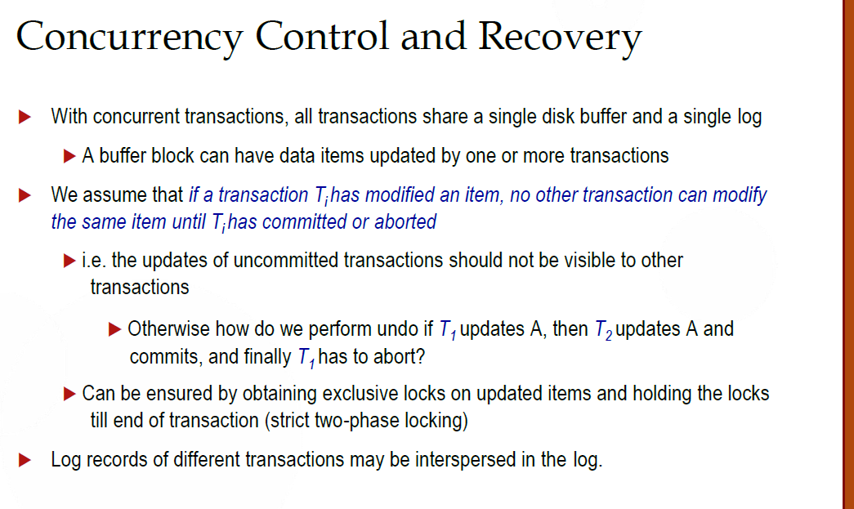

Slide 69
During recovery, it would be very difficult for the recovery system to backtrack all the logs and then start recovering.
Recovery with concurrent transactions can be done in the following four ways.
Interaction with concurrency control
Transaction rollback
Checkpoints
Restart recovery
1. Interaction with concurrency control :
In this scheme, the recovery scheme depends greatly on the concurrency control scheme that is used. So, to rollback a failed transaction, we must undo the updates performed by the transaction.
2. Transaction rollback :
In this scheme, we rollback a failed transaction by using the log.
The system scans the log backward a failed transaction, for every log record found in the log the system restores the data item.

Slide 70
3. Checkpoints :
Checkpoints is a process of saving a snapshot of the applications state so that it can restart from that point in case of failure.
Checkpoint is a point of time at which a record is written onto the database form the buffers.
Checkpoint shortens the recovery process.
When it reaches the checkpoint, then the transaction will be updated into the database, and till that point, the entire log file will be removed from the file. Then the log file is updated with the new step of transaction till the next checkpoint and so on.
The checkpoint is used to declare the point before which the DBMS was in the consistent state, and all the transactions were committed.
To ease this situation, ‘Checkpoints‘ Concept is used by the most DBMS.
In this scheme, we used checkpoints to reduce the number of log records that the system must scan when it recovers from a crash.
In a concurrent transaction processing system, we require that the checkpoint log record be of the form <checkpoint L>, where ‘L’ is a list of transactions active at the time of the checkpoint.
A fuzzy checkpoint is a checkpoint where transactions are allowed to perform updates even while buffer blocks are being written out.

Slide 71
4. Restart recovery :
When the system recovers from a crash, it constructs two lists.
The undo-list consists of transactions to be undone, and the redo-list consists of transaction to be redone.
The system constructs the two lists as follows:
Initially, they are both empty.
The system scans the log backward, examining each record, until it finds the first <checkpoint> record.

Slide 72
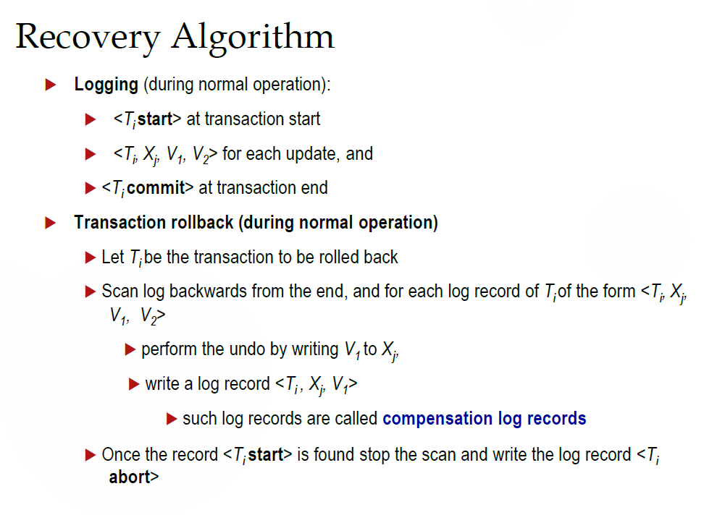

Slide 73
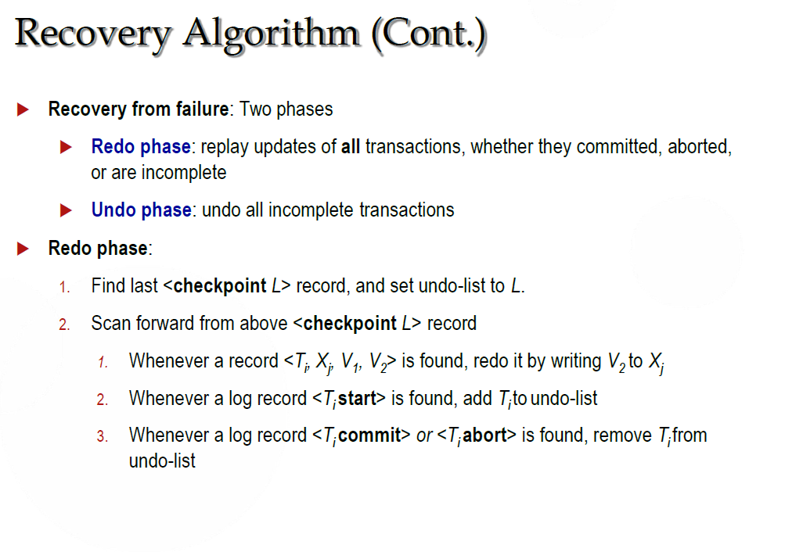

Slide 74
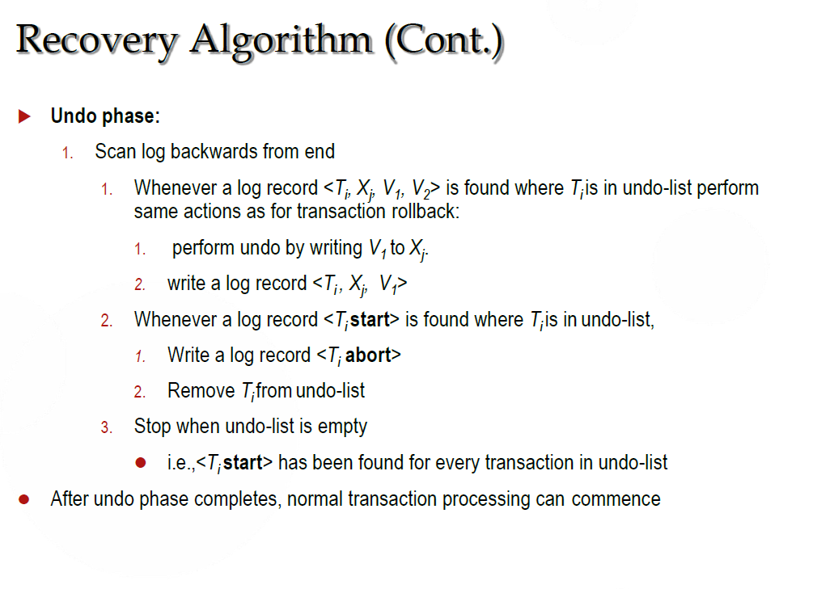

Slide 75
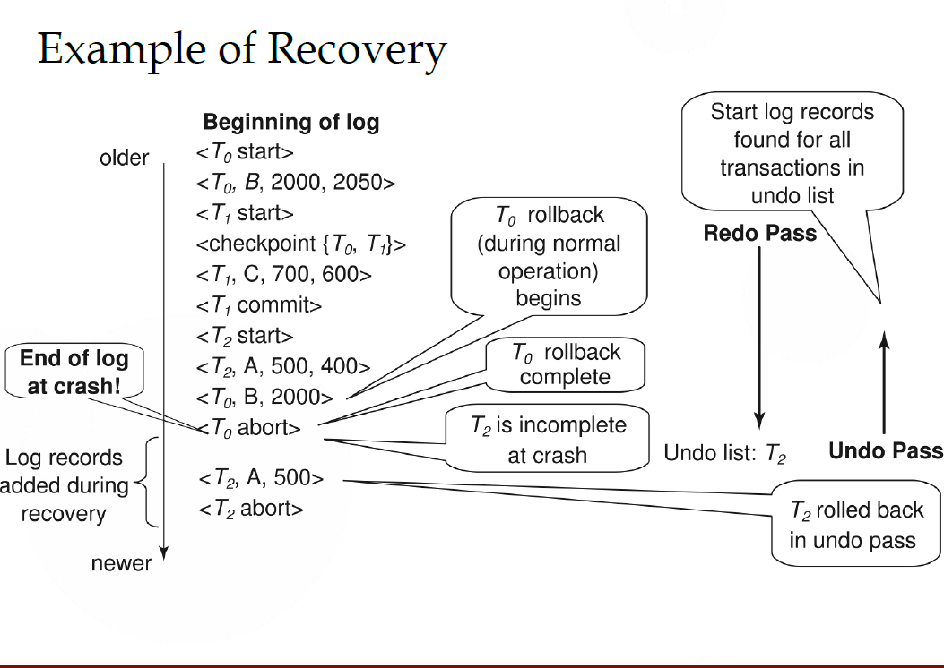

Slide 76
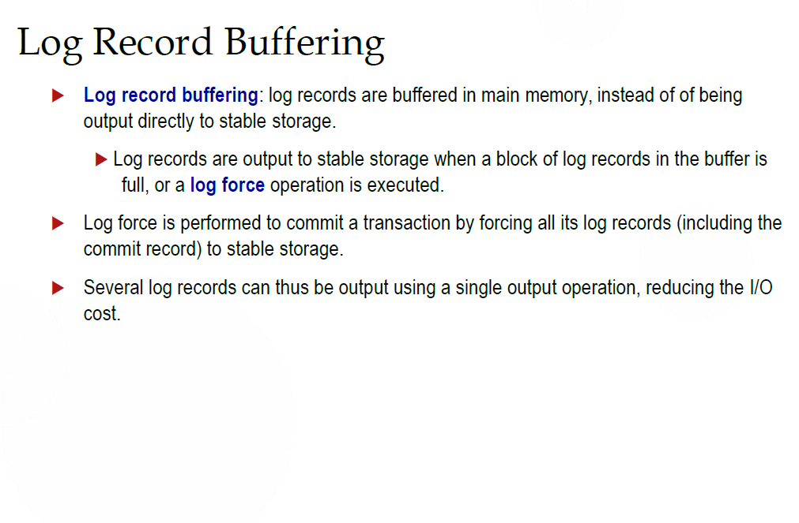

Slide 77
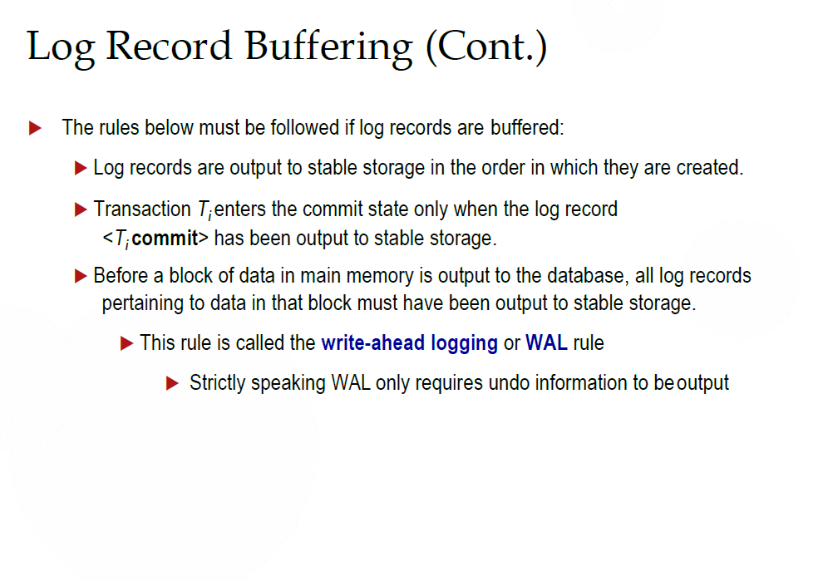

Slide 78
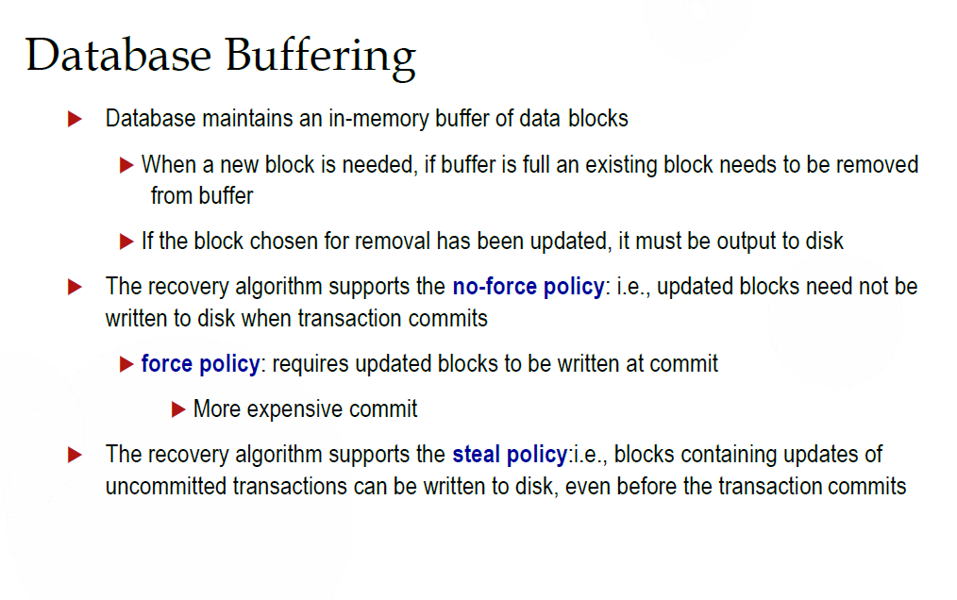

Slide 79


Slide 80


Slide 81


Slide 82


Slide 83


Slide 84
THANK YOU

