Slide 1
SPPM PERSONAL SOFTWARE PROCESS (PSP)
LIKE , COMMENT AND SUBSCRIBE ☺
BY: NEHA

Slide 2
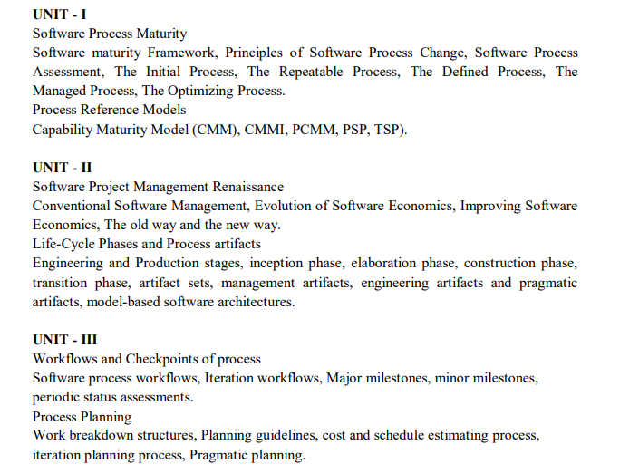

Slide 3
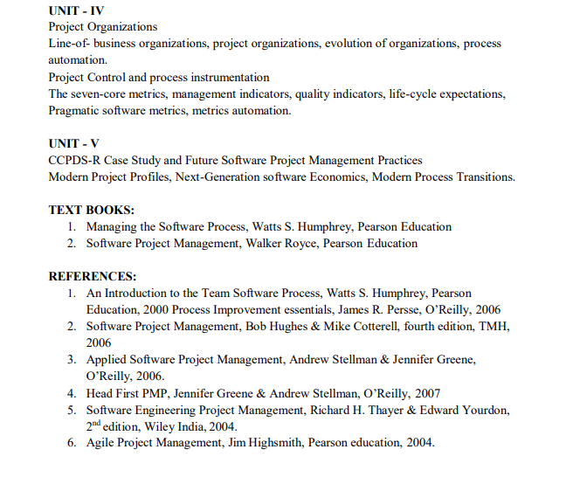
ANSWER
D. Agile planning places emphasis on planning and is iterative

Slide 4
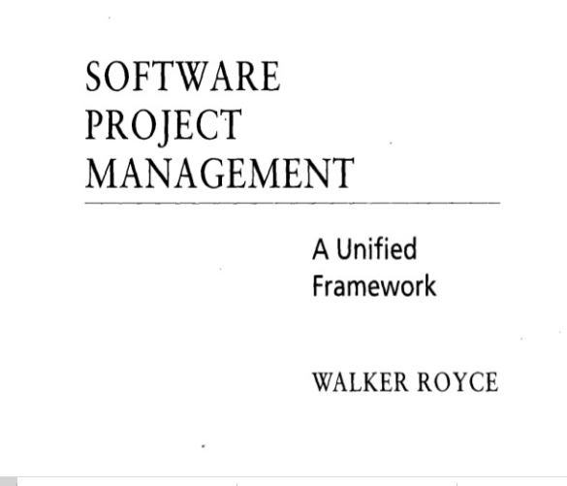
QUESTION-2
What does “Timeboxed” means in Agile terms?
A. Fast B. Flexible C. Frequent D. Fixed

Slide 5

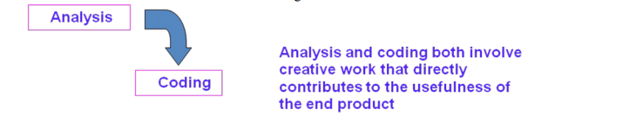
WATERFALLL MODEL

Slide 6
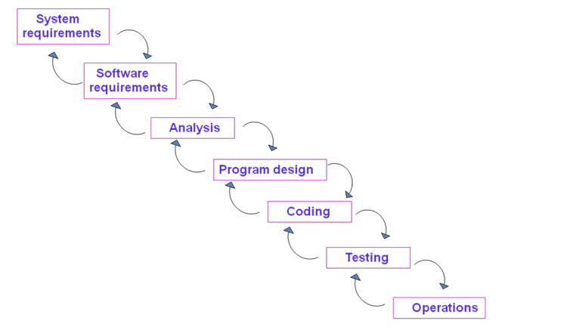

Slide 7
There are five improvements to the basic waterfall model that would eliminate most of the development risks are as follows:
Complete program design before analysis and coding begin (program design comes first)
Maintain current and complete documentation (Document the design)
Do the job twice, if possible (Do it twice)
Plan, control, and monitor testing
Involve the customer

Slide 8
thANK YOU

