Slide 1
SPPM software process, MATURITY FRAMEWORK, and principles of software process change
BY: NEHA NANDAL

Slide 2
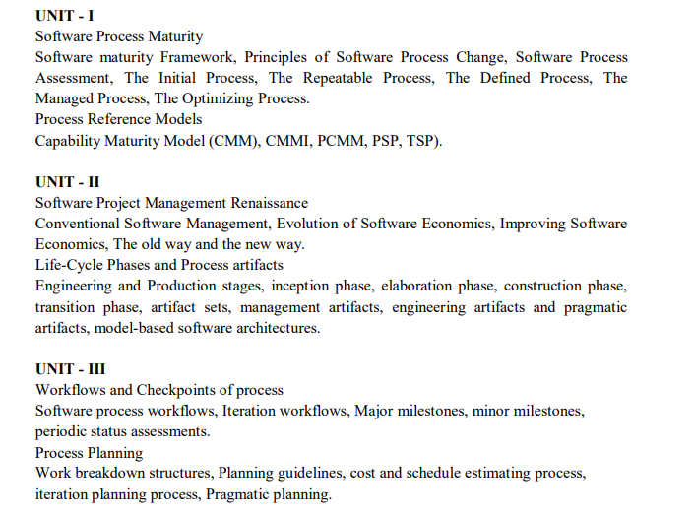

Slide 3
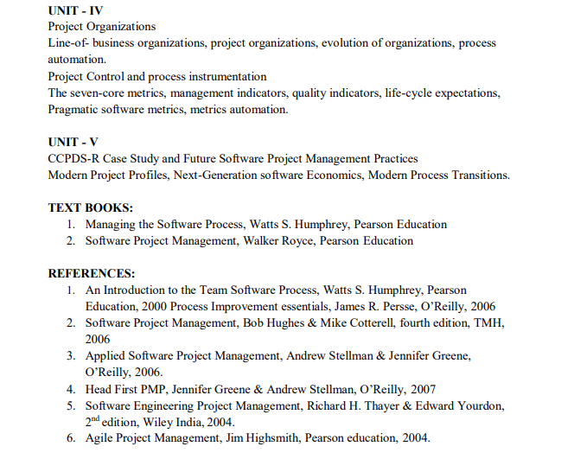
ANSWER
D. Agile planning places emphasis on planning and is iterative

Slide 4
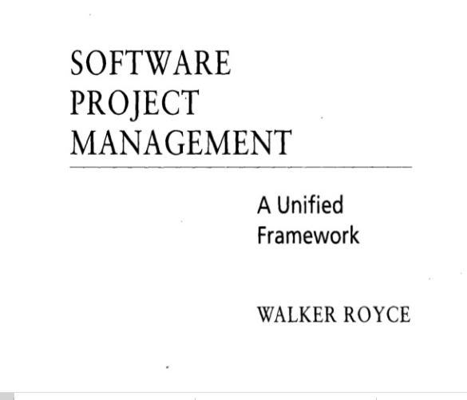
QUESTION-2
What does “Timeboxed” means in Agile terms?
A. Fast B. Flexible C. Frequent D. Fixed

Slide 5
Software Process
A software process is a set of related activities that leads to the production of a software product.
four activities that are fundamental to software engineering
Software Specification The functionality of the software and constraints on its operation must be defined.
Software Design and Implementation The software to meet the specification must be produced.
Software Validation The software must be validated to ensure that it does what the customer wants.
Software Evolution The software must evolve to meet changing customer needs.

Slide 6
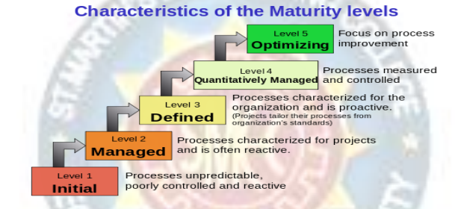
Software Maturity Framework

Slide 7
Process Maturity Levels
Initial. Until the process is under statistical control, orderly progress in process improvement is not possible. Must at least achieve rudimentary predictability of schedules and costs.
Repeatable. The organization has achieved a stable process with a repeatable level of statistical control by initiating rigorous project management of commitments, costs, schedules, and changes.
Defined. The organization has defined the process as a basis for consistent implementation and better understanding. At this point, advanced technology can be introduced.
Managed. The organization has initiated comprehensive process measurements and analysis. This is when the most significant quality improvements begin.
Optimizing. The organization now has a foundation for continuing improvement and optimization of the process

Slide 8
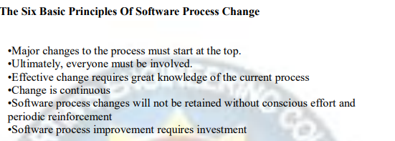
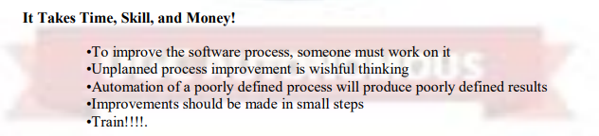

Slide 9
Software Process Assessment
Process assessments help software organizations improve themselves by identifying their crucial problems and establishing improvement priorities.
The basic assessment objectives are:
•Learn how the organization works
•Identify its major problems
•Enroll its opinion leaders in the change process
The essential approach is to conduct a series of structured interviews with key people in the organization to learn their problems, concerns, and creative ideas.

Slide 10
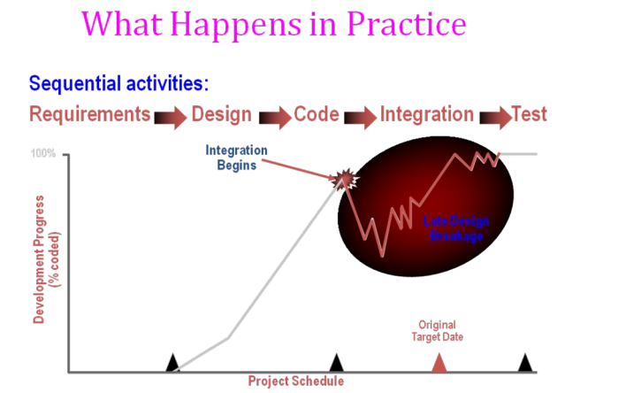

Slide 11
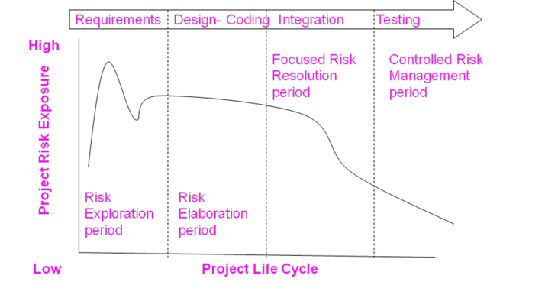
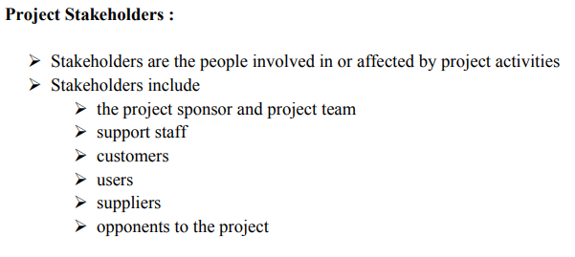
ANSWER
D. More often than daily

Slide 12
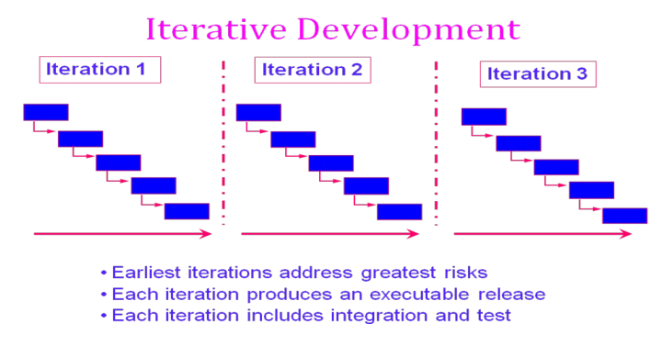

Slide 13
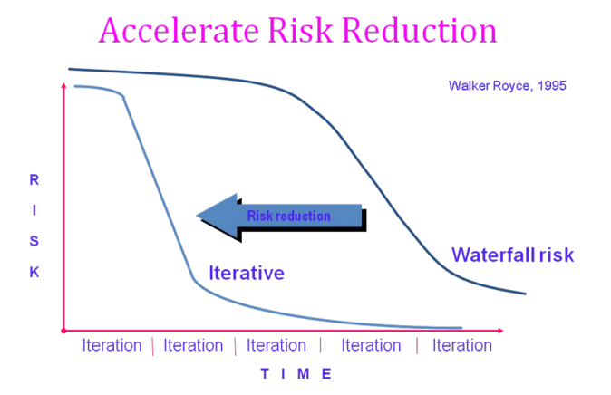

Slide 14
CONVENTIONAL SOFTWARE MANAGEMENT PERFORMANCE Barry Boehm’s Top 10 “Industrial Software Metrics”:
Finding and fixing a software problem after delivery costs 100 times more than finding and fixing the problem in early design phases.
You can compress software development schedules 25% of nominal (small), but no more.
For every $1 you spend on development, you will spend $2 on maintenance.
Software development and maintenance costs are primarily a function of the number of source lines of code.
Variations among people account for the biggest difference in software productivity.
The overall ratio of software to hardware costs is still growing. In 1955 it was 15:85; in 1985, 85:15.
Only about 15% of software development effort is devoted to programming.
Software systems and products typically cost 3 times as much per SLOC as individual software programs. Software-system products cost 9 times as much.
Walkthroughs catch 60% of the errors.
80% of the contribution comes from 20% of the contributors.
- 80% of the engineering is consumed by 20% of the requirements.
- 80% of the software cost is consumed by 20% of the components.
- 80% of the errors are caused by 20% of the components.
- 80% of the software scrap and rework is caused by 20% of the errors.
- 80% of the resources are consumed by 20% of the components.
- 80% of the engineering is accomplished by 20% of the tools.
- 80% of the progress is made by 20% of the people.

Slide 15
ANSWER
D. 5,14,24

Slide 16
QUESTION-6
Which practice prescribe "the code is always written by two programmers at one machine"?
A. Twin Programming
B. Peer Programming
C. Pair Programming
D. Buddy Programming

Slide 17
ANSWER
C. Pair Programming

Slide 18
QUESTION-7
Which statement is true about story in XP?
A. It is a short description of customer visible functionalities B. Each story need to represent a complete feature C. Story is XP terminology for the Use Case D. A Story should not be described in more than one page

Slide 19
ANSWER
A. It is a short description of customer visible functionalities

Slide 20
QUESTION-8
What are the four framework activities found in the Extreme Programming (XP) process model?
a. analysis, design, coding, testing
b. planning, analysis, design, coding
c. planning, analysis, coding, testing
d. planning, design, coding, testing

Slide 21
ANSWER
d. planning, design, coding, testing

Slide 22
Question-9
Agile is a ______ .
a. Sequential
b. Iterative
c. Incremental
d. Both b & c

Slide 23
answer
d. Both b & c

Slide 24
Question-10
In agile development, lengthy documentation is created.
a. True
b. False

Slide 25
answer
b. False

