Slide 1
SPPM PROCESS ASSESSMENT, INITIAL PROCESS AND REPEATABLE PROCESS 28/08/2020
BY: NEHA NANDAL

Slide 2
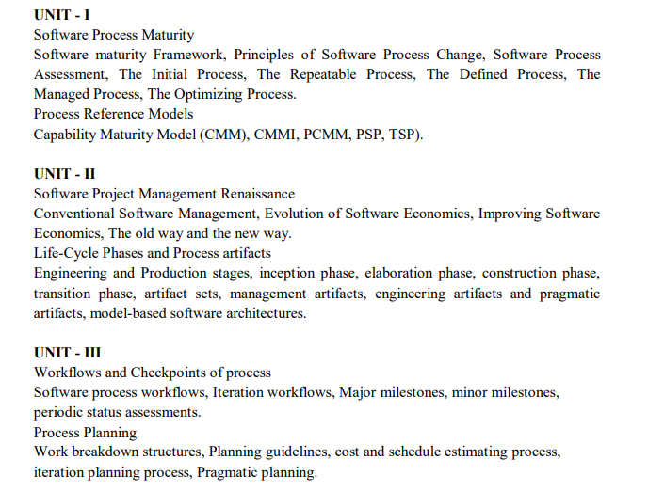

Slide 3
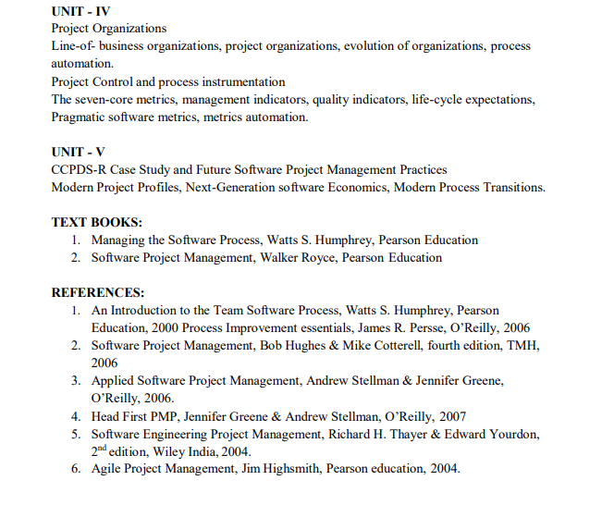
ANSWER
D. Agile planning places emphasis on planning and is iterative

Slide 4
Software Process Assessment
Process assessments help software organizations improve themselves by identifying their crucial problems and establishing improvement priorities.
The basic assessment objectives are:
•Learn how the organization works
•Identify its major problems
•Enroll its opinion leaders in the change process
The essential approach is to conduct a series of structured interviews with key people in the organization to learn their problems, concerns, and creative ideas.

Slide 5
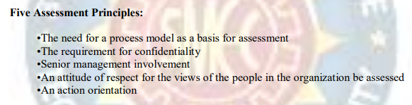

Slide 6
The Initial Process
In the Initial Process, professionals are driven from crisis to crisis by unplanned priorities and unmanaged change.
Why Organizations Are Chaotic(Disorganized)
While lack of a commitment discipline is the common reason for chaotic behavior, there are other forces:
• Under extreme pressure, software managers make a guess instead of a plan. The guess is usually low, so chaos develops.
• When things get rough, there may be a strong temptation to believe in magic. A savior or new technology may be the answer.
• The scale of software projects normally follows an escalating cycle.
• Programs take more code than expected;
• As the programs become larger, new technical and management issues arise. •Since these are unlike previous experience, they are a surprise.
• Even after a higher maturity level is reached, new management, increased competition, or new technical challenges put pressure on processes; then, an organization may revert to the Initial Process.

Slide 7
Unplanned Commitments
Gurus
Magic
As software knowledge is more widely distributed:
The Way Out
•Apply systematic project management - the work must be estimated, planned, and managed.
•Adhere to careful change control - changes must be controlled, including requirements, design, implementation, and test.
•Utilize independent software assurance - an independent technical means is required to assure that all essential project activities are properly performed.

