Slide 1
SPPM REPEATABLE, defined AND MANAGED PROCESS 29/08/2020
BY: NEHA NANDAL

Slide 2
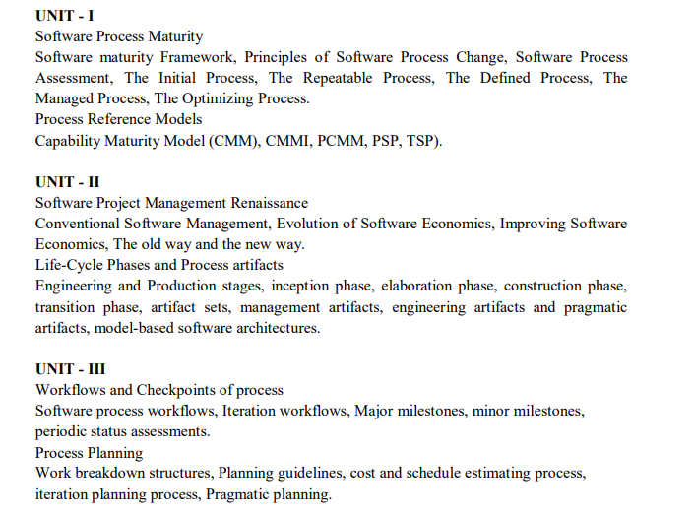

Slide 3
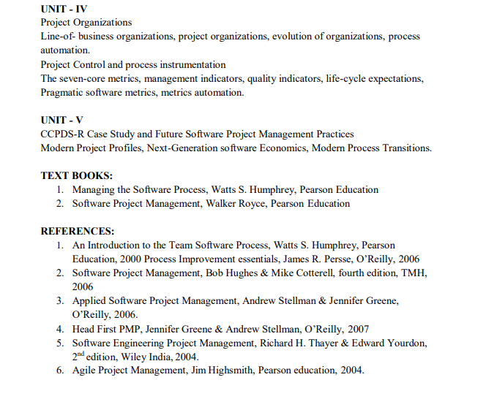
ANSWER
D. Agile planning places emphasis on planning and is iterative

Slide 4
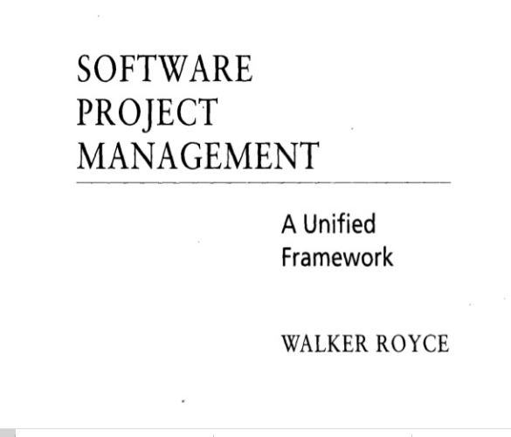
QUESTION-2
What does “Timeboxed” means in Agile terms?
A. Fast B. Flexible C. Frequent D. Fixed

Slide 5
The Initial Process
In the Initial Process, professionals are driven from crisis to crisis by unplanned priorities and unmanaged change.
Why Organizations Are Chaotic(Disorganized)
While lack of a commitment discipline is the common reason for chaotic behavior, there are other forces:
• Under extreme pressure, software managers make a guess instead of a plan. The guess is usually low, so chaos develops.
• When things get rough, there may be a strong temptation to believe in magic. A savior or new technology may be the answer.
• The scale of software projects normally follows an escalating cycle.
• Programs take more code than expected;
• As the programs become larger, new technical and management issues arise. •Since these are unlike previous experience, they are a surprise.
• Even after a higher maturity level is reached, new management, increased competition, or new technical challenges put pressure on processes; then, an organization may revert to the Initial Process.

Slide 6
Unplanned Commitments
Gurus
Magic
As software knowledge is more widely distributed:
The Way Out
•Apply systematic project management - the work must be estimated, planned, and managed.
•Adhere to careful change control - changes must be controlled, including requirements, design, implementation, and test.
•Utilize independent software assurance - an independent technical means is required to assure that all essential project activities are properly performed.

Slide 7
Repeatable Process
Managing Software Organizations
The basic principles of project management are:
•Each project has a plan that is based on a hierarchy of commitments;
•A management system resolves the natural conflicts between the projects and between the line and staff organizations;
•An oversight and review system audits and tracks progress against the plans.
The foundation for software project management is the commitment discipline. Commitments are supported by plans, reviews, and so forth, but commitments are met by people.

Slide 8
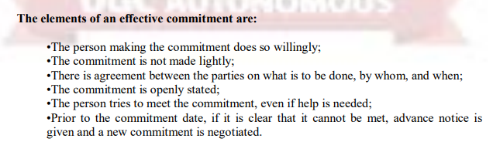
Product and Period Plans
The distinction between period and product can be confusing. Project personnel view their work as the fundamental business of the organization and have little appreciation for period information.
The Contention Process
An effective management system requires a parallel contention system to encourage the open expression of differences and their rational resolution.

