Slide 1
SPPM defined PROCESS 02/09/2020
BY: NEHA NANDAL

Slide 2
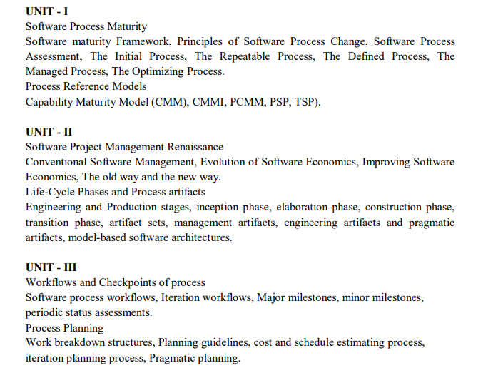

Slide 3
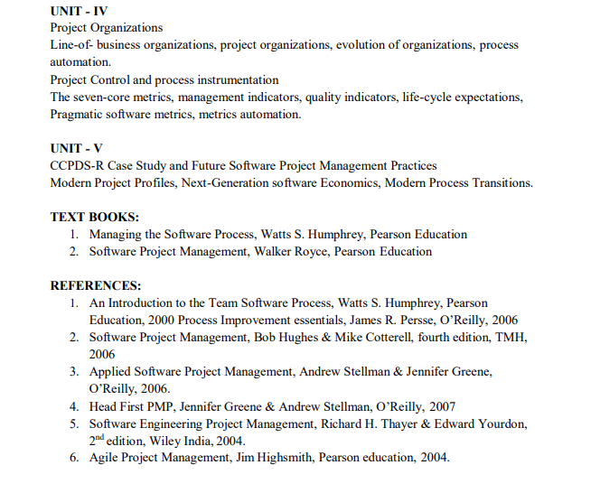
ANSWER
D. Agile planning places emphasis on planning and is iterative

Slide 4
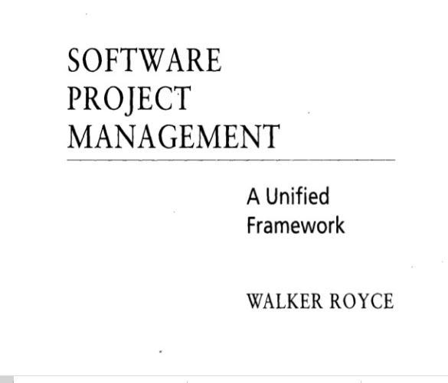
QUESTION-2
What does “Timeboxed” means in Agile terms?
A. Fast B. Flexible C. Frequent D. Fixed

Slide 5
Repeatable Process
Managing Software Organizations
The basic principles of project management are:
•Each project has a plan that is based on a hierarchy of commitments;
•A management system resolves the natural conflicts between the projects and between the line and staff organizations;
•An oversight and review system audits and tracks progress against the plans.
The foundation for software project management is the commitment discipline. Commitments are supported by plans, reviews, and so forth, but commitments are met by people.

Slide 6
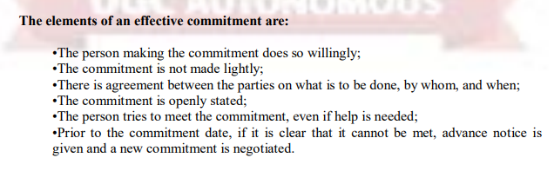
Product and Period Plans
The distinction between period and product can be confusing. Project personnel view their work as the fundamental business of the organization and have little appreciation for period information.
The Contention Process
An effective management system requires a parallel contention system to encourage the open expression of differences and their rational resolution.

Slide 7
The Defined Process
There are a lot of reasons why an organization might decide that it’s time to define a process. Usually workers and management start noticing that there is a lot of time being spent not on the actual work, but on fire-fighting (e.g., doing rework, fixing, re-fixing, testing, retesting, putting out fires caused by tasks that weren’t done at all, repairing relationships with customers, and running around to see if anyone remembers what worked last time).
Defining A Process: Overview
The Facilitator
The Process Definition Team
Reading the Process Diagram

Slide 8
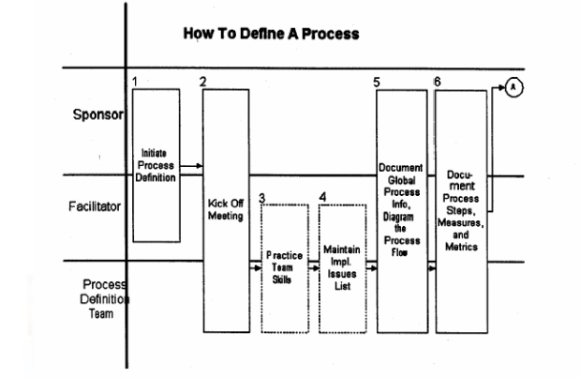
The Steps In Defining A Process

Slide 9
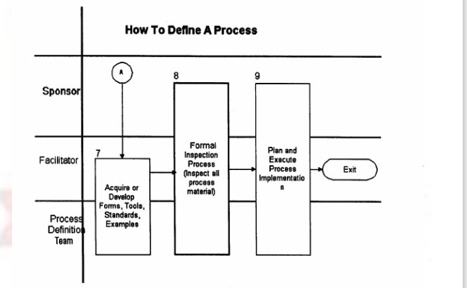

Slide 10
Managed process
A managed process is a performed process that is planned and executed in accordance with policy; employs skilled people having adequate resources to produce controlled outputs; involves relevant stakeholders; is monitored, controlled, and reviewed; and is evaluated for adherence to its process description.
The requirements and objectives for the process are established by the organization. The status of the work products and services are visible to management at defined points (e.g., at major milestones, on completion of major tasks). Commitments are established among those who perform the work and the relevant stakeholders and are revised as necessary. Work products are reviewed with relevant stakeholders and are controlled. The work products and services satisfy their specified requirements.

Slide 11
The Optimization Process
The purpose of optimization is to achieve the “best” design relative to a set of prioritized
criteria or constraints. These include maximizing factors such as productivity, strength,
reliability, longevity, efficiency, and utilization.
Goals of the subject
Modeling issues
Analysis of solutions
Numerical methods

Slide 12
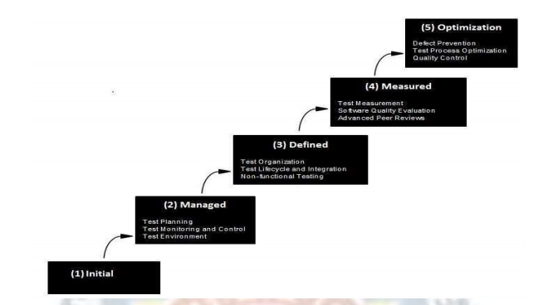
Process Reference Models
Capability Maturity Model (CMM)
The Capability Maturity Model (CMM) is a methodology used to develop and refine an organization's software development process. The model describes a five-level evolutionary path of increasingly organized and systematically more mature processes

Slide 13
Maturity Level and Process Areas
Level | Focus | Key Process Area | Result
5 Optimizing | Continuous Process Improvement | Organizational Innovation and Deployment Causal Analysis and Resolution | Highest Quality / Lowest Risk
4 Quantitatively Managed | Quantitatively Managed | Organizational Process Performance Quantitative Project Management | Higher Quality / Lower Risk
3 Defined | Process Standardization | Requirements Development Technical Solution Product Integration Verification Validation Organizational Process Focus Organizational Process Definition Organizational Training Integrated Project Mgmt (with IPPD extras) Risk Management Decision Analysis and Resolution Integrated Teaming (IPPD only) Org. Environment for Integration (IPPD only) Integrated Supplier Management (SS only) | Medium Quality / Medium Risk
2 Managed | Basic Project Management | Requirements Management Project Planning Project Monitoring and Control Supplier Agreement Management Measurement and Analysis Process and Product Quality Assurance Configuration Management | Low Quality / High Risk
1 Initial | Process is informal and Adhoc |  | Lowest Quality / Highest Risk

Slide 14
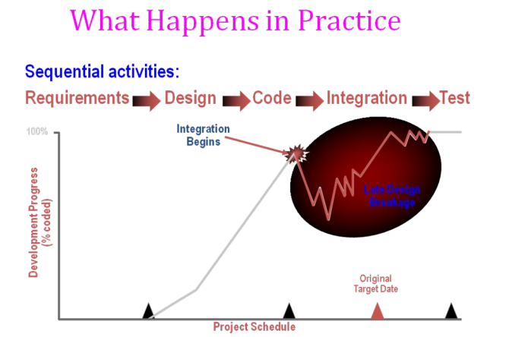

Slide 15
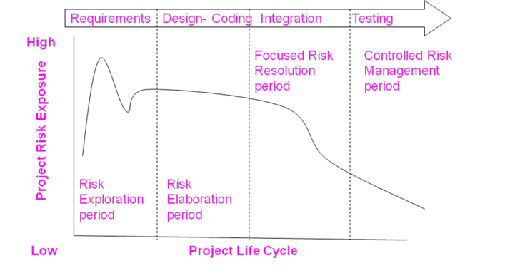
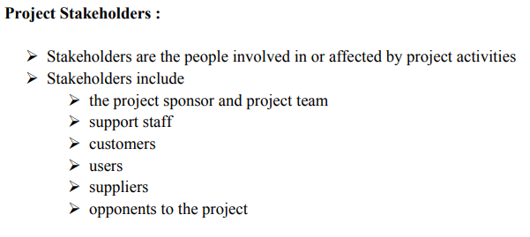
ANSWER
D. More often than daily

Slide 16
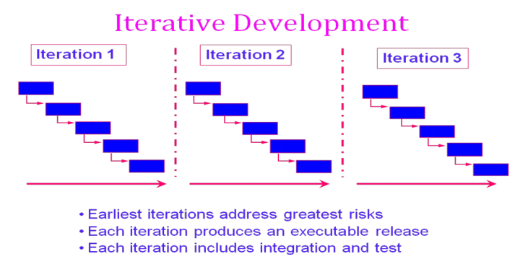

Slide 17
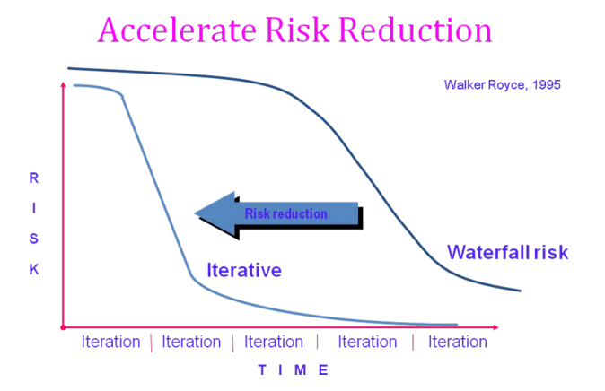

Slide 18
CONVENTIONAL SOFTWARE MANAGEMENT PERFORMANCE Barry Boehm’s Top 10 “Industrial Software Metrics”:
Finding and fixing a software problem after delivery costs 100 times more than finding and fixing the problem in early design phases.
You can compress software development schedules 25% of nominal (small), but no more.
For every $1 you spend on development, you will spend $2 on maintenance.
Software development and maintenance costs are primarily a function of the number of source lines of code.
Variations among people account for the biggest difference in software productivity.
The overall ratio of software to hardware costs is still growing. In 1955 it was 15:85; in 1985, 85:15.
Only about 15% of software development effort is devoted to programming.
Software systems and products typically cost 3 times as much per SLOC as individual software programs. Software-system products cost 9 times as much.
Walkthroughs catch 60% of the errors.
80% of the contribution comes from 20% of the contributors.
- 80% of the engineering is consumed by 20% of the requirements.
- 80% of the software cost is consumed by 20% of the components.
- 80% of the errors are caused by 20% of the components.
- 80% of the software scrap and rework is caused by 20% of the errors.
- 80% of the resources are consumed by 20% of the components.
- 80% of the engineering is accomplished by 20% of the tools.
- 80% of the progress is made by 20% of the people.

Slide 19
ANSWER
D. 5,14,24

Slide 20
QUESTION-6
Which practice prescribe "the code is always written by two programmers at one machine"?
A. Twin Programming
B. Peer Programming
C. Pair Programming
D. Buddy Programming

Slide 21
ANSWER
C. Pair Programming

Slide 22
QUESTION-7
Which statement is true about story in XP?
A. It is a short description of customer visible functionalities B. Each story need to represent a complete feature C. Story is XP terminology for the Use Case D. A Story should not be described in more than one page

Slide 23
ANSWER
A. It is a short description of customer visible functionalities

Slide 24
QUESTION-8
What are the four framework activities found in the Extreme Programming (XP) process model?
a. analysis, design, coding, testing
b. planning, analysis, design, coding
c. planning, analysis, coding, testing
d. planning, design, coding, testing

Slide 25
ANSWER
d. planning, design, coding, testing

Slide 26
Question-9
Agile is a ______ .
a. Sequential
b. Iterative
c. Incremental
d. Both b & c

Slide 27
answer
d. Both b & c

Slide 28
Question-10
In agile development, lengthy documentation is created.
a. True
b. False

Slide 29
answer
b. False

