Slide 1
SPPM MANAGED AND OPTIMIZING PROCESS 04/09/2020
BY: NEHA NANDAL

Slide 2
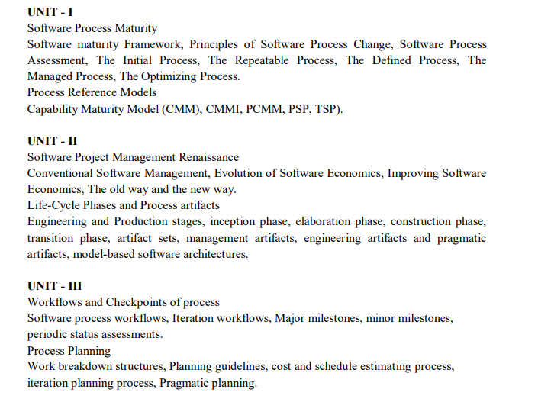

Slide 3
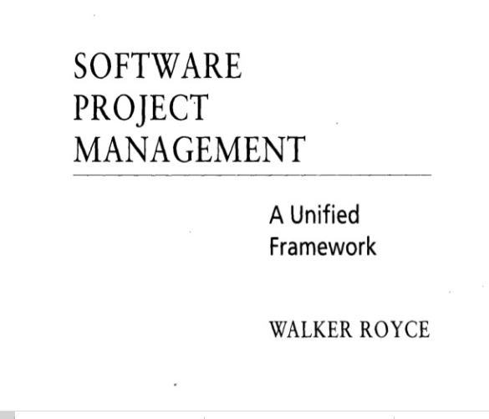
QUESTION-2
What does “Timeboxed” means in Agile terms?
A. Fast B. Flexible C. Frequent D. Fixed

Slide 4
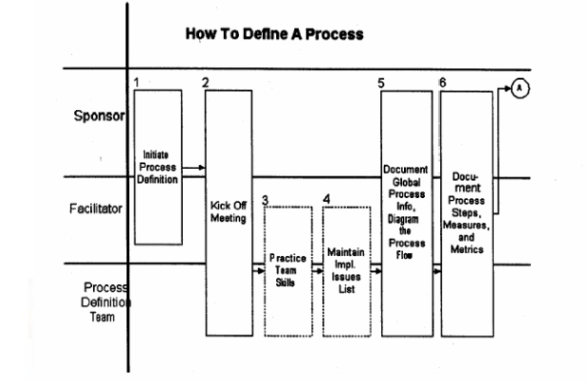
The Steps In Defining A Process

Slide 5
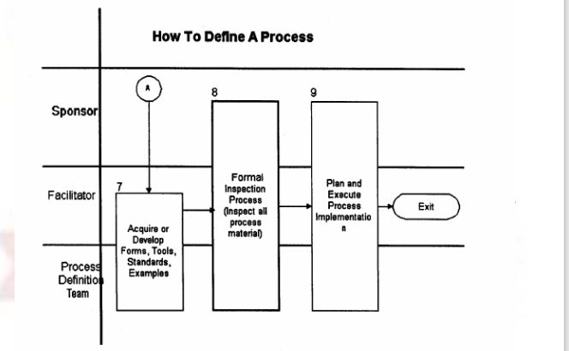

Slide 6
MANAGED PROCESS
A managed process is a performed process that is planned and executed in accordance with policy; employs skilled people having adequate resources to produce controlled outputs; involves relevant stakeholders; is monitored, controlled, and reviewed; and is evaluated for adherence to its process description
The requirements and objectives for the process are established by the organization. The status of the work products and services are visible to management at defined points (e.g., at major milestones, on completion of major tasks). Commitments are established among those who perform the work and the relevant stakeholders and are revised as necessary.

Slide 7
The Optimization Process
The purpose of optimization is to achieve the “best” design relative to a set of prioritized
criteria or constraints. These include maximizing factors such as productivity, strength,
reliability, longevity, efficiency, and utilization.
Goals of the subject
Modeling issues
Analysis of solutions
Numerical methods

Slide 8
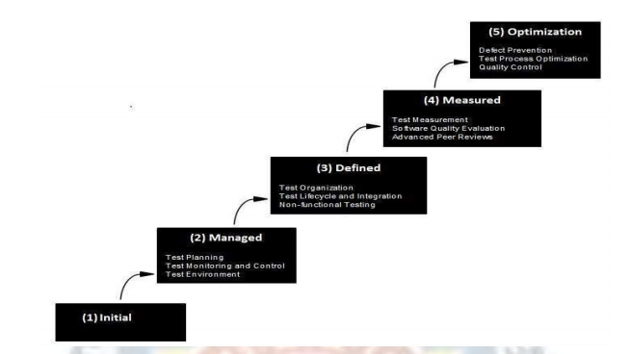
Process Reference Models
Capability Maturity Model (CMM)
The Capability Maturity Model (CMM) is a methodology used to develop and refine an organization's software development process. The model describes a five-level evolutionary path of increasingly organized and systematically more mature processes

Slide 9
Capability Maturity Model Integration
The Capability Maturity Model Integration (CMMI) is a process and behavioral model that helps organizations streamline process improvement and encourage productive, efficient behaviors that decrease risks in software, product and service development.
The CMMI was developed by the Software Engineering Institute at Carnegie Mellon University as a process improvement tool for projects, divisions or organizations. The DoD and U.S.

Slide 10
Level | Focus | Key Process Area | Result
5 Optimizing | Continuous Process Improvement | Organizational Innovation and Deployment Causal Analysis and Resolution | Highest Quality / Lowest Risk
4 Quantitatively Managed | Quantitatively Managed | Organizational Process Performance Quantitative Project Management | Higher Quality / Lower Risk
3 Defined | Process Standardization | Requirements Development Technical Solution Product Integration Verification Validation Organizational Process Focus Organizational Process Definition Organizational Training Integrated Project Mgmt (with IPPD extras) Risk Management Decision Analysis and Resolution Integrated Teaming (IPPD only) Org. Environment for Integration (IPPD only) Integrated Supplier Management (SS only) | Medium Quality / Medium Risk
2 Managed | Basic Project Management | Requirements Management Project Planning Project Monitoring and Control Supplier Agreement Management Measurement and Analysis Process and Product Quality Assurance Configuration Management | Low Quality / High Risk
1 Initial | Process is informal and Adhoc |  | Lowest Quality / Highest Risk
Maturity Level and Process Areas

Slide 11
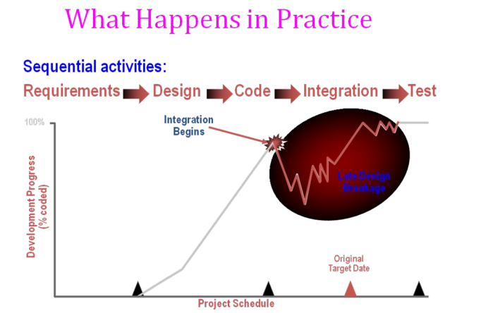

Slide 12
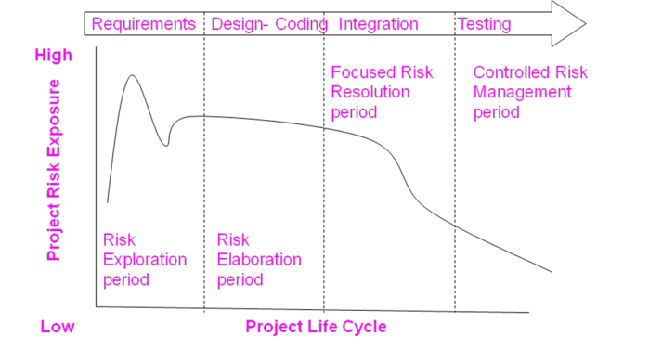
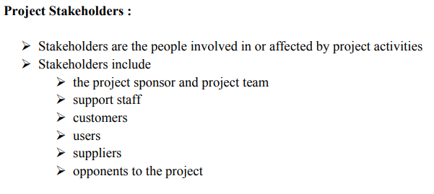
ANSWER
D. More often than daily

Slide 13
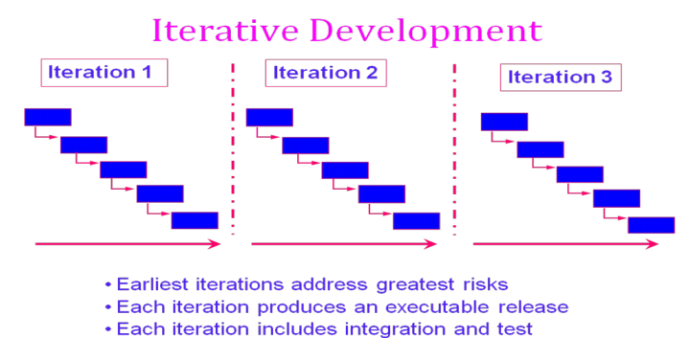

Slide 14
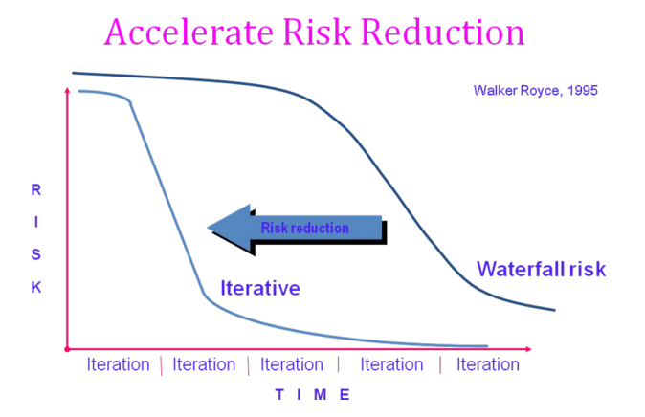

Slide 15
CONVENTIONAL SOFTWARE MANAGEMENT PERFORMANCE Barry Boehm’s Top 10 “Industrial Software Metrics”:
Finding and fixing a software problem after delivery costs 100 times more than finding and fixing the problem in early design phases.
You can compress software development schedules 25% of nominal (small), but no more.
For every $1 you spend on development, you will spend $2 on maintenance.
Software development and maintenance costs are primarily a function of the number of source lines of code.
Variations among people account for the biggest difference in software productivity.
The overall ratio of software to hardware costs is still growing. In 1955 it was 15:85; in 1985, 85:15.
Only about 15% of software development effort is devoted to programming.
Software systems and products typically cost 3 times as much per SLOC as individual software programs. Software-system products cost 9 times as much.
Walkthroughs catch 60% of the errors.
80% of the contribution comes from 20% of the contributors.
- 80% of the engineering is consumed by 20% of the requirements.
- 80% of the software cost is consumed by 20% of the components.
- 80% of the errors are caused by 20% of the components.
- 80% of the software scrap and rework is caused by 20% of the errors.
- 80% of the resources are consumed by 20% of the components.
- 80% of the engineering is accomplished by 20% of the tools.
- 80% of the progress is made by 20% of the people.

Slide 16
ANSWER
D. 5,14,24

Slide 17
QUESTION-6
Which practice prescribe "the code is always written by two programmers at one machine"?
A. Twin Programming
B. Peer Programming
C. Pair Programming
D. Buddy Programming

Slide 18
ANSWER
C. Pair Programming

Slide 19
QUESTION-7
Which statement is true about story in XP?
A. It is a short description of customer visible functionalities B. Each story need to represent a complete feature C. Story is XP terminology for the Use Case D. A Story should not be described in more than one page

Slide 20
ANSWER
A. It is a short description of customer visible functionalities

Slide 21
QUESTION-8
What are the four framework activities found in the Extreme Programming (XP) process model?
a. analysis, design, coding, testing
b. planning, analysis, design, coding
c. planning, analysis, coding, testing
d. planning, design, coding, testing

Slide 22
ANSWER
d. planning, design, coding, testing

Slide 23
Question-9
Agile is a ______ .
a. Sequential
b. Iterative
c. Incremental
d. Both b & c

Slide 24
answer
d. Both b & c

Slide 25
Question-10
In agile development, lengthy documentation is created.
a. True
b. False

Slide 26
answer
b. False

