Slide 1
SPPM PCMM 07/09/2020
BY: NEHA NANDAL

Slide 2
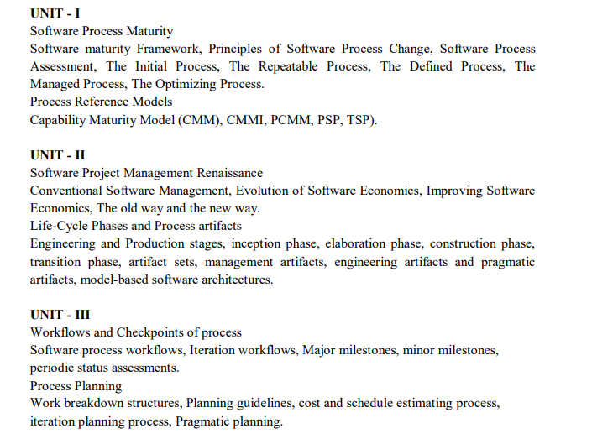

Slide 3
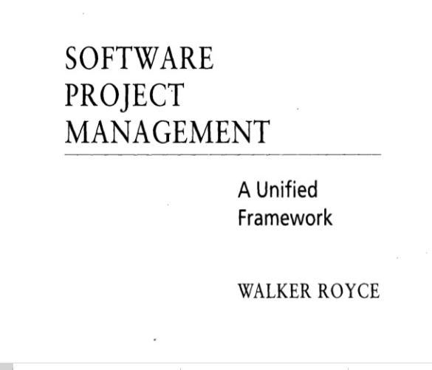
QUESTION-2
What does “Timeboxed” means in Agile terms?
A. Fast B. Flexible C. Frequent D. Fixed

Slide 4
MANAGED PROCESS
A managed process is a performed process that is planned and executed in accordance with policy; employs skilled people having adequate resources to produce controlled outputs; involves relevant stakeholders; is monitored, controlled, and reviewed; and is evaluated for adherence to its process description
The requirements and objectives for the process are established by the organization. The status of the work products and services are visible to management at defined points (e.g., at major milestones, on completion of major tasks). Commitments are established among those who perform the work and the relevant stakeholders and are revised as necessary.

Slide 5
The Optimization Process
The purpose of optimization is to achieve the “best” design relative to a set of prioritized
criteria or constraints. These include maximizing factors such as productivity, strength,
reliability, longevity, efficiency, and utilization.
Goals of the subject
Modeling issues
Analysis of solutions
Numerical methods

Slide 6
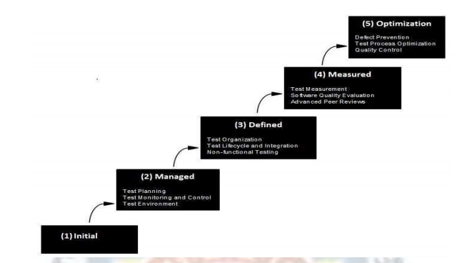
Process Reference Models
Capability Maturity Model (CMM)
The Capability Maturity Model (CMM) is a methodology used to develop and refine an organization's software development process. The model describes a five-level evolutionary path of increasingly organized and systematically more mature processes

Slide 7
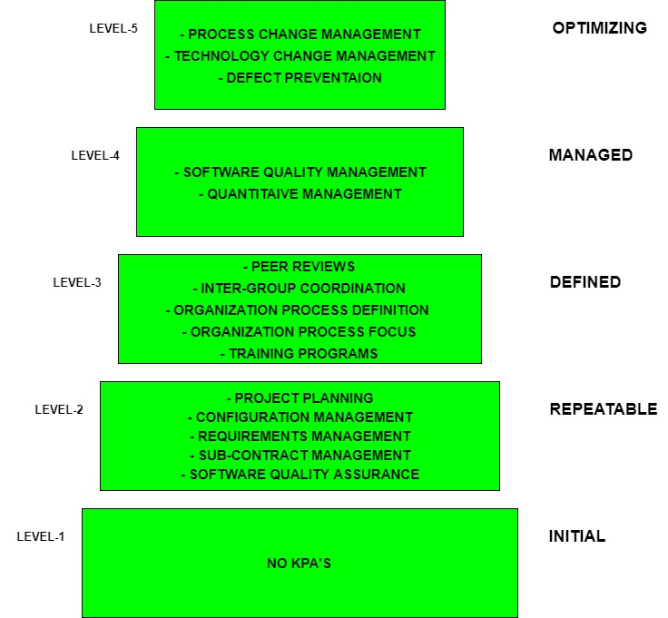

Slide 8
Challenges Faced During CMM Implementation
Lack of Integration: CMM has separate models for each function. Such models often overlap, contradict, and display different levels of maturity. This lack of standardization leads to confusion and conflict during the implementation phase and increase training and appraisal costs.
Limitations of KPA: The “Key Performance Areas (KPA),” that define CMM levels focus on “policing” activities such as specifications, documentation, audits, and inspections, and do not reveal architecturally significant flaws.
Activity-based Approach: CMM is an activity-based approach that considers only the completion of a specific activity, and not whether the completed activity achieved the desired results.
Paperwork: CMM places great importance on paperwork and meetings that take management’s time and effort away from actual work processes. CMM traps the organization in recording and complying with processes, often at the cost of strategic goals.

Slide 9
Capability Maturity Model Integration
The Capability Maturity Model Integration (CMMI) is a process and behavioral model that helps organizations streamline process improvement and encourage productive, efficient behaviors that decrease risks in software, product and service development.
The CMMI was developed by the Software Engineering Institute at Carnegie Mellon University as a process improvement tool for projects, divisions or organizations. The DoD and U.S.

Slide 10
Level | Focus | Key Process Area | Result
5 Optimizing | Continuous Process Improvement | Organizational Innovation and Deployment Causal Analysis and Resolution | Highest Quality / Lowest Risk
4 Quantitatively Managed | Quantitatively Managed | Organizational Process Performance Quantitative Project Management | Higher Quality / Lower Risk
3 Defined | Process Standardization | Requirements Development Technical Solution Product Integration Verification Validation Organizational Process Focus Organizational Process Definition Organizational Training Integrated Project Mgmt (with IPPD extras) Risk Management Decision Analysis and Resolution Integrated Teaming (IPPD only) Org. Environment for Integration (IPPD only) Integrated Supplier Management (SS only) | Medium Quality / Medium Risk
2 Managed | Basic Project Management | Requirements Management Project Planning Project Monitoring and Control Supplier Agreement Management Measurement and Analysis Process and Product Quality Assurance Configuration Management | Low Quality / High Risk
1 Initial | Process is informal and Adhoc |  | Lowest Quality / Highest Risk
Maturity Level and Process Areas

Slide 11
Standard CMMI Appraisal Method For Process Improvement (Scampi)
Scampi A The most rigorous appraisal method, SCAMPI A is most useful after multiple processes have been implemented. It provides a benchmark for businesses and is the only level that results in an official rating. It must be performed by a certified lead appraiser, who is part of the on-site appraisal team.
Scampi B This appraisal is less formal than SCAMPI A; it helps find a target CMMI maturity level, predict success for evaluated practices and give the business a better idea of where they stand in the maturity process.
Scampi C This appraisal method is shorter, more flexible and less expensive than Class A or B. It’s designed to quickly assess a business’s established practices and how those will integrate or align with CMMI practices. It can be used at a high-level or micro-level, to address organizational issues or smaller process or departmental issues. It involves more risk than Class A or B, but it’s more cost-effective.

Slide 12
CMM AND CMMI
CMM measures the maturity level of an organization by determining if an organization completes the specific activities listed in the Key Performance Areas (KPA), oblivious to whether the completion of such activity leads to the desired result. CMMI is also an activity based approach but the major difference is that CMMI takes a more result-oriented approach when defining and measuring Key Performance Areas.
CMM Integration:
- builds an initial set of integrated models.
- improves best practices from source models based on lessons learned.
- establishes a framework to enable integration of future models.

Slide 13
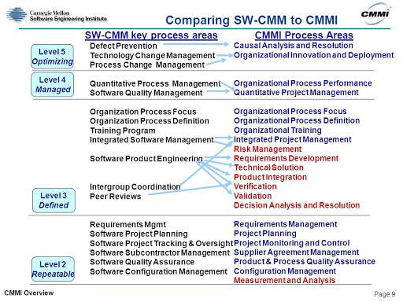

Slide 14
People Capability Maturity Model (PCMM)
People Capability Maturity Model (PCMM) is a maturity framework that focuses on continuously improving the management and development of the human assets of a software or information systems organization. PCMM can be perceived as the application of the principles of Capability Maturity Model to human assets of a software organization.
The primary objective of the People Capability Maturity Model is to improve the capability of the entire workforce. This can be defined as the level of knowledge, skills, and 60 process abilities available for performing an organization’s current and future business activities.

Slide 15
Principles of People Capability Maturity Model (PCMM)
In mature organizations, workforce capability is directly related to business performance.
Workforce capability is a competitive issue and a source of strategic advantage.
Workforce capability must be defined in relation to the organization’s strategic business objectives.
Knowledge-intense work shifts the focus from job elements to workforce competencies.
Capability can be measured and improved at multiple levels, including individuals, workgroups, workforce competencies, and the organization.
An organization should invest in improving the capability of those workforce competencies that are critical to its core competency as a business.
Operational management is responsible for the capability of the workforce.
The improvement of workforce capability can be pursued as a process composed from proven practices and procedures.
The organization is responsible for providing improvement opportunities, while individuals are responsible for taking advantage of them.
Since technologies and organizational forms evolve rapidly, organizations must continually evolve their workforce practices and develop new workforce competencies.

Slide 16
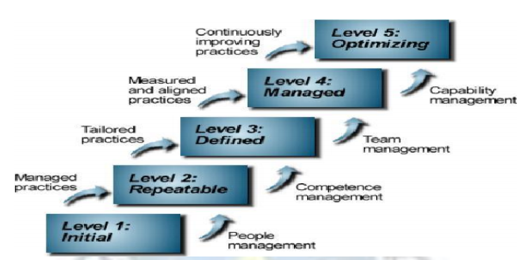
People Capability Maturity Model : five maturity levels

Slide 17
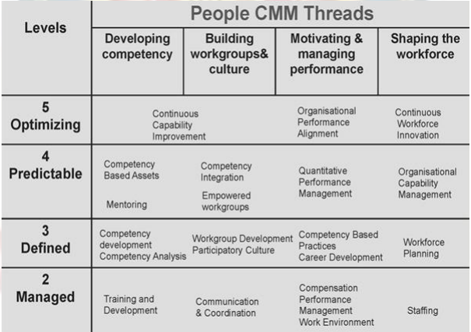

Slide 18
CMM is more Generic and focused on organization process.
PCMM is more focused on the organization workforce.
PCMM has a staged architecture then just maturity levels as in CMM.
It is used world wide by organizations like IBM, BAE Systems, TCS, Ericsson etc.

Slide 19
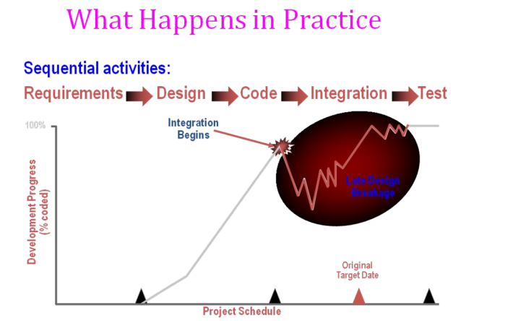

Slide 20
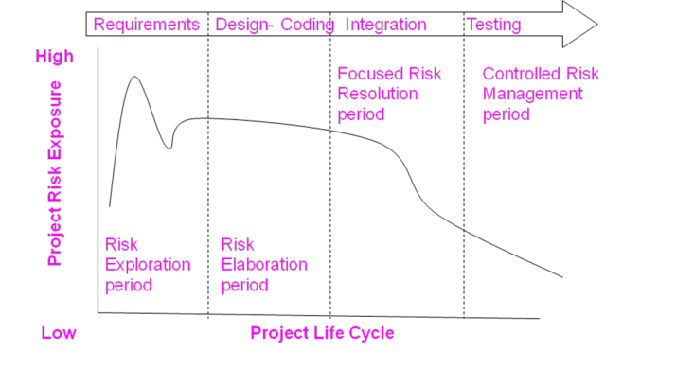
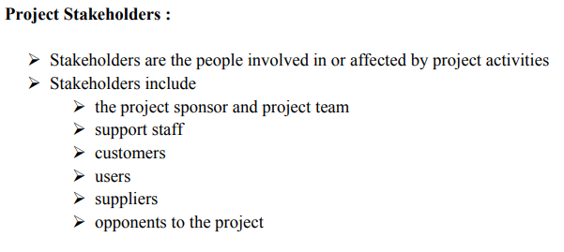
ANSWER
D. More often than daily

Slide 21
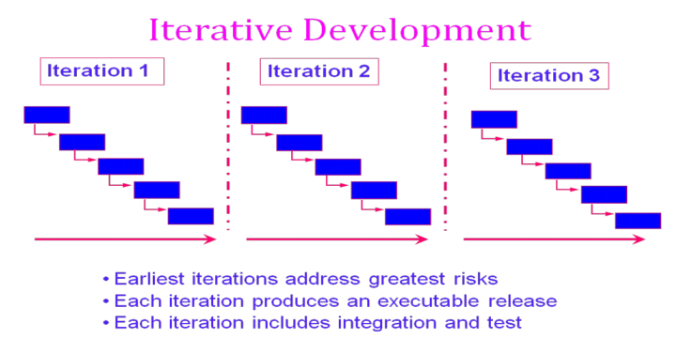

Slide 22
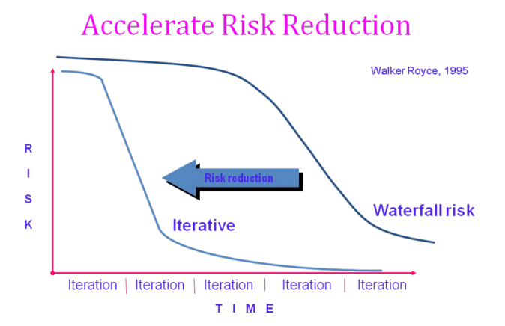

Slide 23
CONVENTIONAL SOFTWARE MANAGEMENT PERFORMANCE Barry Boehm’s Top 10 “Industrial Software Metrics”:
Finding and fixing a software problem after delivery costs 100 times more than finding and fixing the problem in early design phases.
You can compress software development schedules 25% of nominal (small), but no more.
For every $1 you spend on development, you will spend $2 on maintenance.
Software development and maintenance costs are primarily a function of the number of source lines of code.
Variations among people account for the biggest difference in software productivity.
The overall ratio of software to hardware costs is still growing. In 1955 it was 15:85; in 1985, 85:15.
Only about 15% of software development effort is devoted to programming.
Software systems and products typically cost 3 times as much per SLOC as individual software programs. Software-system products cost 9 times as much.
Walkthroughs catch 60% of the errors.
80% of the contribution comes from 20% of the contributors.
- 80% of the engineering is consumed by 20% of the requirements.
- 80% of the software cost is consumed by 20% of the components.
- 80% of the errors are caused by 20% of the components.
- 80% of the software scrap and rework is caused by 20% of the errors.
- 80% of the resources are consumed by 20% of the components.
- 80% of the engineering is accomplished by 20% of the tools.
- 80% of the progress is made by 20% of the people.

Slide 24
ANSWER
D. 5,14,24

Slide 25
QUESTION-6
Which practice prescribe "the code is always written by two programmers at one machine"?
A. Twin Programming
B. Peer Programming
C. Pair Programming
D. Buddy Programming

Slide 26
ANSWER
C. Pair Programming

Slide 27
QUESTION-7
Which statement is true about story in XP?
A. It is a short description of customer visible functionalities B. Each story need to represent a complete feature C. Story is XP terminology for the Use Case D. A Story should not be described in more than one page

Slide 28
ANSWER
A. It is a short description of customer visible functionalities

Slide 29
QUESTION-8
What are the four framework activities found in the Extreme Programming (XP) process model?
a. analysis, design, coding, testing
b. planning, analysis, design, coding
c. planning, analysis, coding, testing
d. planning, design, coding, testing

Slide 30
ANSWER
d. planning, design, coding, testing

Slide 31
Question-9
Agile is a ______ .
a. Sequential
b. Iterative
c. Incremental
d. Both b & c

Slide 32
answer
d. Both b & c

Slide 33
Question-10
In agile development, lengthy documentation is created.
a. True
b. False

Slide 34
answer
b. False

