Slide 1
SPPM PSP AND TSP 09/09/2020
BY: NEHA NANDAL

Slide 2
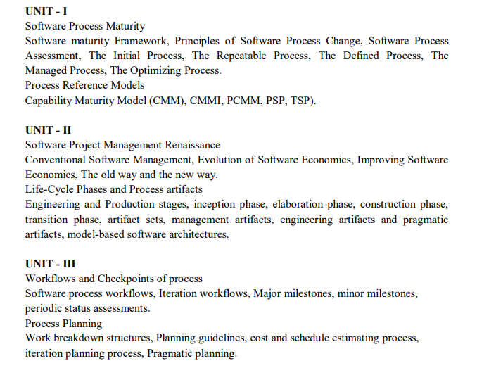

Slide 3
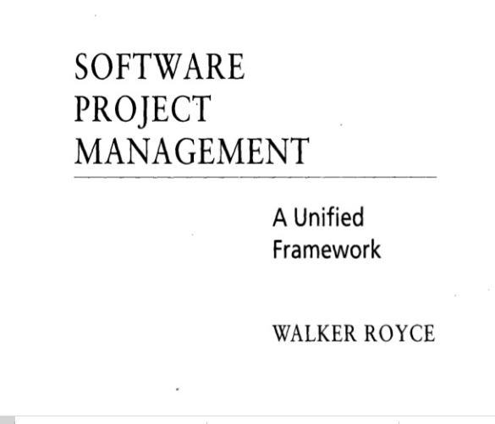
QUESTION-2
What does “Timeboxed” means in Agile terms?
A. Fast B. Flexible C. Frequent D. Fixed

Slide 4
People Capability Maturity Model (PCMM)
People Capability Maturity Model (PCMM) is a maturity framework that focuses on continuously improving the management and development of the human assets of a software or information systems organization. PCMM can be perceived as the application of the principles of Capability Maturity Model to human assets of a software organization.
The primary objective of the People Capability Maturity Model is to improve the capability of the entire workforce. This can be defined as the level of knowledge, skills, and 60 process abilities available for performing an organization’s current and future business activities.

Slide 5
Principles of People Capability Maturity Model (PCMM)
In mature organizations, workforce capability is directly related to business performance.
Workforce capability is a competitive issue and a source of strategic advantage.
Workforce capability must be defined in relation to the organization’s strategic business objectives.
Knowledge-intense work shifts the focus from job elements to workforce competencies.
Capability can be measured and improved at multiple levels, including individuals, workgroups, workforce competencies, and the organization.
An organization should invest in improving the capability of those workforce competencies that are critical to its core competency as a business.
Operational management is responsible for the capability of the workforce.
The improvement of workforce capability can be pursued as a process composed from proven practices and procedures.
The organization is responsible for providing improvement opportunities, while individuals are responsible for taking advantage of them.
Since technologies and organizational forms evolve rapidly, organizations must continually evolve their workforce practices and develop new workforce competencies.

Slide 6
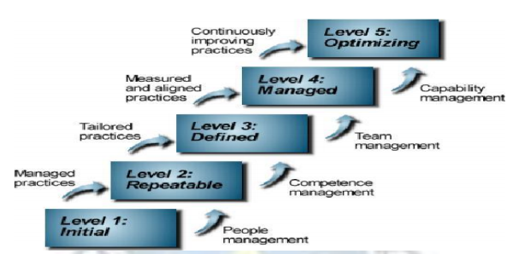
People Capability Maturity Model : five maturity levels

Slide 7
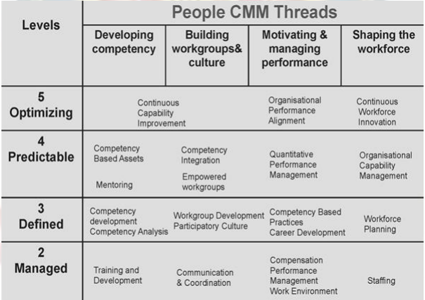

Slide 8
CMM is more Generic and focused on organization process.
PCMM is more focused on the organization workforce.
PCMM has a staged architecture then just maturity levels as in CMM.
It is used world wide by organizations like IBM, BAE Systems, TCS, Ericsson etc.

Slide 9
PERSONAL SOFTWARE PROCESS(PSP)
The PSP is a personal process for developing software or for doing any other defined activity. It provides a measurement and analysis framework for characterizing and managing your personal work.

Slide 10
PSP Phases Diagram

Slide 11
PSP Benefits
Increases personal commitment by investing each engineer with process responsibility
Assists engineers in making accurate plans
Provides steps engineers can take to improve personal and project quality
Sets benchmarks to measure personal process improvements
Demonstrates the impact of process changes on an engineer's performance

Slide 12
Team Software Process (Tsp)
In combination with the personal software process (PSP), the team software process (TSP) provides a defined operational process framework that is designed to help teams of managers and engineers organize projects.
TSP Strategy
Provide a simple process framework based on the PSP.
Use modest, well-defined problems.
Develop products in several cycles.
Establish standard measures for quality and performance.
Provide detailed role definitions.
Use role and team evaluations.
Require process discipline.
Provide guidance on teamwork problems.

Slide 13
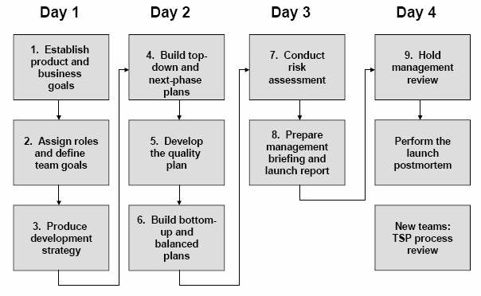
Launch Process
Figure 9: Launch Process

Slide 14
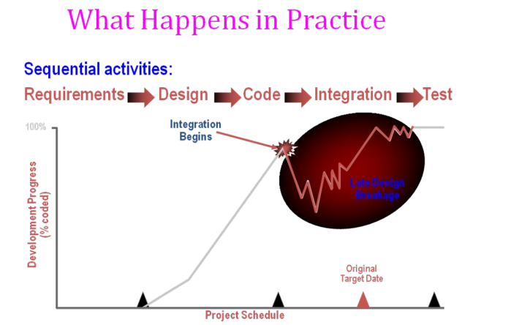

Slide 15
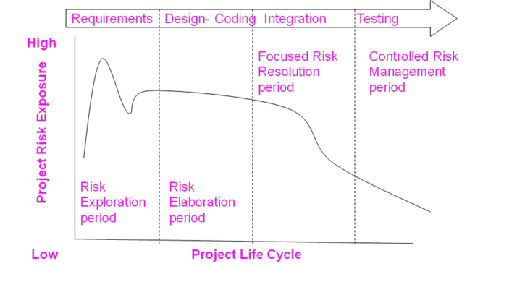
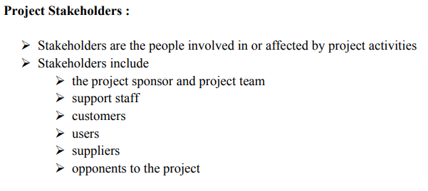
ANSWER
D. More often than daily

Slide 16
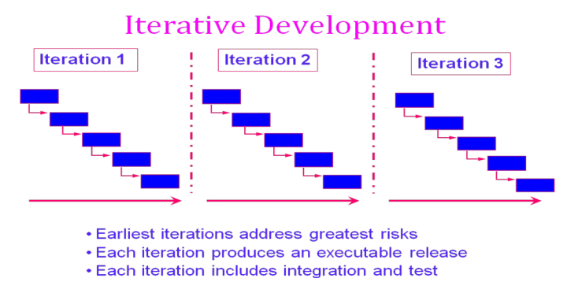

Slide 17
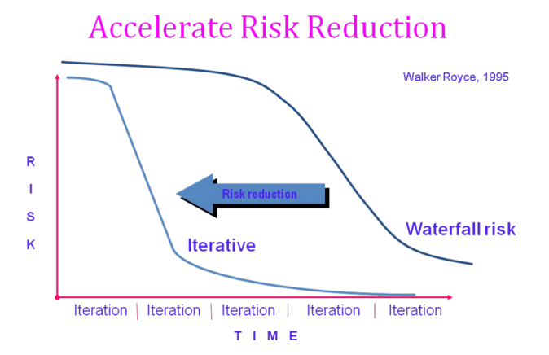

Slide 18
CONVENTIONAL SOFTWARE MANAGEMENT PERFORMANCE Barry Boehm’s Top 10 “Industrial Software Metrics”:
Finding and fixing a software problem after delivery costs 100 times more than finding and fixing the problem in early design phases.
You can compress software development schedules 25% of nominal (small), but no more.
For every $1 you spend on development, you will spend $2 on maintenance.
Software development and maintenance costs are primarily a function of the number of source lines of code.
Variations among people account for the biggest difference in software productivity.
The overall ratio of software to hardware costs is still growing. In 1955 it was 15:85; in 1985, 85:15.
Only about 15% of software development effort is devoted to programming.
Software systems and products typically cost 3 times as much per SLOC as individual software programs. Software-system products cost 9 times as much.
Walkthroughs catch 60% of the errors.
80% of the contribution comes from 20% of the contributors.
- 80% of the engineering is consumed by 20% of the requirements.
- 80% of the software cost is consumed by 20% of the components.
- 80% of the errors are caused by 20% of the components.
- 80% of the software scrap and rework is caused by 20% of the errors.
- 80% of the resources are consumed by 20% of the components.
- 80% of the engineering is accomplished by 20% of the tools.
- 80% of the progress is made by 20% of the people.

Slide 19
ANSWER
D. 5,14,24

Slide 20
QUESTION-6
Which practice prescribe "the code is always written by two programmers at one machine"?
A. Twin Programming
B. Peer Programming
C. Pair Programming
D. Buddy Programming

Slide 21
ANSWER
C. Pair Programming

Slide 22
QUESTION-7
Which statement is true about story in XP?
A. It is a short description of customer visible functionalities B. Each story need to represent a complete feature C. Story is XP terminology for the Use Case D. A Story should not be described in more than one page

Slide 23
ANSWER
A. It is a short description of customer visible functionalities

Slide 24
QUESTION-8
What are the four framework activities found in the Extreme Programming (XP) process model?
a. analysis, design, coding, testing
b. planning, analysis, design, coding
c. planning, analysis, coding, testing
d. planning, design, coding, testing

Slide 25
ANSWER
d. planning, design, coding, testing

Slide 26
Question-9
Agile is a ______ .
a. Sequential
b. Iterative
c. Incremental
d. Both b & c

Slide 27
answer
d. Both b & c

Slide 28
Question-10
In agile development, lengthy documentation is created.
a. True
b. False

Slide 29
answer
b. False

