Slide 1
SPPM TSP, Conventional software management 10/09/2020
BY: NEHA NANDAL

Slide 2
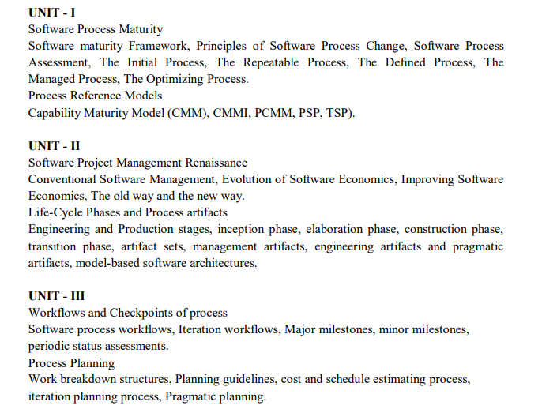

Slide 3
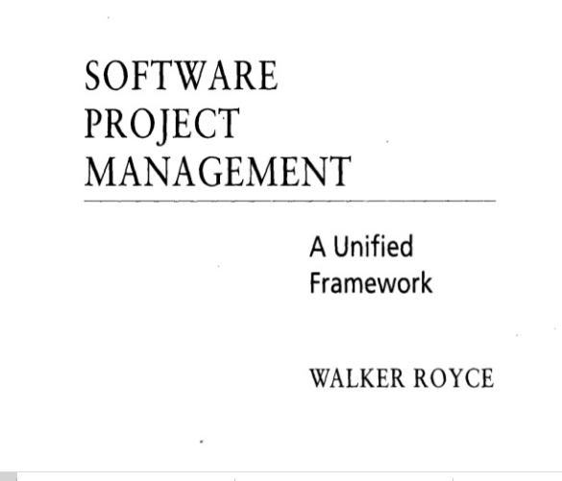
QUESTION-2
What does “Timeboxed” means in Agile terms?
A. Fast B. Flexible C. Frequent D. Fixed

Slide 4
PSP Benefits
Increases personal commitment by investing each engineer with process responsibility
Assists engineers in making accurate plans
Provides steps engineers can take to improve personal and project quality
Sets benchmarks to measure personal process improvements
Demonstrates the impact of process changes on an engineer's performance

Slide 5
Team Software Process (Tsp)
In combination with the personal software process (PSP), the team software process (TSP) provides a defined operational process framework that is designed to help teams of managers and engineers organize projects.
TSP Strategy
Provide a simple process framework based on the PSP.
Use modest, well-defined problems.
Develop products in several cycles.
Establish standard measures for quality and performance.
Provide detailed role definitions.
Use role and team evaluations.
Require process discipline.
Provide guidance on teamwork problems.

Slide 6
LIFE CYCLE PROCESS
LAUNCH
STRATEGY
PLAN
REQUIREMENTS
DESIGN
IMPLEMENT
TEST
POSTMORTEM

Slide 7
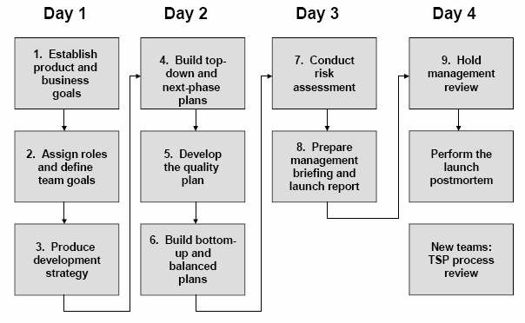
Launch Process
Figure 9: Launch Process

Slide 8
Conventional Software Management
The waterfall model of conventional software management, which is still prevalent in many mature software organizations, has served its purpose.
A comparison of conventional and modern software development models illustrates some of the critical discriminators in this transition.
The life cycle typically follows a sequential transition from requirements to design to code to testing, with ad hoc documentation that attempts to capture complete intermediate representations at every stage.

Slide 9
The top 10 principles of conventional software management are:
1. Freeze requirements before design.
2. Forbid coding before detailed design review.
3. Use a higher-order programming language.
4. Complete unit testing before integration.
5. Maintain detailed traceability among all artifacts.
6. Thoroughly document each stage of the design.
7. Assess quality with an independent team.
8. Inspect everything.
9. Plan everything early with high fidelity.
10. Rigorously control source-code baselines.

Slide 10

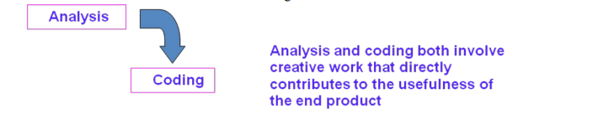
WATERFALL MODEL

Slide 11
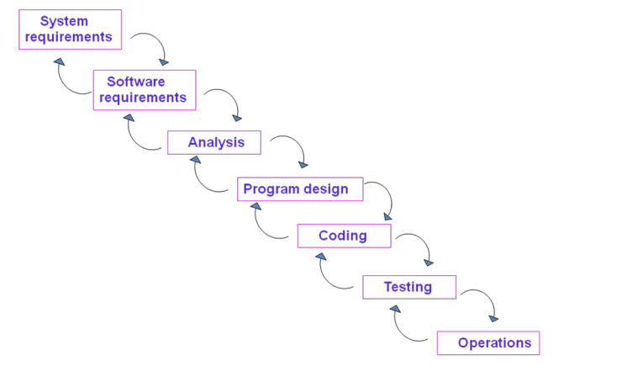

Slide 12
There are five improvements to the basic waterfall model that would eliminate most of the development risks are as follows:
Complete program design before analysis and coding begin (program design comes first)
Maintain current and complete documentation (Document the design)
Do the job twice, if possible (Do it twice)
Plan, control, and monitor testing
Involve the customer

Slide 13
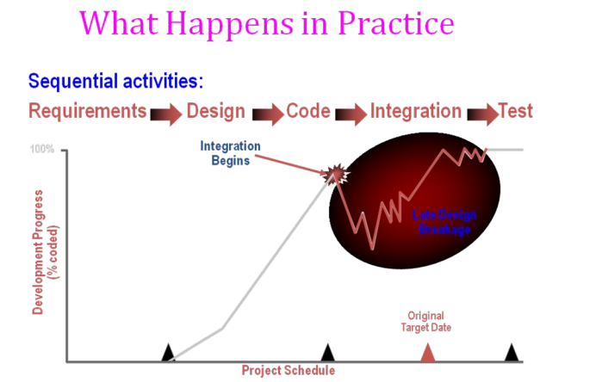

Slide 14
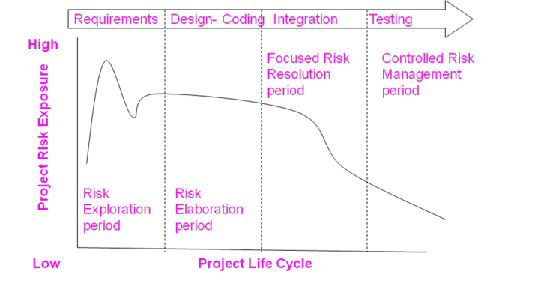
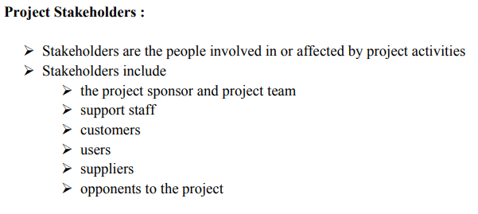
ANSWER
D. More often than daily

Slide 15
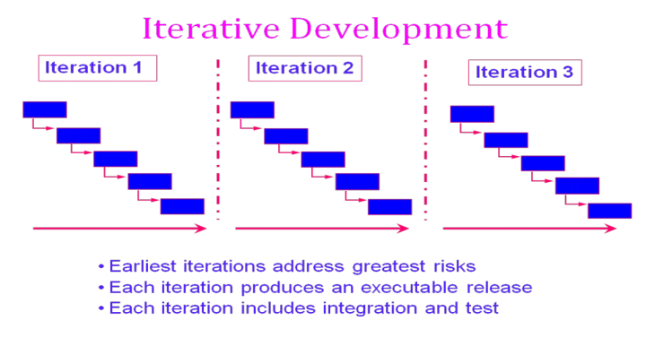

Slide 16
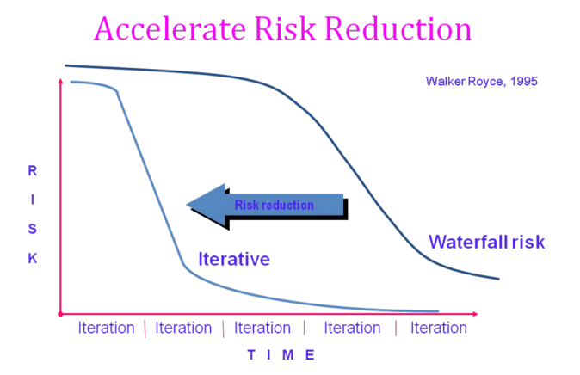

Slide 17
CONVENTIONAL SOFTWARE MANAGEMENT PERFORMANCE Barry Boehm’s Top 10 “Industrial Software Metrics”:
Finding and fixing a software problem after delivery costs 100 times more than finding and fixing the problem in early design phases.
You can compress software development schedules 25% of nominal (small), but no more.
For every $1 you spend on development, you will spend $2 on maintenance.
Software development and maintenance costs are primarily a function of the number of source lines of code.
Variations among people account for the biggest difference in software productivity.
The overall ratio of software to hardware costs is still growing. In 1955 it was 15:85; in 1985, 85:15.
Only about 15% of software development effort is devoted to programming.
Software systems and products typically cost 3 times as much per SLOC as individual software programs. Software-system products cost 9 times as much.
Walkthroughs catch 60% of the errors.
80% of the contribution comes from 20% of the contributors.
- 80% of the engineering is consumed by 20% of the requirements.
- 80% of the software cost is consumed by 20% of the components.
- 80% of the errors are caused by 20% of the components.
- 80% of the software scrap and rework is caused by 20% of the errors.
- 80% of the resources are consumed by 20% of the components.
- 80% of the engineering is accomplished by 20% of the tools.
- 80% of the progress is made by 20% of the people.

