Slide 1
SPPM Conventional software management 11/09/2020
BY: NEHA NANDAL

Slide 2
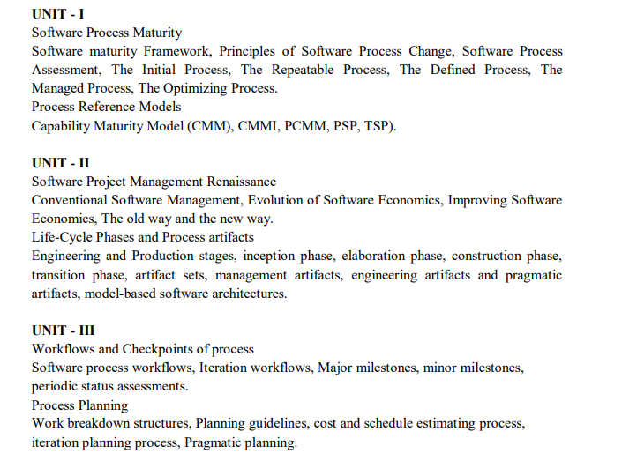

Slide 3
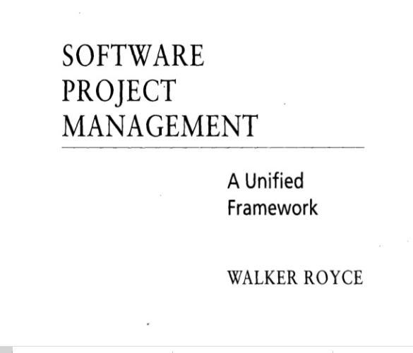
QUESTION-2
What does “Timeboxed” means in Agile terms?
A. Fast B. Flexible C. Frequent D. Fixed

Slide 4
Conventional Software Management
The waterfall model of conventional software management, which is still prevalent in many mature software organizations, has served its purpose.
A comparison of conventional and modern software development models illustrates some of the critical discriminators in this transition.
The life cycle typically follows a sequential transition from requirements to design to code to testing, with ad hoc documentation that attempts to capture complete intermediate representations at every stage.

Slide 5
The top 10 principles of conventional software management are:
1. Freeze requirements before design.
2. Forbid coding before detailed design review.
3. Use a higher-order programming language.
4. Complete unit testing before integration.
5. Maintain detailed traceability among all artifacts.
6. Thoroughly document each stage of the design.
7. Assess quality with an independent team.
8. Inspect everything.
9. Plan everything early with high fidelity.
10. Rigorously control source-code baselines.

Slide 6

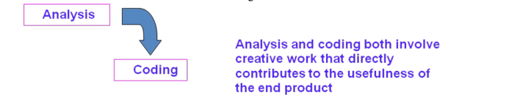
WATERFALLL MODEL

Slide 7
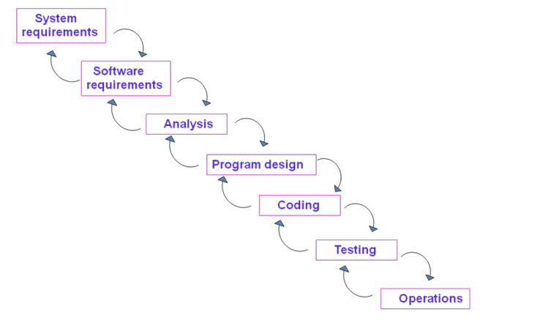

Slide 8
There are five improvements to the basic waterfall model that would eliminate most of the development risks are as follows:
Complete program design before analysis and coding begin (program design comes first)
Maintain current and complete documentation (Document the design)
Do the job twice, if possible (Do it twice)
Plan, control, and monitor testing
Involve the customer

Slide 9
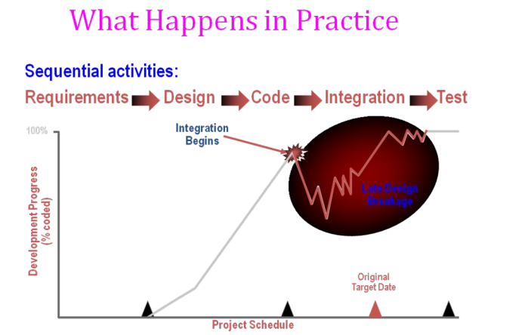

Slide 10
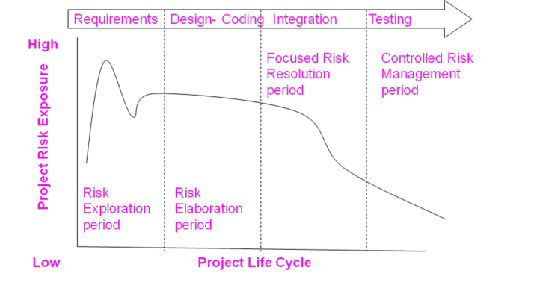
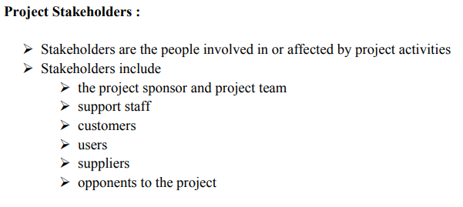
ANSWER
D. More often than daily

Slide 11
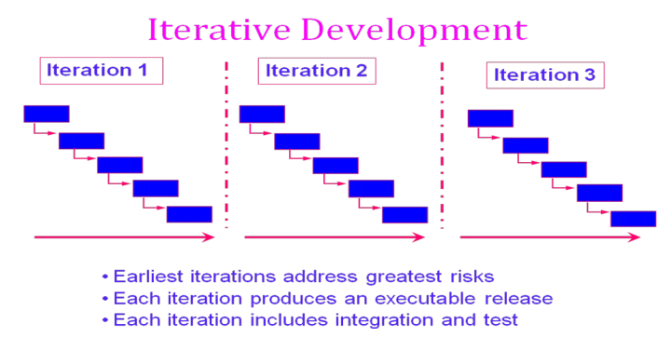

Slide 12
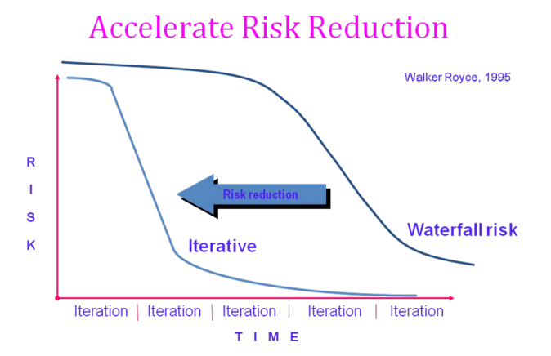

Slide 13
CONVENTIONAL SOFTWARE MANAGEMENT PERFORMANCE Barry Boehm’s Top 10 “Industrial Software Metrics”:
Finding and fixing a software problem after delivery costs 100 times more than finding and fixing the problem in early design phases.
You can compress software development schedules 25% of nominal (small), but no more.
For every $1 you spend on development, you will spend $2 on maintenance.
Software development and maintenance costs are primarily a function of the number of source lines of code.
Variations among people account for the biggest difference in software productivity.
The overall ratio of software to hardware costs is still growing. In 1955 it was 15:85; in 1985, 85:15.
Only about 15% of software development effort is devoted to programming.
Software systems and products typically cost 3 times as much per SLOC as individual software programs. Software-system products cost 9 times as much.
Walkthroughs catch 60% of the errors.
80% of the contribution comes from 20% of the contributors.
- 80% of the engineering is consumed by 20% of the requirements.
- 80% of the software cost is consumed by 20% of the components.
- 80% of the errors are caused by 20% of the components.
- 80% of the software scrap and rework is caused by 20% of the errors.
- 80% of the resources are consumed by 20% of the components.
- 80% of the engineering is accomplished by 20% of the tools.
- 80% of the progress is made by 20% of the people.

Slide 14
Evolution Of Software Economics
Five basic parameters: size, process, personnel, environment, and required quality.
1. The size of the end product (in human-generated components), which is typically quantified in terms of the number of source instructions or the number of function points required to develop the required functionality
2. The process used to produce the end product, in particular the ability of the process to avoid non- value-adding activities (rework, bureaucratic delays, communications overhead)
3. The capabilities of software engineering personnel, and particularly their experience with the computer science issues and the applications domain issues of the project
4. The environment, which is made up of the tools and techniques available to support efficient software development and to automate the process
5. The required quality of the product, including its features, performance, reliability, and adaptability
The relationships among these parameters and the estimated cost can be written as follows:
Effort = (Personnel) (Environment) (Quality) ( Size^{process})

Slide 15
The three generations of software development are defined as follows:
1) Conventional: 1960s and 1970s, craftsmanship. Organizations used custom tools, custom processes, and virtually all custom components built in primitive languages. Project performance was highly predictable in that cost, schedule, and quality objectives were almost always underachieved.
2) Transition: 1980s and 1990s, software engineering. Organiz:1tions used more-repeatable processes and off- the-shelf tools, and mostly (>70%) custom components built in higher level languages. Some of the components (<30%) were available as commercial products, including the operating system, database management system, networking, and graphical user interface.
3) Modern practices: 2000 and later, software production. The philosophy is rooted in the use of managed and measured processes, integrated automation environments, and mostly (70%) off-the-shelf components. Perhaps as few as 30% of the components need to be custom built Technologies for environment automation, size reduction, and process improvement are not independent of one another. In each new era, the key is complementary growth in all technologies. For example, the process advances could not be used successfully without new component technologies and increased tool automation.

Slide 16
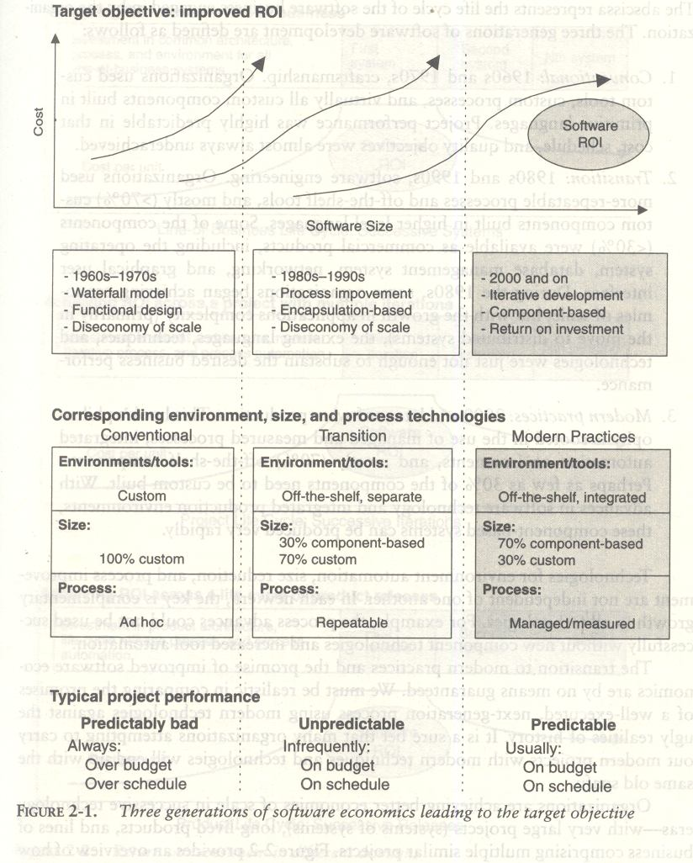

Slide 17

What Does Return On Investment - ROI Mean?
A performance measure used to evaluate the efficiency of an investment or to compare the efficiency of a number of different investments. To calculate ROI, the benefit (return) of an investment is divided by the cost of the investment; the result is expressed as a percentage or a ratio. The return on investment formula: Return on investment i

Slide 18
PRAGMATIC SOFTWARE ESTIMATION:
If there is no proper well-documented case studies then it is difficult to estimate the cost of the software. It is one of the critical problem in software cost estimation.
In order to estimate the cost of a project the following three topics should be considered,
Which cost estimation model to use.
Whether to measure software size in SLOC or function point.
What constitutes a good estimate.
There are a lot of software cost estimation models are available such as, COCOMO, CHECKPOINT, ESTIMACS, Knowledge Plan, Price-S, ProQMS, SEER, SLIM, SOFTCOST, and SPQR/20.

Slide 19
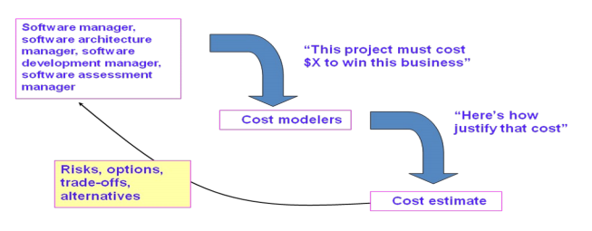
Predominant cost estimation process

Slide 20
Cocomo model
The Constructive Cost Model (COCOMO) is an algorithmic software cost estimation model developed by Barry W. Boehm. The model uses a basic regression formula with parameters that are derived from historical project data and current project characteristics.

