Slide 1
SPPM EVOLUTION OF SOFTWARE ECONOMICS, COCOMO MODEL /09/2020
BY: NEHA NANDAL

Slide 2
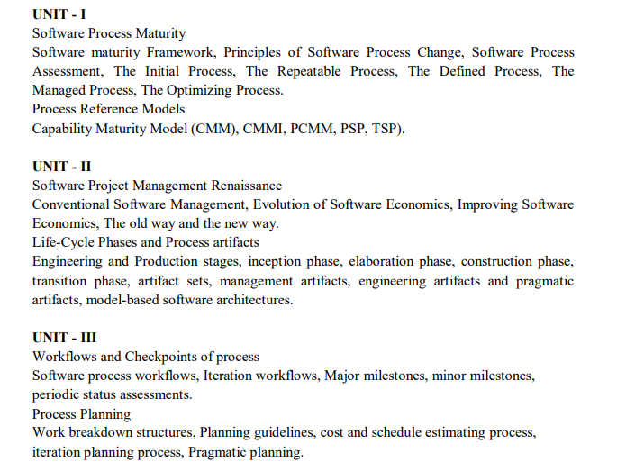

Slide 3
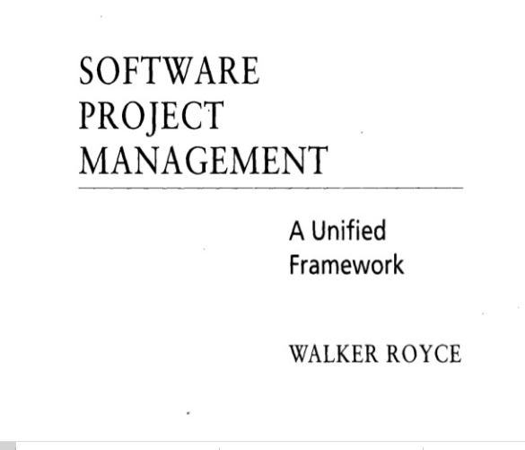
QUESTION-2
What does “Timeboxed” means in Agile terms?
A. Fast B. Flexible C. Frequent D. Fixed

Slide 4
Conventional Software Management
The waterfall model of conventional software management, which is still prevalent in many mature software organizations, has served its purpose.
A comparison of conventional and modern software development models illustrates some of the critical discriminators in this transition.
The life cycle typically follows a sequential transition from requirements to design to code to testing, with ad hoc documentation that attempts to capture complete intermediate representations at every stage.

Slide 5
The top 10 principles of conventional software management are:
1. Freeze requirements before design.
2. Forbid coding before detailed design review.
3. Use a higher-order programming language.
4. Complete unit testing before integration.
5. Maintain detailed traceability among all artifacts.
6. Thoroughly document each stage of the design.
7. Assess quality with an independent team.
8. Inspect everything.
9. Plan everything early with high fidelity.
10. Rigorously control source-code baselines.

Slide 6

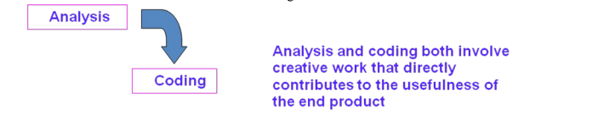
WATERFALLL MODEL

Slide 7
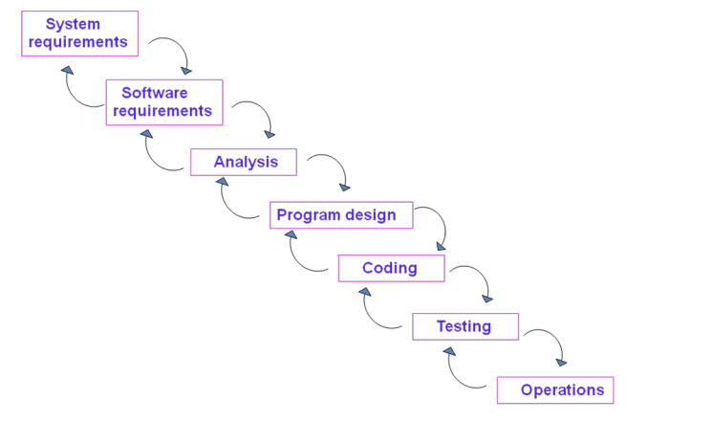

Slide 8
There are five improvements to the basic waterfall model that would eliminate most of the development risks are as follows:
Complete program design before analysis and coding begin (program design comes first)
Maintain current and complete documentation (Document the design)
Do the job twice, if possible (Do it twice)
Plan, control, and monitor testing
Involve the customer

Slide 9
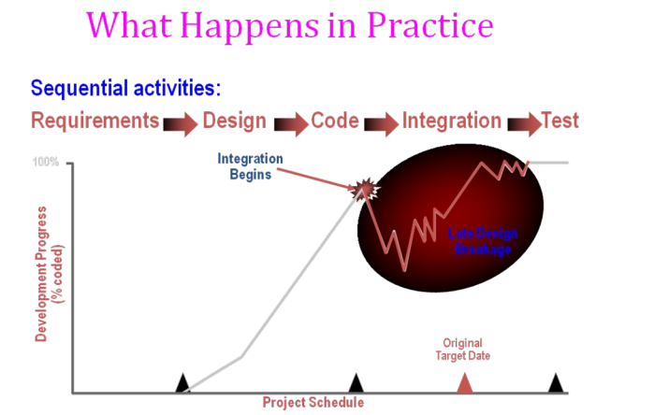

Slide 10
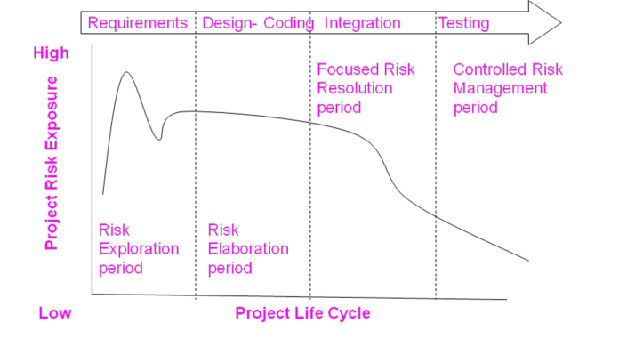
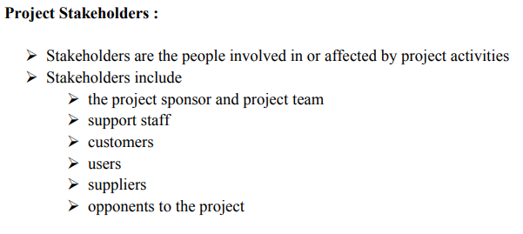
ANSWER
D. More often than daily

Slide 11
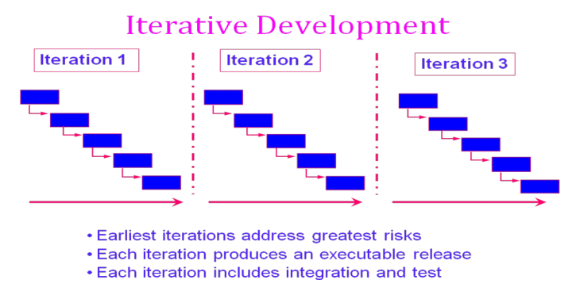

Slide 12
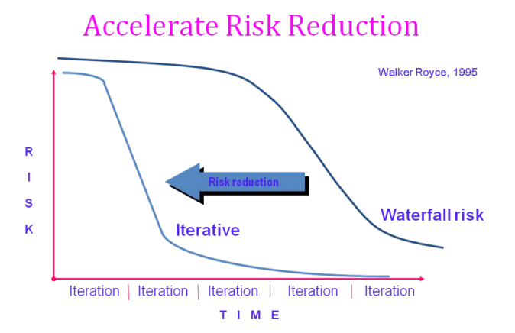

Slide 13
CONVENTIONAL SOFTWARE MANAGEMENT PERFORMANCE Barry Boehm’s Top 10 “Industrial Software Metrics”:
Finding and fixing a software problem after delivery costs 100 times more than finding and fixing the problem in early design phases.
You can compress software development schedules 25% of nominal (small), but no more.
For every $1 you spend on development, you will spend $2 on maintenance.
Software development and maintenance costs are primarily a function of the number of source lines of code.
Variations among people account for the biggest difference in software productivity.
The overall ratio of software to hardware costs is still growing. In 1955 it was 15:85; in 1985, 85:15.
Only about 15% of software development effort is devoted to programming.
Software systems and products typically cost 3 times as much per SLOC as individual software programs. Software-system products cost 9 times as much.
Walkthroughs catch 60% of the errors.
80% of the contribution comes from 20% of the contributors.
- 80% of the engineering is consumed by 20% of the requirements.
- 80% of the software cost is consumed by 20% of the components.
- 80% of the errors are caused by 20% of the components.
- 80% of the software scrap and rework is caused by 20% of the errors.
- 80% of the resources are consumed by 20% of the components.
- 80% of the engineering is accomplished by 20% of the tools.
- 80% of the progress is made by 20% of the people.

Slide 14
Evolution Of Software Economics
Five basic parameters: size, process, personnel, environment, and required quality.
1. The size of the end product (in human-generated components), which is typically quantified in terms of the number of source instructions or the number of function points required to develop the required functionality
2. The process used to produce the end product, in particular the ability of the process to avoid non- value-adding activities (rework, bureaucratic delays, communications overhead)
3. The capabilities of software engineering personnel, and particularly their experience with the computer science issues and the applications domain issues of the project
4. The environment, which is made up of the tools and techniques available to support efficient software development and to automate the process
5. The required quality of the product, including its features, performance, reliability, and adaptability
The relationships among these parameters and the estimated cost can be written as follows:
Effort = (Personnel) (Environment) (Quality) ( Size^{process})

Slide 15
The three generations of software development are defined as follows:
1) Conventional: 1960s and 1970s, craftsmanship. Organizations used custom tools, custom processes, and virtually all custom components built in primitive languages. Project performance was highly predictable in that cost, schedule, and quality objectives were almost always underachieved.
2) Transition: 1980s and 1990s, software engineering. Organiz:1tions used more-repeatable processes and off- the-shelf tools, and mostly (>70%) custom components built in higher level languages. Some of the components (<30%) were available as commercial products, including the operating system, database management system, networking, and graphical user interface.
3) Modern practices: 2000 and later, software production. The philosophy is rooted in the use of managed and measured processes, integrated automation environments, and mostly (70%) off-the-shelf components. Perhaps as few as 30% of the components need to be custom built Technologies for environment automation, size reduction, and process improvement are not independent of one another. In each new era, the key is complementary growth in all technologies. For example, the process advances could not be used successfully without new component technologies and increased tool automation.

Slide 16
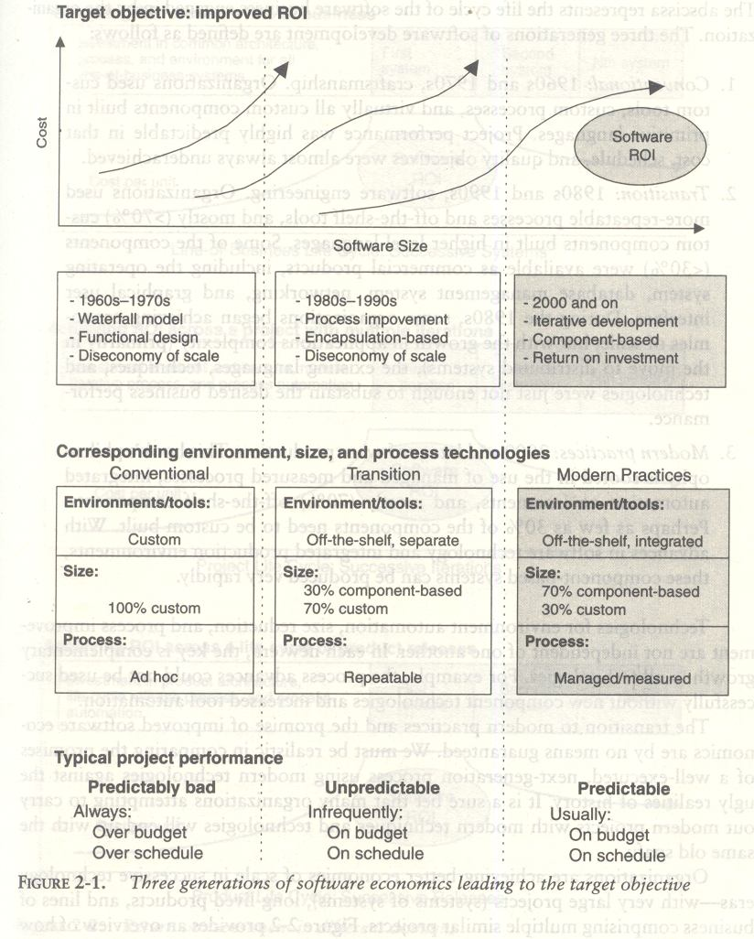

Slide 17

What Does Return On Investment - ROI Mean?
A performance measure used to evaluate the efficiency of an investment or to compare the efficiency of a number of different investments. To calculate ROI, the benefit (return) of an investment is divided by the cost of the investment; the result is expressed as a percentage or a ratio. The return on investment formula: Return on investment i

Slide 18
PRAGMATIC SOFTWARE ESTIMATION:
If there is no proper well-documented case studies then it is difficult to estimate the cost of the software. It is one of the critical problem in software cost estimation.
In order to estimate the cost of a project the following three topics should be considered,
Which cost estimation model to use.
Whether to measure software size in SLOC or function point.
What constitutes a good estimate.
There are a lot of software cost estimation models are available such as, COCOMO, CHECKPOINT, ESTIMACS, Knowledge Plan, Price-S, ProQMS, SEER, SLIM, SOFTCOST, and SPQR/20.

Slide 19
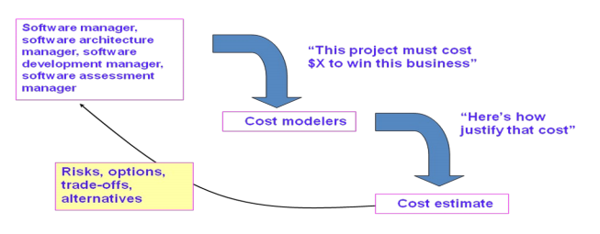
Predominant cost estimation process

Slide 20
Cocomo model
The Constructive Cost Model (COCOMO) is an algorithmic software cost estimation model developed by Barry W. Boehm. The model uses a basic regression formula with parameters that are derived from historical project data and current project characteristics.
This cost estimation model is extensively used in predicting the effort, development time, average team size and effort required to develop a software project.

Slide 21
Software projects under COCOMO model strategies are classified to 3 categories including, organic, semi-detached, and embedded.
Organic
This suits a small software team since it has a generally stable development environment. The problem is well understood and has been solved in the past.
Semi-detached
The software project which requires more experience and better guidance and creativity. For example, Compiler or different Embedded System
Embedded
The project with operating tight constraints and requirements is under this category. The developer requires high experiences and has to be creative to develop complex models.

Slide 22
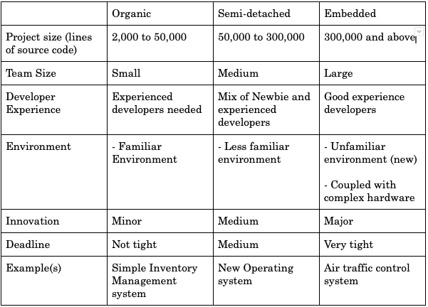
The table below indicates the criteria for selecting the type of software project to be applied for further calculation in the model.

Slide 23
There are basic COCOMO, Intermediate COCOMO, and Detailed/Completed COCOMO.
Basic COCOMO model
The basic COCOMO is used for rough calculation which limits accuracy in calculating software estimation. This is because the model solely considers based on lines of source code together with constant values obtained from software project types rather than other factors which have major influences to Software development process as a whole.
Intermediate COCOMO model
Intermediate COCOMO model is an extension of the Basic COCOMO model which includes a set of cost drivers into account in order to enhance more accuracy to the cost estimation model as a result.
Complete/detailed COCOMO model
The model incorporates all qualities of both Basic COCOMO and Intermediate COCOMO strategies on each software engineering process. The model accounts for the influence of the individual development phase (analysis, design, etc.) of the project.

Slide 24
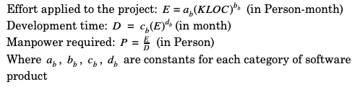
The arithmetic formula of Basic COCOMO is
The arithmetic formula of Basic COCOMO is

Slide 25
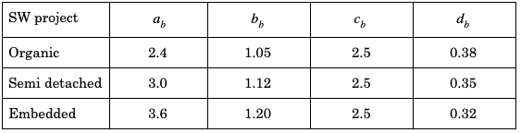
Each of the constant a, b, c, d can be defined as show in the Table 2.

Slide 26
question
A company needs to develop digital signal processing software for one of its newest inventions. The software is expected to have 40000 lines of code. The company needs to determine the effort in person-months needed to develop this software using the basic COCOMO model. The multiplicative factor for this model is given as 2.8 for the software development on embedded systems, while the exponentiation factor is given as 1.20. What is the estimated effort in person-months?

Slide 27
Effort Applied (E) = a_{b}(KLOC)^{b}_{b} [ person-months ] = 2.8 x(40)1.20 = 2.8 x 83.65 = 234.25
Effort Applied (E) = a_{b}(KLOC)^{b}_{b} [ person-months ]
= 2.8 x(40)^1.20
= 2.8 x 83.65
= 234.25

Slide 28
Intermediate COCOMO
Intermediate COCOMO computes software development effort as function of program size and a set of "cost drivers" that include subjective assessment of product, hardware, personnel and project attributes. This extension considers a set of four "cost drivers", each with a number of subsidiary attributes

Slide 29
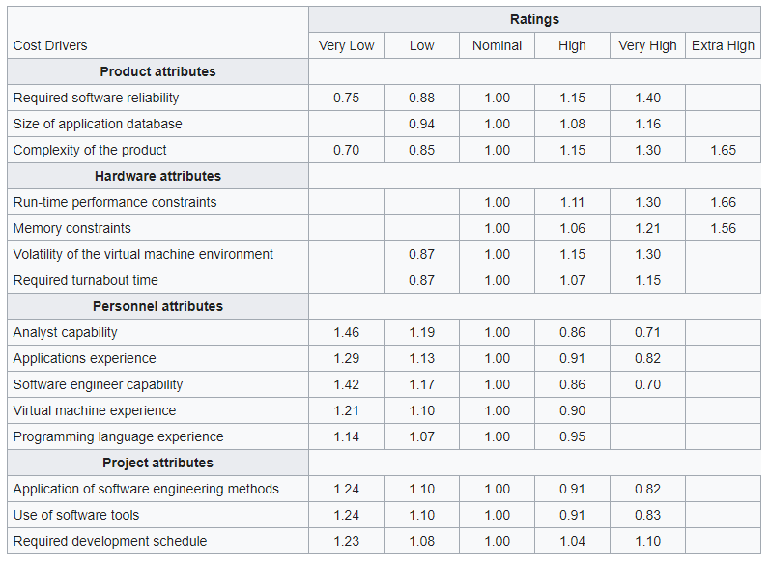
Each of the 15 attributes receives a rating on a six-point scale that ranges from "very low" to "extra high" (in importance or value). An effort multiplier from the table below applies to the rating. The product of all effort multipliers results in an effort adjustment factor (EAF). Typical values for EAF range from 0.9 to 1.4.

Slide 30
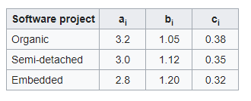
The Intermediate Cocomo formula now takes the form:
E=a_{i}(KLoC)^{(b}_{i}⁾(EAF)
where E is the effort applied in person-months, KLoC is the estimated number of thousands of delivered lines of code for the project, and EAF is the factor calculated above. The coefficient a_{i} and the exponent b_{i} are given in the next table.
The Development time D and also the most effective number of Persons P calculation uses E in the same way as in the Basic COCOMO:
D=2.5 E^{(c}_{i}⁾
P=E/D

Slide 31
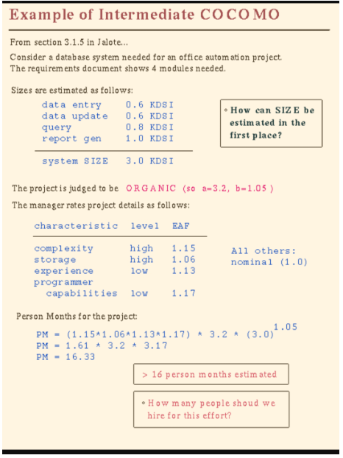

Slide 32
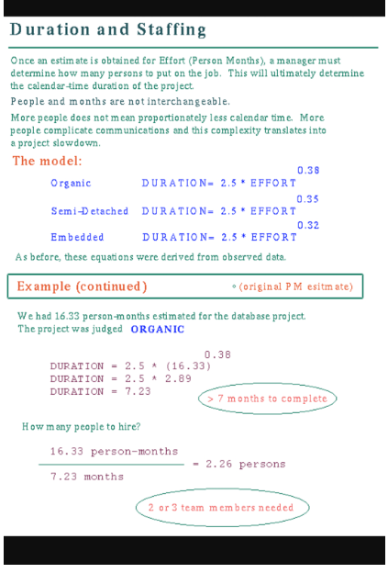

Slide 33
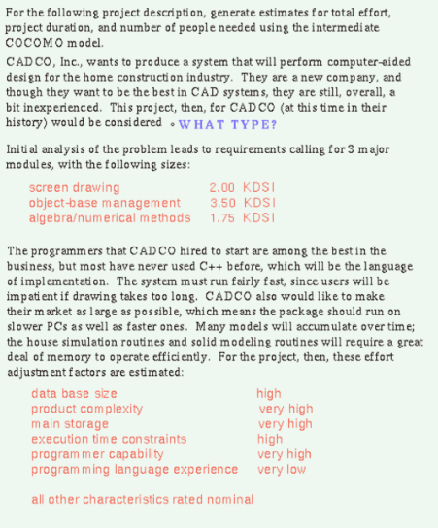

Slide 34
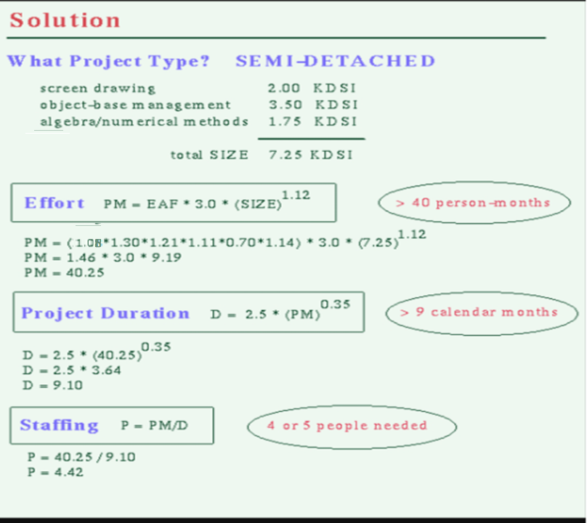

Slide 35
Improving Software Economics
Five basic parameters of the software cost model are
Reducing the size or complexity of what needs to be developed
Improving the development process
Using more-skilled personnel and better teams (not necessarily the same thing)
Using better environments (tools to automate the process)
Trading off or backing off on quality thresholds

Slide 36
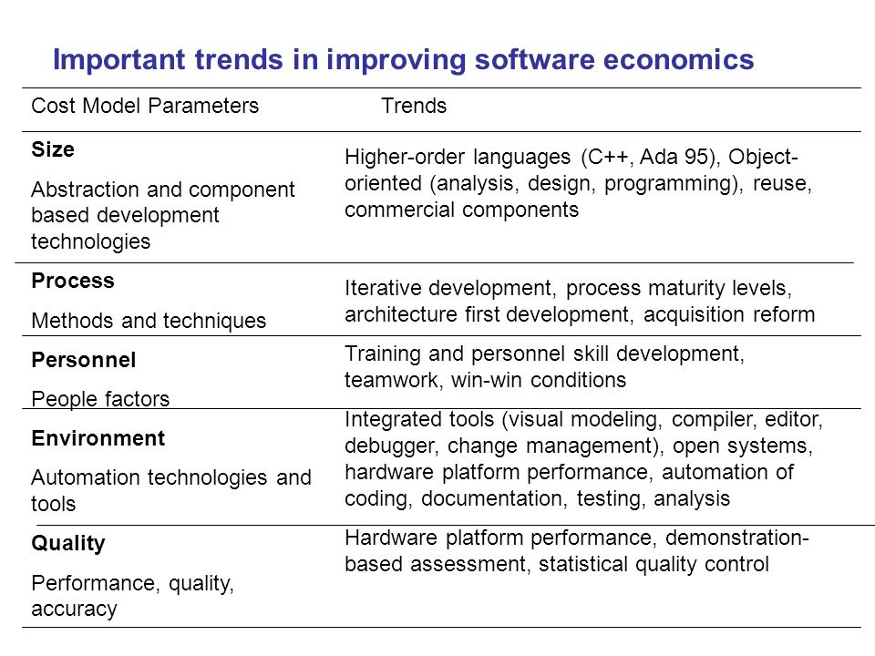

Slide 37
The Old Way and The New
PRINCIPLES OF CONVENTIONAL SE
Make Quality
High Quality software is possible
Give products to customers early
Determine the problem before writing the requirements
Evaluate design alternatives
Use appropriate process model
Minimize Intellectual distance
Put techniques before tools

Slide 38
The Old Way and The New
PRINCIPLES OF CONVENTIONAL SE
Get it right before you make it faster
Inspect code
Good management
People are key to success
Follow with care
Take responsibility
Understand the customer’s priority
The more they see, more they need

