Slide 1
SPPM LIFE CYCLE PHASES 18/09/2020
BY: NEHA NANDAL

Slide 2
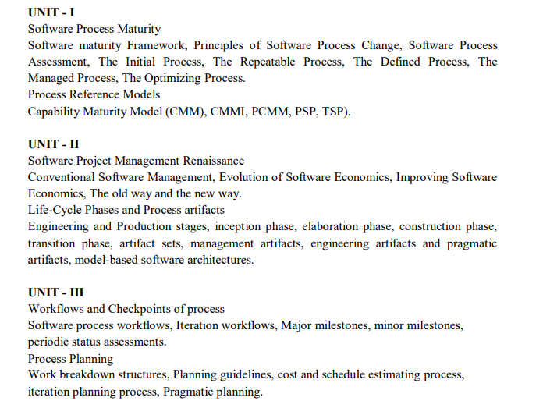

Slide 3
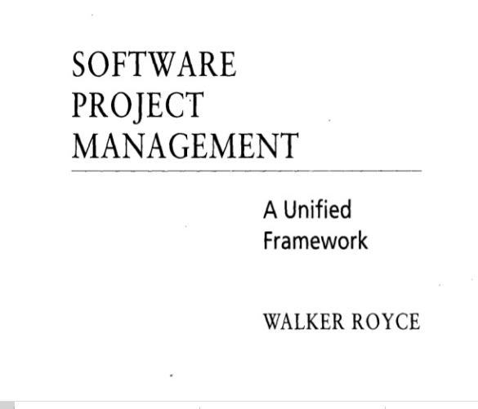
QUESTION-2
What does “Timeboxed” means in Agile terms?
A. Fast B. Flexible C. Frequent D. Fixed

Slide 4
Evolution Of Software Economics
Five basic parameters: size, process, personnel, environment, and required quality.
1. The size of the end product (in human-generated components), which is typically quantified in terms of the number of source instructions or the number of function points required to develop the required functionality
2. The process used to produce the end product, in particular the ability of the process to avoid non- value-adding activities (rework, bureaucratic delays, communications overhead)
3. The capabilities of software engineering personnel, and particularly their experience with the computer science issues and the applications domain issues of the project
4. The environment, which is made up of the tools and techniques available to support efficient software development and to automate the process
5. The required quality of the product, including its features, performance, reliability, and adaptability
The relationships among these parameters and the estimated cost can be written as follows:
Effort = (Personnel) (Environment) (Quality) ( Size^{process})

Slide 5
The three generations of software development are defined as follows:
1) Conventional: 1960s and 1970s, craftsmanship. Organizations used custom tools, custom processes, and virtually all custom components built in primitive languages. Project performance was highly predictable in that cost, schedule, and quality objectives were almost always underachieved.
2) Transition: 1980s and 1990s, software engineering. Organiz:1tions used more-repeatable processes and off- the-shelf tools, and mostly (>70%) custom components built in higher level languages. Some of the components (<30%) were available as commercial products, including the operating system, database management system, networking, and graphical user interface.
3) Modern practices: 2000 and later, software production. The philosophy is rooted in the use of managed and measured processes, integrated automation environments, and mostly (70%) off-the-shelf components. Perhaps as few as 30% of the components need to be custom built Technologies for environment automation, size reduction, and process improvement are not independent of one another. In each new era, the key is complementary growth in all technologies. For example, the process advances could not be used successfully without new component technologies and increased tool automation.

Slide 6
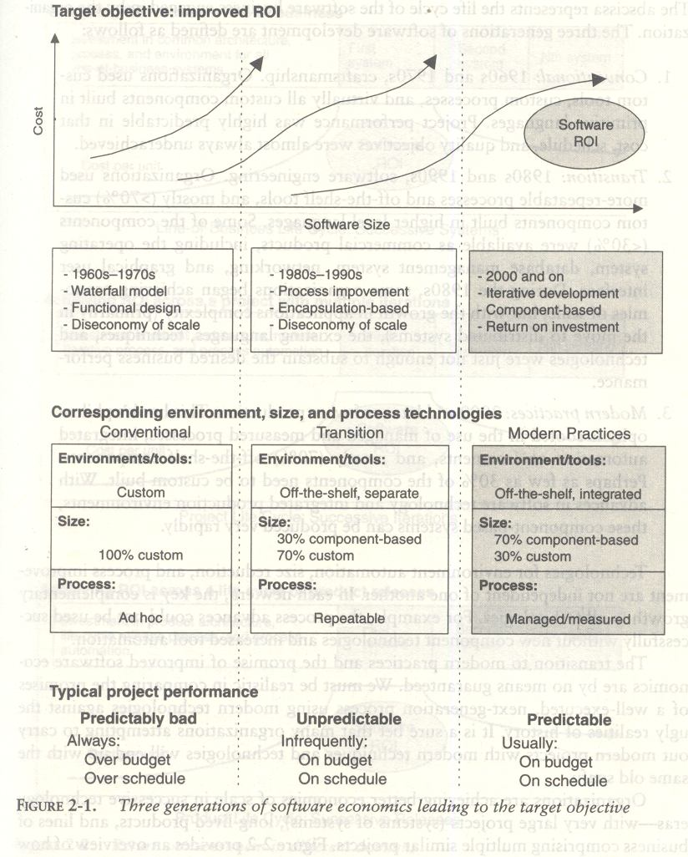

Slide 7

What Does Return On Investment - ROI Mean?
A performance measure used to evaluate the efficiency of an investment or to compare the efficiency of a number of different investments. To calculate ROI, the benefit (return) of an investment is divided by the cost of the investment; the result is expressed as a percentage or a ratio. The return on investment formula: Return on investment i

Slide 8
PRAGMATIC SOFTWARE ESTIMATION:
If there is no proper well-documented case studies then it is difficult to estimate the cost of the software. It is one of the critical problem in software cost estimation.
In order to estimate the cost of a project the following three topics should be considered,
Which cost estimation model to use.
Whether to measure software size in SLOC or function point.
What constitutes a good estimate.
There are a lot of software cost estimation models are available such as, COCOMO, CHECKPOINT, ESTIMACS, Knowledge Plan, Price-S, ProQMS, SEER, SLIM, SOFTCOST, and SPQR/20.

Slide 9
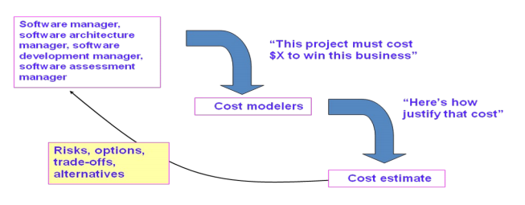
Predominant cost estimation process

Slide 10
Cocomo model
The Constructive Cost Model (COCOMO) is an algorithmic software cost estimation model developed by Barry W. Boehm. The model uses a basic regression formula with parameters that are derived from historical project data and current project characteristics.
This cost estimation model is extensively used in predicting the effort, development time, average team size and effort required to develop a software project.

Slide 11
Software projects under COCOMO model strategies are classified to 3 categories including, organic, semi-detached, and embedded.
Organic
This suits a small software team since it has a generally stable development environment. The problem is well understood and has been solved in the past.
Semi-detached
The software project which requires more experience and better guidance and creativity. For example, Compiler or different Embedded System
Embedded
The project with operating tight constraints and requirements is under this category. The developer requires high experiences and has to be creative to develop complex models.

Slide 12
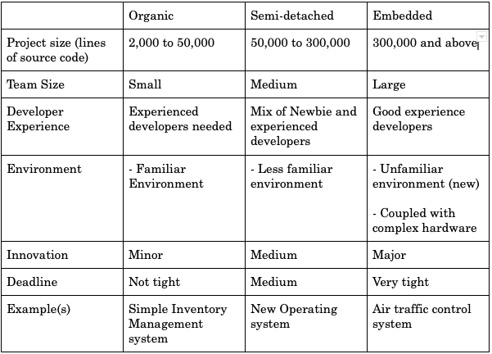
The table below indicates the criteria for selecting the type of software project to be applied for further calculation in the model.

Slide 13
There are basic COCOMO, Intermediate COCOMO, and Detailed/Completed COCOMO.
Basic COCOMO model
The basic COCOMO is used for rough calculation which limits accuracy in calculating software estimation. This is because the model solely considers based on lines of source code together with constant values obtained from software project types rather than other factors which have major influences to Software development process as a whole.
Intermediate COCOMO model
Intermediate COCOMO model is an extension of the Basic COCOMO model which includes a set of cost drivers into account in order to enhance more accuracy to the cost estimation model as a result.
Complete/detailed COCOMO model
The model incorporates all qualities of both Basic COCOMO and Intermediate COCOMO strategies on each software engineering process. The model accounts for the influence of the individual development phase (analysis, design, etc.) of the project.

Slide 14
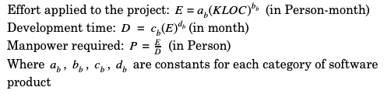
The arithmetic formula of Basic COCOMO is
The arithmetic formula of Basic COCOMO is

Slide 15
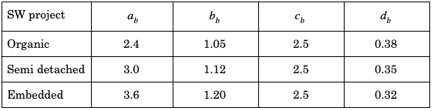
Each of the constant a, b, c, d can be defined as show in the Table 2.

Slide 16
question
A company needs to develop digital signal processing software for one of its newest inventions. The software is expected to have 40000 lines of code. The company needs to determine the effort in person-months needed to develop this software using the basic COCOMO model. The multiplicative factor for this model is given as 2.8 for the software development on embedded systems, while the exponentiation factor is given as 1.20. What is the estimated effort in person-months?

Slide 17
Effort Applied (E) = a_{b}(KLOC)^{b}_{b} [ person-months ] = 2.8 x(40)1.20 = 2.8 x 83.65 = 234.25
Effort Applied (E) = a_{b}(KLOC)^{b}_{b} [ person-months ]
= 2.8 x(40)^1.20
= 2.8 x 83.65
= 234.25

Slide 18
Intermediate COCOMO
Intermediate COCOMO computes software development effort as function of program size and a set of "cost drivers" that include subjective assessment of product, hardware, personnel and project attributes. This extension considers a set of four "cost drivers", each with a number of subsidiary attributes

Slide 19
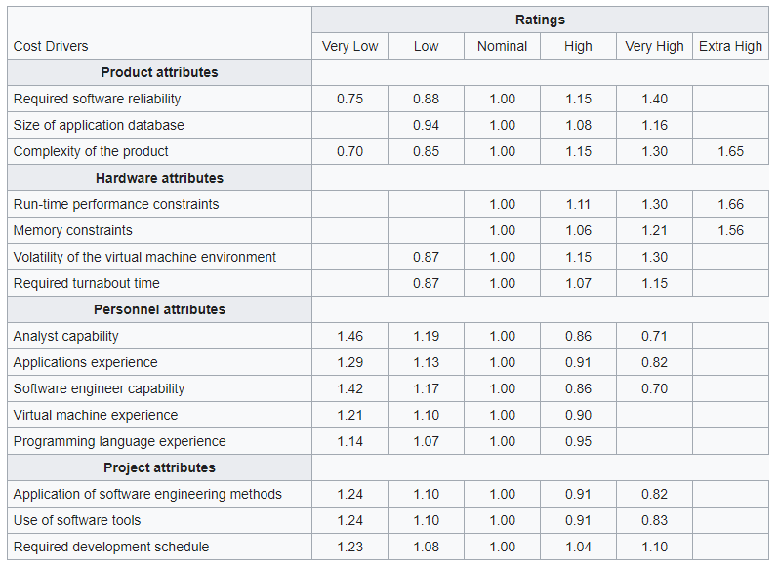
Each of the 15 attributes receives a rating on a six-point scale that ranges from "very low" to "extra high" (in importance or value). An effort multiplier from the table below applies to the rating. The product of all effort multipliers results in an effort adjustment factor (EAF). Typical values for EAF range from 0.9 to 1.4.

Slide 20
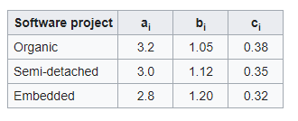
The Intermediate Cocomo formula now takes the form:
E=a_{i}(KLoC)^{(b}_{i}⁾(EAF)
where E is the effort applied in person-months, KLoC is the estimated number of thousands of delivered lines of code for the project, and EAF is the factor calculated above. The coefficient a_{i} and the exponent b_{i} are given in the next table.
The Development time D and also the most effective number of Persons P calculation uses E in the same way as in the Basic COCOMO:
D=2.5 E^{(c}_{i}⁾
P=E/D

Slide 21
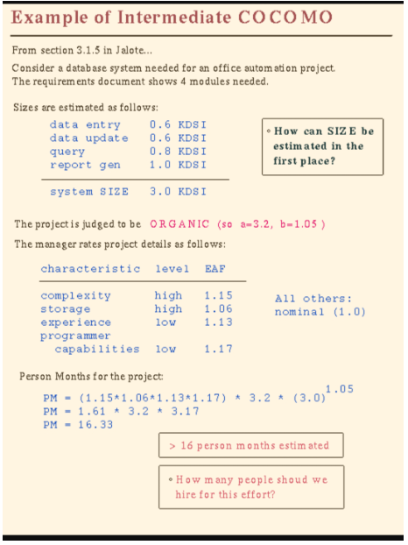

Slide 22
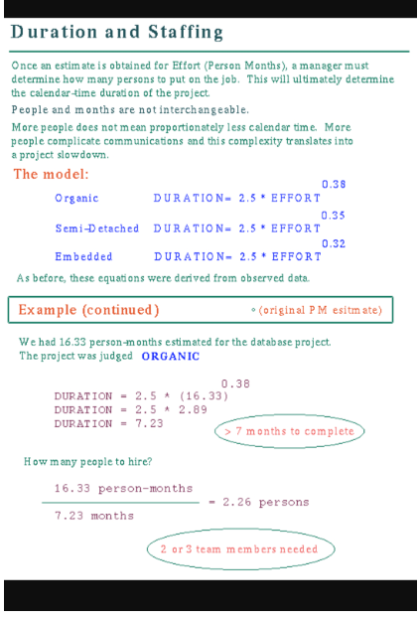

Slide 23
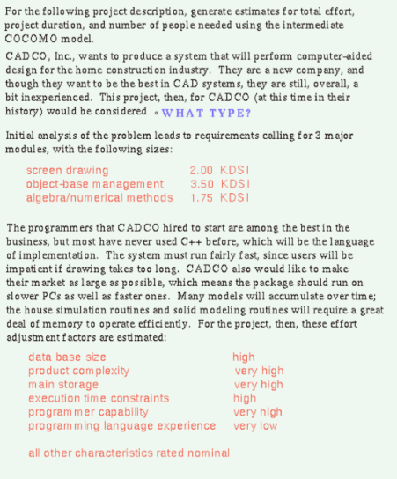

Slide 24
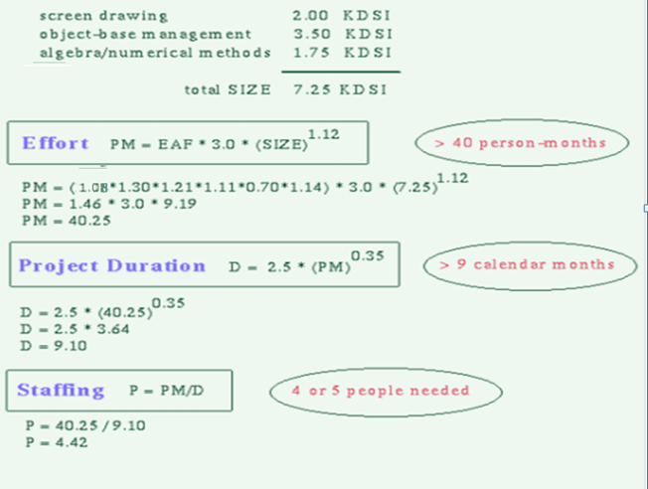

Slide 25
Improving Software Economics
Five basic parameters of the software cost model are
Reducing the size or complexity of what needs to be developed
Improving the development process
Using more-skilled personnel and better teams (not necessarily the same thing)
Using better environments (tools to automate the process)
Trading off or backing off on quality thresholds

Slide 26
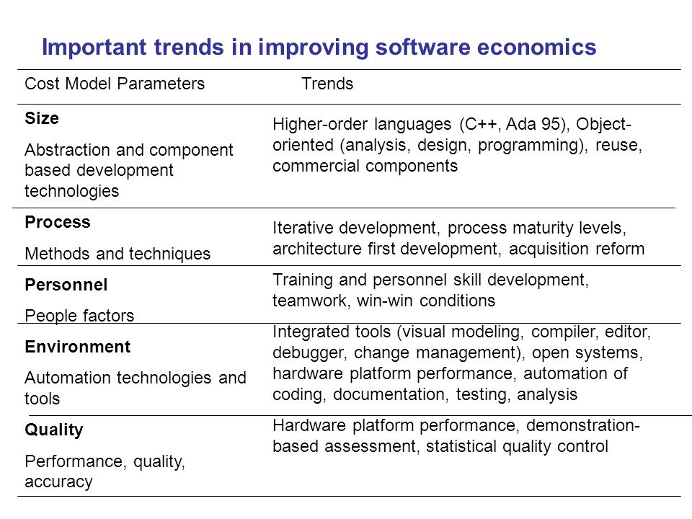

Slide 27
The Old Way and The New
PRINCIPLES OF CONVENTIONAL SE
Make Quality
High Quality software is possible
Give products to customers early
Determine the problem before writing the requirements
Evaluate design alternatives
Use appropriate process model
Minimize Intellectual distance
Put techniques before tools

Slide 28
The Old Way and The New
PRINCIPLES OF CONVENTIONAL SE
Get it right before you make it faster
Inspect code
Good management
People are key to success
Follow with care
Take responsibility
Understand the customer’s priority
The more they see, more they need
Realize that software's entropy increases.
People and time are not interchangeable

Slide 29
The Old Way and The New
PRINCIPLES OF MODERN SE
Base the process on an architecture
Establish an iterative life-cycle process that confronts risk early
Transition design methods to emphasize component-based development
Establish a change management environment
Enhance change freedom through tools that support round-trip engineering
Use a demonstration
Plan intermediate releases in groups of usage scenarios with evolving levels of detail
Establish a configurable process that is economically scalable

Slide 30
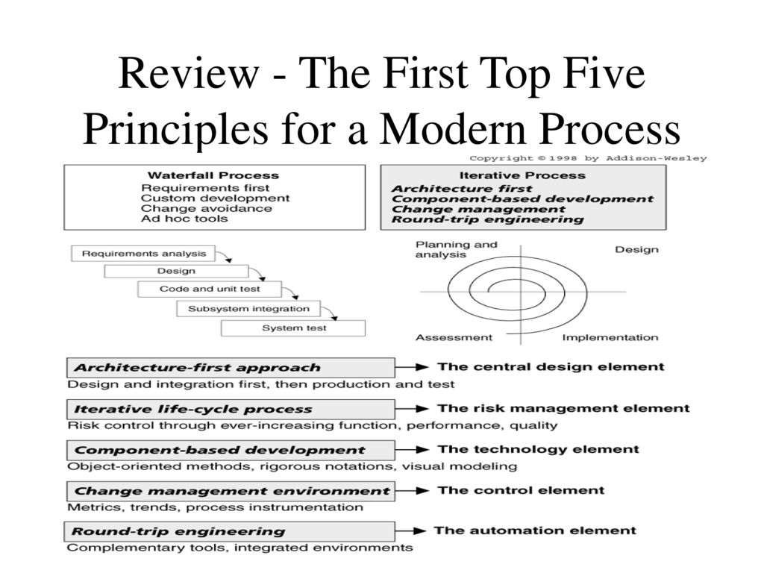

Slide 31
Life-Cycle Phases
LIFE - CYCLE ASPECT | ENGINEERING STAGE EMPHASIS | PRODUCTION STAGE EMPHASIS
Risk reduction | Schedule, technical feasibility | Cost
Products | Architecture baseline | Product release baselines
Activities | Analysis, design, planning | Implementation, testing
Assessment | Demonstration, inspection, analysis | Testing
Economics | Resolving diseconomies of scale | Exploiting economics of scale
Management | Planning | Operations

Slide 32
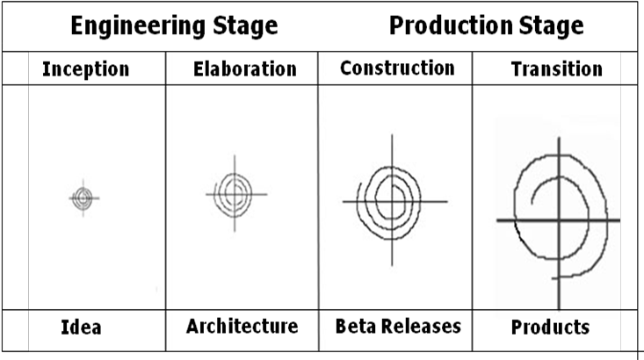
Life Cycle Stages

Slide 33
Inception Phase
Overriding goal of the inception phase is to achieve concurrence among stakeholders on the life- cycle objectives
Essential activities :
Formulating the scope of the project (capturing the requirements and operational concept in an information repository)
Synthesizing the architecture (design trade-offs, problem space ambiguities, and available solution-space assets are evaluated)
Planning and preparing a business case (alternatives for risk management, iteration planes, and cost/schedule/profitability trade-offs are evaluated)

Slide 34
Elaboration Phase
It is easy to argue that the elaboration phase is the most critical of the four phases. At the end of this phase, the “engineering “is considered complete and the project faces its reckoning. During the elaboration phase, an executable architecture prototype is built in one or more iterations, depending on the scope, size, risk and novelty of the project.
Essential activities:
Elaborating the vision (establishing a high-fidelity understanding of the critical use cases that drive architectural or planning decisions)
Elaborating the process and infrastructure (establishing the construction process, the tools and process automation support)
Elaborating the architecture and selecting components (lessons learned from these activities may result in redesign of the architecture)

Slide 35
Construction Phase
During the construction phase :
All remaining components and application features are integrated into the application
All features are thoroughly tested
Essential activities:
Resource management, control, and process optimization
Complete component development and testing against evaluation criteria
Assessment of the product releases against acceptance criteria of the vision

Slide 36
Transition Phase
The transition phase is entered when baseline is mature enough to be deployed in the end-user domain. This phase could include beta testing, conversion of operational databases, and training of users and maintainers.
Essential activities:
Synchronization and integration of concurrent construction into consistent deployment baselines
Deployment-specific engineering (commercial packaging and production, field personnel training)
Assessment of deployment baselines against the complete vision and acceptance criteria in the requirements set

Slide 37
Evaluation Criteria
Is the user satisfied?
Are actual resource expenditures versus planned expenditures acceptable?
Each of the four phases consists of one or more iterations in which some technical capability is produced in demonstrable form and assessed against a set of the criteria.
The transition from one phase to the nest maps more to a significant business decision than to the completion of specific software activity.

Slide 38
Process Artifacts
Life – cycle software artifacts are organized into five distinct sets that are roughly partitioned by the underlying language of the set:
management,
requirements,
design,
implementation, and
deployment.

Slide 39
Management set
The Management set captures the artifacts associated with process planning and execution. Management artifacts are evaluated, assessed and measured through a combination of the following:
a. Relevant stakeholder reviews
b. Analysis of changes between the current version of the artifact and previous versions
c. Major milestone demonstrations of the balance among all artifacts and in particular, the accuracy of the business case and vision artifacts.

Slide 40
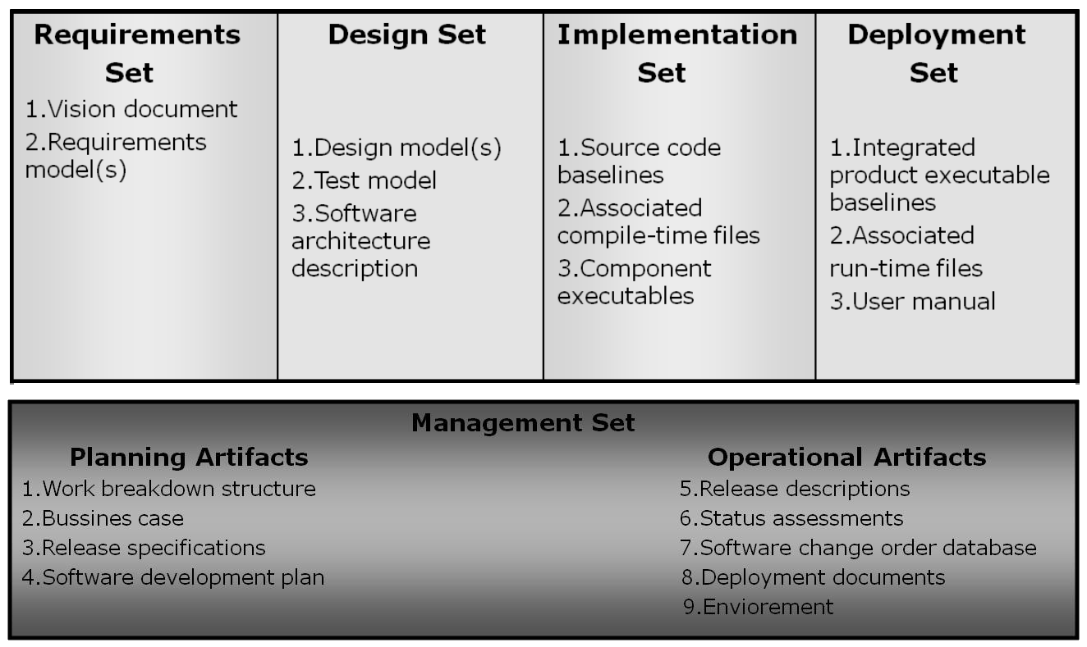
The Engineering Sets:
The engineering sets consist of the requirements set, the design setk the implementation set, and the deployment set.

Slide 41
Management artifacts
The management set includes several artifacts
Work Breakdown Structure –
vehicle for budgeting and collecting costs. The software project manager must have insight into project costs and how they are expended. If the WBS is structured improperly, it can drive the evolving design in the wrong direction.
Business Case –
provides all the information necessary to determine whether the project is worth investing in. It details the expected revenue, expected cost, technical and management plans.
Release Specifications

Slide 42
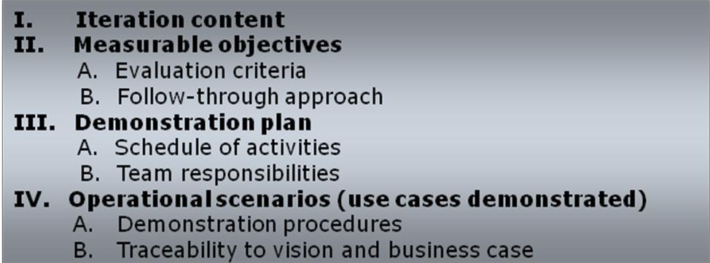
Typical release specification outline :

Slide 43
Two important forms of requirements:
▪Vision statement - which captures the contract between the development group and the buyer.
▪Evaluation criteria – defined as management-oriented requirements, which may be represented by use cases, use case realizations or structured text representations.
➢ Software Development Plan – the defining document for the project’s process. It must comply with the contract, comply with the organization standards, evolve along with the design and requirements.
➢ Deployment – depending on the project, it could include several document subsets for transitioning the product into operational status. It could also include computer system operations manuals, software installation manuals, plans and procedures for cutover etc.
➢ Environment – A robust development environment must support automation of the development process.
It should include: requirements management
visual modeling
document automation
automated regression testing

