Slide 1
SPPM CHECKPOINTS 29/09/2020
BY: NEHA NANDAL

Slide 2
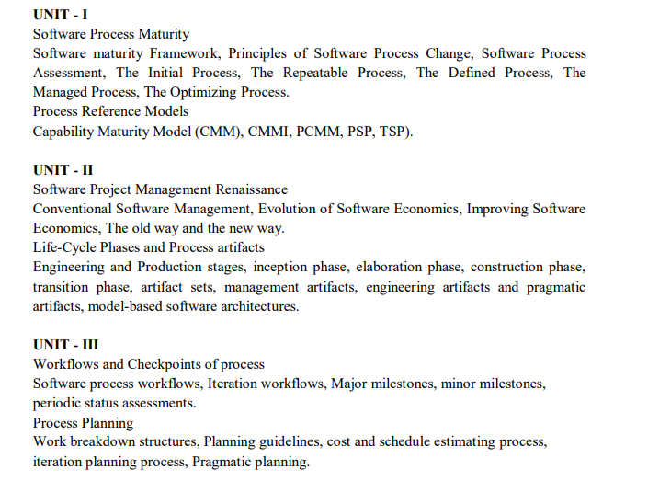

Slide 3
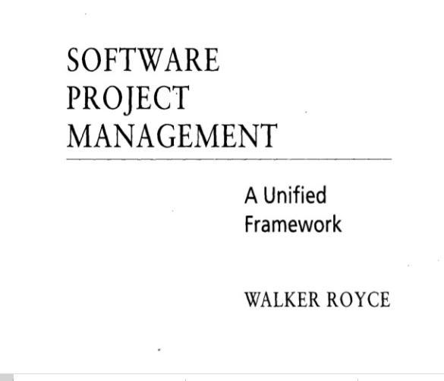
QUESTION-2
What does “Timeboxed” means in Agile terms?
A. Fast B. Flexible C. Frequent D. Fixed

Slide 4
Life-Cycle Phases
LIFE - CYCLE ASPECT | ENGINEERING STAGE EMPHASIS | PRODUCTION STAGE EMPHASIS
Risk reduction | Schedule, technical feasibility | Cost
Products | Architecture baseline | Product release baselines
Activities | Analysis, design, planning | Implementation, testing
Assessment | Demonstration, inspection, analysis | Testing
Economics | Resolving diseconomies of scale | Exploiting economics of scale
Management | Planning | Operations

Slide 5
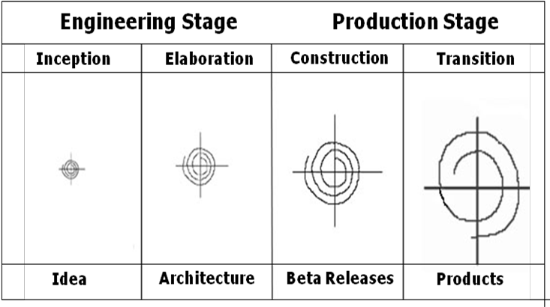
Life Cycle Stages

Slide 6
Inception Phase
Overriding goal of the inception phase is to achieve concurrence among stakeholders on the life- cycle objectives
Essential activities :
Formulating the scope of the project (capturing the requirements and operational concept in an information repository)
Synthesizing the architecture (design trade-offs, problem space ambiguities, and available solution-space assets are evaluated)
Planning and preparing a business case (alternatives for risk management, iteration planes, and cost/schedule/profitability trade-offs are evaluated)

Slide 7
Elaboration Phase
It is easy to argue that the elaboration phase is the most critical of the four phases. At the end of this phase, the “engineering “is considered complete and the project faces its reckoning. During the elaboration phase, an executable architecture prototype is built in one or more iterations, depending on the scope, size, risk and novelty of the project.
Essential activities:
Elaborating the vision (establishing a high-fidelity understanding of the critical use cases that drive architectural or planning decisions)
Elaborating the process and infrastructure (establishing the construction process, the tools and process automation support)
Elaborating the architecture and selecting components (lessons learned from these activities may result in redesign of the architecture)

Slide 8
Construction Phase
During the construction phase :
All remaining components and application features are integrated into the application
All features are thoroughly tested
Essential activities:
Resource management, control, and process optimization
Complete component development and testing against evaluation criteria
Assessment of the product releases against acceptance criteria of the vision

Slide 9
Transition Phase
The transition phase is entered when baseline is mature enough to be deployed in the end-user domain. This phase could include beta testing, conversion of operational databases, and training of users and maintainers.
Essential activities:
Synchronization and integration of concurrent construction into consistent deployment baselines
Deployment-specific engineering (commercial packaging and production, field personnel training)
Assessment of deployment baselines against the complete vision and acceptance criteria in the requirements set

Slide 10
Evaluation Criteria
Is the user satisfied?
Are actual resource expenditures versus planned expenditures acceptable?
Each of the four phases consists of one or more iterations in which some technical capability is produced in demonstrable form and assessed against a set of the criteria.
The transition from one phase to the nest maps more to a significant business decision than to the completion of specific software activity.

Slide 11
Process Artifacts
Life – cycle software artifacts are organized into five distinct sets that are roughly partitioned by the underlying language of the set:
management,
requirements,
design,
implementation, and
deployment.

Slide 12
Management set
The Management set captures the artifacts associated with process planning and execution. Management artifacts are evaluated, assessed and measured through a combination of the following:
a. Relevant stakeholder reviews
b. Analysis of changes between the current version of the artifact and previous versions
c. Major milestone demonstrations of the balance among all artifacts and in particular, the accuracy of the business case and vision artifacts.

Slide 13
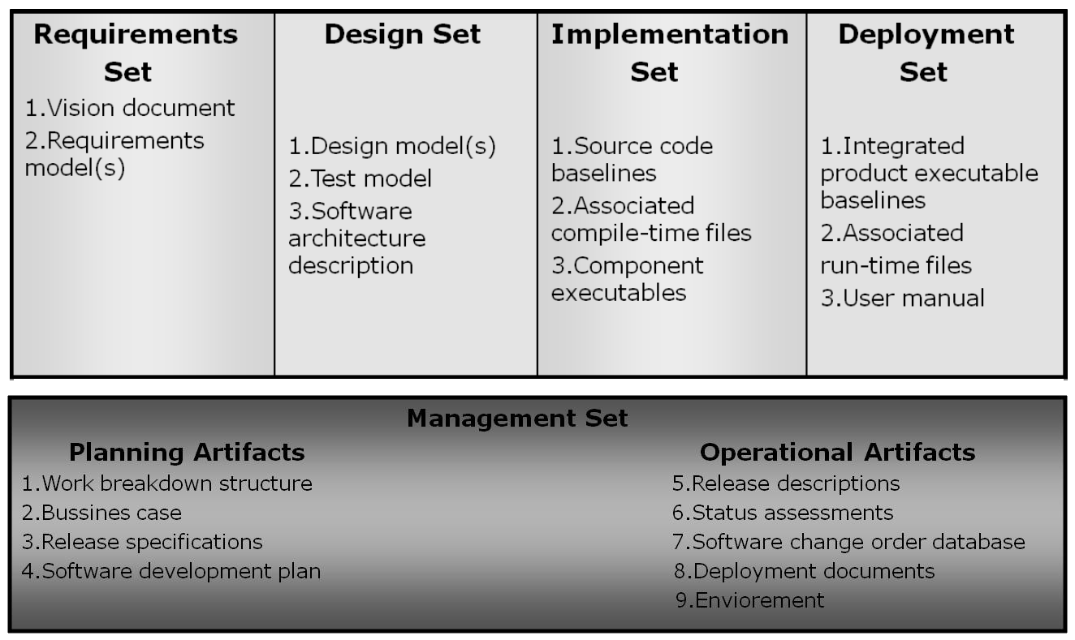
The Engineering Sets:
The engineering sets consist of the requirements set, the design setk the implementation set, and the deployment set.

Slide 14
Management artifacts
The management set includes several artifacts
Work Breakdown Structure –
vehicle for budgeting and collecting costs. The software project manager must have insight into project costs and how they are expended. If the WBS is structured improperly, it can drive the evolving design in the wrong direction.
Business Case –
provides all the information necessary to determine whether the project is worth investing in. It details the expected revenue, expected cost, technical and management plans.
Release Specifications

Slide 15
Typical release specification outline :

Slide 16
▪Vision statement - which captures the contract between the development group and the buyer.
▪Evaluation criteria – defined as management-oriented requirements, which may be represented by use cases, use case realizations or structured text representations.
➢ Software Development Plan – the defining document for the project’s process. It must comply with the contract, comply with the organization standards, evolve along with the design and requirements.
➢ Deployment – depending on the project, it could include several document subsets for transitioning the product into operational status. It could also include computer system operations manuals, software installation manuals, plans and procedures for cutover etc.
➢ Environment – A robust development environment must support automation of the development process.
It should include: requirements management
visual modeling
document automation
automated regression testing

Slide 17
Engineering Artifacts:
In general review, there are three engineering artifacts:
Vision document – supports the contract between the funding authority and the development organization.
It is written from the user’s perspective, focusing on the essential features f the system.
It should contain at least two appendixes – the first appendix should describe the operational concept using use cases, the second should describe the change risks inherent in the vision statement.
Architecture Description – it is extracted from the design model and includes views of the design, implementation, and deployment sets sufficient to understand how the operational concept of the requirements set will be achieved.

Slide 18
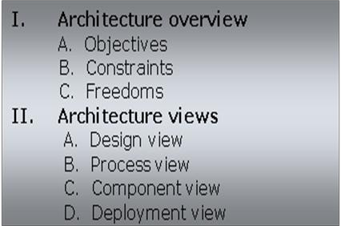
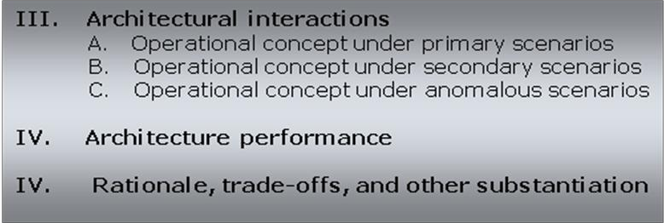
Typical architecture description outline

Slide 19
Pragmatic Artifacts
People want to review information but don't understand the language of the artifact.
Many interested reviewers of a particular artifact will resist having to learn the engineering language in which the artifact is written. It is not uncommon to find people (such as veteran software managers, veteran quality assurance specialists, or an auditing authority from a regulatory agency) who react as follows: "I'm not going to learn UML, but I want to review the design of this software, so give me a separate description such as some flowcharts and text that I can understand."
People want to review the information but don't have access to the tools.
It is not very common for the development organization to be fully tooled. it is extremely rare that the/other stakeholders have any capability to review the engineering artifacts on-line. Consequently, organizations are forced to exchange paper documents. Standardized formats (such as UML, spreadsheets, Visual Basic, C++, and Ada 95), visualization tools, and the Web are rapidly making it economically feasible for all stakeholders to exchange information electronically.

Slide 20
Pragmatic Artifacts
•Human-readable engineering artifacts should use rigorous notations that are complete, consistent, and used in a self-documenting manner
Properly spelled English words should be used for all identifiers and descriptions. Acronyms and abbreviations should be used only where they are well accepted jargon in the context of the component's usage. Readability should be emphasized and the use of proper English words should be required in all engineering artifacts. This practice enables understandable representations, browse able formats (paperless review), more-rigorous notations, and reduced error rates.
•Useful documentation is self-defining
It is documentation that gets used.
•Paper is tangible; electronic artifacts are too easy to change
On-line and Web-based artifacts can be changed easily and are viewed with more skepticism because of their inherent volatility.
.

Slide 21
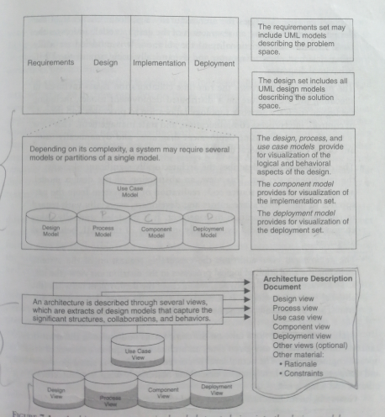
Model-Based Software Architectures

Slide 22
Model-Based Software Architectures-management perspective
Models of software are used in an increasing number of projects to handle the complexity of application domains.
By applying models for the specification of software application domain specific knowledge is separated from technological specific knowledge.
While models can be applied in different phases of a software development process, research projects in the Model-based software architectures group are looking at the following application of models
Generative approaches for tackling problems in the research area of software product lines
Interpreting approaches to enable software architectures for Mobile Grid (and Cloud) Computing
Architecture is the software system design.
The ultimate goal of the engineering stage is to converge on a stable architecture baseline.

Slide 23
The Importance of s/w architecture and its close linkage with modern s/w development processes
Achieving stable s/w architecture represents a significant project milestone at which the critical make/buy decisions should have been resolved.
Architecture representations provide a basis for balancing the trade-offs between the problem space and the solution space.
The architecture and process encapsulate many of the important communications among individuals, teams, organizations, and stakeholders.
Poor architectures and immature processes are often given as reasons for project failures.

Slide 24
Model-Based Software Architectures-technical perspective
Design: Describes architecturally significant structures and functions of the design model.
Process: Describes concurrency and control thread relationships among the design, component, and deployment views.
Component: Describes the structure of the implementation set.
Deployment: Describes the structure of the deployment set.
Generally, an architecture baseline should include the following
Requirements: critical use cases, system-level quality objectives, and priority relationships among features and qualities
Design: Names, attributes, structures, behaviors, groupings, and relationships of significant classes and components
Implementation: Source components inventory and bill of materials of all primitive components

Slide 25
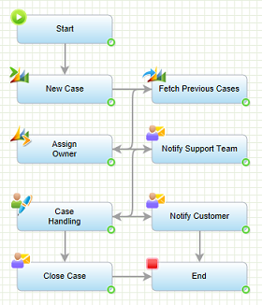
INTRODUCTION TO WORKFLOW
Workflow is the definition, execution and automation of business processes where tasks, information or documents are passed from one participant to another for action, according to a set of procedural rules.

Slide 26
There are seven top-level of software process workflows:
1. Management workflow: controlling the process and ensuring win conditions for all stakeholders
2. Environment workflow: automating the process and evolving the maintenance environment
3. Requirements workflow: analyzing the problem space and evolving the requirements artifacts
4. Design workflow: modeling the solution and evolving the architecture and design artifacts
5. Implementation workflow: programming the components and evolving the implementation and deployment artifacts
6. Assessment workflow: assessing the trends in process and product quality
7. Deployment workflow: transitioning the end products to the user

Slide 27
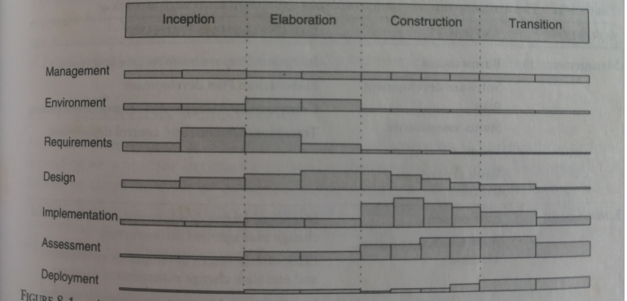

Slide 28
Iteration Workflows
An iteration consists of a loosely sequential set of activities in various proportions, depending on where the iteration is located in the development cycle. Each iteration is defined in terms of a set of allocated usage scenarios. The components needed to implement all selected scenarios are developed and integrated with the results of previous iterations. An individual iteration's workflow, illustrated in Figure, generally includes the following sequence:
• Management: iteration planning to determine the content of the release and develop the detailed plan for the iteration; assignment of work packages, or tasks, to the development team
• Environment: evolving the software change order database to reflect all new baselines and changes to existing baselines for all product, test, and environment components.
• Requirements: analyzing the baseline plan, the baseline architecture, and the baseline requirements set artifacts to fully elaborate the use cases to be demonstrated at the end of this iteration and their evaluation criteria; updating any requirements set artifacts to reflect changes necessitated by results of this iteration's engineering activities

Slide 29
• Design: evolving the baseline architecture and the baseline design set artifacts to elaborate fully the design model and test model components necessary to demonstrate against the evaluation criteria allocated to this iteration; updating design set artifacts to reflect changes necessitated by the results of this iteration's engineering activities
• Implementation: developing or acquiring any new components, and enhancing or modifying any existing components, to demonstrate the evaluation criteria allocated to this iteration; integrating and testing all new and modified components with existing baselines (previous versions)
• Assessment: evaluating the results of the iteration, including compliance with the allocated evaluation criteria and the quality of the current baselines; identifying any rework required and determining whether it should be performed before deployment of this release or allocated to the next release; assessing results to improve the basis of the subsequent iteration's plan
• Deployment: transitioning the release either to an external organization (such as a user, independent verification and validation contractor, or regulatory agency) or to internal closure by conducting a post-mortem so that lessons learned can be captured and reflected in the next iteration

Slide 30
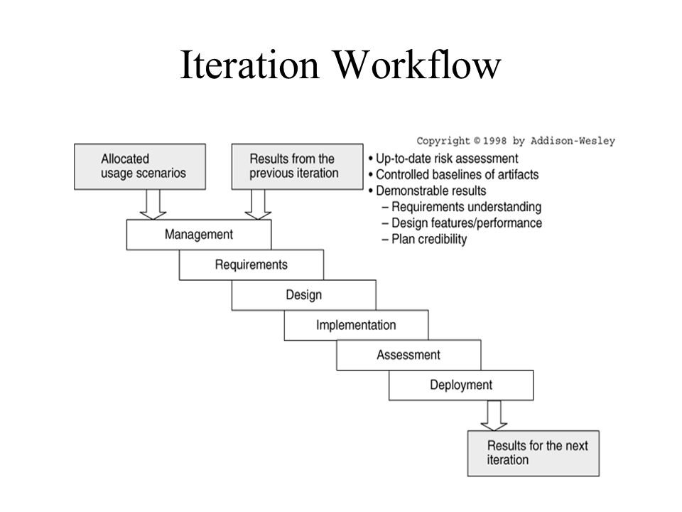

Slide 31
Checkpoints of the process
It is important to place visible milestones in the life cycle in order to discuss the progress of the project by the stakeholders and also to achieve,
Synchronize stakeholder expectations and achieve agreement among the requirements, the design, and the plan perspectives.
2) Synchronize related artifacts into a consistent and balanced state.
3) Identify the important risks, issues, and out-of-tolerance conditions.
4) Perform a global review for the whole life cycle, not just the current situation of an individual perspective or intermediate product.

Slide 32
Three sequence of project checkpoints are used to synchronize stakeholder expectations throughout the lifecycle:
1) Major milestones
2) Minor milestones
3) Status assessments
The most important major milestone is usually the event that transitions the project from the elaboration phase into the construction phase.
The format and content of minor milestones are highly dependent on the project and the organizational culture.
Periodic status assessments are important for focusing continuous attention on the evolving health of the project and its dynamic priorities.

Slide 33
Three types of joint management reviews are conducted throughout the process:
1) Major milestones: These are the system wide events are held at the end of each development phase. They provide visibility to system wide issues.
2) Minor milestones: These are the iteration-focused events are conducted to review the content of an iteration in detail and to authorize continued work.
3) Status assessments: These are periodic events provide management with frequent and regular insight into the progress being made.
An iteration represents a cycle of activities. Each of the lifecycle phases undergo one or more iterations.

Slide 34
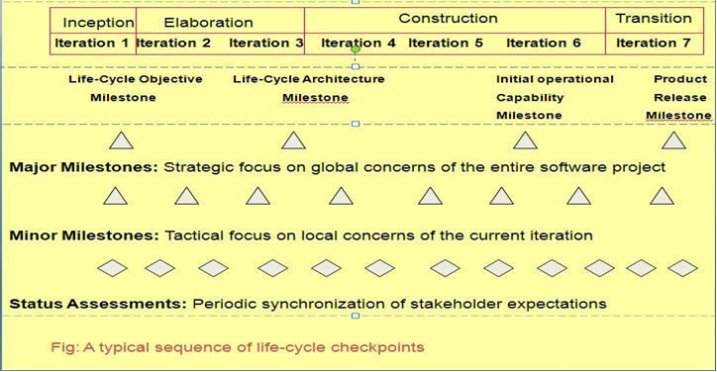

Slide 35
MAJOR MILESTONE
In an iterative model, the major milestones are used to achieve concurrence among all stakeholders on the current state of the project. Different stakeholders have different concern
Life-Cycle Objective Milestone
Life- Cycle Architecture Milestone
Initial Operational Capability Milestone
Product Release Milestone

Slide 36
MINOR MILESTONES
• The number of iteration-specific, informal milestones needed depends on the content and length of the iteration.
• Iterations which have one-month to six-month duration have only two milestones are needed: the iteration readiness review and iteration assessment review. For longer iterations some other intermediate review points are added.
• All iterations are not created equal . An iteration take different forms and priorities , depending on where the project is in the life cycle.
• Early iterations focus on analysis and design. Later iterations focus on completeness, consistency, usability and change management

Slide 37
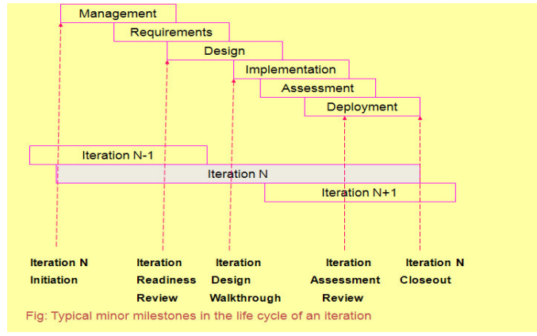

Slide 38
PERIODIC STATUS ASSESSMENT
-These are management reviews conducted at regular intervals (monthly, quarterly) to address progress and quality of project and maintain open communication among all stakeholders.
- The main objective of this assessments is to synchronize all stakeholders expectations and also serve as project snapshots.

Slide 39
Iterative Process Planning:
Like software development, project planning is also an iterative process.
Like software, plan is also an intangible one. Plans have an engineering stage, during which the plan is developed, and a production stage, where the plan is executed

Slide 40
Work breakdown structure
Work breakdown structure is the “architecture” of the project plan and also an architecture for financial plan.
A project is said to be in success, if we maintain good work breakdown structure and its synchronization with the process frame work.
A WBS is simply a hierarchy of elements that decomposes the project plan into discrete work tasks and it provides:
1) A pictorial description of all significant work.
2) A clear task decomposition for assignment of responsibilities.
3) A framework for scheduling, budgeting, and expenditure tracking.

Slide 41
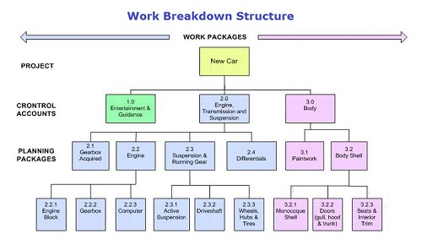

Slide 42
Conventional WBS issue
Conventional WBS are prematurely structured around the product design
CWBS are prematurely decomposed, planned, and budgeted in either too little or too much detail
CWBS are project-specific, and cross-project comparisons are usually difficult or impossibl

Slide 43
EVOLUTIONARY WBS
· First-level WBS elements are the workflows (management, environment, requirements, design, implementation, assessment, and deployment).
· Second-level elements are defined for each phase of the life cycle (inception, elaboration, construction, and transition).
· Third-level elements are defined for the focus of activities that produce the artifacts of each phase.

Slide 44
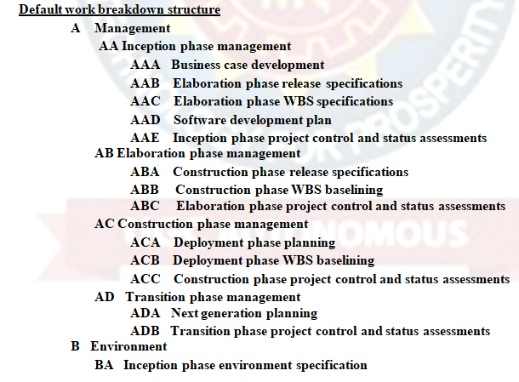
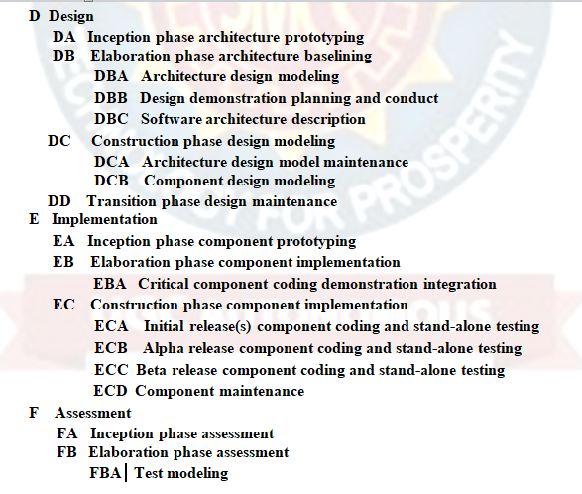
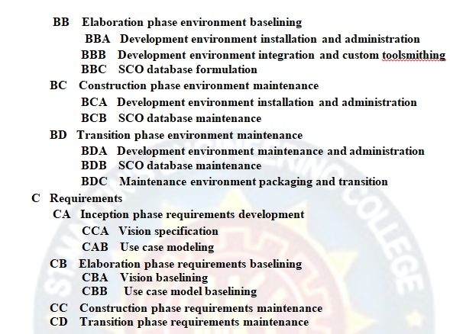
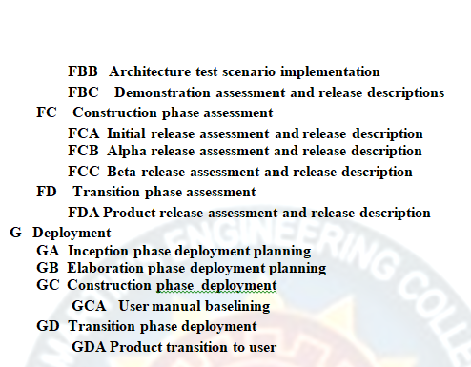

Slide 45
