Slide 1

Combatting Online Misinformation: AI and NLP Solutions for a Digital Age
Neural Nexus Ninjas

Slide 2
INTRODUCTION
The widespread of misinformation across various online platforms erodes people’s trust and brings potential harm to individuals, communities, and entire nations.
With the power of cutting-edge NLP techniques and advanced AI algorithms we can differentiate real and fake information.
We can categorize the sentences from the source and give the value of trust based on various parameters such as the emotional and tonal meaning in the sentences, checking with the facts, getting the real-time data from trusted sources and comparing the available information with it.
We can also check the credibility of the author or source of origin of the information/post.

Slide 3
Types of data in online posts
Textual Data
Media Data
Meta data
Links and URLs
User-generated Data
Location data
Social Network Data
User Interaction Data (comments, likes,. Etc)

Slide 4
Misinformation
Rumor
Spam
Fake News
Spam
Dis-information

Slide 5
Type | Characteristics | Objectiveness | Integrity
Rumors | Ambiguous | Not sure | Not sure
False information | Deception | Yes | False
Fake news | Misguided | Yes | False
Spam | Confused | Yes | Not sure
Disinformation | Mislead/deceive | Yes | False

Slide 6
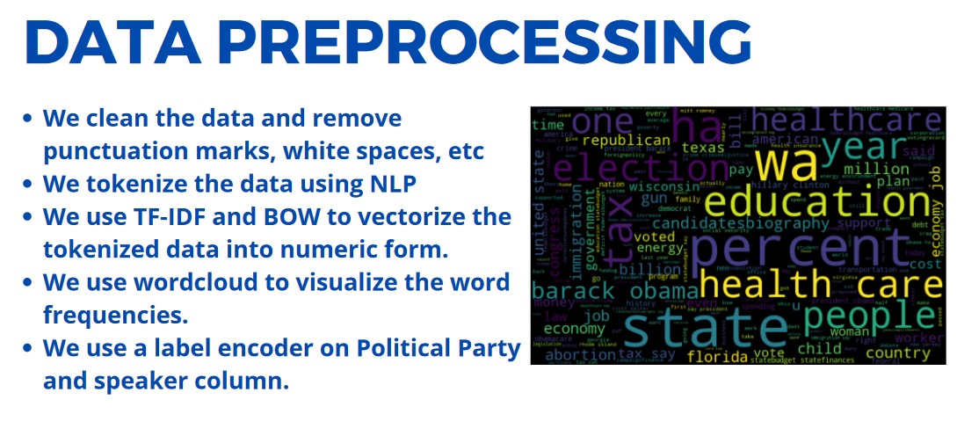

Slide 7
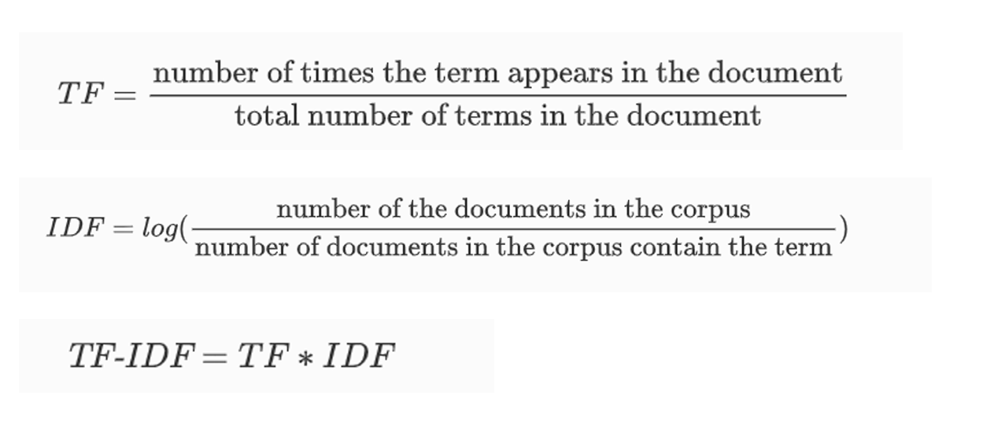
Vectorization using Tf-IDF

Slide 8
Tonal Analysis
Fact checking
Comparing real-time data from trusted sources

Slide 9
MODEL
Data Preprocessing
Cleaning data by removing stop words and tokenizing with stemming or lemmatizing
Vectorizing data by using TF-IDF
Model Selection
Using a hybrid model of combination of traditional ML based models like SVM, Logistic Regression, Random forest and NLP-based models like RNNs, CNNs, Transformer based models like BERT
Combining Output
Combining the output of the models by voting algorithms
Fact checking and Tonal Analysis
Using NLP analysing the tone like positive, negative or neutral
Factchecking the information with the real-time data available and with the facts

Slide 10

Accuracy For various models used
As the accuracy for NB and Decision Tree are below 90% we use an hybrid model which combines
ML models and NLP-based models and increase the accuracy of the final model.

Slide 11
Hybrid Model
Traditional Machine Learning
NLP-based

Slide 12
ML based
Support Vector Machine
Logistic Regression
Random Forest

Slide 13
NLP based
BERT
LSTM
RNNs, CNNs

Slide 14
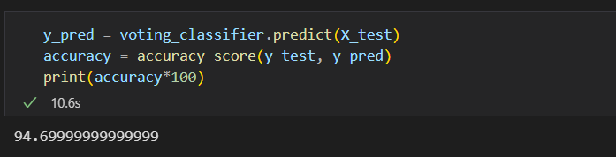
Accuracy for the final model
We got more the 94% for the combined model

Slide 15
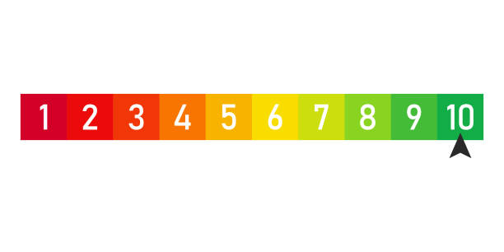
Trust tokens
Range: 1-10
Trust Tokens are calculated based on source of the information

