Slide 1
Banking Management System
A comprehensive relational database solution for managing branches, customers, accounts, and transactions with data integrity and security.
Presented by:
I.Devi
N.Pushpa Kumari
N.Bharani
K.Tejasri

Slide 2
Project Objective
To design and implement a Banking Management System using MySQL to efficiently manage customer details, bank accounts, branches, and transactions while ensuring data consistency and accuracy.
Key Objectives
Manage customer and branch information
Maintain account details and account types
Record and manage bank transactions
Retrieve useful information using SQL queries
Apply MySQL concepts such as Joins, Aggregate Functions, Subqueries, Views, Transactions, Stored Procedures, and Triggers

Slide 3
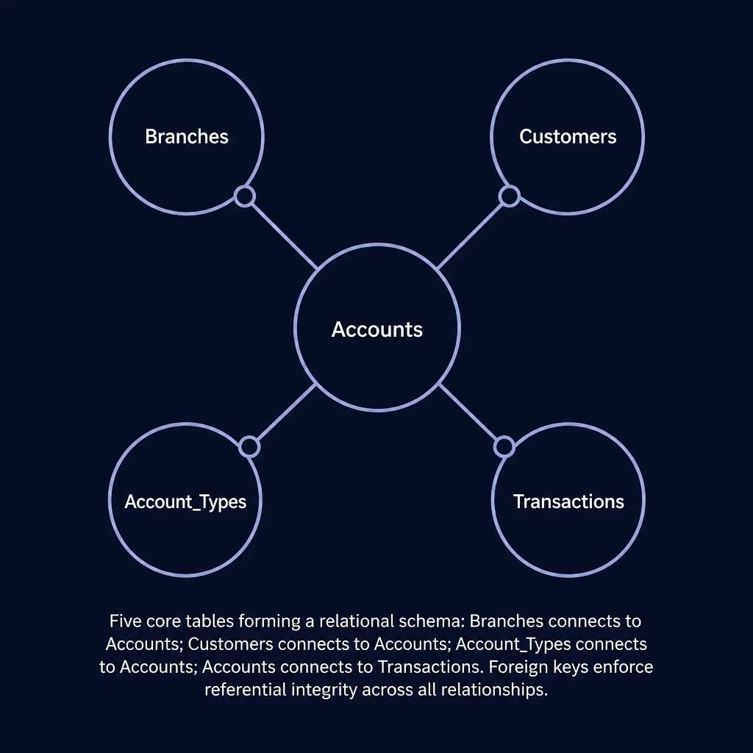
Database Schema Overview
Core Tables
Branches — Physical bank locations
Customers — Account holder profiles
Account Types — Savings, Current classifications
Accounts — Central linking entity with balances
Transactions — Full transaction ledger

Slide 4
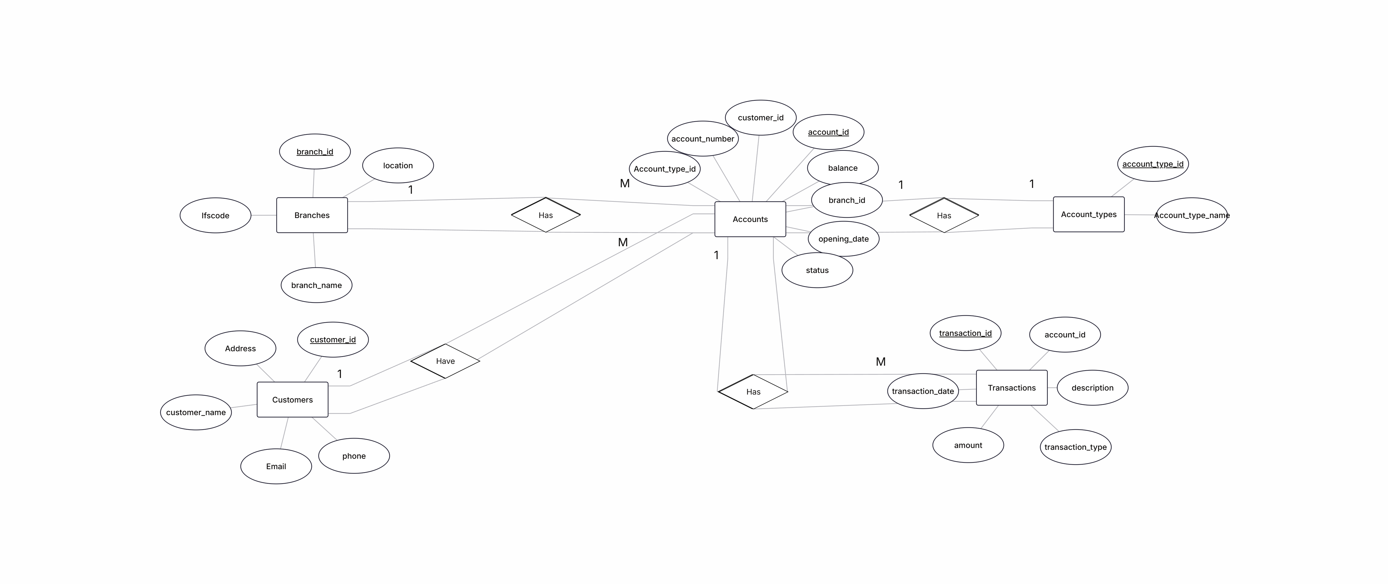
Entity Relationship Diagram (ER Diagram)

Slide 5

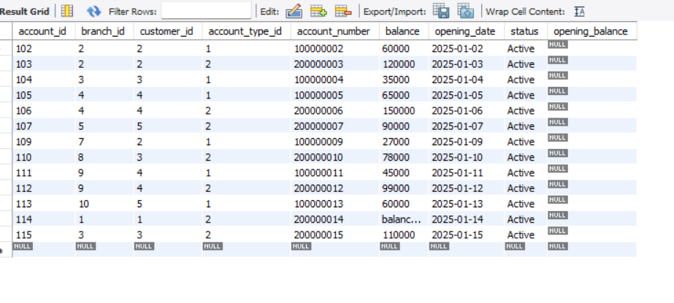
1. Basic SQL / SELECT / WHERE
1.List all customer details.
2.Display all active bank accounts.
23.Display inactive accounts
2

Slide 6
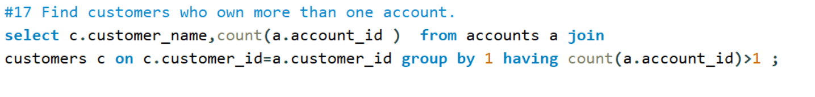
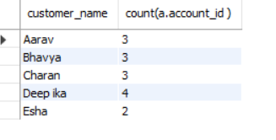
AGGREGATE FUNCTIONS
Count transactions by type.
Calculate total deposits by branch.
Find customers who own more than one account.
Find customers who have never made any transaction.

Slide 7
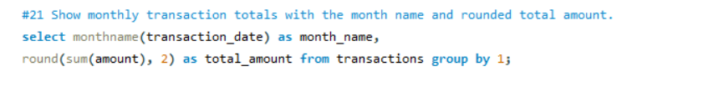

String , Numeric & Date functions all together.
Generate monthly transaction summaries
Display the customer name in uppercase along with the rounded account balance.
Show monthly transaction totals with the month name and rounded total amount.

Slide 8
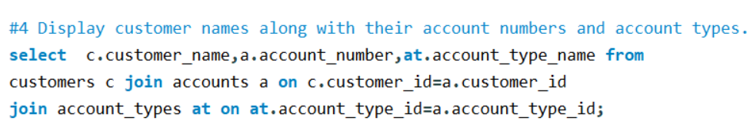
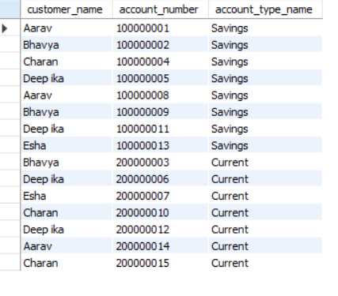
JOINS
Display customer names along with their account numbers and account types
Display account number, branch name, and branch city for all accounts.
Display all customers and the branches where they hold accounts.
Show branch-wise customer count.

Slide 9
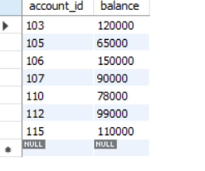
Subquery
Find customers with the highest account balance.
Find the customer(s) having the highest account balance.
Display accounts whose balance is greater than the average account balance.

Slide 10
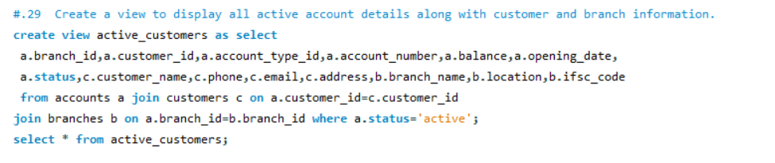
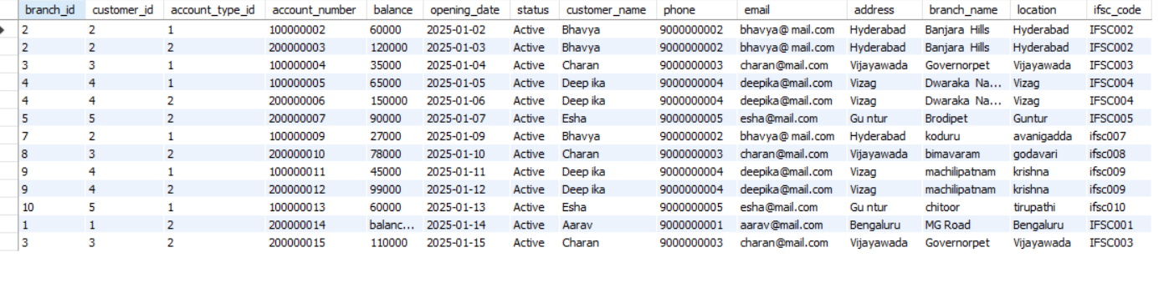
Views

Slide 11
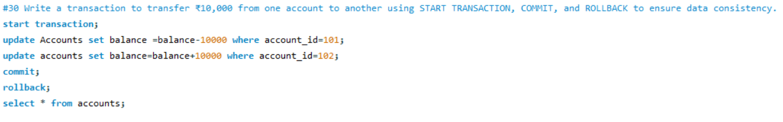
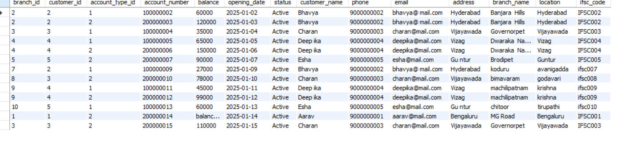
Transactions

Slide 12
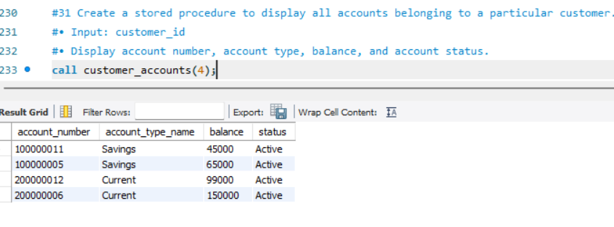
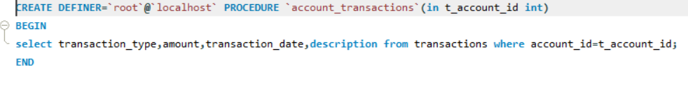
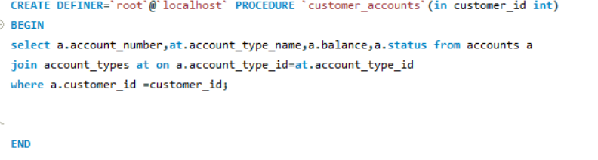
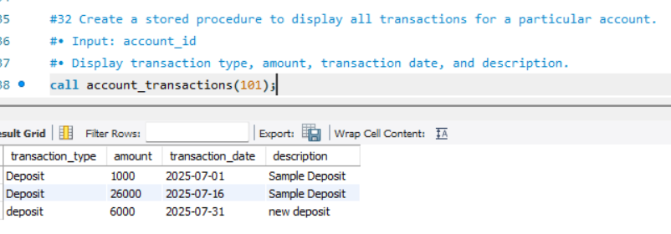
Stored Procedures

Slide 13
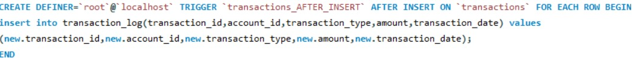
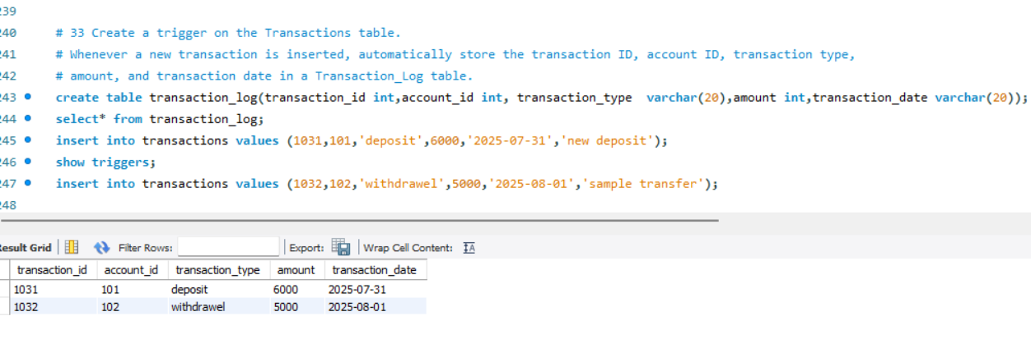
Triggers

Slide 14
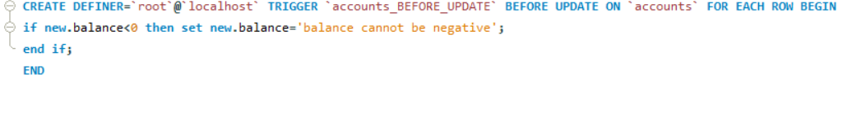
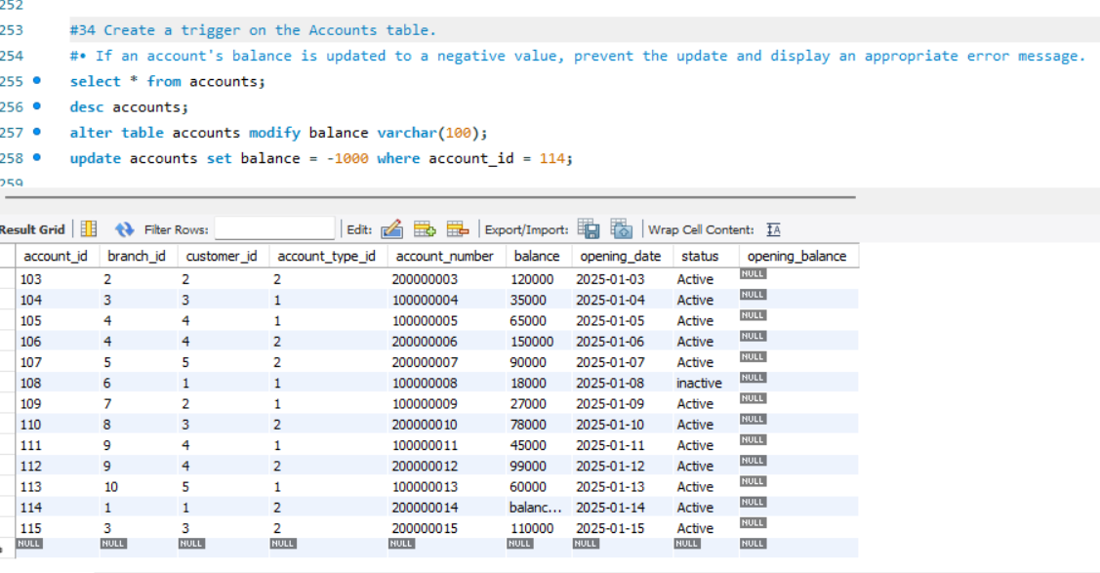

Slide 15
Thank you

