Slide 1


M.Tech/MCA Program
Advanced Industry Integrated Programs
Jointly offered by University and LTIMindTree
Review II
Agentic AI-Based Construction
Schedule Recovery and Optimization
Nandana Jayan
M.Tech Artificial Intelligence & Machine Learning
Knowledge partner | Implementation partner

Slide 2
Agentic AI-Based Construction Schedule Recovery
Introduction
• Construction schedules are vulnerable to activity delays, resource constraints and unexpected disruptions.
• A disrupted schedule must be analyzed quickly to identify affected activities, project delay and downstream propagation.
• The project is designed as a deployable software product combining deterministic scheduling with an Agentic AI recovery layer.
• Recovery Strategy Generation is the first Agentic AI stage; proposed recovery actions will be verified by deterministic scheduling tools.

Slide 3
Agentic AI-Based Construction Schedule Recovery
Objectives
01
Generate reliable baseline schedules
02
Model realistic disruptions
Process PSPLIB data and create feasible baseline schedules.
Generate activity and resource disruption scenarios.
03
Quantify disruption impact
04
Generate and verify recovery plans
Measure feasibility, delay, activity shifts and propagation.
Use Agentic AI to propose strategies and scheduling tools to verify them.

Slide 4
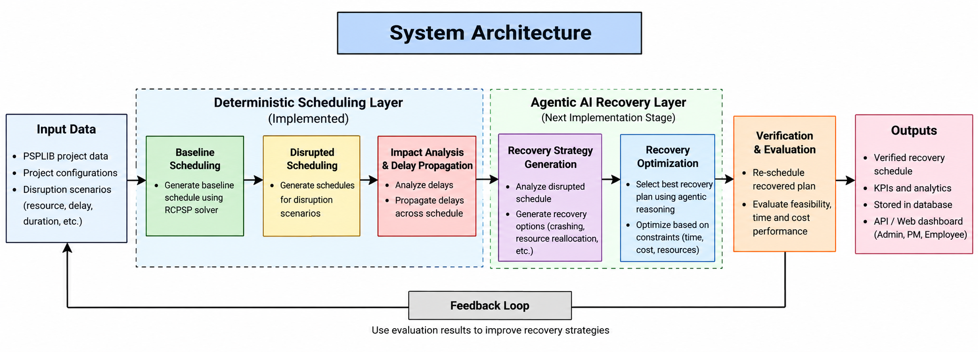
System Architecture

Slide 5
Agentic AI-Based Construction Schedule Recovery
Methodology / Modeling Plan
Development methodology
1
Data & Baseline
2
Disruption Modeling
3
Schedule Re-solving
Process PSPLIB instances and generate feasible baseline schedules.
Generate 20 controlled disruption scenarios per baseline.
Recompute disrupted schedules and record feasibility and delay.
4
Impact & Propagation
5
Agentic Recovery
6
Optimization & Verification
Quantify project delay, activity shifts and propagation.
Analyze affected schedules and propose recovery strategies.
Apply candidate changes, re-schedule and evaluate recovery.
Recovery strategies remain candidate actions until verified by the scheduling engine.

Slide 6
Agentic AI-Based Construction Schedule Recovery
Data Preprocessing & EDA
Dataset & processing
• Source: PSPLIB benchmark project scheduling instances.
• Structured JSON representation for project information, resources and activities.
• Baseline schedules generated for 480 instances.
• Each baseline receives 20 disruption scenarios.
• Total disruption scenarios generated: 9,600.
480
9,600
9,321
Baseline schedules
Disruption scenarios
Feasible disrupted cases
279
4,913
480/480
Infeasible cases
Delayed cases
Impact analyses completed
Batch validation completed all 480 impact-analysis files; downstream processing uses validated outputs.

Slide 7
Agentic AI-Based Construction Schedule Recovery
Approach / Algorithms / Tools
Scheduling & analytics approach
Technology stack
• Constraint-based scheduling with feasibility and solver-status checks.
• Disruption types: duration delay, start delay, resource capacity reduction, resource unavailability and activity suspension.
• Every disruption scenario is re-solved to obtain a disrupted schedule.
• Impact analysis compares each scenario against the authoritative baseline.
• Delay propagation separates potential downstream propagation from actual schedule impact.
Python
OR-Tools / CP-SAT
Data processing & services
Constraint scheduling
FastAPI
PostgreSQL
Backend API
Application data
React
JWT + RBAC
Dashboard UI
Internal access control
Agentic AI is introduced after deterministic impact analysis so proposed recovery actions can be verified.

Slide 8
Agentic AI-Based Construction Schedule Recovery
Milestones Achieved
Milestones achieved to date
Milestone | Work completed | Evidence / Result | Status
Data preparation | PSPLIB → structured JSON | Validated project/resource/activity structure | Achieved
Baseline generation | Generated baseline schedules | 480 baseline schedules | Achieved
Disruption generation | 20 scenarios per baseline | 9,600 scenarios | Achieved
Disrupted scheduling | Re-solved all scenarios | 9,321 feasible; 279 infeasible | Achieved
Impact analysis | Baseline comparison + impact metrics | 480/480 files successful | Achieved
Delay propagation | Potential vs actual affected activities | 9,600 scenarios processed; 4,913 delayed | Achieved
Agentic recovery layer | Strategy taxonomy + architecture defined | Recovery Strategy Generation next | In progress

Slide 9
Agentic AI-Based Construction Schedule Recovery
Pipeline Structure
End-to-end product pipeline
Raw PSPLIB
Data
Processed
JSON
Baseline
Schedules
480
Disruption
Scenarios
9,600
Disrupted
Schedules
Impact
Analysis
Delay
Propagation
Recovery
Strategy Agent
Recovery
Optimization
Verified
Recovery Plan
DETERMINISTIC DATA / SCHEDULING / ANALYTICS
AGENTIC RECOVERY + VERIFICATION
Current completion: stages through Delay Propagation are implemented and batch validated.
Next implementation: Recovery Strategy Generation → Recovery Optimization → Evaluation.

Slide 10
M.Tech/MCA Program
Advanced Industry Integrated Programs
Jointly offered by University and LTIMindTree
Review II
Explainable RAG for Enterprise Policy Change Impact and Dependency Analysis
Team Members
Nandana Jayan

Slide 11
Explainable RAG for Enterprise Policy Change Impact and Dependency Analysis
Introduction
Enterprise policies are interconnected, and a change in one policy can affect related clauses, dependencies and compliance requirements.
Current challenge: manually tracing affected policies and dependencies is time-consuming and difficult to audit.
Proposed solution: an Explainable Retrieval-Augmented Generation (RAG) framework that retrieves relevant policy evidence and traces policy dependencies.
The system analyzes the impact of a proposed policy change and generates evidence-backed explanations for affected policies and required actions.
Primary users: compliance teams, policy owners, risk teams and enterprise decision-makers.

Slide 12
Explainable RAG for Enterprise Policy Change Impact and Dependency Analysis
Objective
Process enterprise policy documents and organize them at policy / clause level.
Retrieve semantically relevant policies and clauses for a given policy change.
Identify relationships and dependencies among policies and clauses.
Analyze affected policies, conflicts and downstream impact caused by a change.
Use LLM-based reasoning over retrieved evidence to produce traceable explanations.
Generate a concise impact report highlighting evidence, affected policies and required follow-up actions.

Slide 13
Explainable RAG for Enterprise Policy Change Impact and Dependency Analysis
Modules
1. Policy Document Processing
2. RAG & Semantic Retrieval
Upload policy PDFs, extract text, clean content, and segment it into traceable clauses / sections.
Create embeddings and retrieve the most relevant policies and clauses for a proposed change.
3. Change & Dependency Analysis
4. Impact, Explainability & Reporting
Compare the change with existing requirements and trace relationships across policies and clauses.
Identify affected areas / conflicts and generate evidence-backed explanations and impact reports.

Slide 14
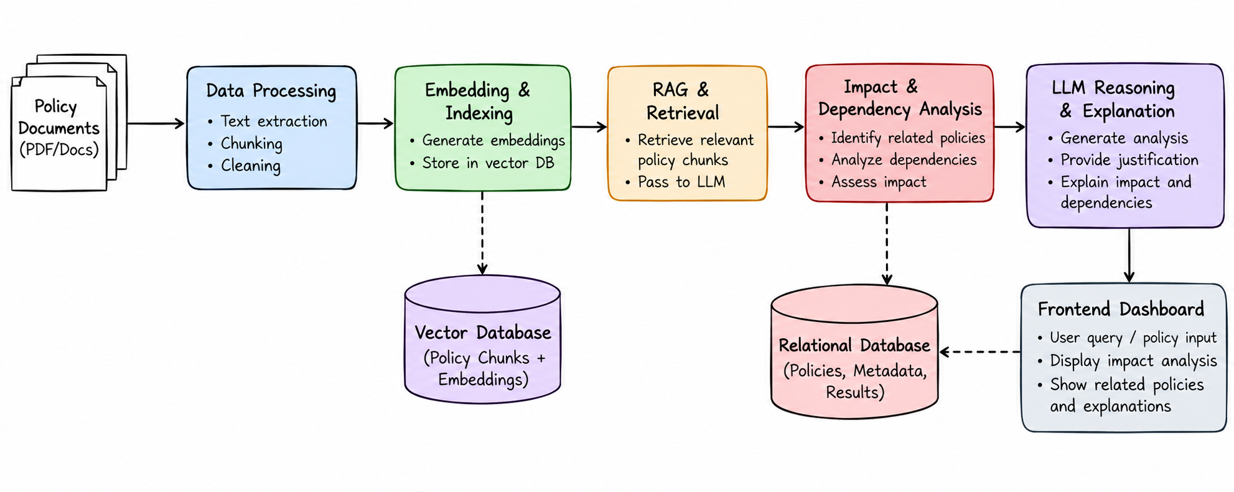
Explainable RAG for Enterprise Policy Change Impact and Dependency Analysis
System Architecture

Slide 15
Explainable RAG for Enterprise Policy Change Impact and Dependency Analysis
Data Preprocessing & EDA
Policy Document Preparation
EDA / Quality Checks
Input: enterprise policy PDFs / policy documents.
Extract text and preserve document / section metadata.
Clean extraction artefacts and normalize text.
Segment content into policy clauses / sections.
Attach identifiers for traceability back to source evidence.
Document count and policy coverage.
Document length and clause-length distributions.
Missing / empty extracted text checks.
Duplicate and near-duplicate content checks.
Metadata and clause-ID consistency checks.

Slide 16
Explainable RAG for Enterprise Policy Change Impact and Dependency Analysis
Approach / Algorithms / Tools
Retrieval
Reasoning & Graph
Application
Sentence Transformers
FAISS / Chroma
Semantic similarity
LLM + LangChain
NetworkX
Dependency traversal
Python
FastAPI / Streamlit
PostgreSQL / SQLite
Core approach: RAG + dependency graph + LLM reasoning + evidence-backed explanation

Slide 17
Project Plan / Milestones Progress
Milestone | Work | Status | Next Step
Problem definition & scope | Defined policy-change impact, dependency tracing and explainability objectives | Completed | Freeze functional requirements
Literature review & gap | Reviewed RAG, policy analysis, dependency / impact-analysis approaches | Completed | Use findings to finalize design
Module design | Defined document processing, retrieval, dependency, impact and reporting modules | Completed | Implement modules
System architecture & pipeline | Defined end-to-end architecture and processing pipeline | Completed | Implement data + retrieval flow
Implementation & evaluation | Dataset ingestion, retrieval experiments, graph analysis and impact evaluation | Planned | Build prototype and evaluate
Milestone | Work | Status | Progress
Dataset Processing | Policy documents processed and prepared for analysis | Completed | Completed
Database Connection | Database configured and application connectivity established | Completed | Completed
Frontend Dashboard | Initial dashboard implemented for the policy analysis workflow | Completed | Completed
Policy Document Processing | Clause-level extraction, cleaning and traceable policy segmentation | In Progress | Implementation ongoing
RAG & Semantic Retrieval | Embeddings, vector indexing and relevant-clause retrieval | In Progress | Implementation ongoing
Dependency & Impact Analysis | Dependency graph, affected-policy tracing and conflict analysis | In Progress | Implementation ongoing

Slide 18
Explainable RAG for Enterprise Policy Change Impact and Dependency Analysis
Pipeline Structure
Policy Documents
Text Extraction
& Clause Chunking
Embeddings
& Indexing
Policy Change
Input
Semantic Retrieval
Dependency &
Impact Analysis
Explainable
Impact Report
Retrieved clauses + dependency evidence → LLM reasoning → traceable explanation of affected policies, conflicts and required actions

