Slide 1
Experiment 15
Emerging BI Technologies and Their Applications in Future Retail
BIA Laboratory (E1CSC25703) · UCI Online Retail dataset

Slide 2
Aim and scope
Investigate emerging BI technologies and show their use in a future retail scenario:
• AI-driven analytics – segmentation, key influencers, anomalies, forecast
• Cloud BI – Power BI Service publishing and sharing
• Real-time BI – simulated live sales feed
• Advanced visualization – interactive dashboards, map, treemap, heat map

Slide 3
Dataset and preparation
541,909 transactions · Dec 2010 – 9 Dec 2011 · UK online retailer
• Cancelled invoices removed: 9,288
• Non-positive quantity/price removed: 10,624 / 2,517
• Missing CustomerID: 135,080 (kept for sales, excluded from RFM)
• Duplicates removed: 5,268
• Rows analysed: 522,713
• SalesAmount = Quantity × UnitPrice

Slide 4
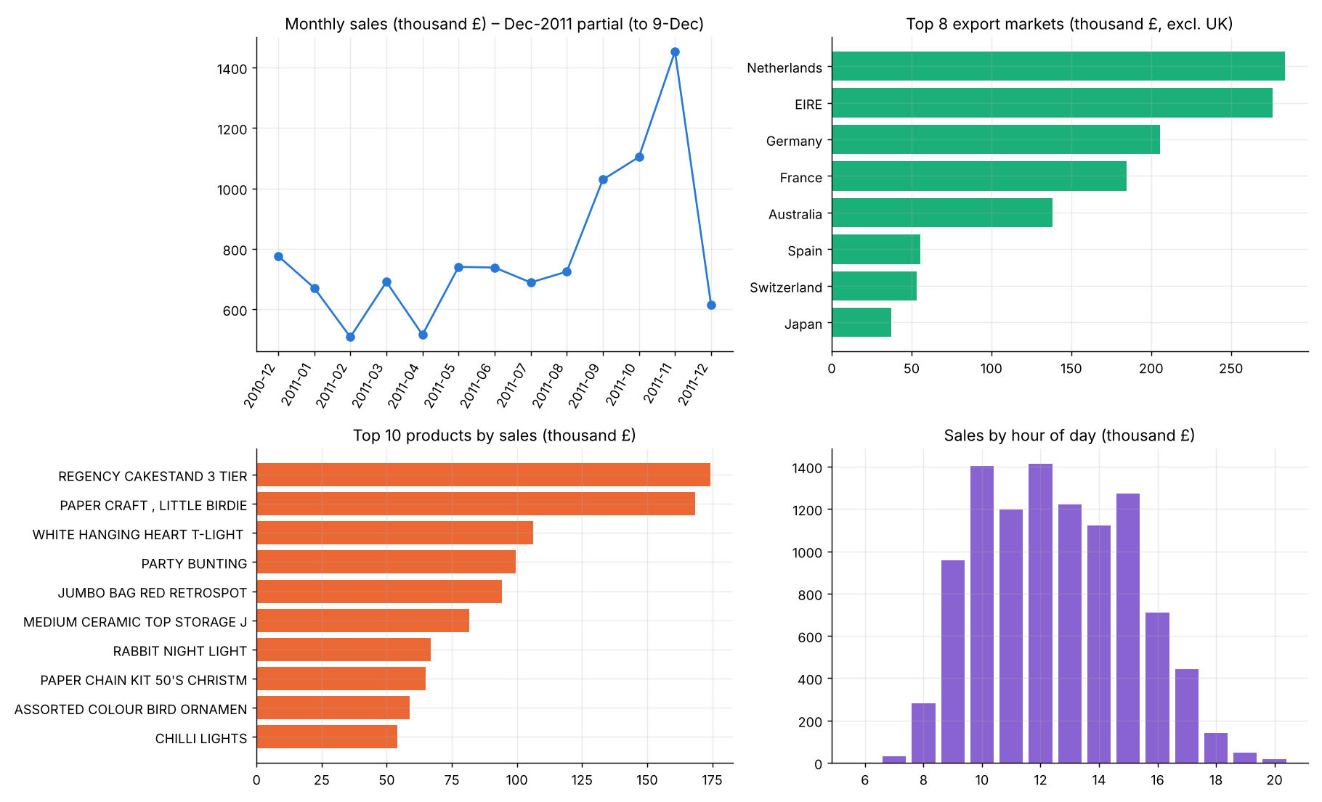
Traditional BI – KPIs and overview
Total sales
Orders
Customers
Avg order
£10.25M
19,776
4,334
£519

Slide 5
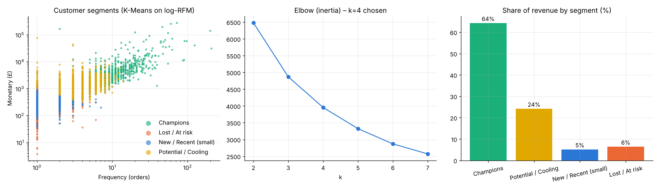
AI analytics 1 – customer segmentation
RFM + K-Means (k = 4): Champions = 64% of revenue from 16% of customers

Slide 6
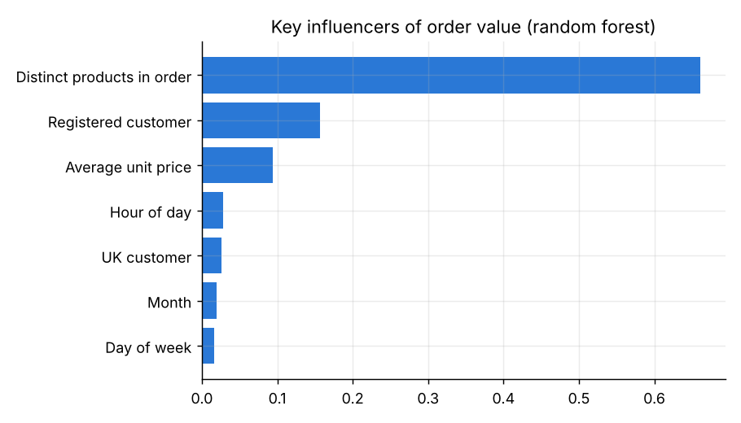
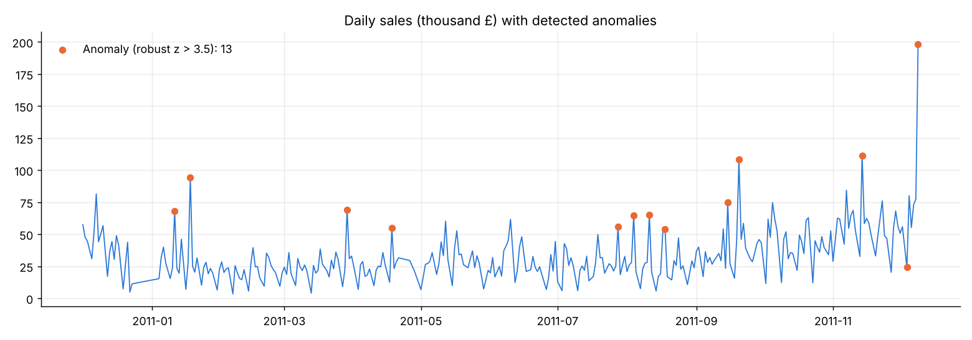
AI analytics 2 – key influencers and anomalies
Distinct products per order drive order value most.
13 anomalous days flagged (robust z > 3.5) – review for bulk orders or promotions.

Slide 7
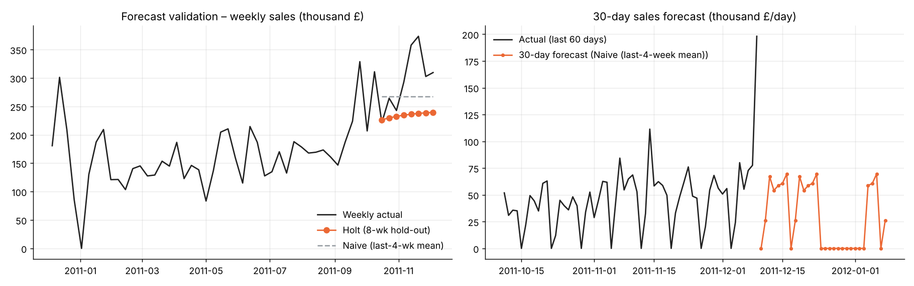
AI analytics 3 – forecasting
Naive 4-week mean won the hold-out (MAPE 14.9%); one year of data = no learnable seasonality

Slide 8
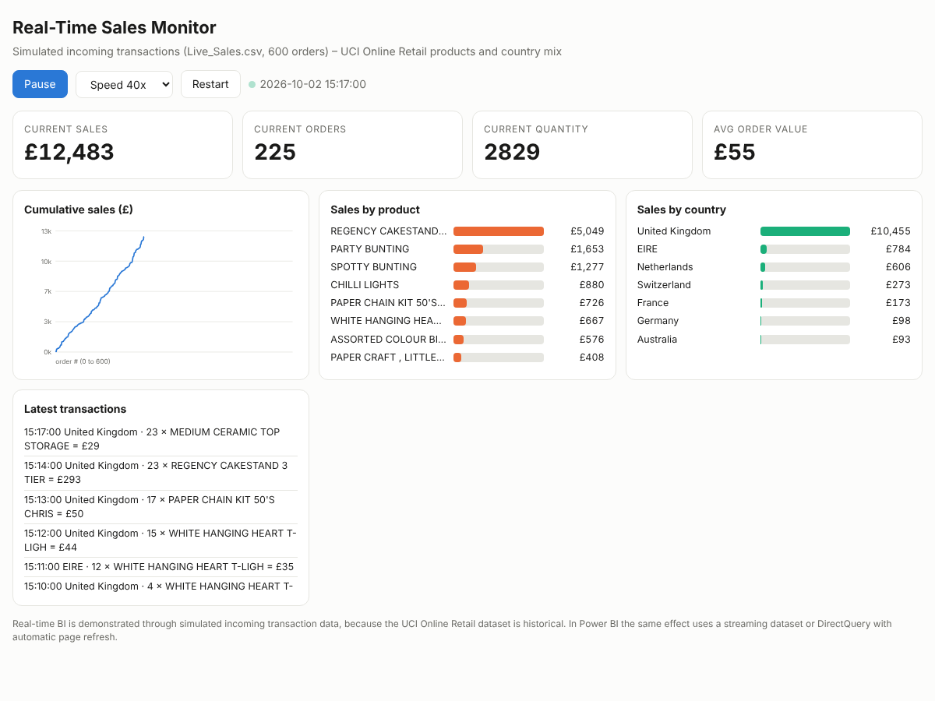
Real-time BI – simulated live feed
Historical dataset → simulated incoming transactions (Live_Sales.csv)

Slide 9
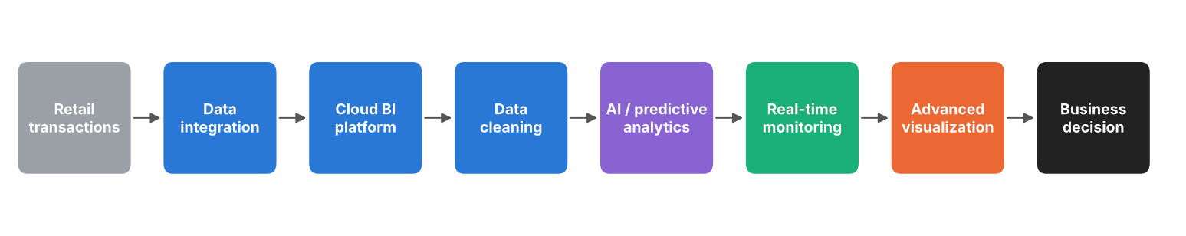
Future scenario – AI-powered smart retail BI
Monitor sales continuously · predict demand · identify top products · detect unusual patterns · interactive dashboards · support decisions

Slide 10
Technology comparison
Technology | Application | Scalability | Implementation effort | Business benefit
AI-driven Analytics | Customer segmentation, anomaly detection, forecasting | High | Moderate | Automated insights
Cloud BI | Online reporting, sharing, scheduled refresh | High | Moderate | Anywhere access
Real-Time BI | Continuous monitoring of live sales | High | High | Faster response
Advanced Visualization | Interactive dashboards, map, drill-down | High | Low–Moderate | Better understanding

Slide 11
Qualitative ROI – traditional vs emerging BI
Factor | Traditional BI | Emerging BI
Data analysis | Manual / interactive | AI-assisted (RFM, anomalies, key influencers)
Reporting | Static / interactive | Interactive + automated refresh
Forecasting | Separate analysis | Integrated in dashboard
Monitoring | Periodic | Near-real-time architecture
Collaboration | Local files | Cloud-based sharing
Decision support | Historical | Historical + predictive

Slide 12
Key insights
• UK = 85.1% of sales; top export markets: Netherlands, EIRE, Germany.
• Peak month 2011-11 (£1,453,266); Nov is highest, Q4 seasonal build-up before Christmas.
• Top product: REGENCY CAKESTAND 3 TIER (£174,157).
• Champions segment = 64% of revenue from 691 customers (16% of base).
• 13 anomalous days detected (spikes/drops) – candidates for stock/promo/outage review.
• 30-day forecast ≈ £886,729 using Naive (last-4-week mean) (hold-out MAPE 14.9%); Christmas shutdown (24-Dec to 3-Jan) applied; only 1 year of history, so seasonality is not learnt – treat as indicative.

Slide 13
Conclusion
Emerging BI extends reporting into AI-assisted analytics, predictive analysis, cloud sharing, near-real-time monitoring and interactive visualization.
Limitations: one year of history, partial last month, simulated real-time data.
Next: connect a live data stream, add promotion data, and use Power BI Service alerts.

