Slide 1


CareSync
Secure Healthcare Appointment Management Platform
AWS Cloud Infrastructure Provisioned Using Terraform
Powered by Amazon Web Services · Infrastructure as Code with Terraform
Notes:
Welcome slide. Introduce CareSync as a production-grade cloud-native healthcare platform fully provisioned on AWS with Terraform. Emphasize this is not a simple demo — it uses 15+ AWS services organized into reusable Terraform modules.

Slide 2






Problem Statement
Why healthcare platforms need a cloud-native approach
Poor Scalability
Healthcare IT
Challenges
Traditional servers cannot auto-scale under demand spikes
Weak Security
68%
3×
∞
Patient data stored without encryption or access controls
of breaches involve
patient data
more costly to fix
post-deployment
manual server mgmt
effort wasted
Manual Management
Infrastructure provisioned manually — slow and error-prone
Cloud-Native Solution
No Monitoring
AWS + Terraform delivers automatic scaling, enterprise security, managed services, and full observability — solving every challenge above.
No alerting when services fail or slow down
Poor Automation
Reminders, cleanups, and backups handled manually
Notes:
Healthcare organizations face five core challenges: scalability gaps during peak booking periods, weak data security, manual and error-prone server management, absence of real-time monitoring, and heavy reliance on manual automation for reminders and cleanup. CareSync addresses all five using AWS managed services and Terraform.

Slide 3






Proposed Solution
CareSync — a secure, scalable cloud-native healthcare platform
CareSync is a cloud-native platform built entirely on AWS, provisioned with Terraform IaC, providing appointment management, medical record handling, automated notifications, and secure data storage.
Patient
Registration
Appointment
Booking
Medical
Records
Automated
Reminders
Secure
Deployment
AWS Cloud
Terraform IaC
15+ managed services
Multi-AZ high availability
Built-in security controls
15 reusable modules
Automated provisioning
Remote state with S3 + DynamoDB
Notes:
CareSync solves healthcare IT challenges by providing a five-pillar solution: patient registration, appointment booking, medical records management, automated notifications, and secure cloud deployment. The entire infrastructure is provisioned automatically with Terraform, using 15+ AWS services across two availability zones.

Slide 4





System Features
Core capabilities of the CareSync platform
Patient Registration
Appointment Booking
Appointment Tracking
Prescription Management
Secure sign-up with JWT authentication
Real-time slot selection and confirmation
View, reschedule, and cancel bookings
Upload and retrieve prescriptions via S3
Medical Report Upload
Appointment Reminders
Notification Cleanup
KMS-encrypted document storage on S3
Lambda + SNS automated patient notifications
EventBridge scheduler purges stale records
Notes:
Seven core features: Patient registration uses JWT-based auth stored in Secrets Manager. Appointment booking stores data in RDS PostgreSQL. Tracking allows CRUD operations via REST API. Prescriptions and medical reports are stored as S3 objects with KMS encryption. Reminders are triggered by EventBridge and sent via SNS. Cleanup Lambda purges notification records older than a configurable threshold.

Slide 5



Technology Stack
Frontend, Backend, Database, and Infrastructure
Frontend
Backend
Database
Infrastructure
Cloud Platform
React
Node.js
PostgreSQL
Terraform
Amazon Web Services
Vite
Express.js
Amazon RDS
15 Modules
15+ Services
JavaScript
REST APIs
Multi-AZ
Remote State
us-east-1
Notes:
The stack is split into five distinct layers. React + Vite on the frontend is served via CloudFront for low latency. Node.js + Express forms the backend API. PostgreSQL on Amazon RDS Multi-AZ handles all relational data. Terraform provisions all 15 modules. AWS is the cloud platform — region us-east-1 with multi-AZ redundancy.

Slide 6
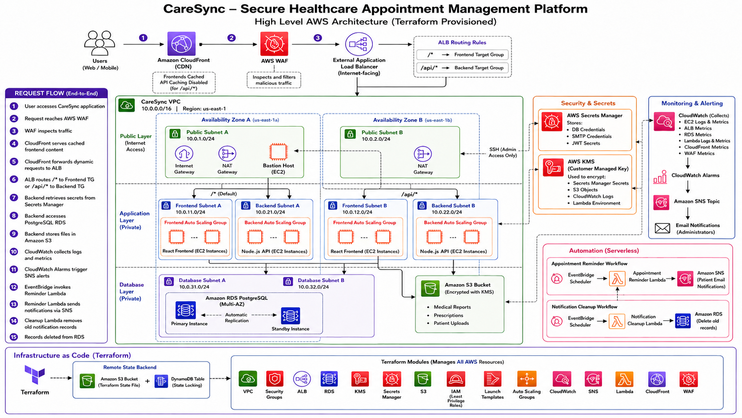
High-Level Architecture
Notes:
The request path: User → WAF (filters malicious traffic) → CloudFront (caches static assets) → ALB (routes based on path pattern) → Frontend EC2 (/* path) or Backend EC2 (/api/* path) → RDS for data or S3 for file storage. All components are in private subnets except the ALB and CloudFront distribution.

Slide 7











Terraform Infrastructure as Code
Automated, repeatable, version-controlled provisioning
Automation
Terraform Workflow
Full infrastructure deployed with terraform apply
Repeatability
Write
Init
Plan
Apply
Identical environments every time — dev, staging, prod
HCL modules + variables
terraform init
Review change set
Provision AWS resources
Version Control
Remote State Management
Infrastructure changes tracked in Git like application code
Terraform CLI
S3 Bucket
DynamoDB
Collaboration
state file
lock
Remote state enables team-based workflows safely
Error Reduction
No manual SSH — eliminates human configuration drift
Notes:
Terraform was chosen because it treats infrastructure the same way you treat application code — versioned, reviewed, and deployed through a standard pipeline. The four-step workflow (Write → Init → Plan → Apply) ensures every change is intentional. Remote state in S3 means the team can collaborate; DynamoDB locking prevents concurrent applies from conflicting.

Slide 8
Terraform Module Structure
15 purpose-built modules — each follows main.tf / variables.tf / outputs.tf
terraform/ (root)
Networking
Compute
Database
Storage
📁 vpc
📁 alb
📁 rds
📁 s3
📁 security-groups
📁 launch-templates
📁 asg
Security
Serverless
Monitoring
Edge
📁 kms
📁 lambda
📁 sns
📁 cloudfront
📁 secrets-manager
📁 cloudwatch
📁 iam
📁 waf
Each module contains: main.tf · variables.tf · outputs.tf
Notes:
The Terraform codebase is organized into 15 modules, grouped by function. Each module is independent and follows the standard three-file convention: main.tf defines resources, variables.tf declares inputs, outputs.tf exposes values to other modules. This modularity means you can update, say, the WAF module without touching the VPC module. Module outputs are wired together in the root module using variable passing.

Slide 9





Terraform Remote Backend
S3 state storage + DynamoDB locking for team-safe deployments
State Storage
Remote Backend Architecture
terraform.tfstate stored in S3 — encrypted, versioned
Terraform CLI
terraform apply
Team Collaboration
Multiple engineers share the same state safely
STATE
LOCK
State Locking
S3 Bucket
DynamoDB
DynamoDB prevents concurrent apply operations
terraform.tfstate
KMS encrypted
terraform-lock
State locking
Disaster Recovery
Both resources provisioned by Terraform itself during bootstrap
State file versioned — roll back to any past state
Notes:
The remote backend is configured with an S3 bucket for state storage and a DynamoDB table for state locking. The S3 bucket has versioning enabled and KMS encryption. When a developer runs terraform apply, Terraform first acquires a lock in DynamoDB — if another apply is running, it waits. After the apply completes, the lock is released and the updated state is written back to S3. This prevents state corruption in team environments.

Slide 10


Security Architecture
Layered defence: IAM · KMS · Secrets Manager · WAF
Layer 1 — Edge Protection
Layer 2 — Identity & Access
WAF Rate Limiting Rule
Least Privilege IAM Roles
AWS Managed Common Rule Set
EC2 Instance Profiles
SQL Injection Rule Set
Lambda Execution Roles
Known Bad Inputs Rule Set
No static credentials
Layer 3 — Secret Management
Layer 4 — Encryption at Rest
DB Credentials in Secrets Manager
KMS encrypts S3 objects
SMTP Credentials
KMS encrypts Secrets
JWT Signing Secret
KMS encrypts CloudWatch Logs
Auto-rotation enabled
KMS encrypts Lambda env vars
Notes:
Security is implemented in four concentric layers. Edge: WAF sits in front of CloudFront, blocking DDoS, injection attacks, and known bad actors before they reach the application. Identity: every EC2 and Lambda has a minimal IAM role — no static credentials exist. Secrets: all sensitive values (DB passwords, JWT secret, SMTP creds) are stored in Secrets Manager, not in environment variables or code. Encryption: KMS with customer-managed keys encrypts all data at rest — S3, Secrets, CloudWatch logs, Lambda environment variables.

Slide 11





Conclusion
CareSync demonstrates a production-grade AWS deployment provisioned entirely with Terraform
Secure Architecture
IaC Provisioning
High Availability
IAM + KMS + Secrets Manager + WAF — layered security
15 Terraform modules — zero manual AWS console work
Multi-AZ RDS + Auto Scaling across 2 AZs
Full Observability
Serverless Automation
Edge Optimised
CloudWatch metrics, alarms, and SNS admin alerts
Lambda reminders + cleanup via EventBridge scheduler
CloudFront CDN + WAF for low latency and protection
Thank You
Notes:
Closing slide. CareSync achieves six production-grade objectives: layered security using four AWS services; full infrastructure-as-code with 15 Terraform modules; multi-AZ high availability; end-to-end observability; serverless automation for two background workflows; and edge optimization with CloudFront and WAF. The project demonstrates that a solo engineer can build and deploy a healthcare-grade cloud architecture by combining AWS managed services with Terraform IaC.

