Slide 1


CareSync
Highly Available 3 tier Healthcare Platform on AWS
Cloud Engineering & Architecture | AWS Project Showcase
Presented by ─ Nandana Suresh
📅 2025 | Cloud Architecture & AWS Engineering Project | Healthcare Domain

Slide 2
Project Overview
What is CareSync?
🔴 Business Problem
Healthcare systems often lack:
• Scalable appointment infrastructure
• High availability during peak hours
• Secure multi-tier architecture
• Fault-tolerant backend systems
🏥
Healthcare Platform
Cloud-native appointment booking system for patients
👤
User Features
Register/Login, browse doctors, book & manage appointments
✅ Our Solution
☁️
AWS Powered
CareSync implements:
• Microservices on EC2 with Docker
• External & Internal ALBs for routing
• Auto Scaling Groups across Multi-AZ
• VPC with layered subnet isolation
• Route53 custom domain integration
Deployed on AWS using industry-grade cloud architecture
🔧
Microservices
Independent services: Auth, Doctor, Patient, Appointment, Frontend

Slide 3
Microservices Architecture
Internal ALB / API Gateway
Frontend
Service
Auth
Service
Doctor
Service
Patient
Service
Appointment
Svc
nginx + React
Node.js
Node.js
Node.js
Node.js
Port: 80
Port: 4001
Port: 4003
Port: 4001
Port: 4004
S reverse proxies API calls to backend
JWT-based register, login, token validation
Doctor listing, profiles, specialization search
Patient records, profile management
Book, cancel appointments
🗄 Shared MongoDB Database
Principles: Independent Deployment • Independent Scaling • API Communication • Single Responsibility per Service • Loose Coupling

Slide 4
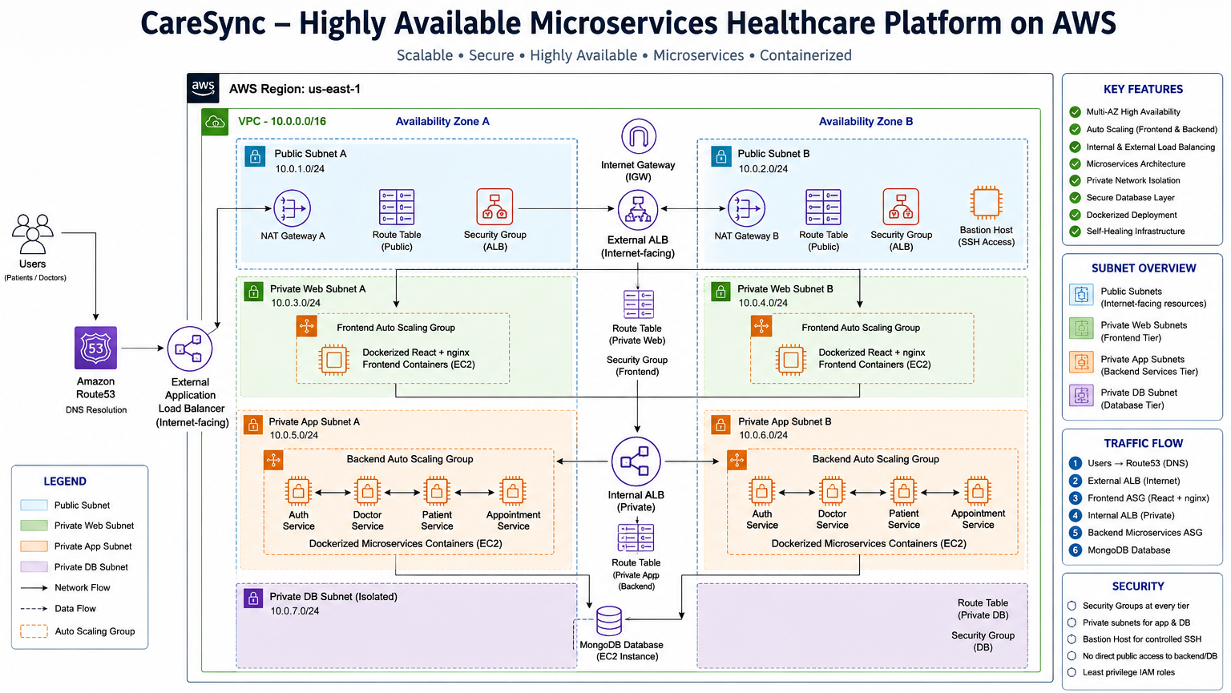

Slide 5
VPC & Networking Design
Why Layered
Isolation?
Custom VPC
Internet Gateway
🔒 Public layer only has ALB & Bastion — no app logic
🛡 Backend EC2s in private-app: no direct internet
Bastion
Host
NAT Gateway
External ALB (Internet-Facing)
🗄 DB in deepest private subnet — zero internet route
Private-Web Subnets
Frontend ASG (EC2 + Docker + nginx)
📡 NAT GW allows egress only (no inbound from internet)
Private-App Subnets
🏗 Each tier has dedicated Security Group rules
Backend ASG • Internal ALB (Auth / Doctor / Patient / Appointment)
✅ Follows AWS Well-Architected Framework
Private-DB Subnet
MongoDB — No public access, app-tier only

Slide 6
Load Balancing Strategy
External ALB (Internet-Facing)
Path-Based Routing Rules
• Routes to Frontend ASG (port 80)
• Health checks on /health endpoint
• Cross-AZ load balancing enabled
/
Port: 80
→ Frontend Service
/api/auth/*
Port: 4001
→ Auth Service
/api/doctors/*
Port: 4003
Internal ALB (Private Subnet)
→ Doctor Service
• Path-based routing to microservices
• Not accessible from internet
• Distributes across Backend ASG
/api/patients/*
Port: 4002
→ Patient Service
/api/appointments/*
Port: 4004
→ Appointment Service

Slide 7
Auto Scaling & High Availability
Availability Zone A (ap-south-1a)
Availability Zone B (ap-south-1b)
🖥 Frontend EC2
🖥 Frontend EC2
Docker • nginx/Node • Health: ✅
Docker • nginx/Node • Health: ✅
🖥 Backend EC2
🖥 Backend EC2
Docker • nginx/Node • Health: ✅
Docker • nginx/Node • Health: ✅
Launch Templates
Golden AMI (Docker pre-installed)
Min: 1 / Max: 2
Multi-AZ Failover
Instance Refresh
Self-Healing

Slide 8
Route53 & Custom Domain Setup
🌐 app.caresync-project.online
User Browser
Route53 Resolver
External ALB
Frontend ASG
Enters domain in browser
Hosted zone resolves A record to ALB
Alias record → ALB DNS name → Target Group
EC2 serves React app via nginx
Route53 Configuration Details
Record Type:
A record (Alias)
Target:
External ALB DNS name
Health Check:
ALB-integrated
:
Hosted Zone:
caresync-project.online

Slide 9
Security Architecture
Internet (Untrusted)
Route53 + External ALB (Port 80/443 only from Internet)
Public Subnets — Bastion Host
Private-Web Subnets — Frontend EC2s (from ALB SG only)
Private-App Subnets — Backend EC2s (from Frontend SG only)
Private-DB Subnet — MongoDB (from Backend SG only, Port 27017)
🔐 Principle of Least Privilege | 🌐 No Direct Internet to Backend | 🔑 Bastion Host for Admin SSH | 🛡 SG Chaining per Tier | 📋 IAM Scoped Roles

Slide 10
Conclusion
✅
Scalable Healthcare Platform
🏗
Production-Grade Architecture
CareSync handles concurrent users via Auto Scaling Groups with multi-AZ redundancy, ensuring uptime even under high load
Designed using AWS Well-Architected principles — secure, reliable, performant, and operationally excellent
🔒
High Availability Achieved
🎓
Real Cloud Engineering
Multi-AZ deployment with ALBs, ASGs and self-healing instances eliminates single points of failure
Hands-on expertise in EC2, VPC, ALB, Route53, Docker, ASGs, Security Groups, and production debugging
CareSync — From idea to production-ready cloud architecture — One microservice at a time.

Slide 11
Thank You!
CareSync | Highly Available Microservices Healthcare Platform on AWS
Shyam Sundar | Cloud Engineering Project | 2025 | AWS + Docker + Microservices

