Slide 1
Developer Dashboards: The Need for Qualitative Analysis
Presented by
Gopi Krishna Swargam
Nandanamudi Jyothi Kiran
Junaid Sidrah
Mohannad

Slide 2
Analytics approach
Organizations are adopting analytics approach to get lot of insights
Organizations already have a lot of data
Analyzing the data of organization gives lot of insights and useful information which is not directly visible
Data driven decision making gives us lot of insights
Data driven decision making can be quantitative analysis or qualitative analysis

Slide 3
Quantitative analysis
It is mathematical analysis of the measurable figures
It shows high level data trends
Quantitative analysis only gives a birds eye view of the project and helps only the project managers or module leads to monitor and measure the performance of a project
Quantitative analysis is of not much use to the developers of a team
Most analytic approaches focus on quantitative analysis and visualize the analysis through chart like dashboards

Slide 4
Quantitative dashboards: (a) IBM Rational Quality Manager and (b) Mozilla Metrics. These dashboards provide aggregate views of project activity that are most suitable for project managers.

Slide 5
Need for Qualitative analysis
Developers want a dashboard which can
Allow them to review their status
See all bugs assigned to them and any changes done to them since the last time the developer looked at it
Any one working on similar bugs or issues and show status
Assign fixed issues to someone who can review and provide comments

Slide 6
Quantitative analysis vs Qualitative analysis
Quantitative property is measured
Quantitative dashboards provide statistical summaries of various development metrics
Quantitative dashboards address aggregate developer questions
Qualitative property is described rather than measured
Qualitative dashboards emphasize the attributes and relationships of a set of artifacts that are of interest to the developer
Qualitative dashboards provide insights into the specific items developers are working on

Slide 7
Research Study
qualitative study:
To understand how developers engage and interact with the Bugzilla issue tracking system.
developers’ insights:
Strengths
Weaknesses
future enhancements

Slide 8
Four high-level Themes
Eighteen developers reported challenges maintaining awareness of the status of their own issues.
15 developers expressed interest in the ability to invisibly observe the development of other issues without being forced to take an active role.
Twelve developers also expressed a desire to easily gain an understanding of their colleagues’ workloads, for instance, when requesting code reviews
Developers found it challenging to assess other developers’ roles in the Mozilla organization

Slide 9
Situational Awareness:
Developers must maintain awareness of what’s happening on their projects as they manage a constant flow of information and react accordingly.
Developers often find themselves trying to identify the status of an issue as well as trying to track their own tasks.
What are the workloads of others?
Which bugs do I need to fix, review, or follow up on?

Slide 10
Situational Awareness:
supplementing quantitative dashboards with more developer-specific qualitative data can improve developers’ situational awareness of their working context.
From the experience in analyzing the data available in Bugzilla, we also believe the data required to build developer-specific qualitative dashboards already exists; much like quantitative analytics.
The goal of this awareness is to keep better track of the ever-increasing number of issues involved in complex software systems.

Slide 11
Bugzilla Qualitative Dashboard
Task-Oriented Views:
Enhance developer’s daily activities, such as
issue tracking and prioritization,
patch submission,
personal workload management,
colleague workload estimation,
maintaining lists of issues that need follow-up and so on.

Slide 12
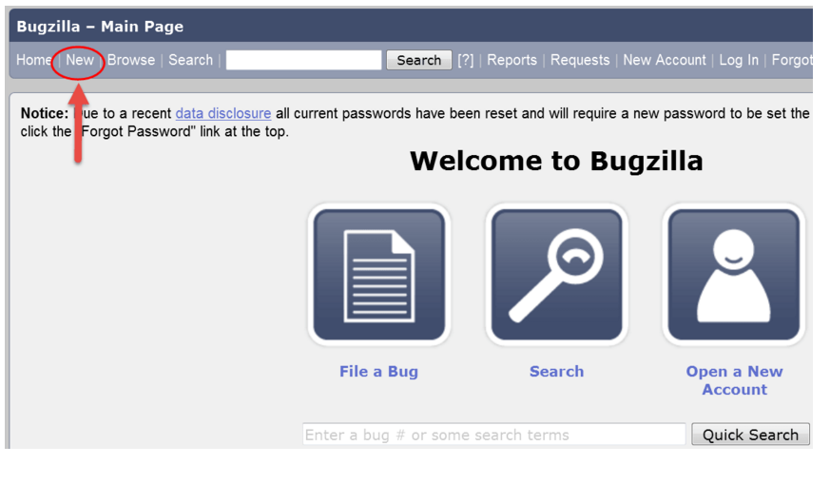
Difficulties to Generate Bugzilla Qualitative Dashboard
First, the Bugzilla user interface doesn't support process management, presenting too much information to the user and little direction, as noted by seven developers from our study:
“The Bugzilla interface is bad; too many fields.”
http://www.guru99.com/bugzilla-tutorial-for-beginners.html

Slide 13
Cont…
Second, Bugzilla’s slow performance hinders real-time data exploration
“The speed of Bugzilla is the major issue”
“Bugzilla is too slow; this is wasting a lot of time—very frustrating.”

Slide 14
Cont…
Third, developers are often unable to correctly formulate queries to access and correlate various pieces of metadata:
“Running searches on Bugzilla is kind of scary sometimes”
“Querying in Bugzilla is hard; [the user] has to spend a few minutes to figure out how to do the query … [there’s] no good way to query certain information.”

Slide 15
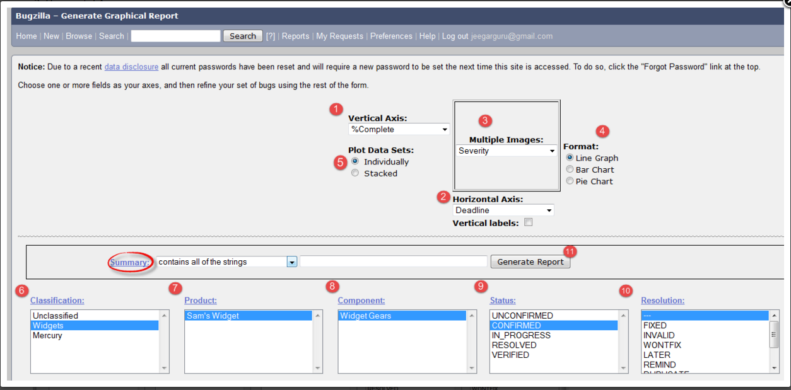
Cont…
http://www.guru99.com/bugzilla-tutorial-for-beginners.html

Slide 16
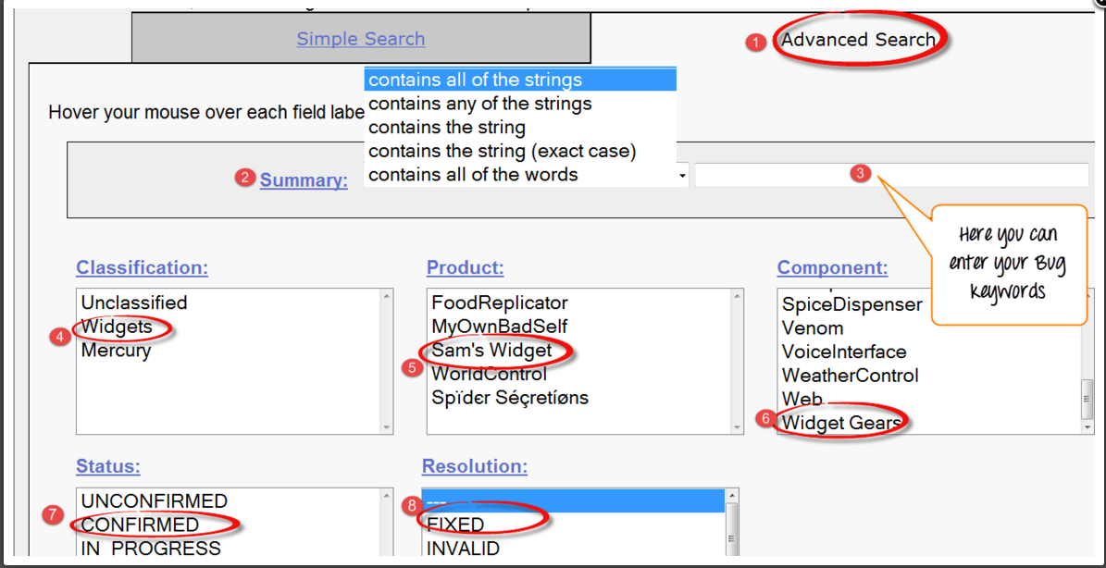
Cont…
http://www.guru99.com/bugzilla-tutorial-for-beginners.html

Slide 17
Mozilla Quantitative Analytics
Two initiatives:
Community Management Metrics
Provides insights on the evolution of the community contributions
Bugzilla Anthropology
Analyzes project performance
Disadvantage:
They’re tailored toward project managers and their activities; they
don’t provide developers with any useful support for their typical
daily tasks.

Slide 18
Contrasting Qualitative and Quantitative Dashboards
Qualitative Dashboards:
For the Mozilla team, qualitative analytics can generate developer-specific views of the Bugzilla repository.
The qualitative approach filters important and relevant information from the repository and presents it to the developers in support of common tasks
Qualitative analytics let users access data from the existing issue-tracking system to enhance Bugzilla with the means to increase developers’ situational awareness of the project.

Slide 19
Mozilla Quantitative Dashboard
Dashboards plays an important role in developers day to day activity.
The support from this dashboard is categorized into four tasks that explains how dashboards are helpful for the developers and where they fall short, has been provided in this paper.
Assessing Community Effectiveness and Evolution
Measuring Developer Contributions
Measuring Developer Effectiveness
Determining Performance Trends
These four task provides us the advantages as well as disadvantages in terms of how useful is this dashboard to the owners of Mozilla module and to its developers.

Slide 20
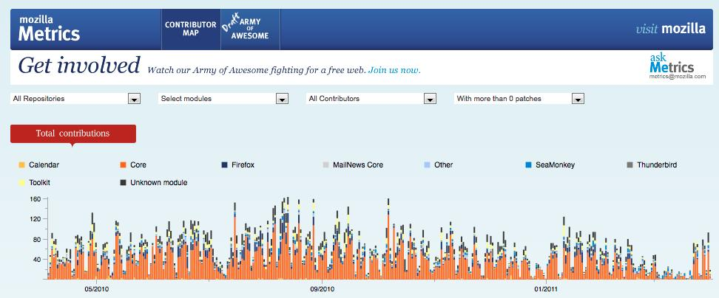
Assessing Community Effectiveness and Evolution
This dashboard provides
a complete insight of all the
contributions for different
modules of Mozilla.
This helps the owners of
Mozilla modules to know
how effective the contributors are and how to engage with the
contributors to maximize the throughput.
But on an whole, it doesn’t benefit the developers, as the contributors might include not just developers. It contains the whole community of the organization (employees and volunteers).

Slide 21
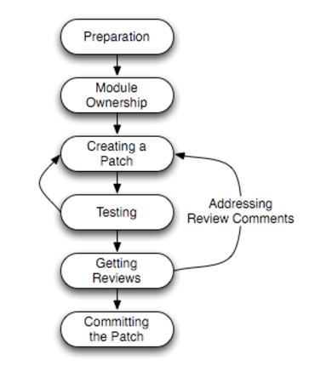
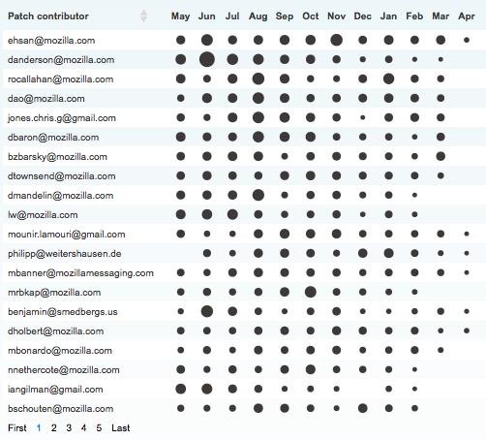
Measuring Developer Contributions
The dashboard measures the developers contributions in a given month.
This doesn’t support developers in achieving daily tasks.
Developers wants to know workloads of reviewers before patching. So, that they can estimate the time needed to give the review back as there might be patches in the queue to review.
This helps the managers to explore the developer’s activity.
It helps developers to know what type of work the others are working on for assigning the task and as well as to know about their own patches to know who is awaiting for reviews.

Slide 22
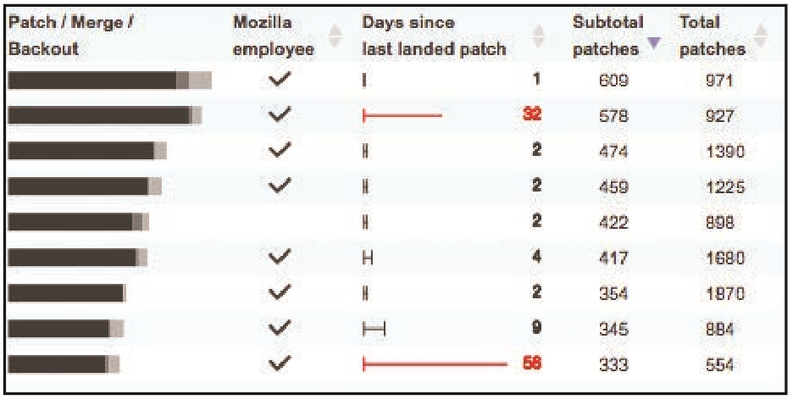
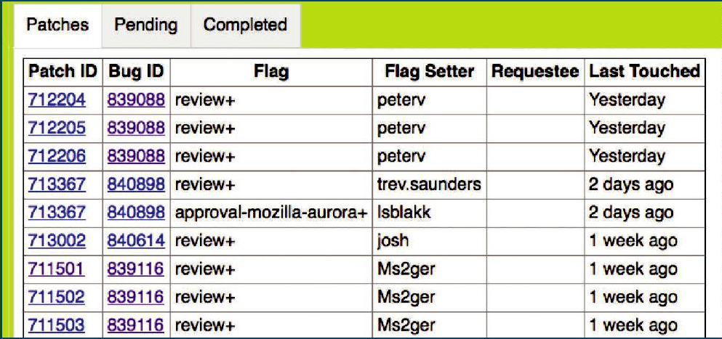
Measuring Developer Effectiveness
Quantitative dashboards are used
to measure the developers productivity.
This can be a gauge to know what all
patches he or she committed and his
recent patches and which are successfully
committed to code.
Developers can review what all the
patches are under list are pending,
completed and what tasks are
blocking and recently solved.
They can customize the dashboards
to organize their information as they want.

Slide 23
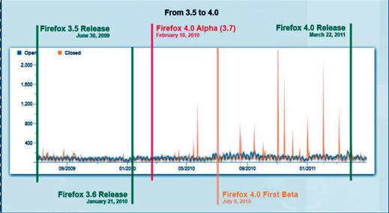
Determining Performance Trends
The performance can be
evaluated using this dashboards.
From the managers perceptive
this is useful to know the status
and the health of the project and
can sense the project momentum
to meet the deadlines.
From the developers perception
this is used to prioritize the bugs.
They are interested in having a personal list of bugs. If there is something interesting about a bug they will cc themselves so that they can communicate their interests with others without taking the actual ownership.

Slide 24
Cont….
But, there is public list of bugs which is visible to everyone on the project. By prioritizing, the developers can improve time management concentrating on those that are of high priority and needed.
Thus dashboards can improve the developers’ ability to keep pace with the evolution of uses they care about the most.
But, as far as concerned this is just quantitative dashboards. But there is need for qualitative developer oriented dashboards as they provide a innumerable amount of information about the modern software system developments and regarding their maintenance along with the quantitative analysis.

Slide 25


