Slide 1
Review Analysis On Amazon Products
By
Team: Give ME Prize
Jyothikiran Nandnamudi
Gopi Krishna Swargam
Sidrah Junaid

Slide 2
System Architecture
Data Sets
Apache Spark Initialization
Loading Data into Spark SQL
Map-Reduce on the data for each query

Slide 3
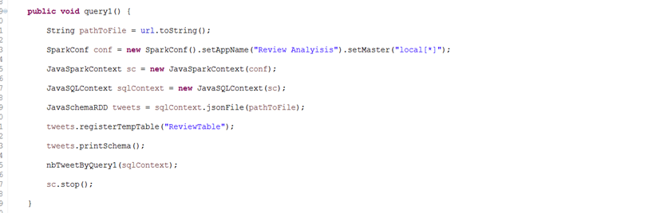
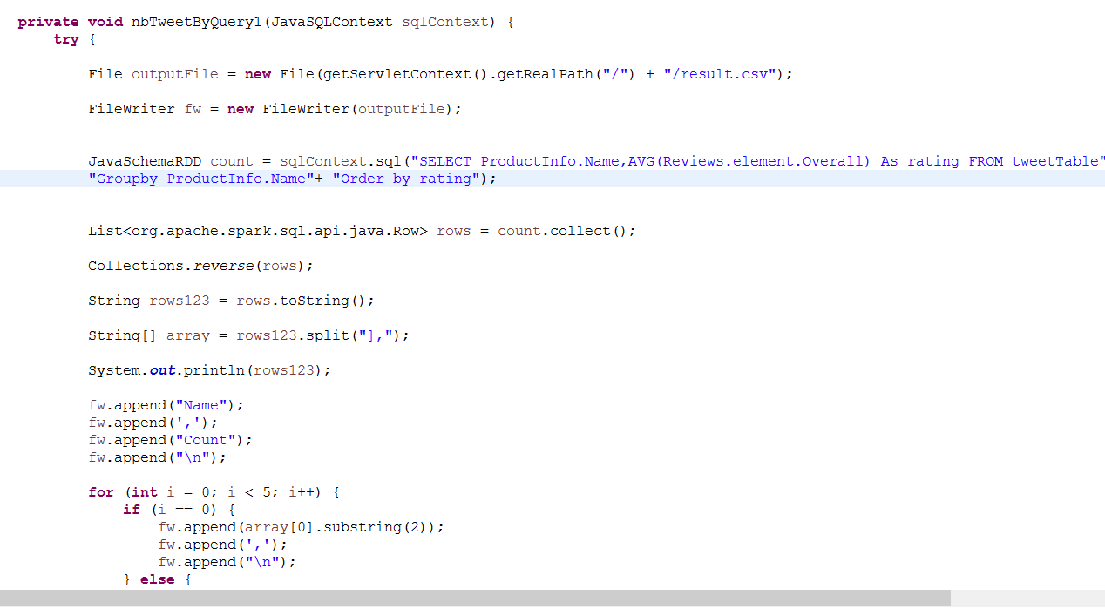

Slide 4
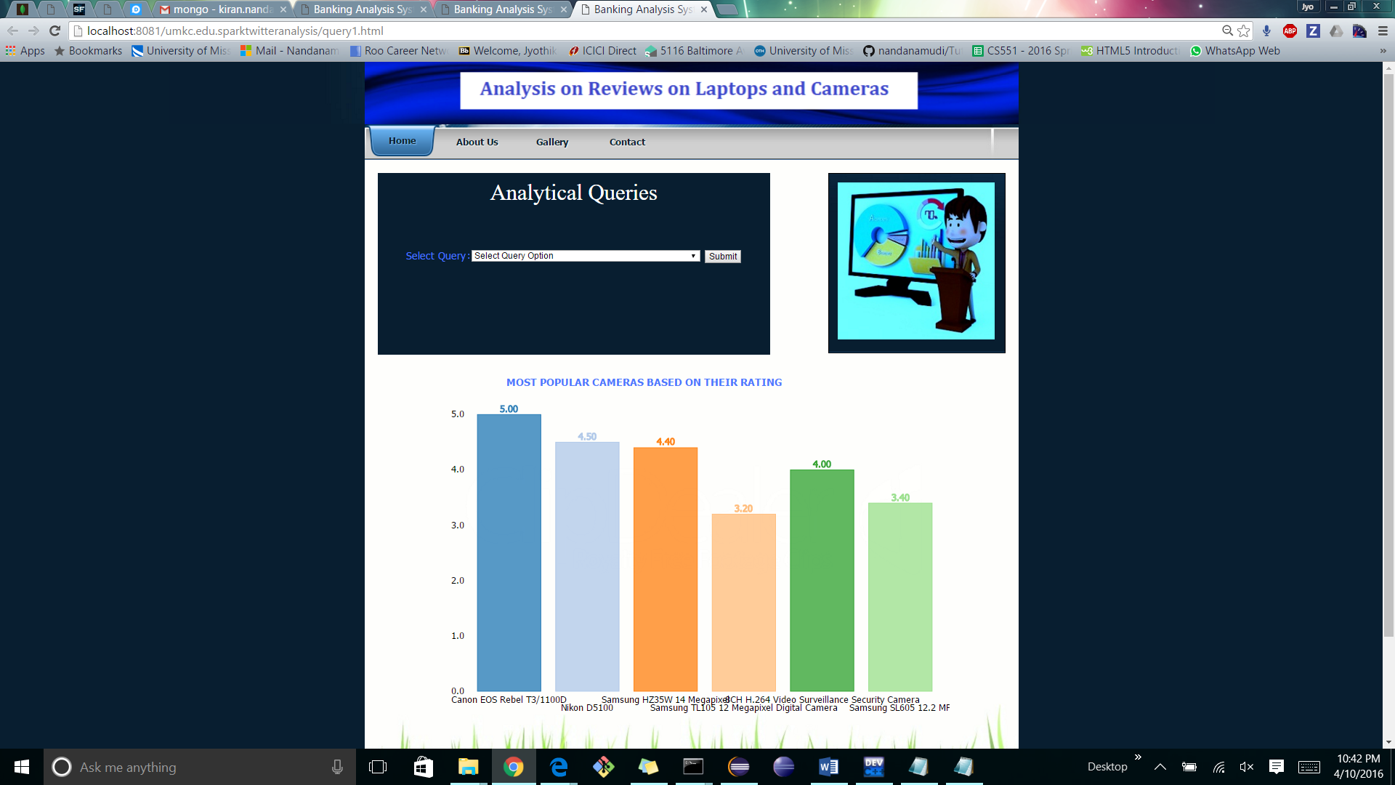

Slide 5
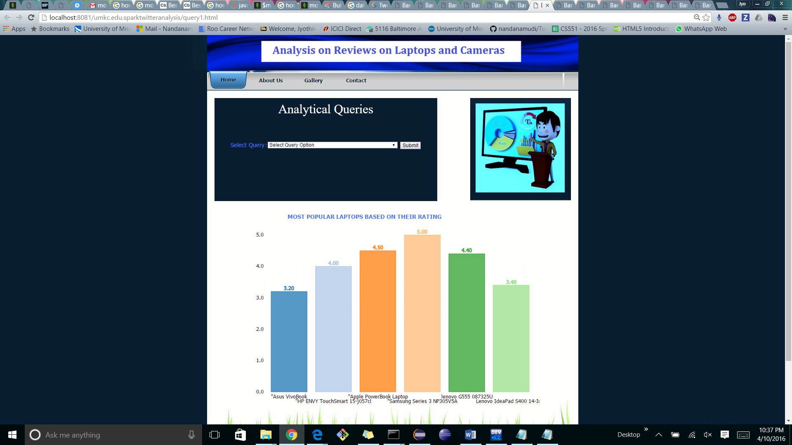

Slide 6
References
http://stackoverflow.com/questions/34236112/java-lang-noclassdeffounderror-org-apache-spark-sparkconf
https://m.oschina.net/blog/467423
https://www.mapr.com/ebooks/spark/03-apache-spark-architecture-overview.html
http://www.ibm.com/analytics/us/en/industry/banking/
http://www.ibmbigdatahub.com/blog/analytics-banking-services
http://www.taywils.me/2013/11/05/javasparkframeworktutorial.html
https://github.com/mbostock/d3/wiki/Gallery
Hongning Wang, Yue Lu and ChengXiang Zhai. Latent Aspect Rating Analysis without Aspect Keyword Supervision. The 17th ACM SIGKDD Conference on Knowledge Discovery and Data Mining (KDD'2011), P618-626, 2011.
Hongning Wang, Yue Lu and Chengxiang Zhai. Latent Aspect Rating Analysis on Review Text Data: A Rating Regression Approach. The 16th ACM SIGKDD Conference on Knowledge Discovery and Data Mining (KDD'2010), p783-792, 2010.

