Slide 1
CS5542 Big Data Analytics and Applications Tutorial 1 January 19, 2017
UMKC

Slide 2
Topics to cover
Ubuntu
Git
ZenHub
IntelliJ
SBT and Maven

Slide 3
Introduction of Ubuntu
Debian-based Linux operating system
Open source
Latest release: 15.10
Latest preview: 16.04
Install Ubuntu 14.04 LTS

Slide 4
Ubuntu Installation
Install Oracle VM Virtual Box:
https://www.virtualbox.org/wiki/Downloads
On windows:
http://www.htpcbeginner.com/install-virtualbox-on-windows/
On Mac os x:
http://aztcs.org/meeting_notes/mac/virtualmachines/virtualbox/VirtualBoxMac.pdf
Install Ubuntu 14.04 LTS using Oracle VM Virtual Box:
https://brb.nci.nih.gov/bdge/installUbuntu.html
Notes:
Install Java in Ubuntu if it's not available.
If you want to make use of GPU, it's not possible with Virtual machine OS. You may have to install Ubuntu directly in a seperate hard drive partition. Check if your GPU is compatible with Tensorflow.
People with Mac OS can run tensorflow directly, you don't need to install Ubuntu. All the installation procedures are going to be different (Intellij, pycharm, git, tensorflow etc.). But if you want to install Ubuntu you can follow the same procedure using Virtual Machine.

Slide 5
Git Basic Tasks
1. Create Git remote repository using Git account
2. Clone git repository to your local
3. Use git to add file into local
4. Modify files and use git to commit change
5. Use git to push the commit to remote
6. Use git to pull (sync) content with remote

Slide 6
Git Project Management Tasks
1. Use Git to branch a project
2. Use Git to check different branches
3. Use Git to merge different versions

Slide 7
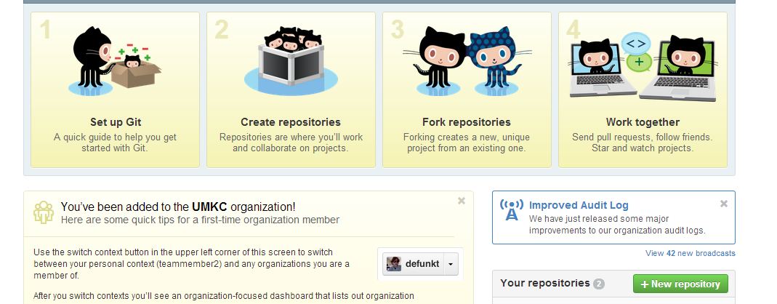
Git 1. Create Repository

Slide 8

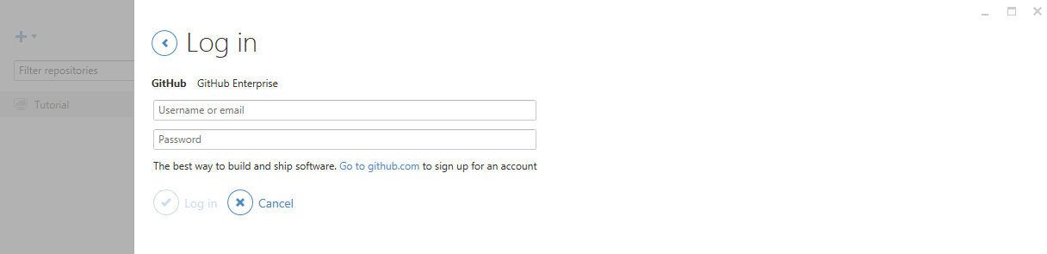
Git
For Windows user, please open GitHub desktop by double clicking icon
login to your GitHub desktop with your GitHub account (It is very important to login before you do the rest of steps. Because after you login, you secure connection has been made)

Slide 9

Git
Then open Git Shell by clicking icon

Slide 10
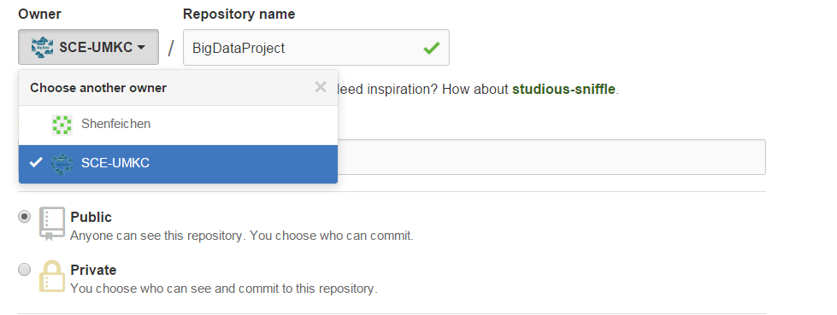
Git 1. Create Repository
We will add each group to our created organization “SCE-UMKC”.
Create your project under Owner SCE-UMKC, give a project name. That is the repository. E.g., Project Naming RealTime-Fall2016-YourProjectName
If you are not the member of SCE-UMKC yet, you can just create a repository under your username

Slide 11
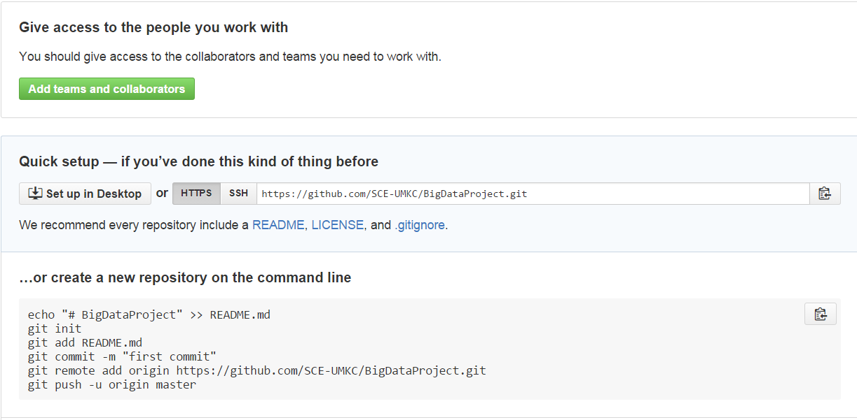
Git 2. Clone repository to your local
git clone https://github.com/xxxxxxx.git

Slide 12
Git
After clone, you will find a folder has the same name as repository
Use the following command to go inside the folder
cd <folder_name> (e.g., cd BigDataProject)

Slide 13
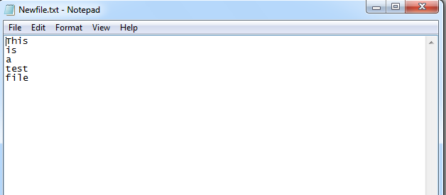
Git 3. Add file to local repository
In the local repository folder, we can add a new file
If you are a Linux or a Mac user
vi Newfile.txt
If you are a Windows user
echo This is a test file > Newfile.txt

Slide 14
Git 4. Commit this change
git commit –m ‘Someone committed on Sometime’
After commit, you can check git status to see if work directory clean
git status

Slide 15
Git 5. Push the change to remote
For Windows user, we first test if we are able to connect to GitHub
ssh -T git@github.com
https://help.github.com/articles/generating-ssh-keys

Slide 16
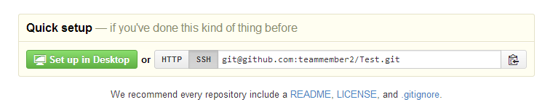
Git 5. Push the change to remote
Setup remote connection by SSH git address git remote set-url origin git@gxxxxxx.git

Slide 17
Git 5. Push the change to remote
Now you can push all to GitHub
git push --all

Slide 18
Git 6. Sync local with remote
If something change in remote, for sync purpose, you can type
git pull

Slide 19
For now, Windows users have done all basic steps.
But for Linux and Mac users, there are some more steps

Slide 20
Git 5. Push the change to remote (Non-Windows User)
For Linux or Mac user, we have more work to do before pushing change to remote
We have to setup SSH
Here are several steps

Slide 21
Git 5. Push the change to remote (Non-Windows User)
Generate a SSH key with your github email address
ssh-keygen -t rsa –C ‘your_email@example.com‘
It will ask you the file name to save this key and passphrase. Give the key name and make passphrase as empty.
For example, we give key name as id_rsa, key pair would be:
id_rsa and id_rsa.pub

Slide 22
Git 5. Push the change to remote (Non-Windows User)
(2) Add your new private key to the ssh-agent
ssh-agent -s
eval $(ssh-agent)
ssh-add Your_Key_Name

Slide 23
Git 5. Push the change to remote (Non-Windows User)
(3) Copy public key to your github account
vi Your_Key_Name.pub
Copy the content of this file

Slide 24
Git 5. Push the change to remote (Non-Windows User)
(4) Copy key to your GitHub account
In the user bar in the top-right corner of any page, click setting button
Click SSH Keys in the left sidebar.
Click Add SSH key.
In the Title field, add a descriptive label for key
Paste your key into the "Key" field.
Click Add key.

Slide 25
Git 5. Push the change to remote (Non-Windows User)
(5) SSH to github for testing ssh -T git@github.com

Slide 26
Git 5. Push the change to remote (Non-Windows User)
(6) Switching remote URLs from HTTPs to SSH git remote set-url origin git@gxxxxxx.git

Slide 27
Git 5. Push the change to remote (Non-Windows User)
(7) Now you can push
git push --all

Slide 28
Git 6. Sync local with remote (Non-Windows User)
If something change in remote, for sync purpose, you can type
git pull

Slide 29
Git Project Management 1. Branch
A and B work on the same project
A wants to develop on feature A
B wants to develop on feature B
They work in parallel
BranchA and BranchB

Slide 30
Git Project Management 1. Branch
Create a branch
git branch branchA
Delete a branch
git branch –d branchA
Force delete a branch
git branch –D branchA
Rename the current branch
git branch –m branchA

Slide 31
Git Project Management 2. Checkout
A and B has to checkout their own branch to work on
git checkout branchA
git checkout branchB

Slide 32
Git Project Management 3. Merge
User A works on featureA, after finish, user A commit it with the message ‘finish featureA’
git commit –m ‘finish featureA’
User B works on featureB, after finish, user B commit it with the message ‘finish featureB’
git commit –m ‘finish featureB’
User C works on main features on master branch, user C commit it with the message ‘finish main features’
git commit –m ‘finish main features’

Slide 33
Git Project Management 3. Merge
In master, we can merge all features and delete branchA and branchB
git checkout master
git merge branchA
git merge branchB
git branch –d branchA
git branch –d branchB

Slide 34
Git Project Management 3. Merge
At last, master push all change to remote repository
git push --all

Slide 35

ZenHub for GitHub project management
ZenHub is a GitHub plugin for agile project management
It needs either Chrome or Firefox as the browser.
Go to https://www.zenhub.io/
Click “Add ZenHub to GitHub”, it will install a plugin on your browser
Click plugin icon
It will ask you to login to GitHub (You have to create your GitHub account before)
After login, you have to grant the permission for ZenHub to access your GitHub project
Done

Slide 36
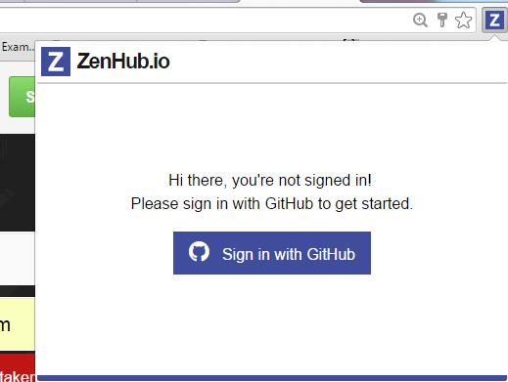

Slide 37
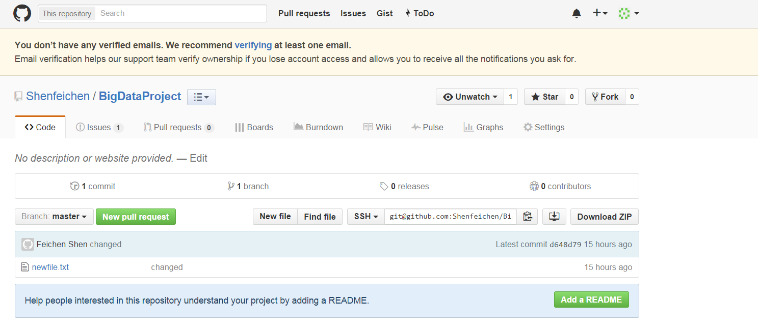
ZenHub
Click issues, we can add issues
Click Boards, we can drag and drop stories to different completion status
Click burndown, we can add milestone and assign different stories to milestone and then generate burndown chart

Slide 38
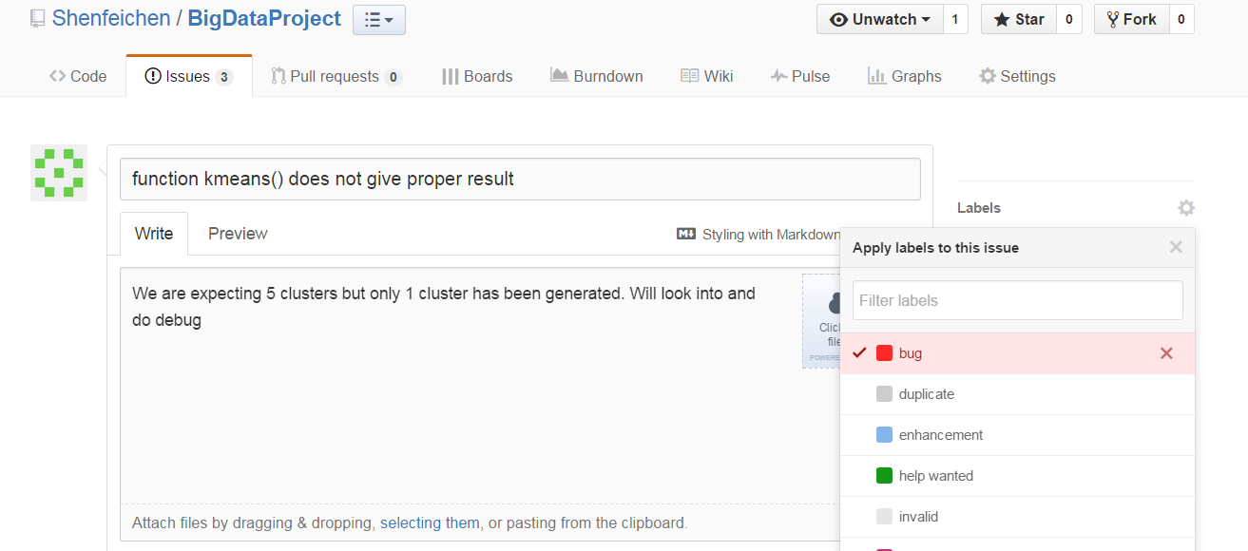
Add Issues
Click issues
Click New issues

Slide 39
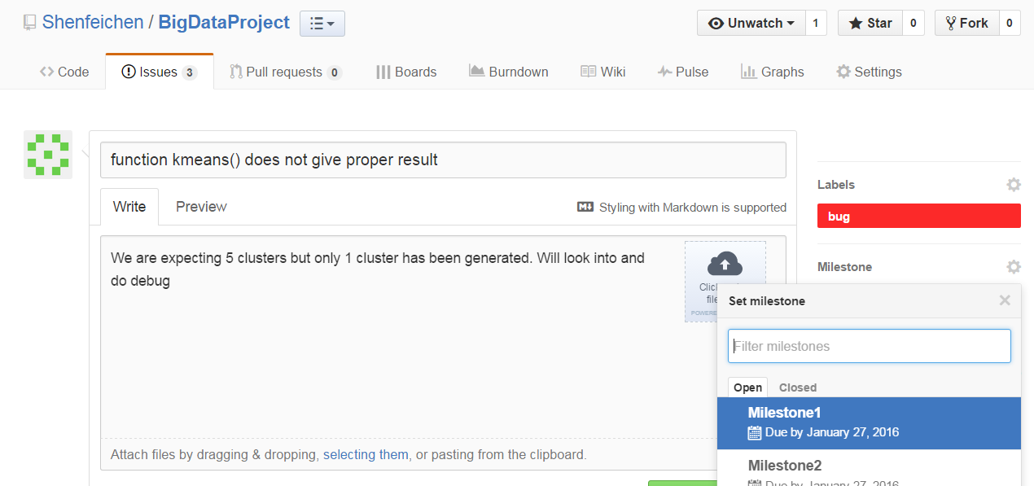
Add Issues

Slide 40
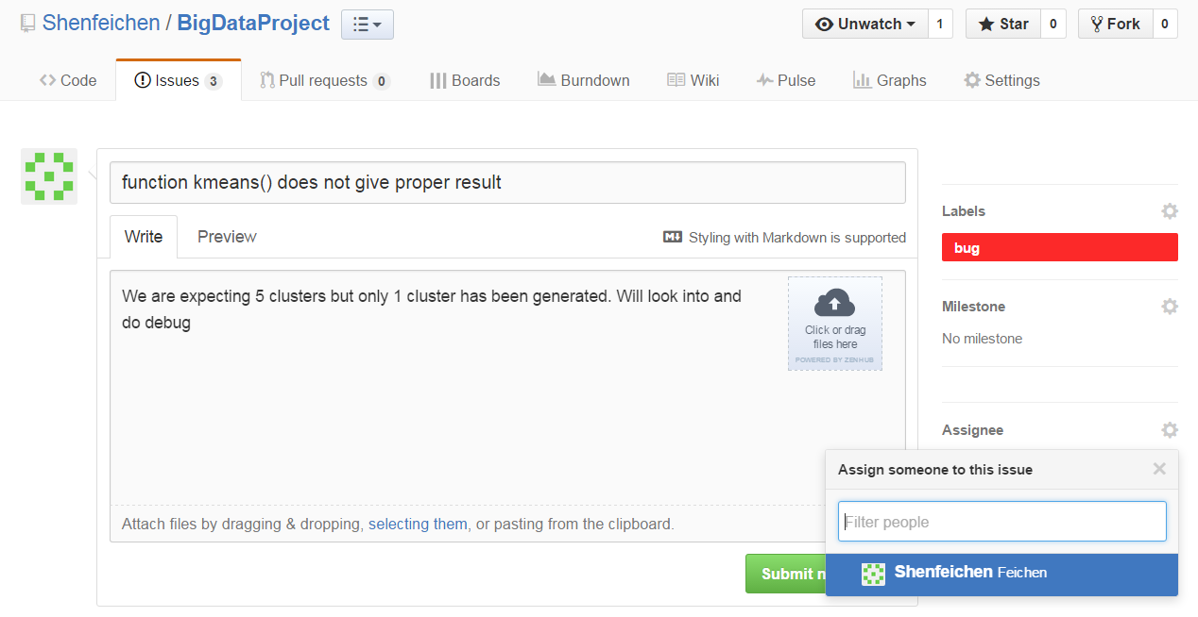
Add Issues

Slide 41
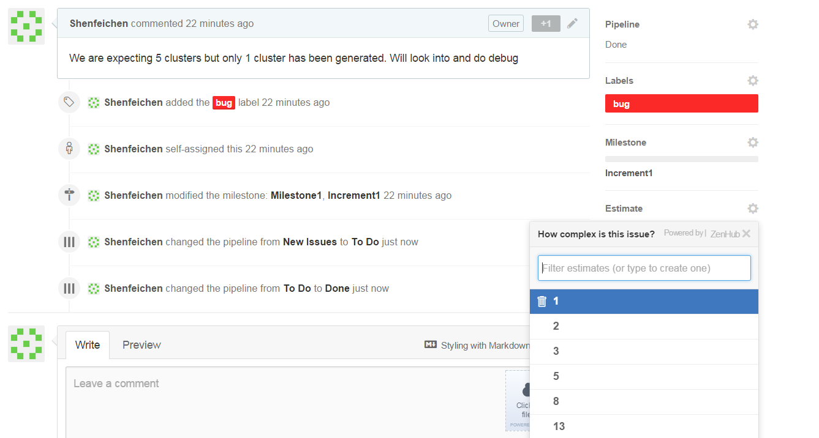
Add Issues
Story point is a arbitrary measure used by Scrum teams. This is used to measure the effort required to implement a story.

Slide 42
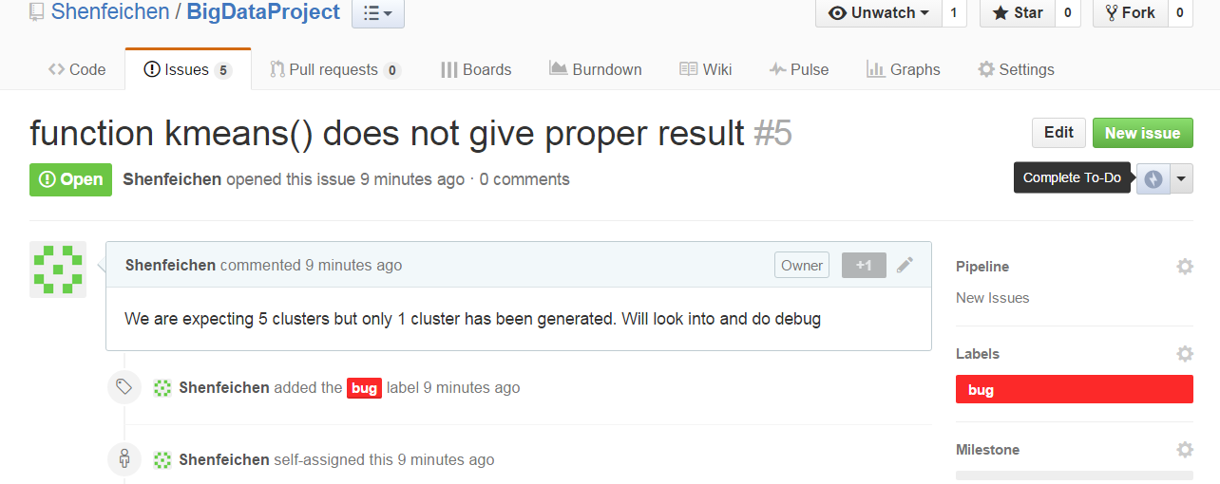
Add Issues

Slide 43
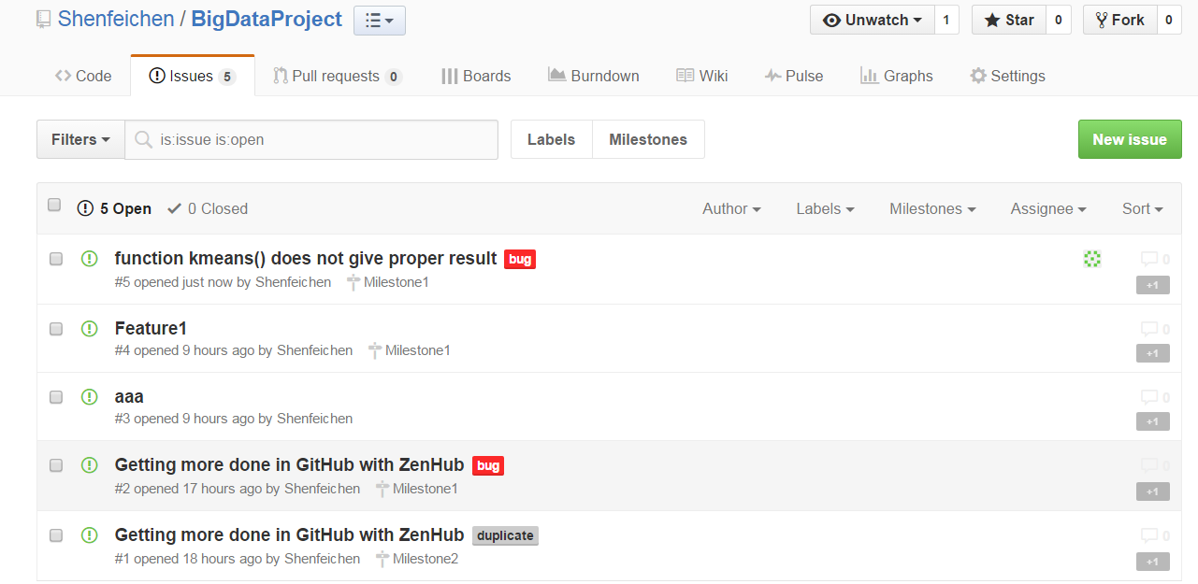
Add Issues

Slide 44
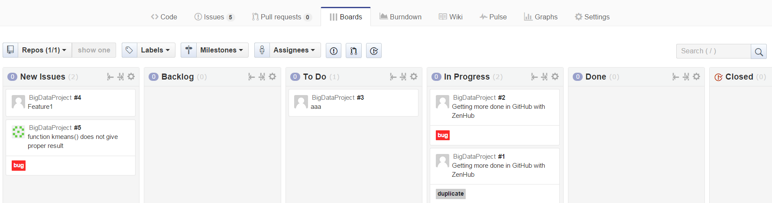
Board

Slide 45
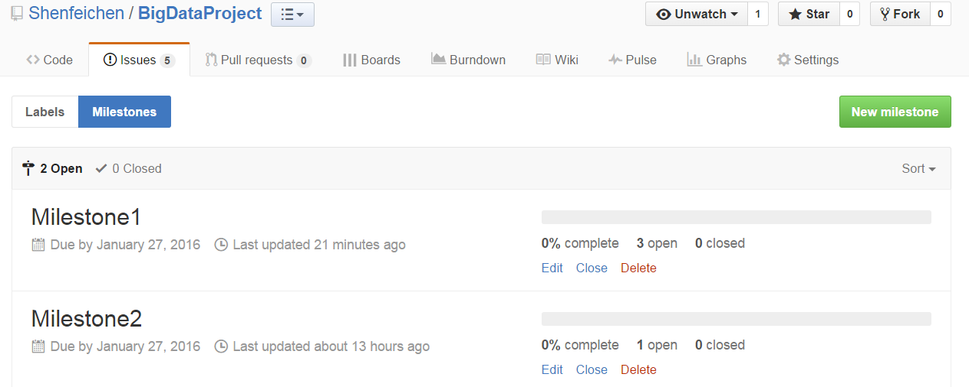
Add Milestones
Issues → Milestones → New Milestones
You can create Milestones

Slide 46
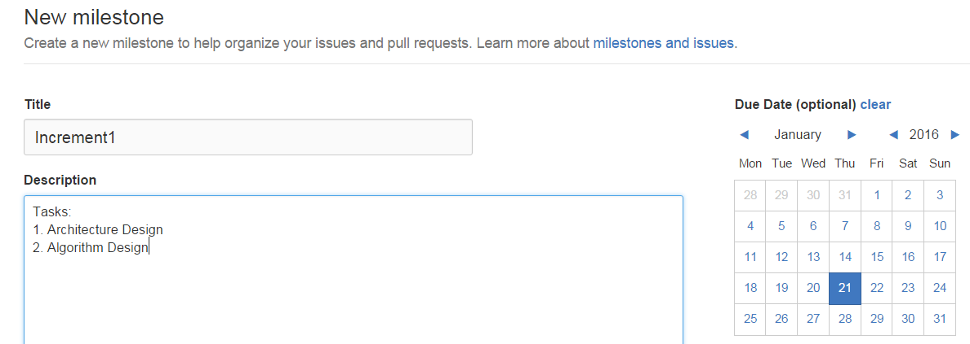
Add Milestones

Slide 47
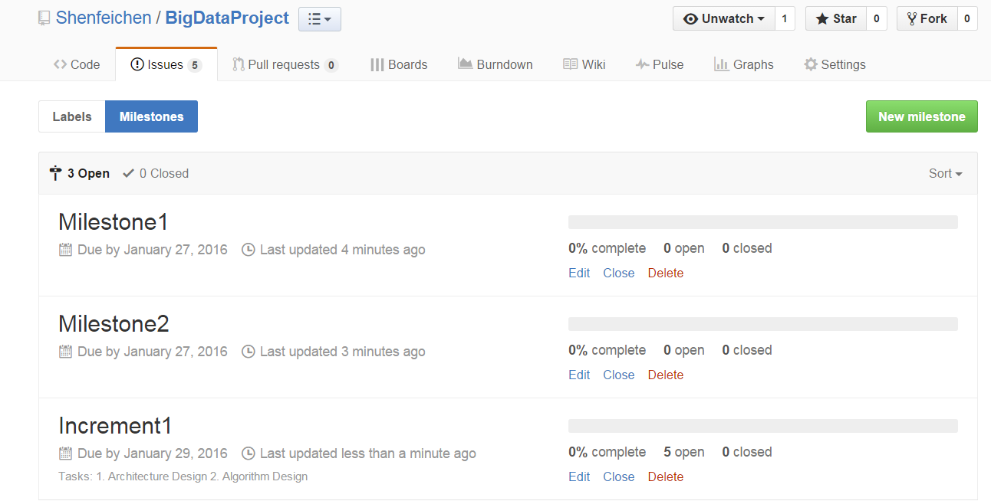

Slide 48
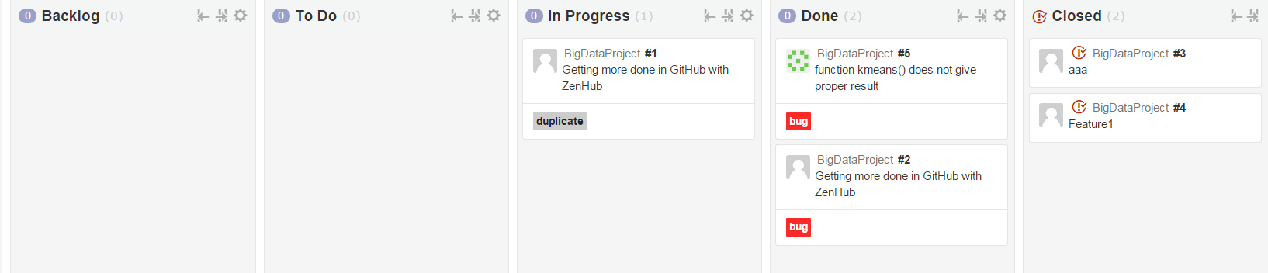
Add Milestones
Increment1 has 5 issues
I drag two of them to “Closed” status

Slide 49
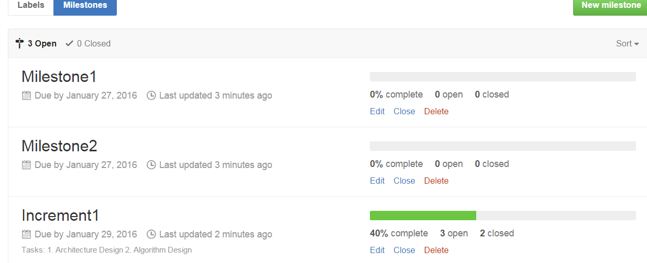
Add Milestones
Then the complete of Milestones will also change

Slide 50
Build Burndown Chart
A burn down chart is a graphical representation of work left to do versus time.

Slide 51
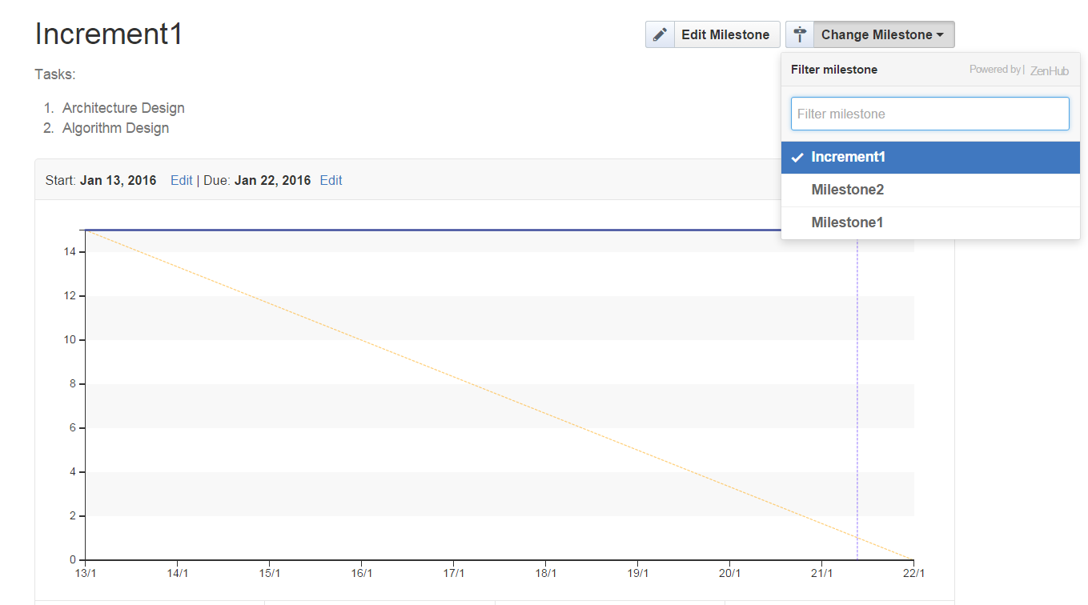
Build Burndown Chart
Go to burndown option, select a specific milestone, to see the burndown chart

Slide 52
Code Contribution
The Code Contribution on the Github Project will be used to evaluate your individual score on the contribution towards the project.

Slide 53
INTELLIJ

Slide 54
IntelliJ
Java- Scala integrated development environment (IDE)
Can be Downloaded from https://www.jetbrains.com/idea/
IDE used for Storm and Spark

Slide 55
Intellij Ubuntu
https://www.jetbrains.com/idea/download/#section=linux
Move to desired installation location
Unpack the idea idea-2016.3.3.tar.gz file using the following command: tar xfz idea-2016.3.3.tar.gz
Run idea.sh from the bin subdirectory
To run idea.sh: command: sh idea.sh

Slide 56
Attention
Make sure to add Scala to IntelliJ environment while installing

Slide 57
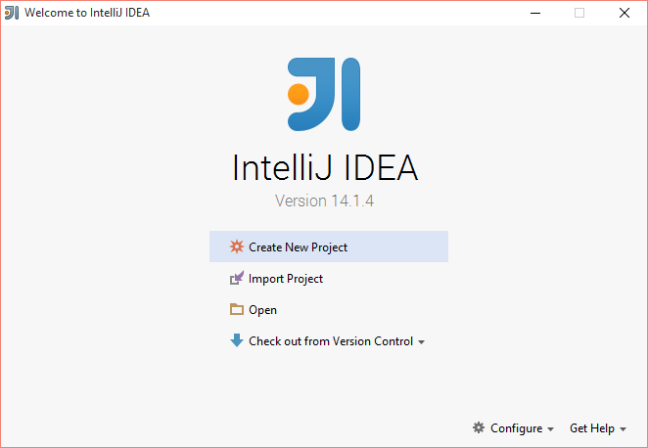

Slide 58
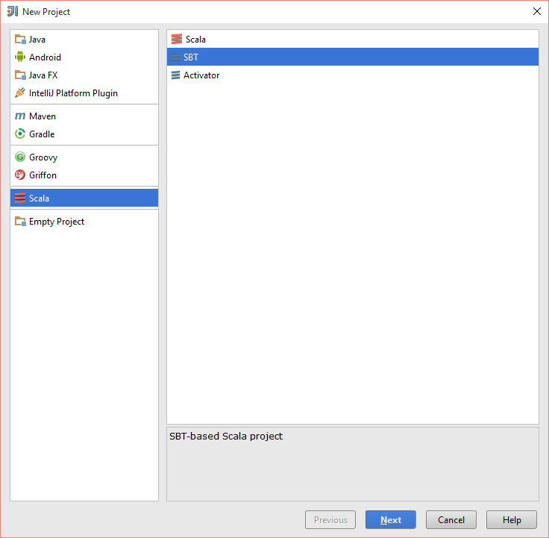
For Scala Project

Slide 59
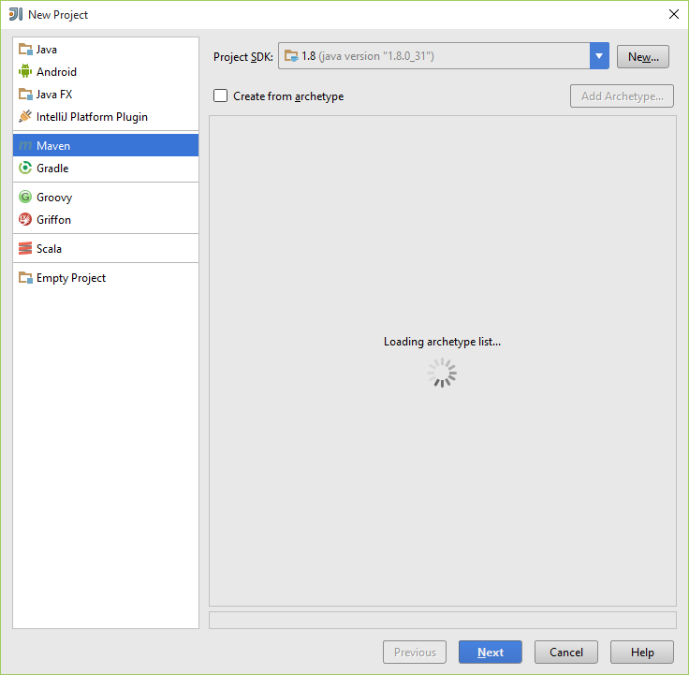
For Java Project

Slide 60
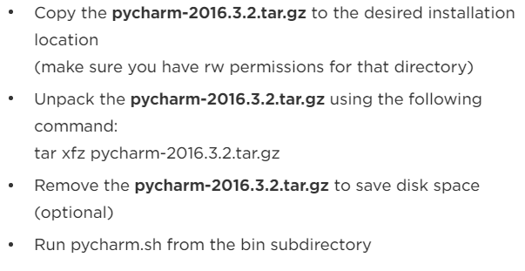
PyCharm
https://www.jetbrains.com/pycharm/download/#section=linux

Slide 61
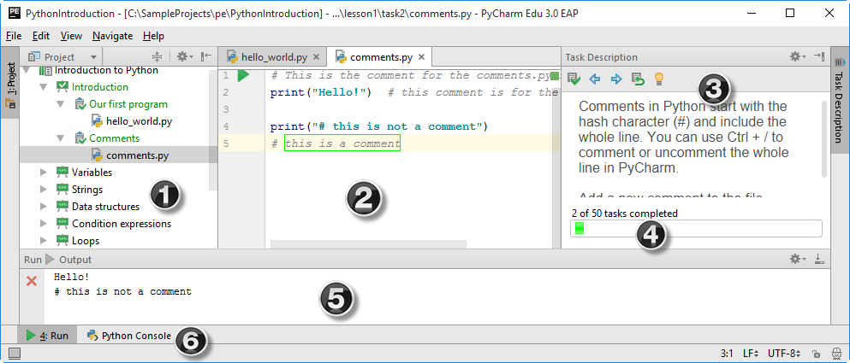
PyCharm
Notes:
Where (1) is the Project tool window that shows the project itself, (2) is the editor, (3) is the Task Description tool window with the course progress bar (4) , (5) is the Run tool window and (6) is the Python Console tool button.

Slide 62
BUILD TOOLS: SBT and MAVEN

Slide 63
What is Build Tools?
Build automation is the act of scripting or automating a wide variety of tasks that software developers do in their day-to-day activities including things like:
compiling computer source code into binary code
packaging binary code
running automated tests
deploying to production systems
creating documentation and/or release notes

Slide 64
SBT
SBT stands for Scala Build Tool
SBT is an open source build tool for Scala and Java projects, similar to Java's Maven or Ant.

Slide 65
SBT - Installation
http://www.scala-sbt.org/0.13/tutorial/Installing-sbt-on-Windows.html
Install SBT.

Slide 66
SBT Commands
sbt clean : cleans the jars and classes generated from previous run
sbt package : creates a light jar, with the classes generated
sbt assembly : creates a fat jar without all the dependies compiled with it.
Note : we would be creating fat jar for deployment in spark

Slide 67
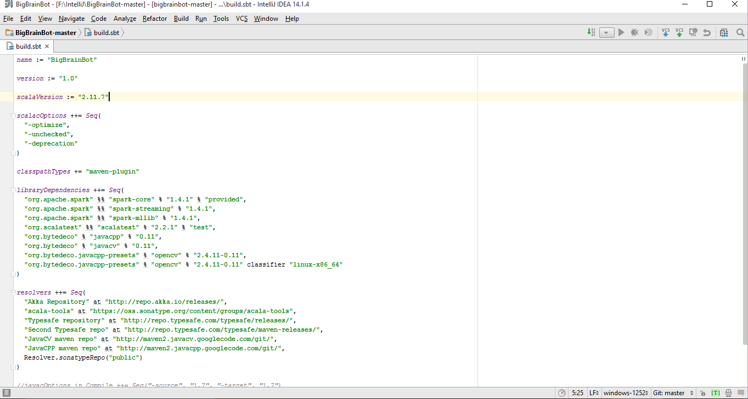
SBT related Files
Two main files which are involved with sbt are
Build.sbt : Dependencies libraries are specified

Slide 68
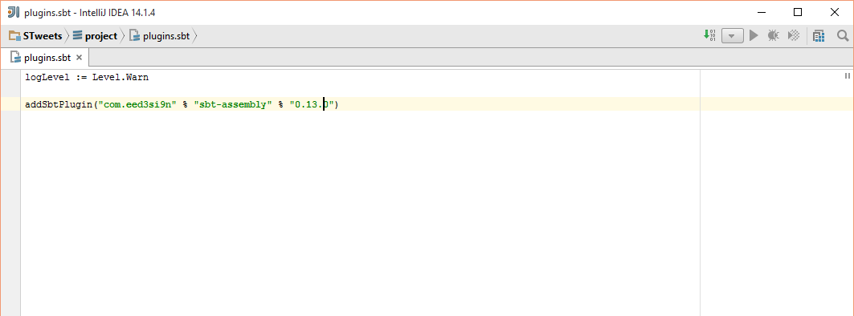
SBT related Files
Plugins.sbt / assembly.sbt : The version of sbt used is specified in this

Slide 69
Maven
Apache Maven is a software project management and comprehension tool. Based on the concept of a project object model (POM), Maven can manage a project's build, reporting and documentation from a central piece of information.

Slide 70
Maven - Installation
https://maven.apache.org/
Install Maven

Slide 71
Maven Commands
mvn compile - compile the source code of the project
mvn test - test the compiled source code using a suitable unit testing framework. These tests should not require the code be packaged or deployed
mvn package - take the compiled code and package it in its distributable format, such as a JAR.

Slide 72
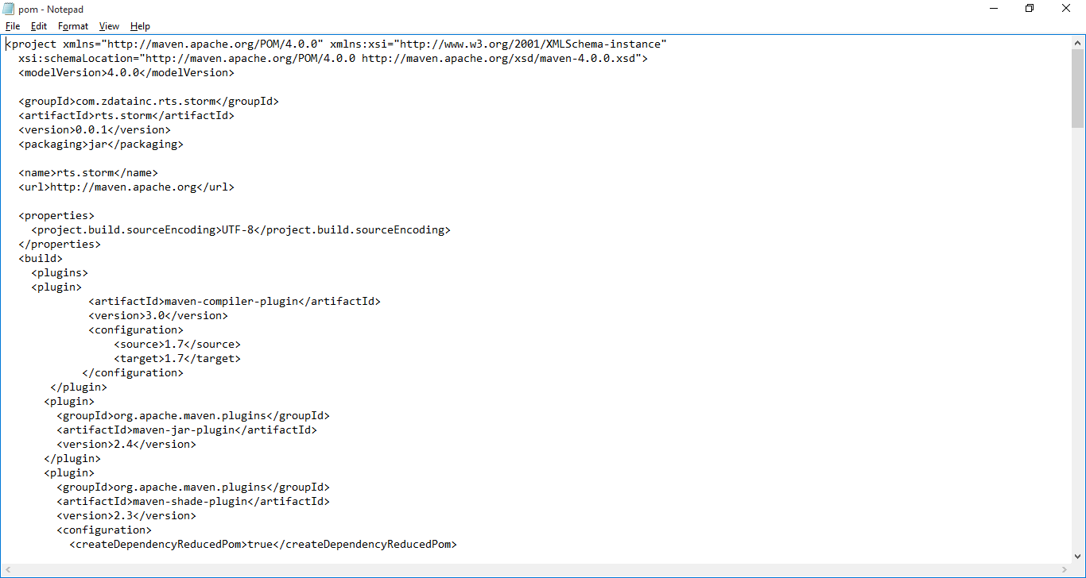
Maven related File: pom.xml

Slide 73
Wiki: Lab Submission
Create a repository for all Lab assignment submissions
Create a folder for each lab assignment and place all code inside source code folder
Use Github wiki pages to submit reports for each lab
Include all wiki links in README.md file

Slide 74
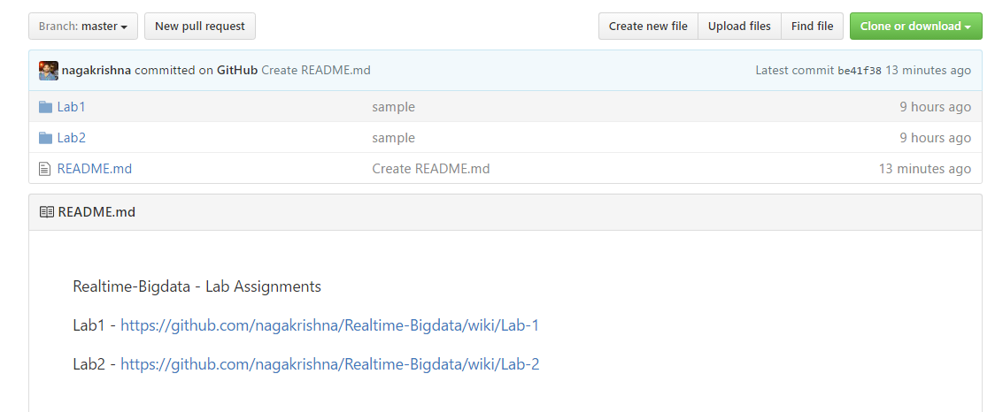
Wiki: Lab Submission

Slide 75
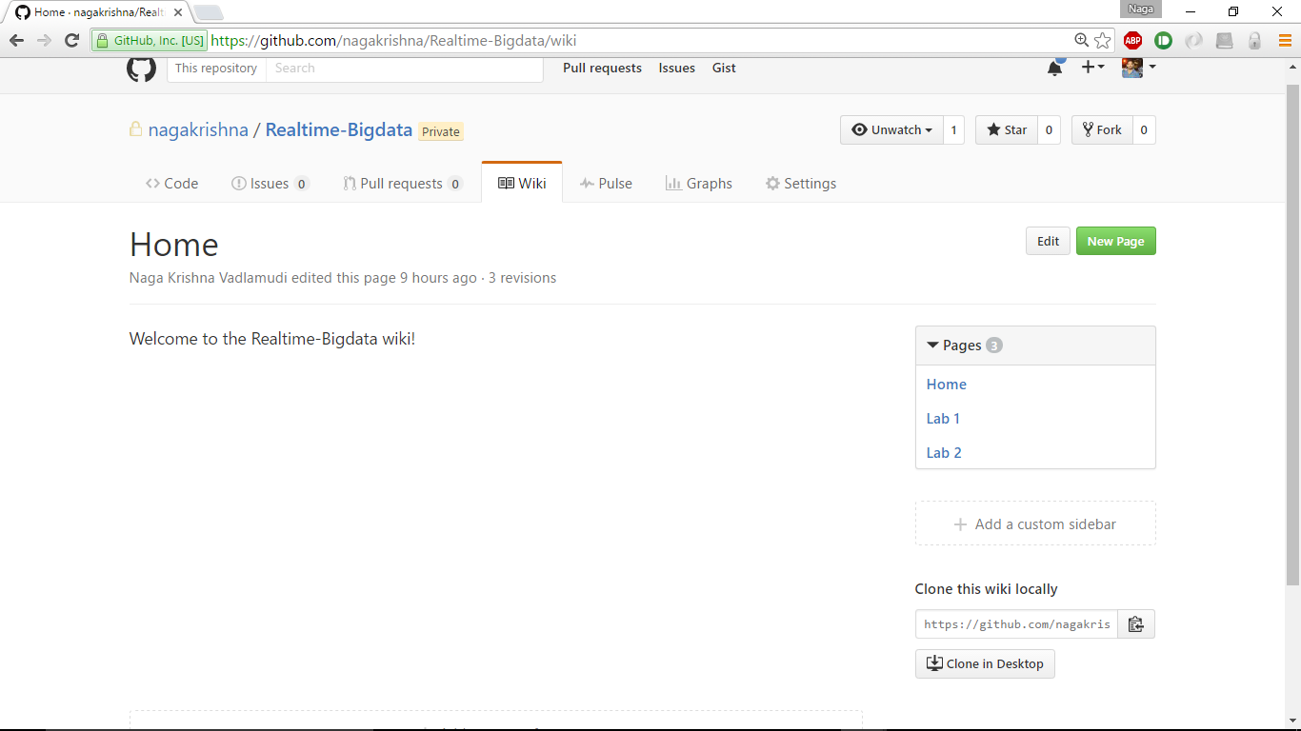
Wiki: Lab Submission

Slide 76
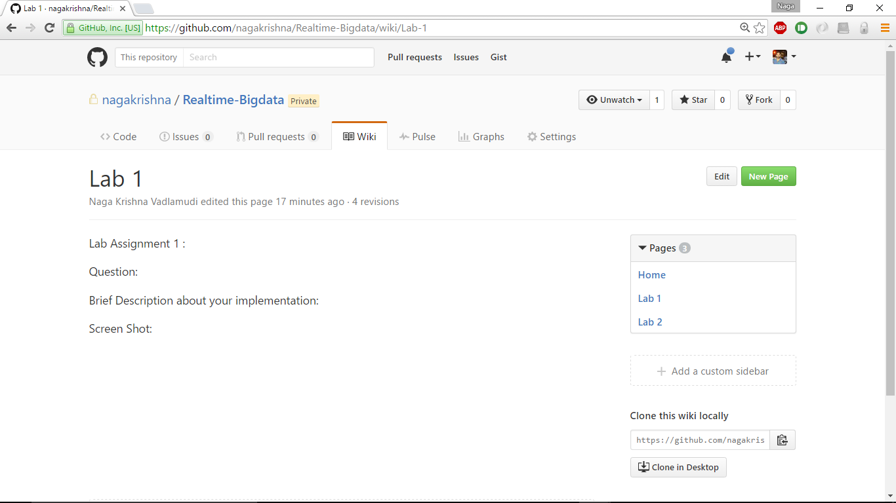
Wiki: Lab Submission

Slide 77
END

