Slide 1


PROJECT :
Insights to Guide a Legacy Newspaper’s Survival in a Post-COVID Digital Era
CONTENTS
1. Overview of Trends ( Net circulation, copies Printed, returned copies)
2. City wise Contribution to Net Circulation and revenue in 2024
3. Revenue Contribution by ad-Categories
4. Revenue Per Copy Sold
5. Digital pilot campaign outliers
Created by: Yadhu Nandan

Slide 2
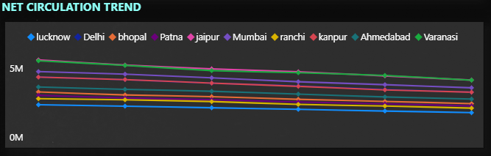
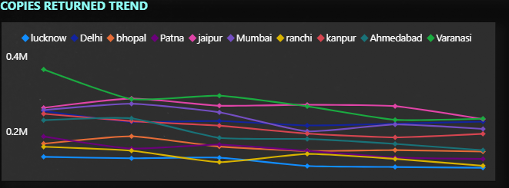
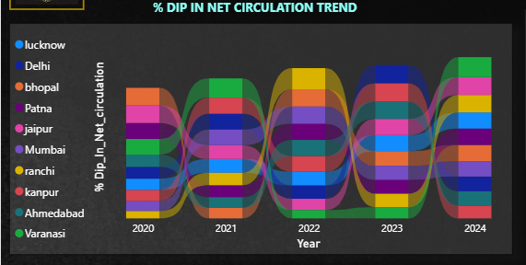
1. Overview of Trends
Consistent Year-on-Year Decline
Both Net Circulation and Copies Sold/Printed have shown a consistent decline across all cities.
Low Performers
Lucknow and Ranchi consistently rank at the bottom across all years in circulation metrics.
Copies Returned vs Overall Circulation
While Copies Returned have decreased, the overall fall in circulation suggests this is not a positive trend, but rather reflects lower distribution volumes.
Sharpest Decline in 2024
In terms of Net Circulation % dip for 2024, Varanasi, Jaipur, and Ranchi recorded the steepest declines.

Slide 3
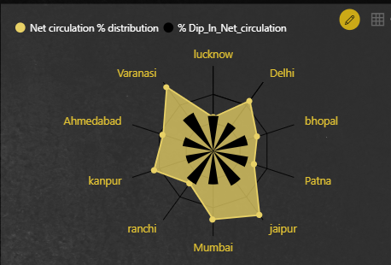
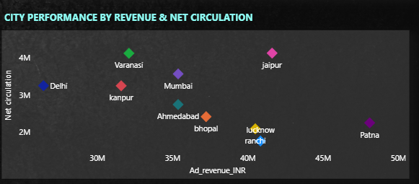
2. City wise Contribution
2024 City-wise Circulation vs Revenue Insights:
Top Contributors to Net Circulation
Varanasi and Jaipur led in net circulation volumes in 2024.
Circulation vs Revenue Mismatch
Despite its high circulation, Varanasi ranks among the bottom 3 cities in revenue generation. In contrast, Jaipur, with similar high circulation, is among the top 2 revenue-generating cities.
Patna – Highlighter
Even with a low contribution to net circulation, Patna delivers the highest revenue among all cities — highlighting a strong revenue-to-circulation efficiency.

Slide 4
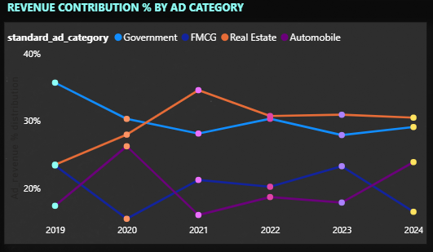
3. Revenue Contribution by ad-Categories
Top Performing Categories
Government and Real Estate consistently lead in revenue contribution. Notably, Real Estate has shown significant growth in recent periods.
Low Performing Categories
FMCG and Automobile remain at the bottom in terms of revenue contribution. Among them, FMCG is showing a declining trend, indicating reduced ad spends or engagement.

Slide 5
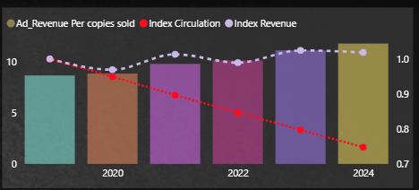
4. Revenue Per Copy Sold
Apparent Growth in Revenue per Copy Sold
While Revenue per Copy Sold appears to be increasing, this growth is misleading.
Underlying Reality
The overall revenue (indexed to 2019) has shown only marginal growth, whereas circulation has dropped significantly.
Pseudo Growth Indicator
As a result, the rise in revenue per copy is more of a mathematical effect than a real performance improvement — a pseudo positive trend driven by falling volumes, not stronger monetization.

Slide 6
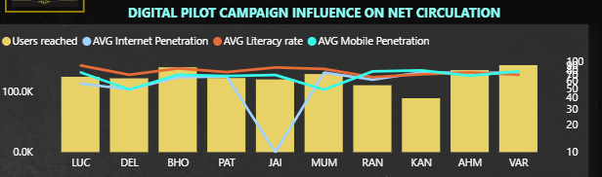
5. Digital pilot campaign outliers
Kanpur
Holds the highest Digital Readiness Score, indicating strong potential for digital engagement. However, actual user participation in digital campaigns was relatively low, highlighting an underutilization of digital capacity.
Jaipur
Despite low smartphone penetration and limited digital infrastructure, the user reach in digital campaigns was higher than Kanpur. This suggests effective campaign execution or higher engagement levels despite infrastructural challenges.

Slide 7
Key Observations:
Circulation Overview
Continuous YoY decline in Print Sold and Net Circulation across all cities.
Net Circulation dropped 25% vs 2019 – a major concern.
Varanasi, Jaipur, Mumbai lead; Lucknow, Ranchi at the bottom.
⚠️ Circulation – Key Concerns
Varanasi & Jaipur, despite high contribution, saw sharp dips in 2024.
Tier 2 cities are the main drivers of circulation strength.
📉 Revenue vs Circulation
Revenue follows a sinusoidal pattern, unlike the steady fall in circulation.
As a result, the rise in revenue per copy is more of a mathematical effect than a real performance improvement.
💰 Revenue Trends
Revenue growth is stagnant, with minimal improvement since 2019.
Patna and Jaipur are top revenue-generating cities in 2024.
Govt and Real Estate lead in category revenue; Real Estate shows strong growth.
📲 Digital Campaign Insights
Users prefer mobile app platforms – cost-effective and high engagement.
High-readiness cities like Kanpur saw low participation.
Jaipur, despite poor smartphone penetration, showed high user reach.

Slide 8
Quantifying What Went Wrong
Print Ad Revenue Decline:
Net Circulation Decrease: The decline in net circulation is a critical factor. From the dashboard, we see a decrease of 6.22% in net circulation, dropping from 31.56M to 29.6M. This suggests a reduced audience base for print ads, directly impacting ad revenues. The cities like Jaipur and Mumbai, which contributed significantly to the circulation, might have seen a stagnation or fall in readership, leading to lower ad visibility.
Returned Copies: There's a notable 5.52% of returned copies, indicating inefficiencies in distribution or reduced demand for the physical copies. This suggests a shrinking audience for traditional print ads.
Audience Engagement: The avg bounce rate of 65.77% and avg adopted user rate of 19.31% from digital platforms show that user engagement is not as strong as expected.

Slide 9
Recovery Potential (Mobile-Based & Regional Growth)
Mobile-Based Content:
Best Performing Platforms: Mobile App Beta: Highest real usage (23.4%), best cost/user reached (₹8.7).
PDF WhatsApp Push: Good reach, strong usage in Tier 2 cities (33% in Delhi, 27% in Lucknow).
Opportunity:
Focus on Mobile App Beta & WhatsApp Push in Tier 2/3 cities.
Improve platform stickiness to reduce high bounce rate (65.77%).
Regional Opportunities:
Tier 2 Cities:
Major contributors to ad revenue (62.47%) and net circulation (60.76%).
Better digital adoption than Tier 1 & 3 (avg readiness: 69.9%).
Top Cities to Focus:
Lucknow, Delhi, Patna – high user base and digital readiness.
Varanasi, Ahmedabad – strong campaign response and rising circulation.

Slide 10
Digital Roadmap (Actionable Steps)
Prioritize Mobile App Beta & WhatsApp Push:
Double down on top-performing platforms with better real usage and low cost
Enhance Digital Adoption in Tier 2 Cities:
Tailored marketing and regional content in cities like Patna, Lucknow, Bhopal.
Address High Bounce Rate:
Optimize UX/UI and content relevance to reduce bounce (currently 65.77%).
Focus on Retention: Improve user conversion from "Accessed" to "Really Used" (currently 19.3%).
Monitor Campaign Influence on Circulation:
Track quarterly net circulation growth; align digital strategy accordingly.
Localized Campaign: Use city-wise readiness and response data to create hyper-local digital pushes.
Content Personalization: Leverage user data to push relevant, language-specific content via mobile.

