Slide 1
CS-400 Project 2022
Made by - Aryan Bisht
19010119
Supervisor:- Dr. Kaushal Bhardwaj

Slide 2

Steganography in video
Made by: Aryan Bisht
Semester: 7th
Submission Date: 2022
Supervisor:
Dr. Kaushal Bhardwaj

Slide 3

Objective..
In my project I primarily targeting the info security issues while sending the info over the network using steganographic techniques. To propose a combination of steganography and cryptography techniques to provide authentication and confidentiality of that secret data. Security acts as an important role which have double layer of data hiding.

Slide 4
What is Steganography?
The word steganography is of Greek origin and means ”covered or hidden writing”. Steganography is the art and science of communication in way which hides the existence of the communication.Steganography is a method of hiding secret message behind cover media or cover message which include audio, text, image and video. Secret message will be embed in those cover media to not letting unauthorized people know the message that being transfer between the trusted two parties.

Slide 5
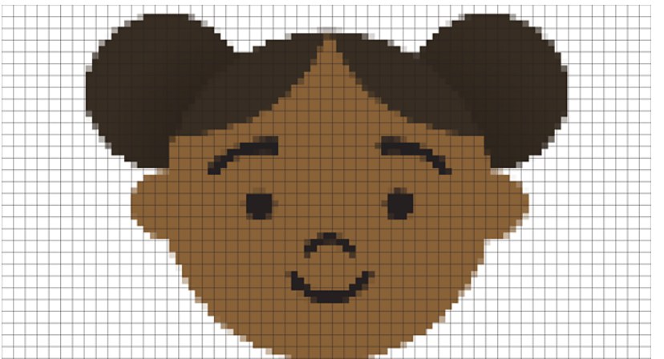
What is an image and pixel?
Digital images can be made by putting together lots of tiny squares, known as pixels -short for picture element.When an image is digitised to be stored on a computer, it’s turned into a set of pixel
A pixel is the smallest unit of a digital image or graphic that can be displayed and represented on a digital display device. A pixel is the basic logical unit in digital graphics. Pixels are combined to form a complete image, video, text, or any visible thing on a computer display.
An RGB image, is stored as an m-by-n-by-3 data array that defines red, green, and blue color components for each individual pixel.

Slide 6
How RGB and pixel related?
A digital color image pixel is just numbers representing a RGB data value (Red, Green, Blue). Each pixel's color sample has three numerical RGB components (Red, Green, Blue) to represent the color of that tiny pixel area. These three RGB components are three 8-bit numbers for each pixel. Three 8-bit bytes (one byte for each of RGB) is called 24 bit color. Each 8 bit RGB component can have 256 possible values, ranging from 0 to 255. For example, three values like (250, 165, 0), meaning (Red=250, Green=165, Blue=0) to denote one Orange pixel. Photo editor programs have an EyeDropper tool to show the 3 RGB color components for any image pixel.
The composite of the three RGB values creates the final color for that one pixel area. In the RGB system, we know Red and Green make Yellow. So, (255, 255, 0) means Red and Green, each fully saturated (255 is as bright as 8 bits can be), with no Blue (zero), with the resulting color being Yellow.

Slide 7
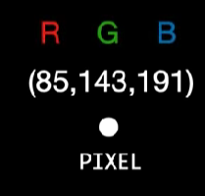
255 is the maximum possible number that can be stored in an 8 bit byte. Larger numbers require multiple bytes, for example two bytes (16 bits) can hold up to 256x256 = 65536 unique values. 24 bit RGB color images use 3 bytes, and can have 256 shades of red, and 256 shades of green, and 256 shades of blue. This is 256x256x256 = 16.7 million possible combinations or colors for 24 bit RGB color images. The pixel's RGB data value shows "how much" Red, and Green, and Blue, and the three colors and intensity levels will be combined at that image pixel, at that pixel location.

Slide 8
Video Steganography
It is a technique of hiding any kind of data into digital video format. In this case video (combination of pictures) is used as carrier for hiding the data.Generally to hide the data in each of the images in the video, which is unnoticeable by the human eye. H.264, Mp4, MPEG, AVI are the formats used by video.This can achieved by using the frames of the video. As we know videos are made from images only. If we can extract those images and then encode data on them and again make video from those frame we can implement steganography in video.We use a algorithm called LSB.

Slide 9
LSB Algorithm
Least significant bit (LSB) coding is the simplest way to embed information in a digital Image.LSB stands for Least Significant Bit. The idea behind LSB embedding is that if we change the last bit value of a pixel, there won’t be much visible change in the color. When applying LSB techniques to each byte of a 24-bit image, three bits can be encoded into each pixel.
Steps are given at next slide:-

Slide 10
The algorithm is as follows:-
For each character in the data, its ASCII value is taken and converted into 8-bit binary .
Three pixels are read at a time having a total of 3*3=9 RGB values. The first eight RGB values are used to store one character that is converted into an 8-bit binary.
The corresponding RGB value and binary data are compared. If the binary digit is 1 then the RGB value is converted to odd and, otherwise, even.
The ninth value determines if more pixels should be read or not. If there is more data to be read, i.e. encoded or decoded, then the ninth pixel changes to even. Otherwise, if we want to stop reading pixels further, then make it odd.
Repeat this process until all the data is encoded into the image.

Slide 11
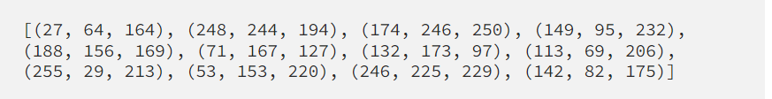
Example.
The message to be hidden is ‘Hi’.
The message is of three bytes, therefore, the pixels required to encode the data are 3 x 3 = 9. Consider a 4 x 3 image with a total of 12 pixels, which are sufficient to encode the given data.

Slide 12


Step 1 :-
The ASCII value of H is 72, whose binary equivalent is 01001000.
Step 2 :-
Read the first three pixels.
Step 3 :-
Now, change the pixel value to odd for 1 and even for 0 as in the binary equivalent of data.
For example, the first binary digit is 0 and the first RGB value is 27, it needs to be converted to even, which implies 26.
Similarly, 64 gets converted to 63 because the next binary digit is 1 so the RGB value should be made odd.
So, the modified pixels are:

Slide 13
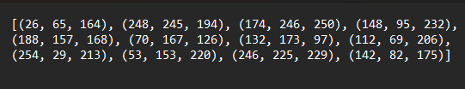
Step 4 :-
Since we have to encode more data, the last value should be even. Similarly, i can be encoded in this image.
While making the pixel values odd/even by doing +1 or -1, you should take care of binary conditions. I.e., the pixel value should be more than or equal to 0 and less than or equal to 255.
The new image will look like:

Slide 14
SHA256
SHA stands for Secure Hash Algorithm.The significance of the 256 in the name stands for the final hash digest value, i.e. irrespective of the size of plaintext/cleartext, the hash value will always be 256 bits. SHA-256 is one of the most secure hashing functions. A secure hashing algorithm. It is an unkeyed cryptographic hashing function that takes an input of variable length and produces a 256-bit long hash output.

Slide 15
AES
Advanced Encryption Standard (AES) is a specification for the encryption of electronic data.That means it takes 128 bits as input and outputs 128 bits of encrypted cipher text as output. AES relies on substitution-permutation network principle which means it is performed using a series of linked operations which involves replacing and shuffling of the input data. The Advanced Encryption Standard (AES) is a symmetric block cipher. It take input a key of size 128, 256-bit length.

Slide 16
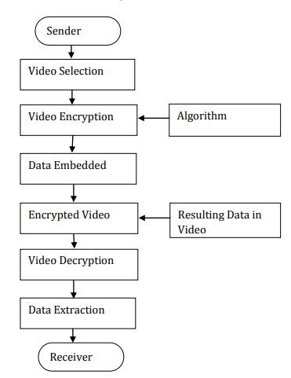
Flow
Diagram

Slide 17
Implementation
STEP 1:- We will load the video from the user.
STEP 2 :- We will get all the frames from the video.
STEP 3:- We will get the message and password from the user and using SHA256 and AES will generate the key to encrypt the data.
STEP 4 :- Using LSB will encode the encrypted message into the frames of video.
STEP 5 :- Now, will make the video from the stegano-images.

Slide 18
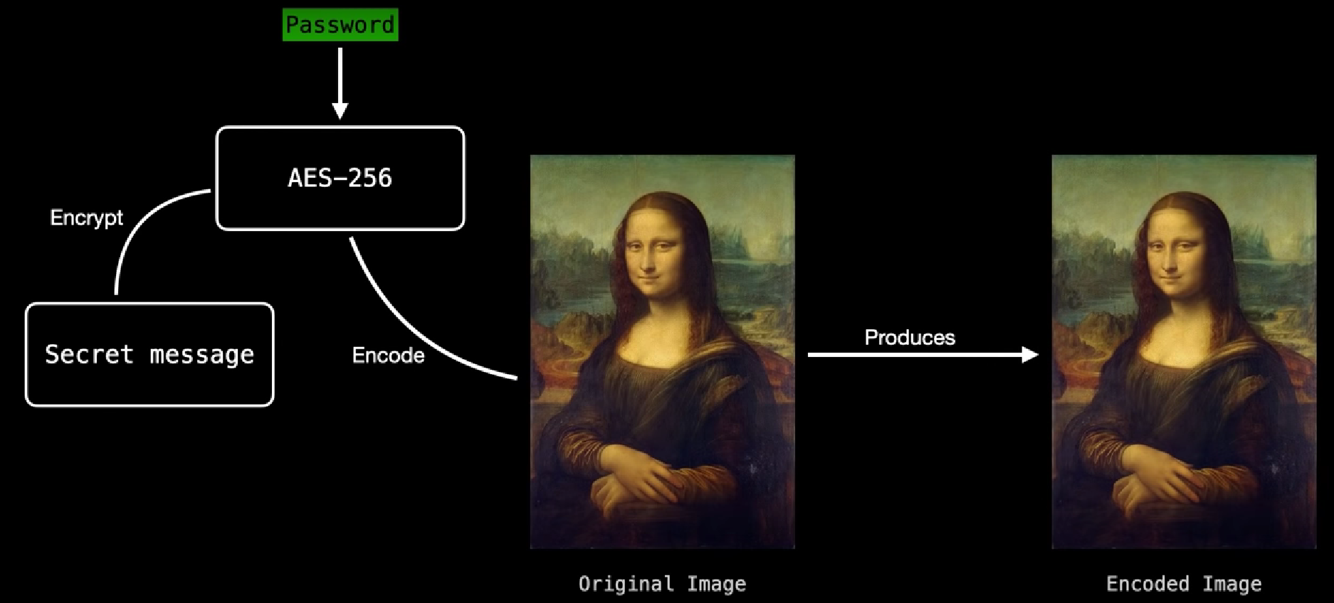

Slide 19
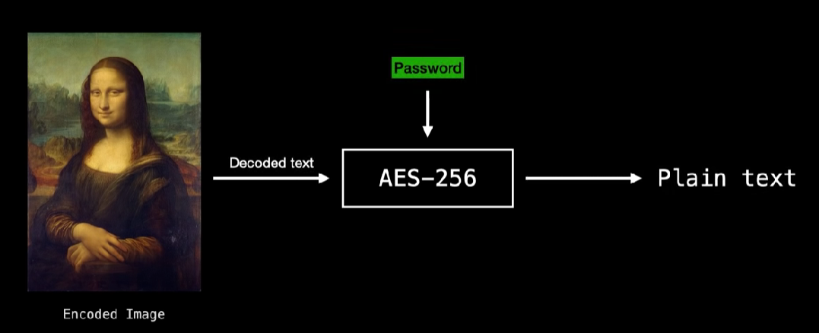

Slide 20
Possible Modifications
It to too much time to render video from frames, as we are making a lossless video from the frames. Find a way to render it faster
The size of the encoded video is very large as it’s a lossless video.Size can be small.

Slide 21
Future of project
I want to make this project to next level and want to design a app for this project which will be make it user friendly and easy to use to all other so that this can be used by all people who are in need for this. From, this your can send the message without fear to get hacked or some-one seeing his/her messages.

Slide 22
Thank You!!

