Slide 1


Submitted to Manipal Academy of Higher Education towards the partial fulfilment of the Requirements for the Degree of Post Graduate Diploma in Data Science
SUBMITTED BY
Nandan Dutta
19125760058

Slide 2


Customer Order Date Prediction
Your most unhappy customers are your greatest source of learning
….Bill Gates
21st May 2020

Slide 3
Objectives
Project Background
Data Source Summary
Data Wrangling & Storage
Feature Generation
Conclusion
Feature Ranking
Data Modeling & Analysis
Exploratory Data Analysis

Slide 4




Tools

Slide 5

Project Background
Utilizing data from a large online grocery delivery service, can we predict when an existing customer is likely to order again?
Knowing when a customer is likely to order again can help optimize retention strategy
Retention Statistics:2% increase in customer retention can lead to up to a 10% reduction in costs
Typical American business loses 15% of customers annually (Smallbiztrends.)

Slide 6
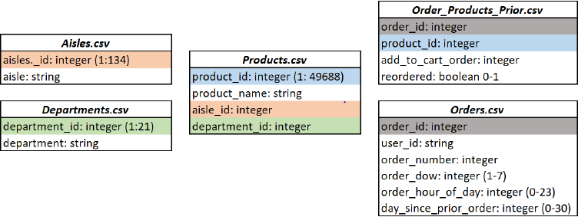
Data Source Summary
Dataset is sourced from Kaggle competition
Dataset includes group of relational csv files containing over 3 million orders for 200,000 customers

Slide 7
Data Wrangling & Storage
Loaded csv files from Kaggleto tables
Five csv files with varying amounts of information loaded into five separate tables
Data verification: 206,209 users (instances) with range of 4 to 100 orders each
Days since prior order range from 1-31 days, target group will be combination of this feature once EDA is performed

Slide 8
Exploratory Data Analysis
Several questions concerning our merged dataset to answer prior to generating target and feature
What was the distribution of the days since prior order for a user?
How many orders did the average user have?
What days of the week and time of day were most popular for users to order?
What is the most popular department type of products ordered?
How many unique products did a user order during the time frame of our dataset?

Slide 9
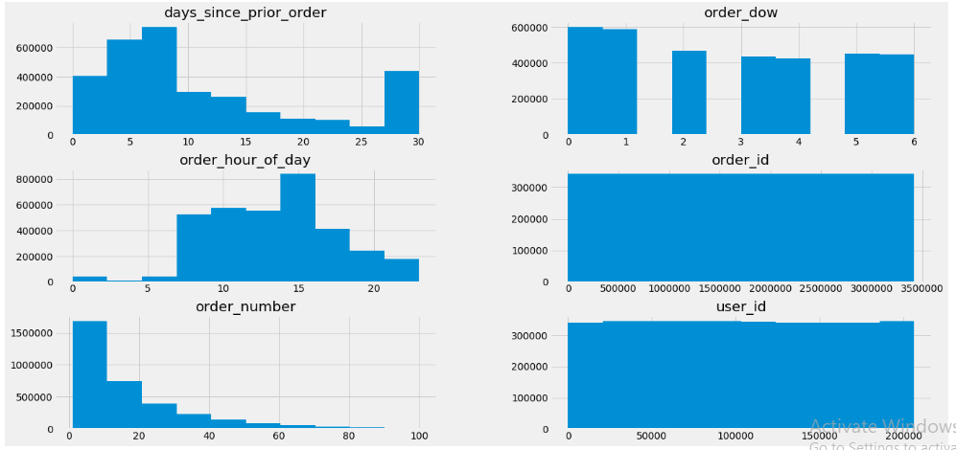
Exploratory Data Analysis
Histogram for all features

Slide 10
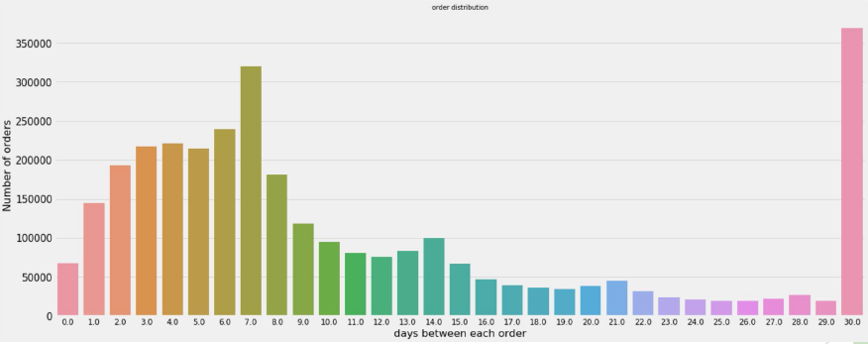
Exploratory Data Analysis
Distribution of Days Since Prior Order

Slide 11
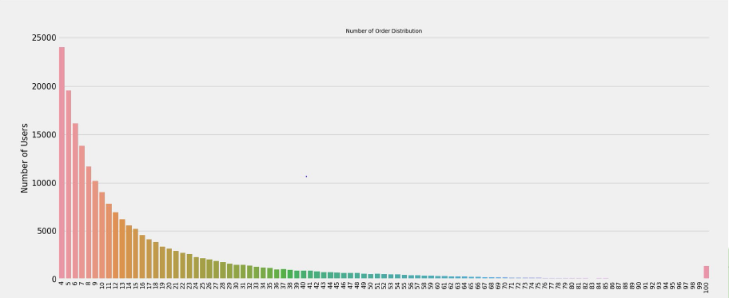
Exploratory Data Analysis
Number of Orders per User

Slide 12
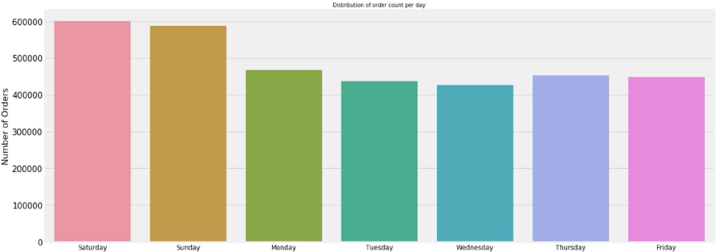
Exploratory Data Analysis
Order Count per Day of the Week

Slide 13
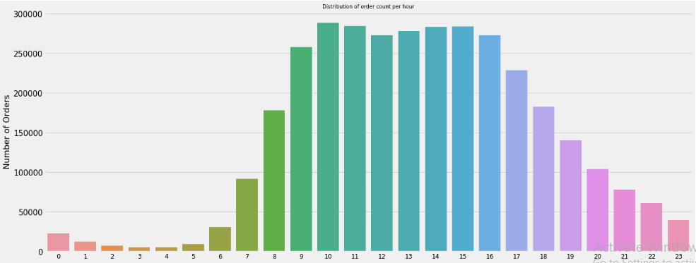
Exploratory Data Analysis
Distribution of order count per hour

Slide 14
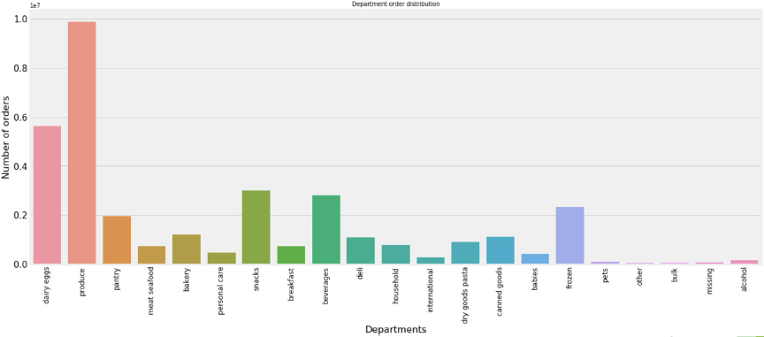
Exploratory Data Analysis
Order distribution by Department

Slide 15
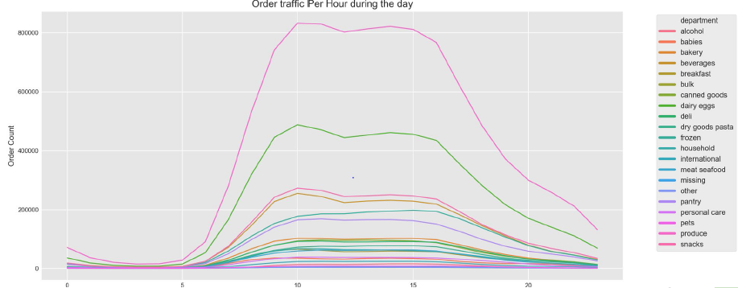
Exploratory Data Analysis
Order traffic per hour by Department type

Slide 16
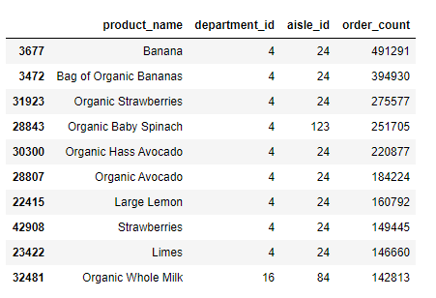
Exploratory Data Analysis
Top most ordered products are produce

Slide 17
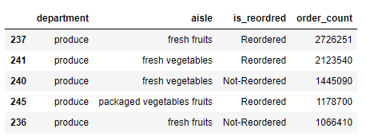
Exploratory Data Analysis
Top most aisle ordered

Slide 18

Exploratory Data Analysis
Days between second and first orders

Slide 19
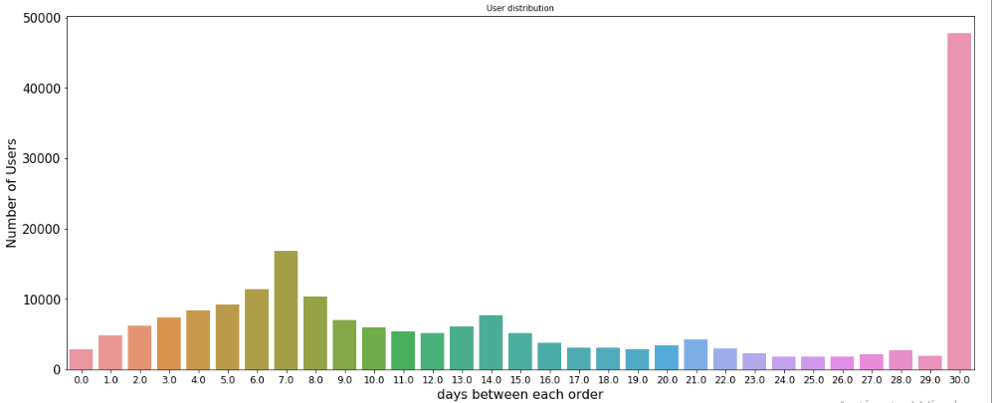
Exploratory Data Analysis
User distribution

Slide 20
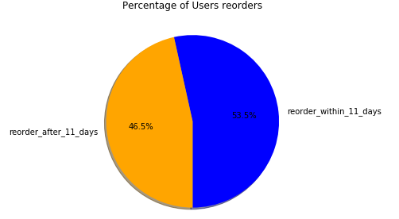
Exploratory Data Analysis
Percentage of Users reorders

Slide 21
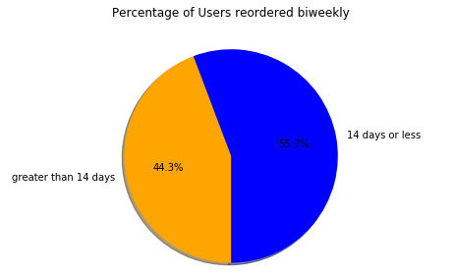
Exploratory Data Analysis
Percentage of Users reordered biweekly

Slide 22
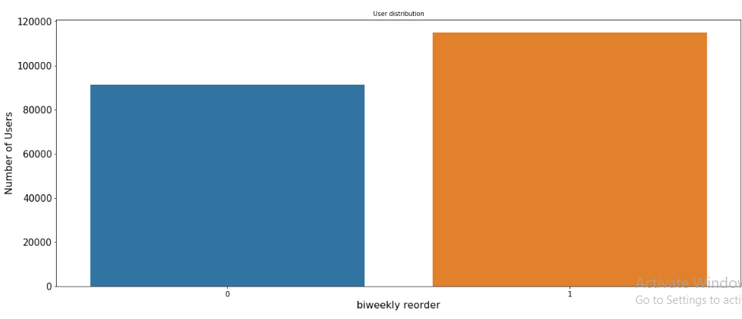
Exploratory Data Analysis
User distribution Biweekly

Slide 23
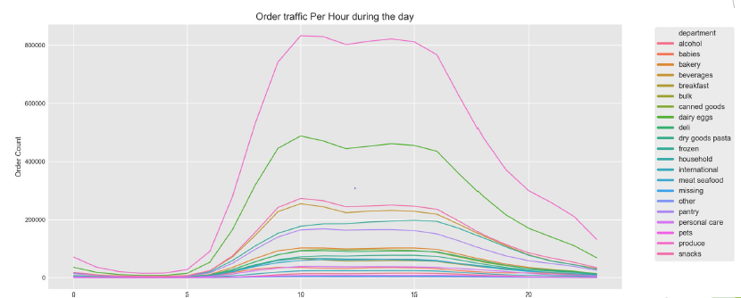
Exploratory Data Analysis
Order traffic per hour by Department type

Slide 24
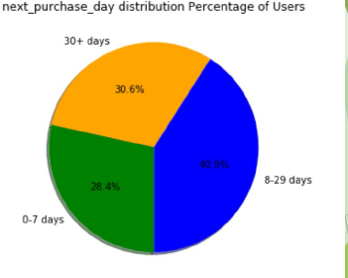
Feature Generation
Through preliminary EDA three distinct groups of next purchase day became evident
Target defined as next purchase day for users grouped by 0-7 days, 8-29 days, and 30+days
Multiclass Classification problem
Assigned labels to each group; 0-7 days assigned “0”; 8-29 days assigned “1”; 30+ days assigned “2”
Feature generation based upon intuitive predictive qualities from dataset

Slide 25
Feature Generation
42 total feature included in dataset
Examples of features created include : Number of inactive days per user
Number of unique products ordered by user
Number of reordered products by user
Preferred day of week for order by user Preferred hour of day by userEncoded (Morning=0; Afternoon=1; Night 2)
Number of perishable items by userBakery, Produce, Meat, Seafood, Dairy defined as perishable
Number of food vs nonfood items purchased by user
Mode of department type of first product added to cart by user

Slide 26
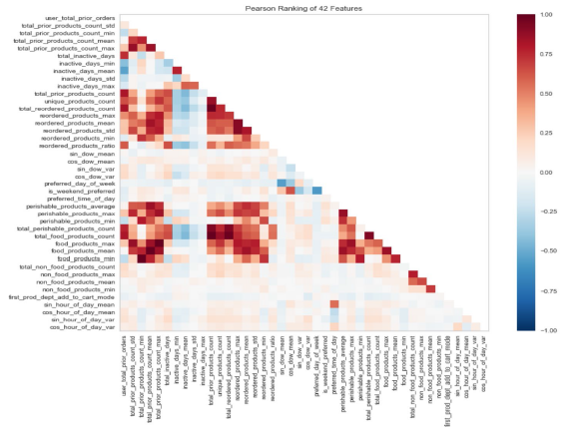
Feature Ranking
Yellowbrick2D Rank – Feature Ranking

Slide 27
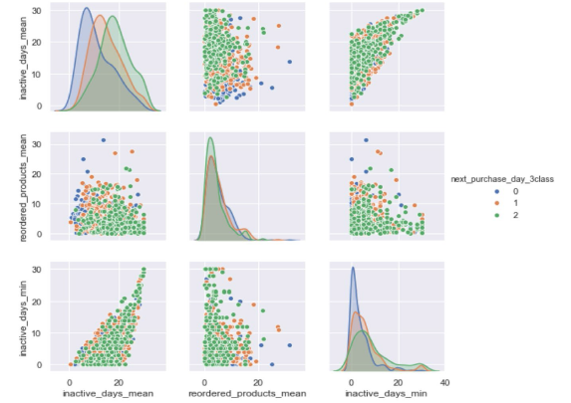
Feature Plot
Plot Top 3 Features Relative to Target

Slide 28
Data Modelling and Analysis
Model selection process :
Used Cross Validation method to evaluate the performance of different models :
Tried different classification models from sklearn
Tried different scaler techniques for each model
Hyperparameter Tuning using GridSearchCVfrom sklearn
Model Evaluation:
Feature Importance
Confusion Matrix
Classification Report

Slide 29
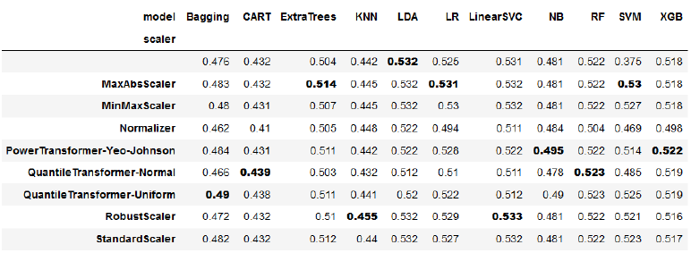
Data Modelling and Analysis
Multiclass Classification - Model Selection
Cross Validation Scores:

Slide 30
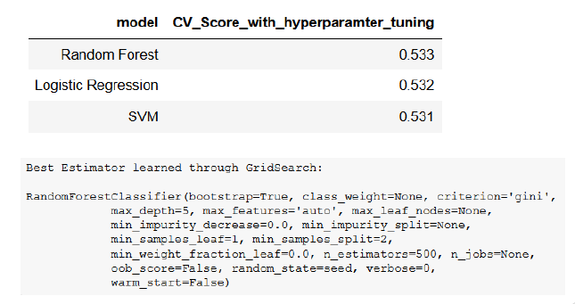
Data Modelling and Analysis
Multiclass Classification -Model Selection
GridSearchCVscores:

Slide 31
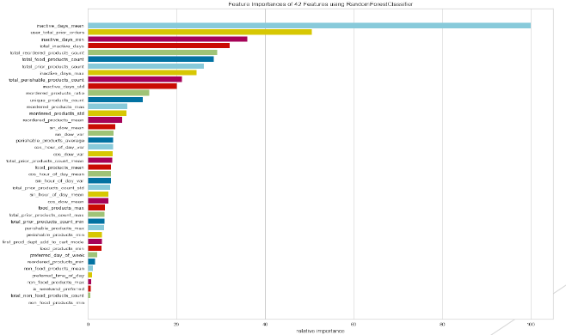
Data Modelling and Analysis
Multiclass Classification -Model Evaluation
Feature Importance using yellowbrick FeatureImportances visualizer:

Slide 32
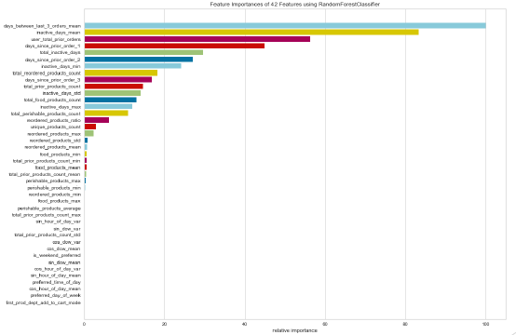
Data Modelling and Analysis
Multiclass Classification -Model Evaluation
Feature Importance after dropping features with low importance and adding new features:

Slide 33
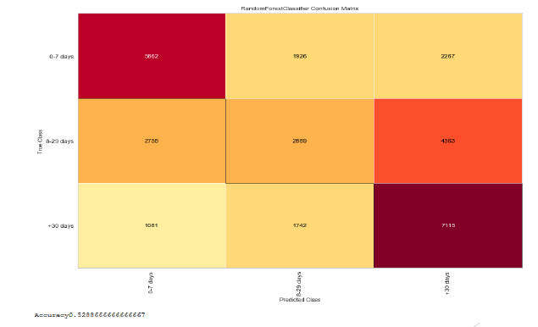
Data Modelling and Analysis
Multiclass Classification -Model Evaluation
Confusion Matrix using yellowbrick ConfusionMatrix visualizer:

Slide 34
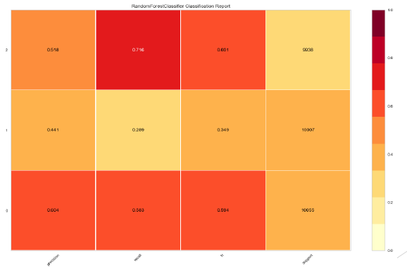
Data Modelling and Analysis
Multiclass Classification -Model Evaluation
Classification Report using yellowbrick Classification Reportvisualizer:

Slide 35
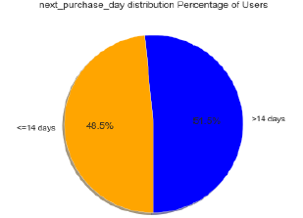
Data Modelling and Analysis
Another Approach
Redefined the target (next purchase day) for users and regrouped them by <=14 days as 0 and >14 days as 1
More balanced data set
Binary Classification Problem
Applied the same steps of model selection and evaluation as in the multiclass problem

Slide 36
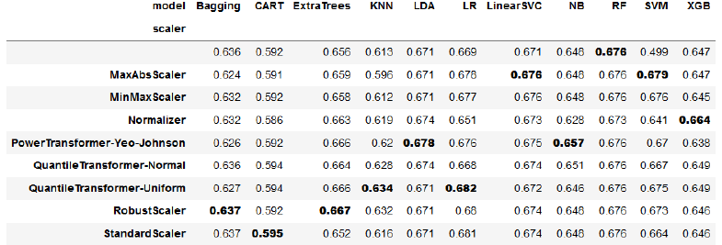
Data Modelling and Analysis
Binary Classification -Model Selection
Cross Validation Scores:
Selected Logistic Regression model since it scored higher

Slide 37
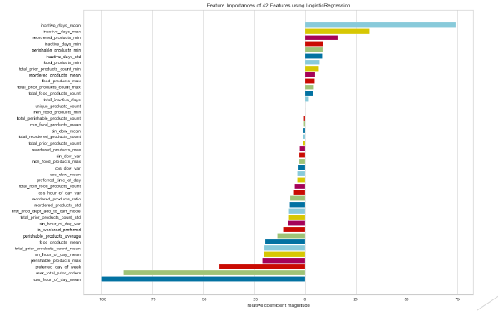
Data Modelling and Analysis
Binary Classification -Model Evaluation
Feature Importance using yellowbrick Feature Importances visualizer:

Slide 38
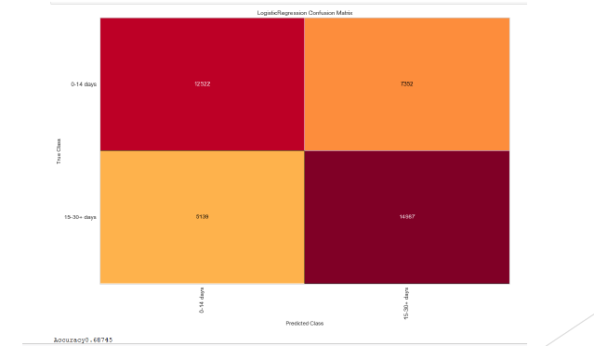
Data Modelling and Analysis
Confusion Matrix using yellowbrick Confusion Matrix visualizer:
Binary Classification -Model Evaluation

Slide 39
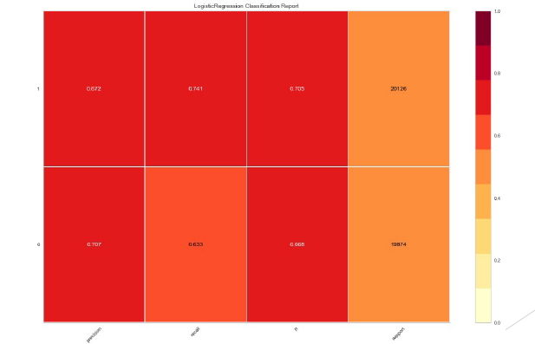
Data Modelling and Analysis
Classification Report using yellowbrick Classification Report visualizer:
Binary Classification -Model Evaluation

Slide 40
Conclusion
Multiclass RF model with hypertunedscore of 0.53 may not be high enough to deploy in real world setting;however grouping users into three groups is more useful for a business case
If we had more time, finding ways to increase the Multiclass RF model score would be priority
Ways to improve score:
Biggest flaw was most likely lack of strong features
Bringing more data from other sources outside of the Instacartcsv set could enhance outcome
Features such as user demographics, spending habits, and grocery store ordered from

Slide 41
THANK YOU!
Nandan Dutta
Phone:
9903404639
Email:
19125760058@datascience.manipal.edu

