Slide 1
“TICKETDABBLER” DATABASE
Group 3
Arnav, Alisa, Jaya
Nandani, Rebecca

Slide 2
TABLE OF CONTENTS
01
02
03
BUSINESS OVERVIEW
DATABASE RELATED
LEARNING EXPERIENCES
- business scenarios
- mission statement & objective
- ERD
- relational schema
- SQL queries
- challenges
- solutions
- extend the project

Slide 3

OUR BUSINESS
The business is similar to Ticketmaster, a comprehensive event management and ticketing solution platform. With an expansive reach spanning concerts, sports events, theatre productions, and more, our platform connects event clients, venues, and customers in a seamless ecosystem. Customers can explore a diverse range of events, check tickets with ease, and gain access to the events they're passionate about.

Slide 4
MISSION
Statement
Objective
The purpose of the Ticketmaster-like database system is to effectively store, manage, and facilitate the exchange of event-related data. Our database fosters seamless collaboration and information sharing among clients, venues, and customers.
Major Entities: events, venues, address, customers, clients, orders, tickets, seats, reviews
To maintain (enter, update and delete) data on all entities;
To perform searches on all entities;
To report on all entities;
To track the status of events, events at venues, orders

Slide 5
BUSINESS PROCESS
Ticket Purchase
Customer Review
Event Listings
Event Management
customers can search events they are interested in according to names, dates, categories, etc
The events are allocated to various venues. The platform records the client information so that they can be contacted
Customers can place orders to buy tickets for events and choose preferred seats
Customers can provide ratings and leave comments for events.

Slide 6
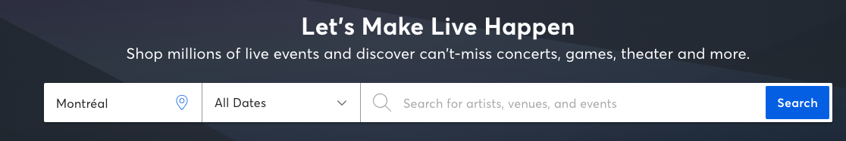
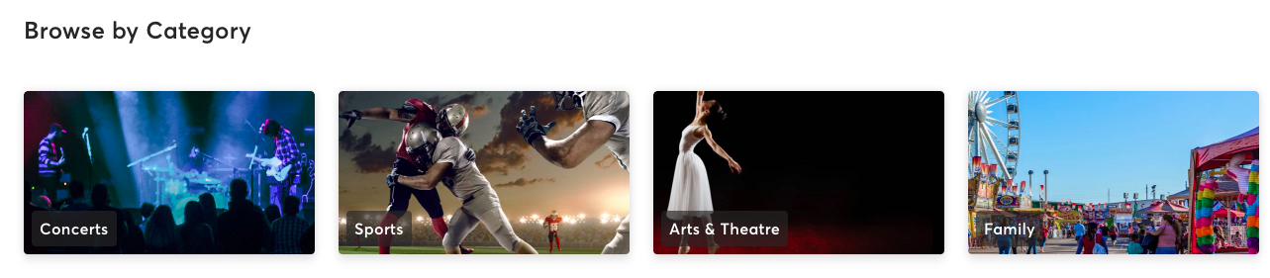
BUSINESS FUNCTIONS: EVENTS SEARCH
01

Slide 7
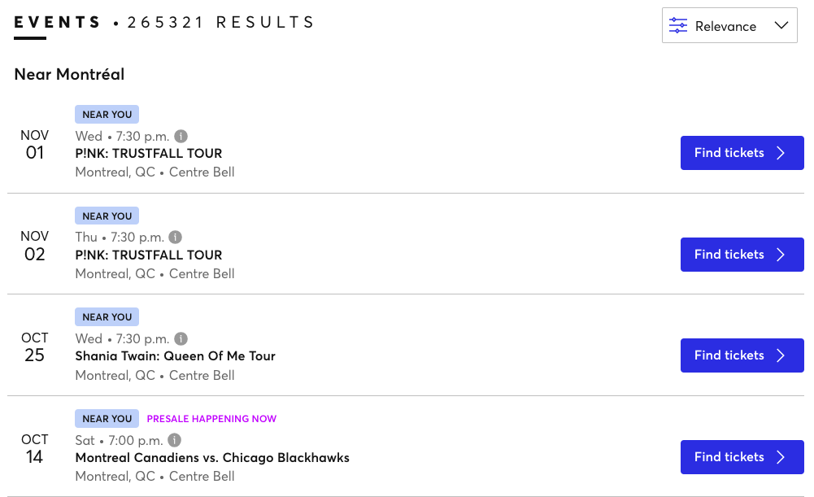
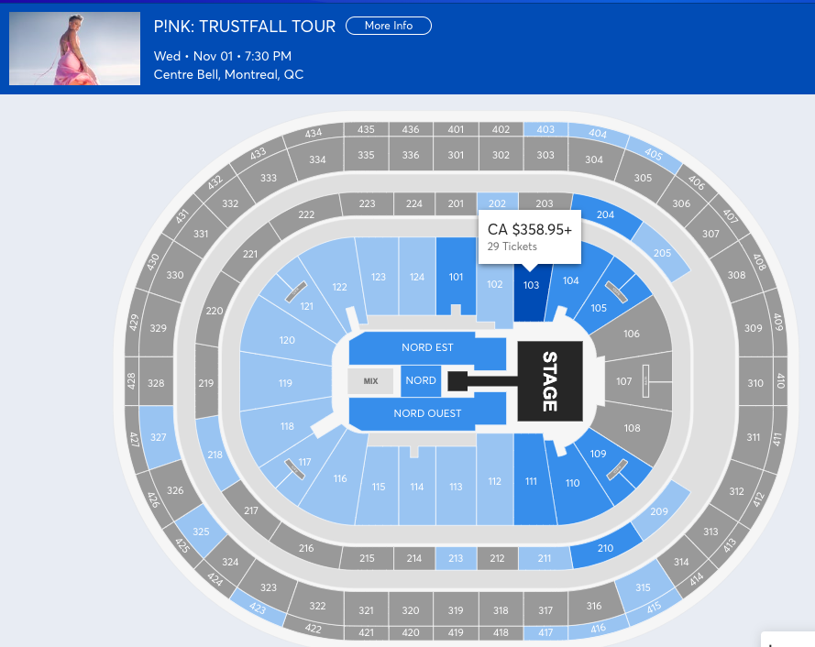
BUSINESS FUNCTIONS: TICKETS PURCHASE
01

Slide 8
BUSINESS RULES & ASSUMPTIONS
Business Rules:
A customer must be associated with an address.
An event must have at least one venue and can have multiple venues.
An event can have multiple reviews from different customers.
An order must be associated with a customer, and each order can have multiple tickets.
A ticket must be associated with an event, a seat, and an order.
Clients must have events associated with them, and each event must have payments to the client and Ticketmaster.
Events must have clients, indicating partnerships between clients and events.
Events must have a start and end date, and venues must host events during specific time periods.
Business Assumptions:
Customers have a single address associated with them (billing address), assuming customers cannot have multiple addresses. But multiple customers can have the same address.
The system assumes that events can take place in multiple venues and across different categories and genres.
Ticket prices are stored at the ticket level, assuming they remain constant regardless of the seat or order.
Clients are assumed to be external entities or event organizers who collaborate with the event management system.
The system assumes that events, orders, and tickets are linked together accurately for tracking purposes.
Reviews are associated with customers and events, assuming customers can only leave reviews for events they attended.

Slide 9
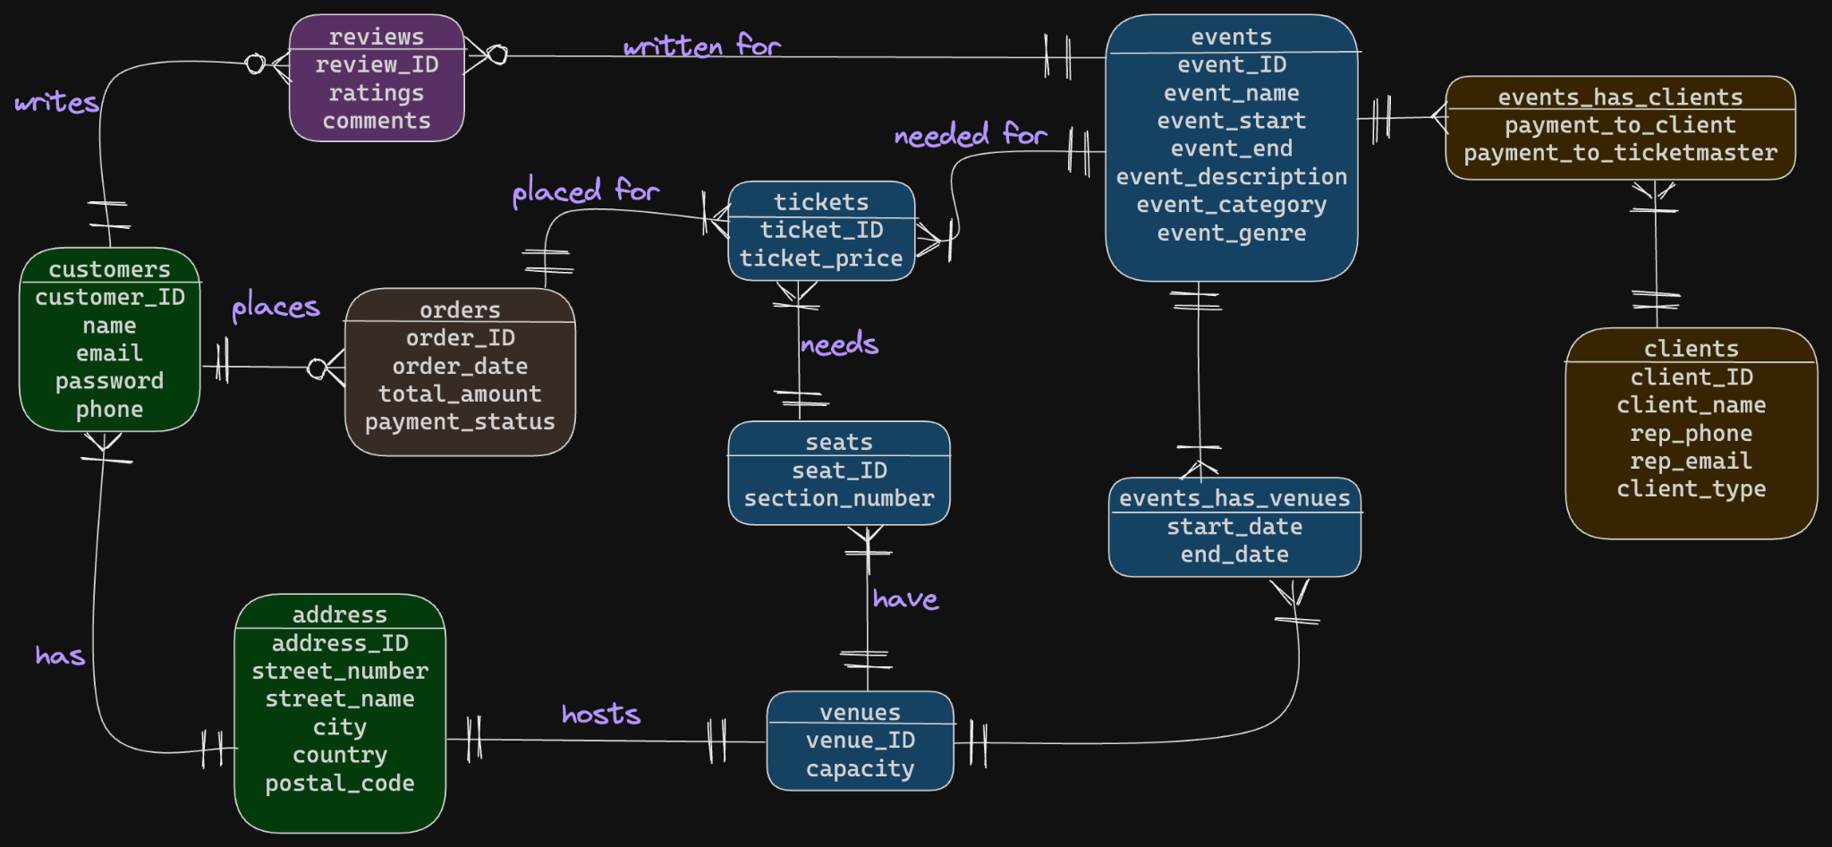
ERD

Slide 10
RELATIONAL SCHEMA
address(address_ID, street_number, street_name, city, country, postal_code)
customers(customer_ID, name, email, password, phone, address_ID)
Foreign Key: address_ID References address(address_ID)
events(event_ID, event_name, event_start, event_description, event_end, event_category, event_genre)
reviews(review_ID, rating, comments, customer_ID, event_ID)
Foreign Key: customer_ID References customers(customer_ID)
Foreign Key: event_ID References events(event_ID)
orders(order_ID, order_date, total_amount, payment_status, customer_ID)
Foreign Key: customer_ID References customers(customer_ID)
clients(client_ID, client_name, rep_phone, rep_email, client_type)
Primary Key: address_ID
Primary Key: customer_ID
Primary Key: event_ID
Primary Key: review_ID
Primary Key: order_ID
Primary Key: client_ID

Slide 11
RELATIONAL SCHEMA CONT.
venues(venue_ID, name, capacity, address_ID)
Foreign Key: address_ID References address(address_ID)
seats(seat_ID, section_number, venue_ID)
Foreign Key: venue_ID References venues(venue_ID)
tickets(ticket_ID, ticket_price, events_ID, order_ID, seat_ID)
Foreign Key: event_ID References events(event_ID)
Foreign Key: order_ID References orders(order_ID)
Foreign Key: seat_ID References seats(seat_ID)
events_has_clients(event_ID, client_ID, payment_to_client, payment_to_ticketmaster)
Foreign Key: event_ID References events(event_ID)
Foreign Key: client_ID References clients(client_ID)
events_has_venues(event_ID, venue_ID, start_date, end_date)
Foreign Key: event_ID References events(event_ID)
Foreign Key: venue_ID References venues(venue_ID)
Primary Key: venue_ID
Primary Key: seat_ID
Primary Key: ticket_ID
Primary Key: event_ID, client_ID
Primary Key: event_ID, venue_ID

Slide 12
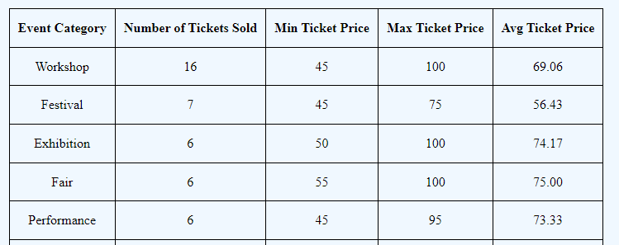
SQL QUERIES EXAMPLES
Query 1:
SELECT
e.event_category,
COUNT(t.ticket_ID) AS num_tickets_sold,
MIN(t.ticket_price) AS min_ticket_price,
MAX(t.ticket_price) AS max_ticket_price,
ROUND(AVG(t.ticket_price), 2) AS avg_ticket_price
FROM
events e
JOIN
tickets t ON e.event_ID = t.event_ID
GROUP BY
e.event_category
ORDER BY
num_tickets_sold DESC;
Ticket Price Distribution and Category Analysis:
This query analyzes the distribution of ticket prices across event categories, providing insights into pricing strategies for different types of events.

Slide 13
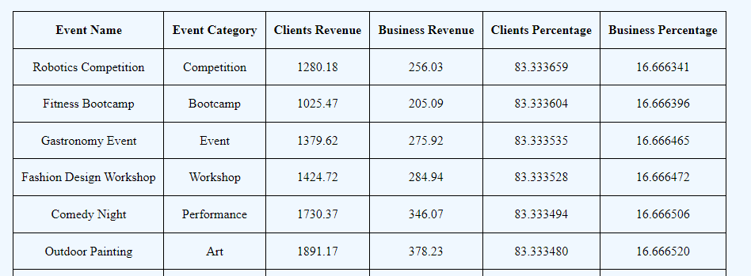
SQL QUERIES EXAMPLES
Query 2:
SELECT
e.event_name,
e.event_category,
SUM(ec.payment_to_client) AS revenue_to_clients,
SUM(ec.payment_to_ticketmaster) AS revenue_to_ticketmaster,
(SUM(ec.payment_to_client) / (SUM(ec.payment_to_client) + SUM(ec.payment_to_ticketmaster))) * 100 AS client_percentage,
(SUM(ec.payment_to_ticketmaster) / (SUM(ec.payment_to_client) + SUM(ec.payment_to_ticketmaster))) * 100 AS ticketmaster_percentage
FROM
events e
JOIN
events_has_clients ec ON e.event_ID = ec.event_ID
GROUP BY
e.event_ID
ORDER BY
client_percentage DESC;
Revenue Distribution Between Clients and Ticketmaster:
This query calculates the revenue distribution by percentage between clients and Ticketmaster for each event, considering the payments made to clients and Ticketmaster for each event.

Slide 14
LEARNING EXPERIENCE: ISSUES & CHALLENGES
TIME LIMIT
NEW SKILLS
TEAMWORK
MEANINGFUL DEVELOPMENT
We have a very limited work time for the whole project
We have to apply new skills such as building a webpage
We have different working schedules and may be hard to accommodate each others
How we can build insights on these data and make useful queries that can further help the business development

Slide 15
LEARNING EXPERIENCE: SOLUTIONS
TIME
SKILLS
TEAMWORK
INSIGHTS
Let members who have prior knowledge on building website start to work on the part to save time learning
Plan out the work and timeline at the beginning and set norms to make sure members can get work done on time
Frequently communicate in group chat to keep track on our project and also set up touchpoint to ensure timeline and members feel comfortable doing tasks
We consider multiple situations and select the most meaningful queries to make sure we can make use of these data to help the business

Slide 16
EXTENDING OUR WORK
Security Enhancements and Backup
Implement Data Archiving and Purging
Scalability and Performance Optimization
Ensure secured data storage; implementing more rigorous user authentication systems; and securing ticket transfer or resale methods
Identify historical data that is no longer frequently accessed but needs to be retained for compliance or reference purposes. Move such data to an archival database or storage while keeping the main operational database optimized for current transactions.
Consider implementing database scaling solutions to accommodate future growth in data and user traffic. Implement techniques such as sharding, partitioning, and caching to optimize database performance and reduce latency

Slide 17
THANKS
Do you have any questions?

