Slide 1
InternNova Week 6
Final Data Analytics Project
End-to-end analysis • EDA • Visualization • Power BI • Git/GitHub
Nandani Rana
InternNova Internship • Week 6 Submission

Slide 2
1. Project Objective
Build a complete, reproducible analytics workflow from raw data to business decisions.
Business Goal
Understand sales, profit, category and regional performance and identify actionable improvement areas.
Analytical Approach
Prepare data → inspect quality → perform EDA → visualize patterns → build Power BI dashboard.
Delivery Goal
Document the work and maintain the project through meaningful Git commits and GitHub version control.
• Use data rather than assumptions to identify performance patterns.
• Translate findings into practical business recommendations.
• Demonstrate an end-to-end analytics and Git/GitHub workflow.
InternNova Week 6 • Nandani Rana • 2

Slide 3
2. Dataset & Data Preparation
Superstore sales dataset used across the internship workflow.
Records
10,194
sales records
Columns
21
business and transaction fields
Missing Values
0
after quality inspection
Duplicates
0
duplicate rows detected
• Inspected column names, data types and categorical fields.
• Validated completeness and consistency before analysis.
• Prepared the cleaned dataset for Python EDA and Power BI.
• Kept the workflow reproducible by storing analytical files and outputs in the GitHub repository.
InternNova Week 6 • Nandani Rana • 3

Slide 4
3. Exploratory Data Analysis
Key analytical findings from the cleaned dataset.
Total Sales
$2.33M
dashboard total
Total Profit
$292.30K
overall profitability
Positive-Profit Transactions
80.71%
8,228 transactions
• Sales–Profit correlation is approximately 0.48, indicating a moderate positive relationship.
• Discount–Profit correlation is approximately −0.22, indicating that higher discounts are associated with weaker profitability.
• Sales–Quantity correlation is approximately 0.20, showing a relatively weak positive relationship.
• Monthly sales show substantial variation, with strong peaks toward the end of 2025 and into 2026.
InternNova Week 6 • Nandani Rana • 4

Slide 5
4. Data Visualization
Five Python visualizations were created and stored with their source code.
Monthly Sales Trend
Line chart
Tracks sales movement over time.
Sales by Product Category
Bar chart
Compares category-level sales.
Profit by Product Category
Bar chart
Highlights profitability differences.
Sales by Region
Bar chart
Compares regional sales performance.
Discount vs Profit
Scatter plot
Shows the relationship between discount and profit.
InternNova Week 6 • Nandani Rana • 5

Slide 6
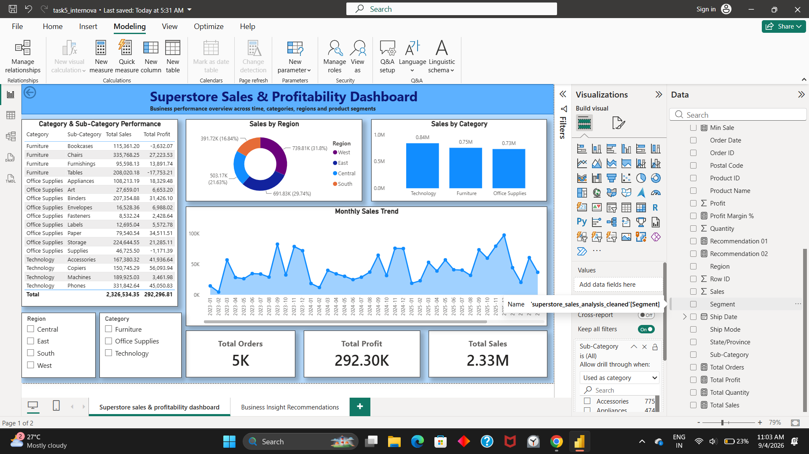
5. Power BI Dashboard
Interactive dashboard built with KPI cards, visuals and slicers.
InternNova Week 6 • Nandani Rana • 6

Slide 7
6. Business Insights & Recommendations
Turning analytical findings into decision support.
Insight 01
Technology leads category sales at approximately $0.84M.
Insight 02
Office Supplies has the lowest category sales at approximately $0.73M.
Insight 03
Tables generate negative total profit of approximately −$17.75K.
Insight 04
West is the highest-sales region at approximately $0.74M.
Insight 05
Monthly sales peak at roughly $98K in December 2025.
Recommendation 01
Prioritize Technology products and sustain investment in strong-performing areas.
Recommendation 02
Review pricing and discount strategy for Tables to address negative profitability.
Decision Principle
Focus on profitable growth rather than sales volume alone.
InternNova Week 6 • Nandani Rana • 7

Slide 8
7. Git & GitHub Workflow
Version-controlled project structure and meaningful commit history.
• Repository created as a public GitHub project.
• Local repository initialized/cloned and connected to the GitHub remote.
• Work added through separate meaningful commits for EDA, visualizations, Power BI and insights.
• Final repository contains Dataset, EDA, Visualizations, PowerBI, README and Insights/Recommendations.
• The repository currently shows 8 commits on the main branch.
Repository
Public
InternNova-Week6-Final-Data-Analytics-Project
GitHub
github.com/nandaniirana/InternNova-Week6-Final-Data-Analytics-Project
InternNova Week 6 • Nandani Rana • 8

Slide 9
Conclusion
• The project demonstrates a complete analytics pipeline from data preparation to business decision support.
• EDA and visualizations revealed clear category, regional, time and profitability patterns.
• Power BI converted the analysis into an interactive management dashboard.
• Git/GitHub provides a reproducible and documented project history.
Thank you

