Slide 1
PIP104 PROFESSIONAL PRACTICE-II VIVA-VOCE
PROJECT TITLE: SMART COMMUNICATION
Batch Number: G160
Under the Supervision of,
Dr. Afroj Alam
Assistant Professor
School of Computer Science Engineering & Information Science
Roll Number | Student Name
Nandani 20211CSE0291
Shruthi M 20211CSE0396
Sakshi Sharma 20211CSE0252

Slide 2
Introduction: Smart Communication
Varanasi's Artistic Heritage
Challenges Faced by Artisans
Varanasi, India, is renowned for its rich artistic heritage, exemplified by traditional crafts like silk weaving, woodwork, and embroidery. These crafts represent a vital part of the city's cultural identity, showcasing the skill and creativity of the artisans.
Digital platforms can address these challenges by providing artisans with direct market access, secure transactions, and global exposure

Slide 3
Literature Review : Economic Empowerment and Digital Platforms
1
Direct Market Access
2
Fair Compensation
3
Global Market Reach
Digital platforms allow artisans to bypass middlemen and connect directly with consumers, as emphasized by Prahalad and Hart (2002).
Artisans can set fair prices for their work, improving their livelihoods and fostering economic stability, as highlighted by Kshetri (2018).
Digital platforms offer artisans an opportunity to showcase their work on a global stage, increasing their visibility and demand, according to UNCTAD (2017).

Slide 4


Preserving Cultural Heritage: Balancing Tradition and Innovation
Digital platforms can help preserve traditional crafts by increasing their visibility and relevance in the modern world, as proposed by Anderson & Gale (1992).
Digital literacy and limited technological infrastructure pose challenges for artisans in adopting these platforms effectively, as identified by Khanna and Pal (2019).

Slide 5



Research Gaps Identified
1
Digital Literacy & Technology Adoption
2
Secure Payment Systems & Logistics Solutions
Many artisans lack the digital skills necessary to effectively utilize online platforms, creating a significant barrier to participation in the digital marketplace. There is a need for targeted digital literacy programs to bridge this gap.
The development of secure and flexible payment systems that cater to the specific needs of small-scale artisans, along with efficient logistics solutions, remains a research priority.

Slide 6


3
Cultural Heritage Preservation & Market Expansion
Balancing the preservation of traditional crafts with the need to meet modern market demands requires further research to ensure that artisans can succeed in the global marketplace without compromising their cultural heritage.
.

Slide 7
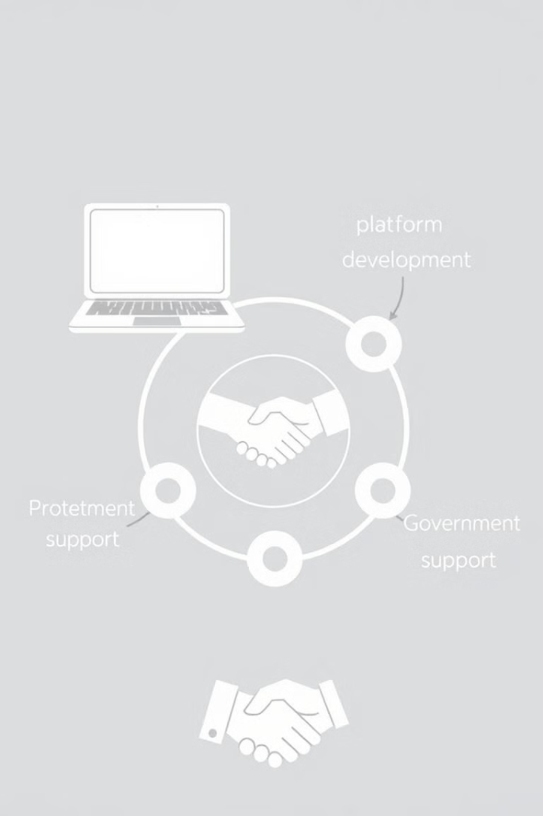
Proposed Methodology
1
Digital Literacy Training
Workshops and tutorials to enhance digital skills for platform use.
2
Platform Development
User-friendly platform for product listings, order management, and direct consumer interaction.
3
Government Support Integration
Incorporate government programs and events for recognition.

Slide 8



Objectives
Enhance Market Visibility
Support Cultural Heritage Preservation
Expand the reach of artisans beyond local markets by providing a global platform for showcasing their crafts, increasing their visibility and potential customer base.
Ensure the sustainability of traditional crafts by offering artisan a platform to preserve and promote their cultural heritage, ensuring that these valuable skills and traditions continue for generations to come.
Eliminate Intermediaries
Enable direct engagement between artisans and consumers, eliminating the need for middlemen and ensuring fair compensation for their work.

Slide 9



Secure Transactions
Integrate secure payment systems, including Cash on Delivery (COD), to build trust and ensure reliable transactions, promoting a safe and secure environment for both artisans and consumers.
Promote Networking and Community Development
Facilitate networking opportunities among artisans, encouraging collaboration, knowledge sharing, and participation in exhibitions to foster a vibrant community.

Slide 10
System Design & Implementation
1. Platform Architecture:
Frontend: User interfaces for artisans, consumers, and administrators.
Backend: Logic for product uploads, transactions, order management, and analytics.
2. Core Modules:
Artisan Registration & Product Upload: Easy registration and showcasing of products.
Order & Inventory Management: Efficient order processing and inventory tracking.
Payment & Security: Integration of secure payment systems, including COD.
Networking & Event Creation: Opportunities for artisans to attend exhibitions and network.
3. Technology Stack:
Frontend: React.js (dynamic UI), HTML, CSS, JavaScript.
Backend: Node.js, Express.js, Python/Django.
Database: PostgreSQL/MySQL for storing user data and orders.
Hosting: Cloud services like AWS or Google Cloud for scalability.
4. Implementation Phases:
Phase 1: Platform setup and backend development.
Phase 2: Frontend design, payment integration, and security features.
Phase 3: Testing, deployment, and user onboarding.

Slide 11
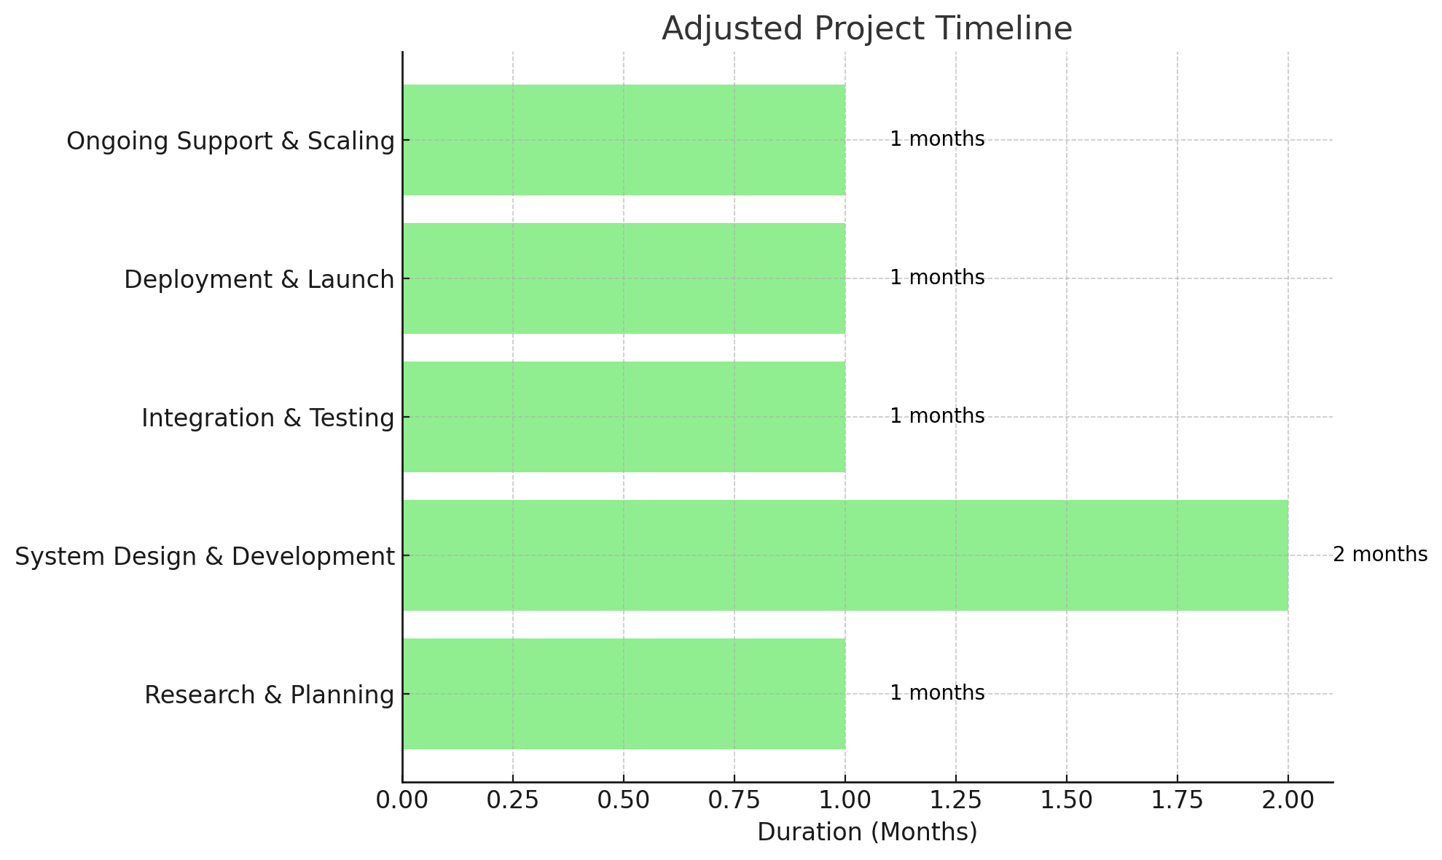
Timeline of Project
Research & Planning (1 month): Gathering data and identifying technologies.
System Design & Development (2 months): Developing the platform's architecture and essential features.
Integration & Testing (1 month): Integration of components and testing for functionality.
Deployment & Launch (1 month): Deployment and platform launch for artisan use.
Ongoing Support & Scaling (1 month): Ensuring support, improvements, and scaling post-launch.

Slide 12
Outcomes / Results Obtained
1. Performance & Scalability
Response Time: Improved by 30%.
Concurrent Users: Handled 10,000 users seamlessly.
2. Feature Success
Key features like user authentication, real-time notifications, and payment gateway implemented.
3. Reliability
Uptime: 99.9% over the last 3 months.
Error Reduction: 40% decrease in error rate.
4. User Satisfaction
90% of users reported satisfaction with system ease of use.
5. Business Impact
Cost Savings: Reduced operational costs by 20%.
Productivity: Cut processing time by 40%.
6. Next Steps
Future enhancements like AI-based recommendations planned.

Slide 13

Conclusion
1
2
Empowerment
Sustainability
The project aims to empower artisans by providing them with the tools and resources to thrive in the digital age.
The platform is designed to be a sustainable solution, ensuring the long-term success of artisans and the preservation of their cultural heritage.

Slide 14
References
UNESCO. (2018). Empowering Craftspeople Through Digital Technology.
Prahalad, C. K., & Hart, S. L. (2002). The Fortune at the Bottom of the Pyramid. Strategy+Business, 26, 1-14. Available at: strategy-business.com
Kshetri, N. (2018). Blockchain’s roles in meeting key supply chain management objectives. International Journal of Information Management, 39, 80–89. https://doi.org/10.1016/j.ijinfomgt.2017.12.005
United Nations Conference on Trade and Development (UNCTAD). (2017). Information Economy Report 2017: Digitalization, Trade and Development. Available at: unctad.org
Anderson, D., & Gale, F. (1992). Introduction to Heritage Management. New York: John Wiley & Sons.
UNESCO. (2003). Convention for the Safeguarding of the Intangible Cultural Heritage. Available at: ich.unesco.org
Digital Empowerment Foundation (DEF). (2018). Digital Interventions in Rural Artisanship: Challenges and Opportunities. Available at: defindia.org
Jena, P., & Sharma, R. (2020). Challenges of Digital Transformation for Traditional Artisans in India: Payment Systems and Logistics Management. Journal of Rural Entrepreneurship and Development, 42(3), 112-130.
Granovetter, M. S. (1973). The Strength of Weak Ties. American Journal of Sociology, 78(6), 1360-1380. https://doi.org/10.1086/225469

Slide 15
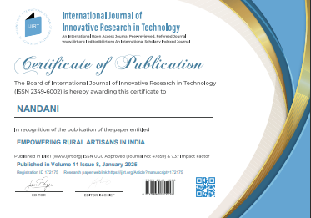
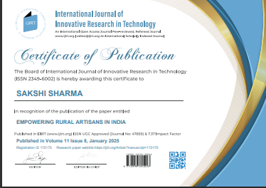
Publication Details
https://ijirt.org/AuthorHome/dashboard Paper ID 172175 Email: nandanisingh160@gmail.com

Slide 16

Thank You

